Slide 1
DZip: improved general-purpose lossless compression based on novel neural network modeling
Mohit Goyal, Kedar Tatwawadi, Shubham Chandak, Idoia Ochoa
Available at https://github.com/mohit1997/Dzip-torch

Slide 2
Outline
Introduction
Need for compression
Lossy vs Lossless compression
Images: Lossy compression is fine
Text or Documents: Lossless compression is needed (different from abstraction)
General-Purpose compressors
Objective
Lossless compression algorithms (predictor plus encoder)
Neural network are very powerful learners (if you look closely predictor is a classifier) and have been shown to compress well
Predictor can be trained in multiple ways: Static, Adaptive and Semi Adaptive manner
DZip: Combining adaptive and semi adaptive techniques yields better performance
Contributions
Methodology
Experimental results I (Performance Comparison)
Experimental results II (Speed Comparison)
Conclusion

Slide 3
Introduction
Compression is important for increasing data throughput

Slide 4
Introduction
Compression is important for increasing data throughput
Broadly two categories:
Lossy Compression: Images, Videos and Stock data
Original:
“Do not send money”
Lossy Compression:
“Do now send money”
Credits: Eric Roberts
Lossy Image Compression (Theis et al. 2017)

Slide 5
Introduction
Compression is important for increasing data throughput
Broadly two categories:
Lossy Compression: Images, Videos and Stock data
Lossless Compression: Text, documents and Biological data (Discrete Sequences)
Original:
“Do not send money”
Lossy Compression:
“Do now send money”
Credits: Eric Roberts
Lossy Image Compression (Theis et al. 2017)

Slide 6
Objective
Lossless Compression - Prediction + Entropy Coding

Slide 7
Objective
Lossless Compression - Prediction + Entropy Coding

Slide 8
Objective
Lossless Compression - Prediction + Entropy Coding
Classification Task!

Slide 9
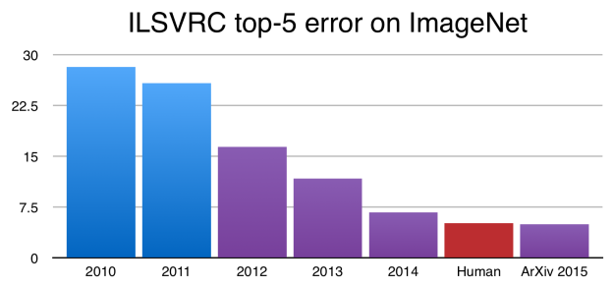
Objective
Lossless Compression - Prediction + Entropy Coding
Neural networks are excellent classifiers
ImageNet Large Scale Visual Recognition Challenge

Slide 10
Objective
Lossless Compression - Prediction + Entropy Coding
Neural networks are excellent classifiers
Many successful works on neural network based compression
NN-based
Real-Time Adaptive Image Compression (ICML 2017)

Slide 11
Objective
Lossless Compression - Prediction + Entropy Coding
Neural networks are excellent classifiers
Many successful works on neural network based compression
General purpose compression - data type independent
Text
Genomic data
Webpages
Executables
Audio

Slide 12
Objective
Lossless Compression - Prediction + Entropy Coding
Neural networks are excellent classifiers
Many successful works on neural network based compression
General purpose compression - data type independent
DZip: General-Purpose Lossless Data Compression with Neural Networks (for sequential data)

Slide 13
Contributions
Hybrid Modeling by combining adaptive and semi-adaptive techniques
03
Adaptive Modeling
Similar data unavailable
No model storage overhead
Adaptively train model
Symmetric encoding and decoding
Slower decoding than semi-adaptive
Static Modeling
Large amounts of data available
Fixed model accessible to encoder-decoder
Faster Compression
01
02
Semi-adaptive Modeling
Similar data unavailable
Utilize data to be compressed
Learned model needs to be stored
Slower encoding and faster decoding
Combine both!
Notes:
• Static modeling
• Fixed model accessible to encoder & decoder
• Suitable when lot of similar data available for training
• Semi-adaptive modeling
• Model learned from data to be compressed
• Model parameters stored as part of compressed file
• Suitable when similar data not available
• Adaptive modeling
• Encoder/decoder start with same random model
• Model updated adaptively based on data seen till now
• No need to store model as model updates are symmetric
• Suitable when similar data not available and/or using a simple predictor (e.g., count based),

Slide 14
Contributions
Hybrid Modeling by combining adaptive and semi-adaptive techniques
Works on various domains: text, genomics, floating point data, html code

Slide 15
Contributions
Hybrid Modeling by combining adaptive and semi-adaptive techniques
Works on various domains: text, genomics, floating point data, html code
Improved Compression: 29% reduction on Gzip and 8% reduction on BSC

Slide 16
Contributions
Hybrid Modeling by combining adaptive and semi-adaptive techniques
Works on various domains: text, genomics, floating point data, html code
Improved Compression: 29% reduction on Gzip and 8% reduction on BSC
Roughly 4 times faster than state-of-the-art NN-based Compressors (GPUs)

Slide 17
Neural Network based Lossless Compression
Data type specific compressors:
Images (Townsend et al. 2019)
DNA (Silva et al. 2019)
Text (Mahoney et al. 2000)
General-purpose compressors:
CMIX, Knoll et al. 2019
Detects data-type
Data-type specific context models combined with RNNs (Recurrent Neural Networks)
NNCP , Bellard et al. 2019
RNN based adaptive modeling
Proposed Method: DZip
Hybrid Modeling with GPU accelerated compression

Slide 18
Methodology
Two Models:
Bootstrap (light, semi-adaptive)
Supporter (heavy, adaptive)
Combined: Bootstrap + Supporter

Slide 19
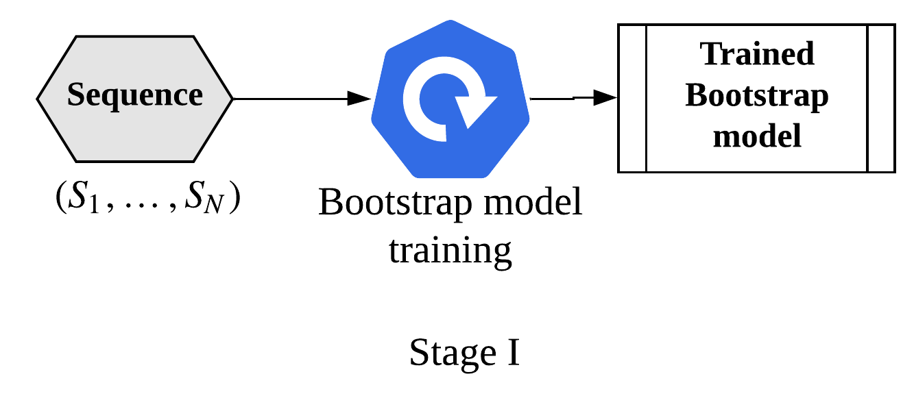
Methodology
Two Models:
Bootstrap (light)
Supporter (Heavy)
Combined: Bootstrap + Supporter
Two stages:
Train and save bootstrap

Slide 20
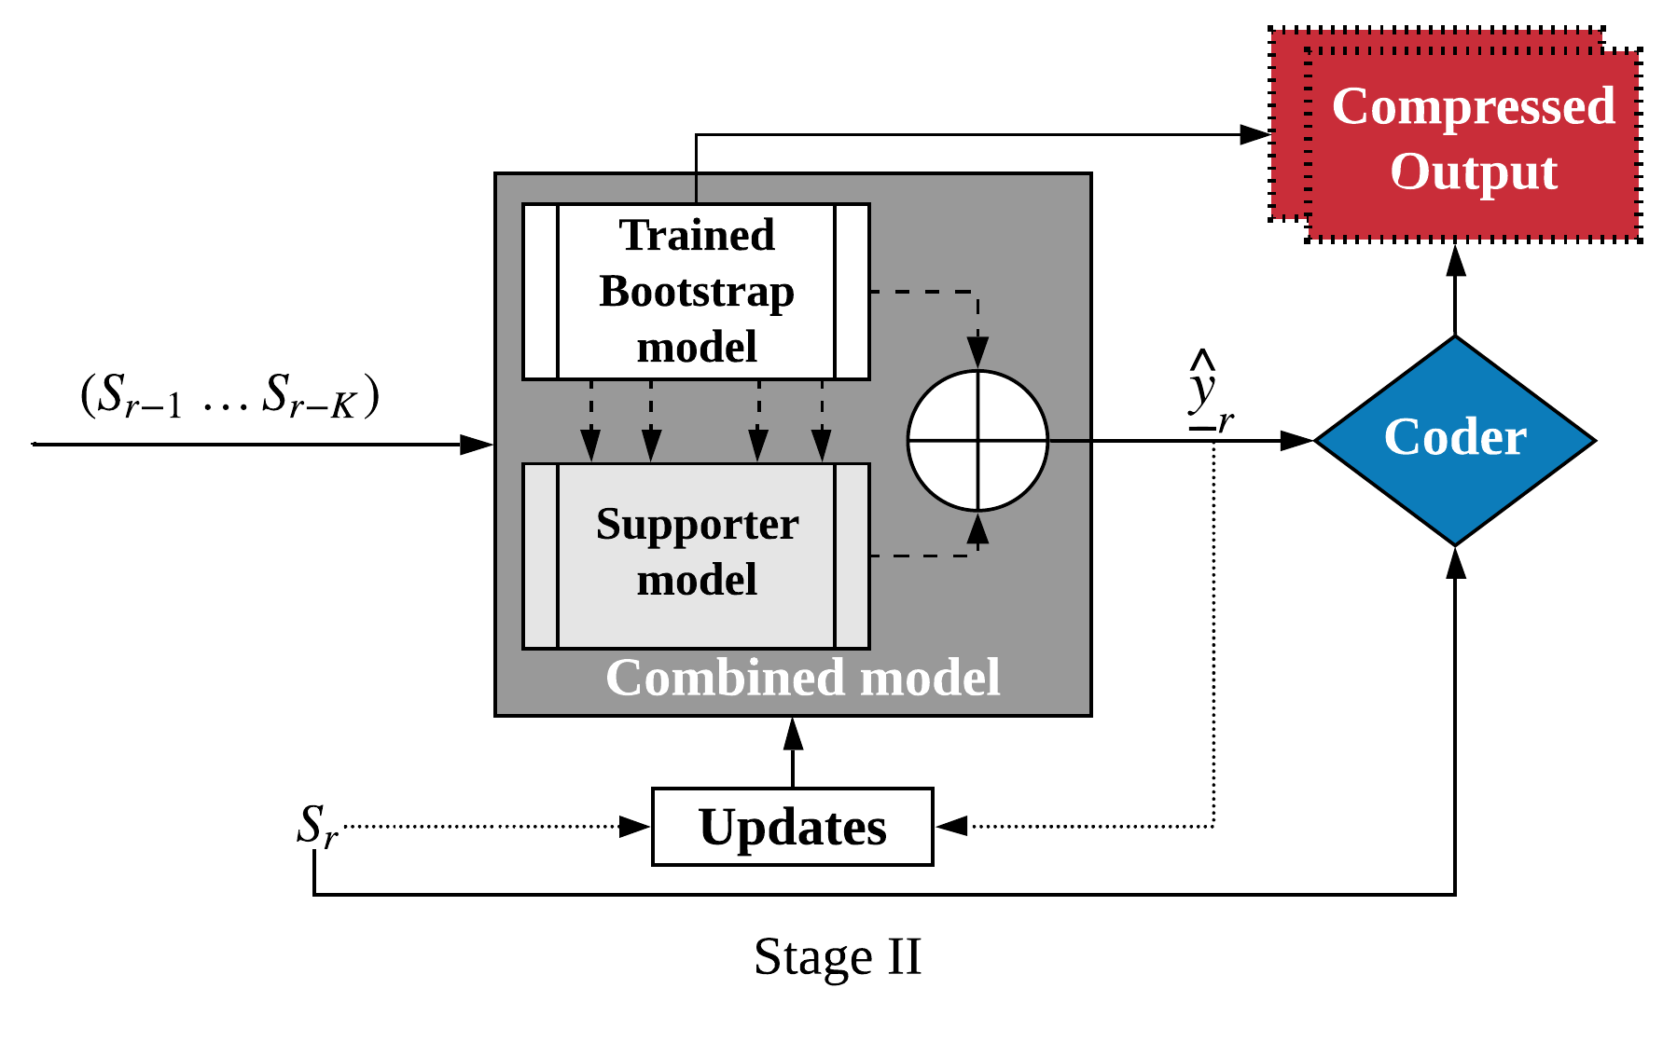
Methodology
Two Models:
Bootstrap (light)
Supporter (heavy)
Combined: Bootstrap + Supporter
Two stages:
Train and save bootstrap
Compress and adaptively train combined model
Randomly Initialized (seeded)

Slide 21
Methodology
Two Models:
Bootstrap (light)
Supporter (Heavy)
Combined: Bootstrap + Supporter
Two stages:
Train and save bootstrap
Compress and adaptively train combined model

Slide 22
Methodology
Two Models:
Bootstrap (light)
Supporter (Heavy)
Combined: Bootstrap + Supporter
Two stages:
Train and save bootstrap
Compress and adaptively train combined model

Slide 23
Methodology
Two Models:
Bootstrap (light)
Supporter (Heavy)
Combined: Bootstrap + Supporter
Two stages:
Train and save bootstrap
Compress and adaptively train combined model
DZip bootstrap only mode: faster compression

Slide 24
Experiments
Datasets:
Text Data
Genomic Data
HTML
Executables
Scientific Floating Point Data
Audio
Synthetic Data
Methods for Comparison:
Traditional: Gzip, 7zip, BSC, ZPAQ
NN-based: LSTM Compress, NNCP, CMIX
Specialized Compressors

Slide 25
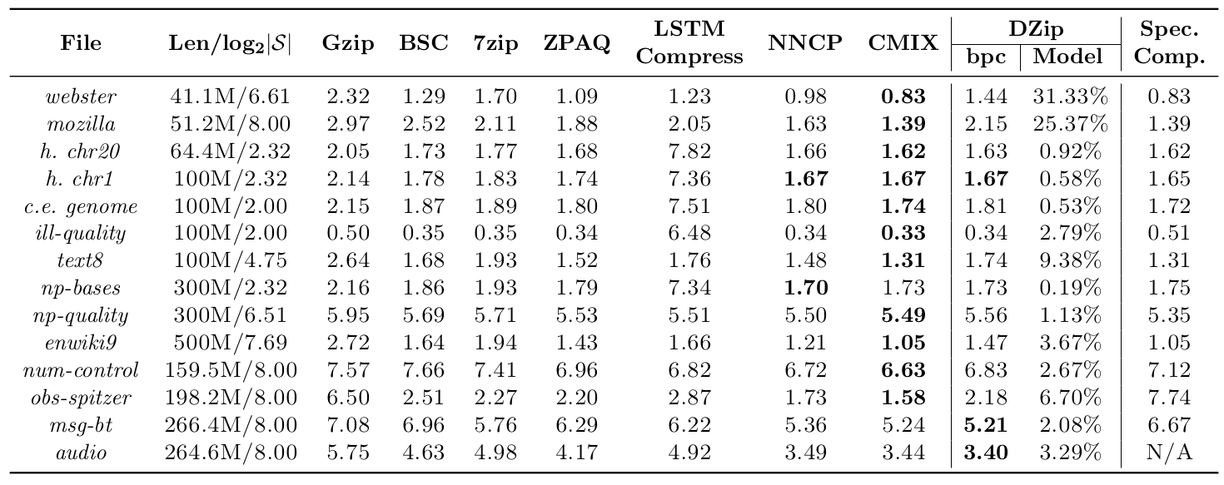
Compression Performance (Length of Sequence)

Slide 26
Compression Performance (Text)

Slide 27
Compression Performance (Executables)

Slide 28
Compression Performance (DNA sequence)

Slide 29
Compression Performance (Quality Scores)

Slide 30
Compression Performance (Floating point)

Slide 31
Compression Performance (Audio)

Slide 32
Synthetic Datasets
XOR-k : Deterministic (Entropy rate 0 bpc) HMM-k : Stochastic (Entropy rate 0.469 bpc) k : Memory of the sequence

Slide 33
Computational Requirements
DZip running time (GPU):
Bootstrap Training: 2-5 minutes per MB
Bootstrap encoding/decoding: 0.4/0.7 minutes per MB
Combined encoding/decoding 2.5/2.8 minutes per MB
Compared to NNCP, compresses/decompresses 4/15 times faster
Compared to CMIX, compresses/decompresses 5/10 times faster
Gzip, BSC, 7zip and ZPAQ take a few seconds per MB
Note: DZIP requires same hardware for performing encoding and decoding. (PyTorch Limitation)

Slide 34
Conclusion
DZip: Faster and Efficient NN-based General-Purpose Compressor
Can be run in two modes:
Hybrid mode (better compression)
Bootstrap only mode (4 times faster encoding with 3% worse compression)
DZip provides near-optimal compression for synthetic datasets
DZip is faster than other NN-based methods
DZip provides improved compression with higher compression time

Slide 35
Thank You!
Questions can be posted on IEEE Sigport.
Check out DZip at https://github.com/mohit1997/Dzip-torch

Slide 36
Hybrid vs Bootstrap only Mode

Slide 37
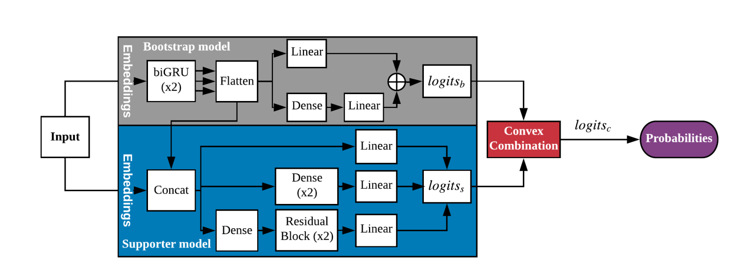
Model and Loss function

Slide 38
I’m adding some material I have to the following slides, see the Slack message for details. You can use this in the presentation after suitable modifications.
-Shubham

Slide 39
Simplified arithmetic coding step

Slide 40
• Static modeling
• Fixed model accessible to encoder & decoder
• Suitable when lot of similar data available for training
• Semi-adaptive modeling
• Model learned from data to be compressed
• Model parameters stored as part of compressed file
• Suitable when similar data not available
• Adaptive modeling
• Encoder/decoder start with same random model
• Model updated adaptively based on data seen till now
• No need to store model as model updates are symmetric
• Suitable when similar data not available and/or using a simple predictor (e.g., count based),

Slide 41
