Slide 1
Realistic rendering in material aging for artwork objects
{ A. Moutafidou, G. Adamopoulos, A. Drosou, D. Tzovaras, I. Fudos }

Slide 2
outline
Objectives
MLE function
Distribution function for bronze plate
Distribution function for silver plate
Distribution function for egg-tempera plate
Experiments

Slide 3
objectives
Modeling the effect of aging is a computational intensive task.
Specialized tools are needed to expedite the simulation process.
Production of artificial aging models due to small deformations in the surface.
Creation a plausible realistic model intended for computer graphics applications.

Slide 4
Maximum likelihood function (mle)
Given a statistical model (possibly multi-dimensional) :
Determine the set of values of the model parameters that maximize the likelihood function
This process determines a probability distribution function that best fits a random set of
input data.
The method of maximum likelihood is based on the :
Likelihood function L(θ ; x)

Slide 5
Given a statistical model :
A family of distributions f(. ; θ )θ ϵ Θ )
θ denotes the multi-dimensional parameter for the model
The method defines a maximum likelihood estimate (MLE):
θ ϵ $\arg_{\text{θ} \text{ϵ} \text{Θ}}maxL(\text{θ} \text{; }\text{x})$
We derive the MLE distribution for each pair of :
(type of material, artificial aging time)
And determine the parameters of the Gaussian pdf that best fits each set of microprofilometry measurements.

Slide 6
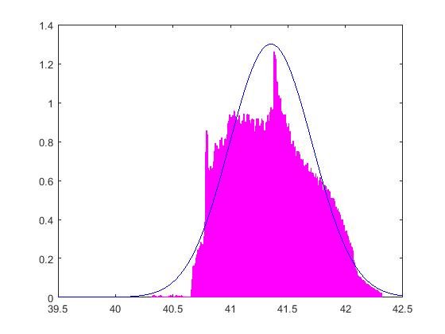
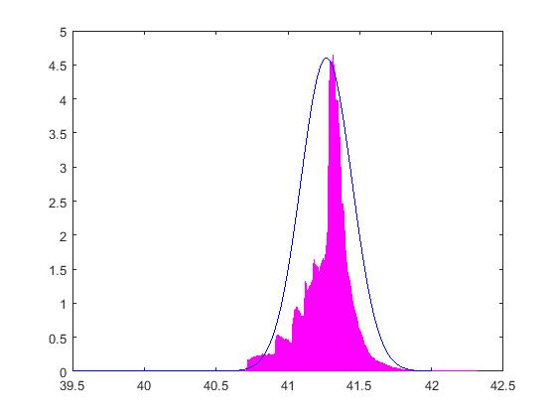
Micro-profilometry mesurments on bronze sample plate.

Slide 7
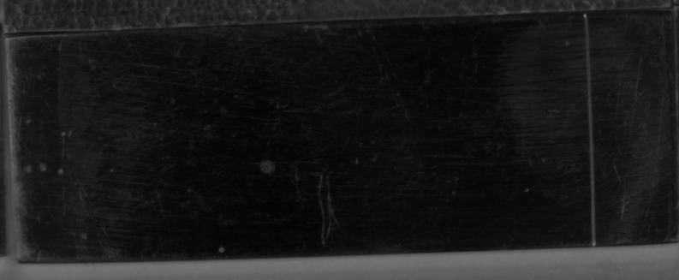
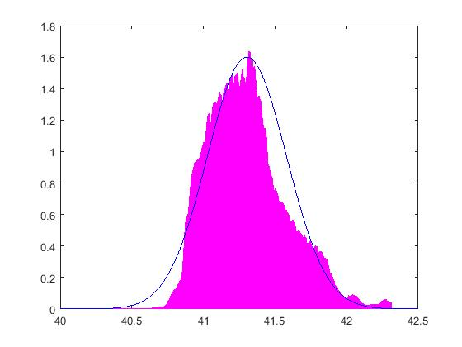
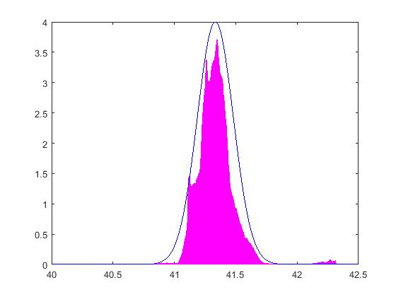
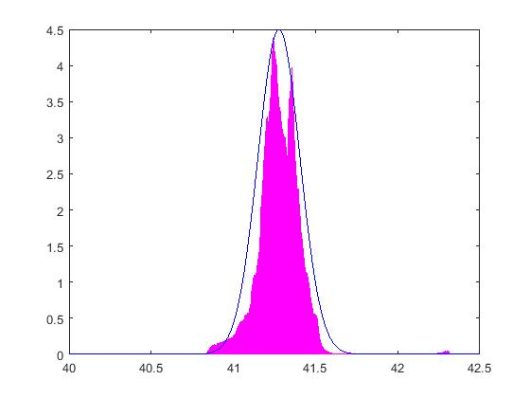
Micro-profilometry mesurments on silver sample plate.

Slide 8
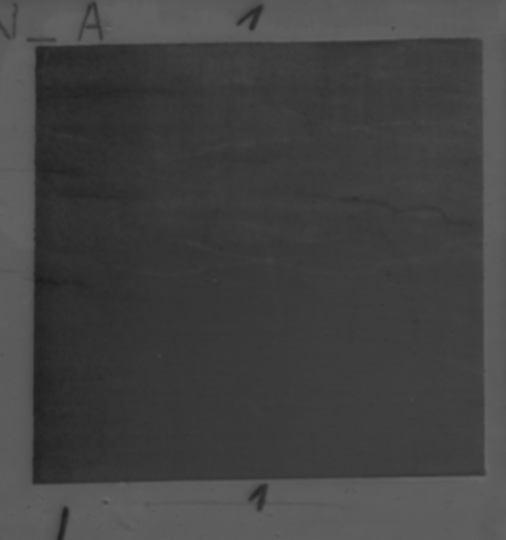
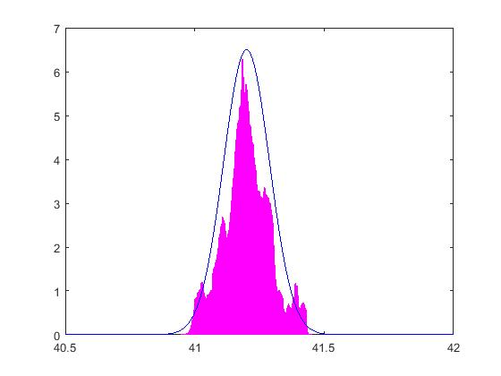
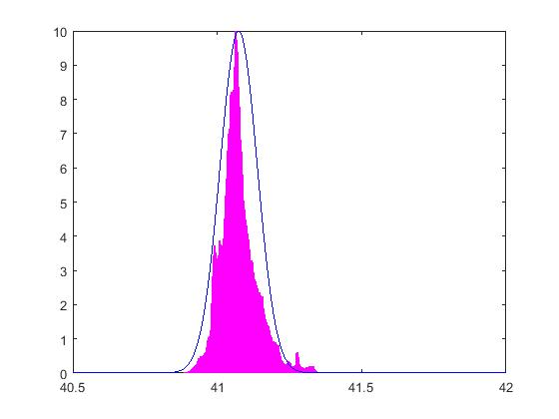
Micro-profilometry mesurments on egg-tempera sample plate.

Slide 9
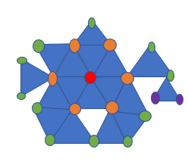
Aging simulation (1)
Dents/Bumps occur :
Where large deviations from the mean value (distance from the metal plate plane) are obtained.
Created around a vertex and present themselves by translating the neighboring vertices.
Following an RBF function to attenuate the displacement in the neighborhood.
Vertex Neighborhood

Slide 10
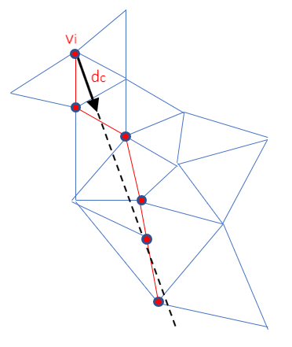
Aging simulation (2)
Cracks occur :
When extreme deviations from the mean value (distance from the metal plate plane) are obtained.
Which are more likely to occur when bumps or dents are present.
Where geometry of the crack depends on the geometry of the existing object and the local deformations that have already occurred.
Crack Path

Slide 11
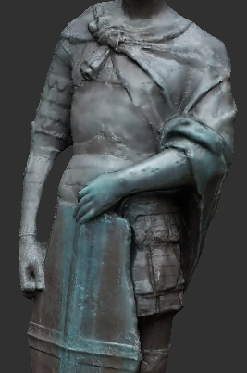
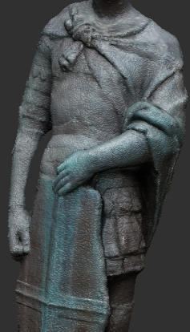
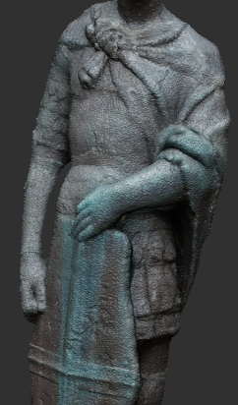
Experiments (Dents/bumps)

Slide 12
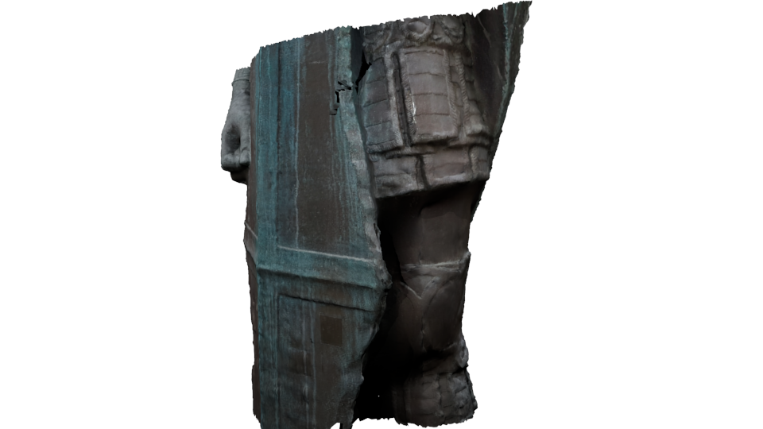
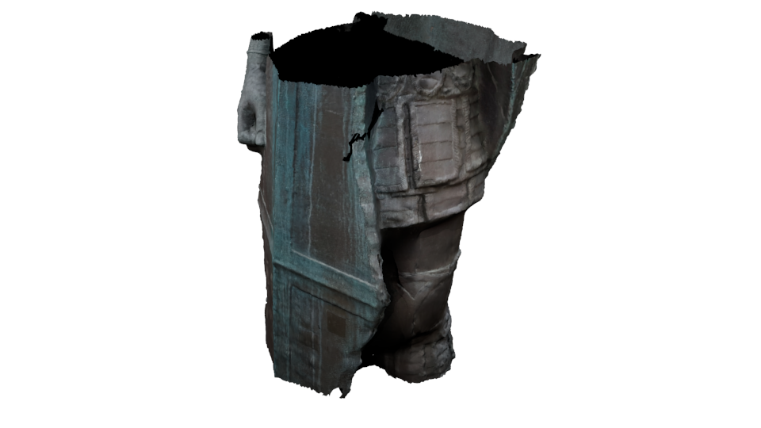
Experiments (Cracks)

Slide 13
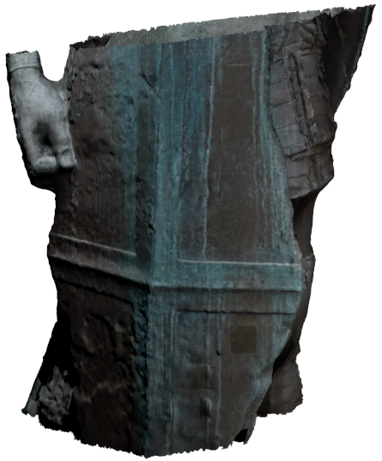
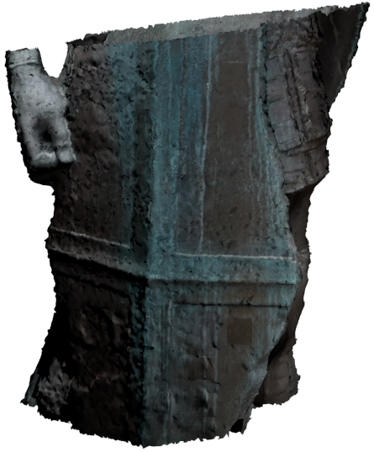
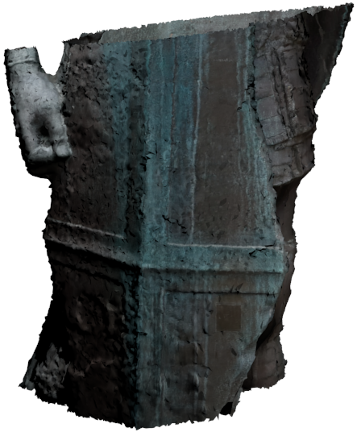
Experiments (Dents/bumps/cracks)

Slide 14
Conclusion
We have reported on the design and development
A method for realistic rendering of the aging effect
On artwork objects
Based on microprofilometry measurements
Taken on material samples
During an artificial aging process.

Slide 15
Thank you!!!

