Slide 1
Compression Noise Reduction via Non-local Filtering with Rectified Regularity for Urban Building Scenes
Qijun Wang, Feng Gao
Email to: wangqijun308@163.com
Anhui University, Hefei, China, 230601

Slide 2
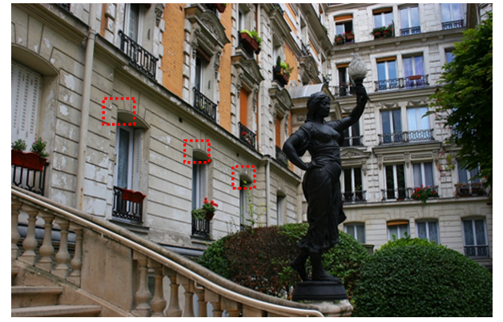
Motivation
Notably, the well-known non-local methods such as non-local mean filter (NLM), block matching and 3D filtering (BM3D) , and Weighted Nuclear Norm Minimization (WNNM), are applied to compression noise reduction. These methods have demonstrated good and stable performances without any training stage.

Slide 3
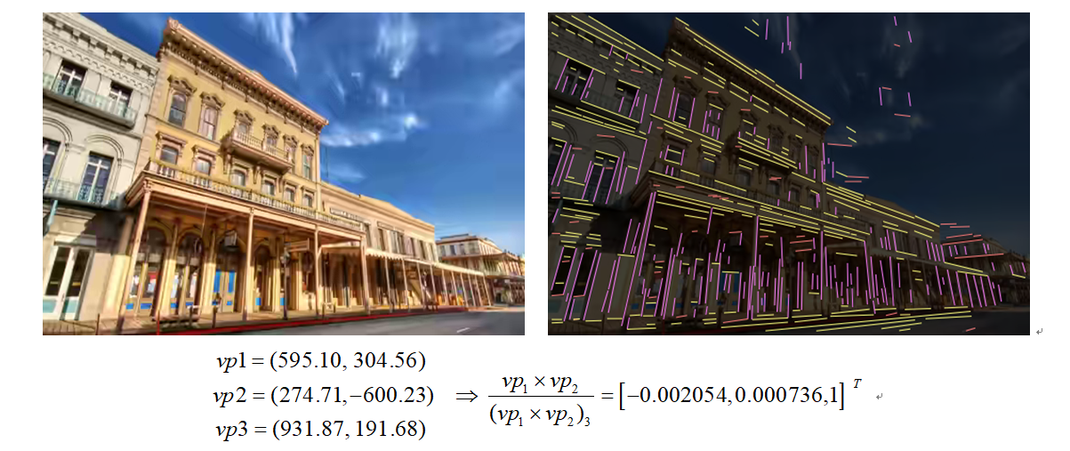
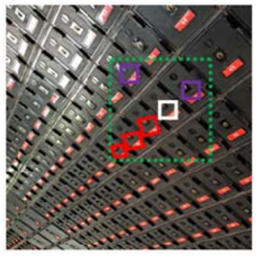
Planar Perspective Transformation

Slide 4
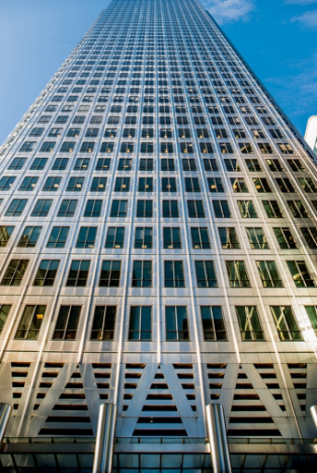
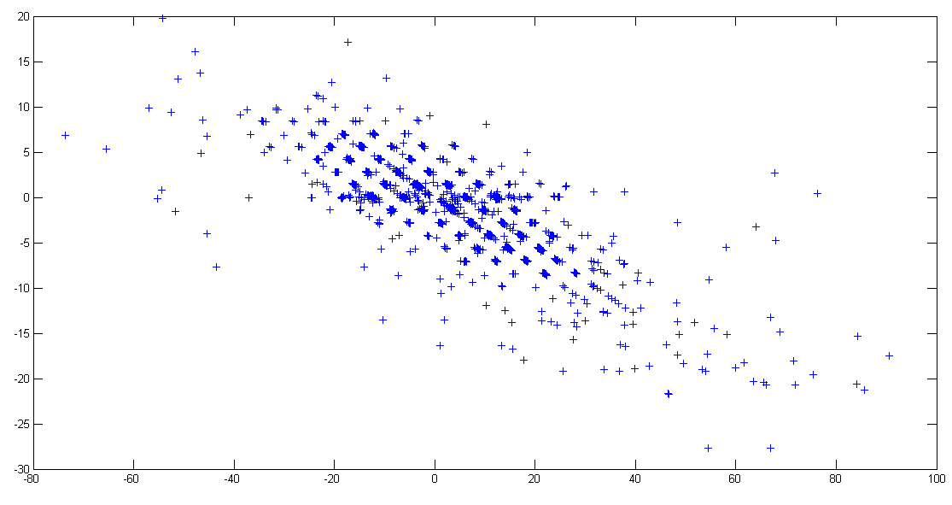
Image Regularity
In the rectified domain, repeated patterns demonstrate regularity, and motion vectors (right) accumulate in some positions.

Slide 5
General Framework

Slide 6
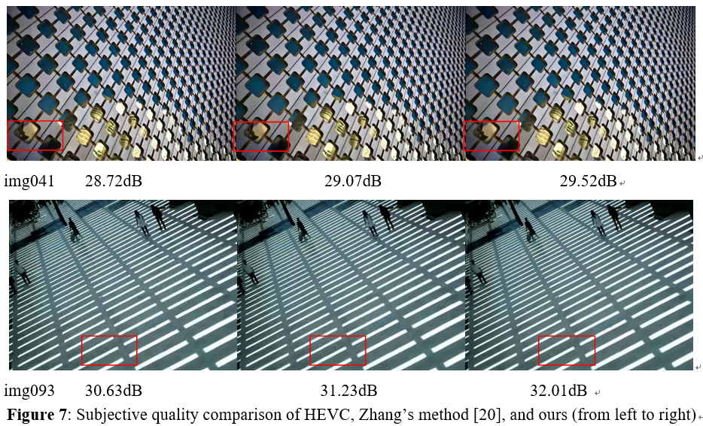
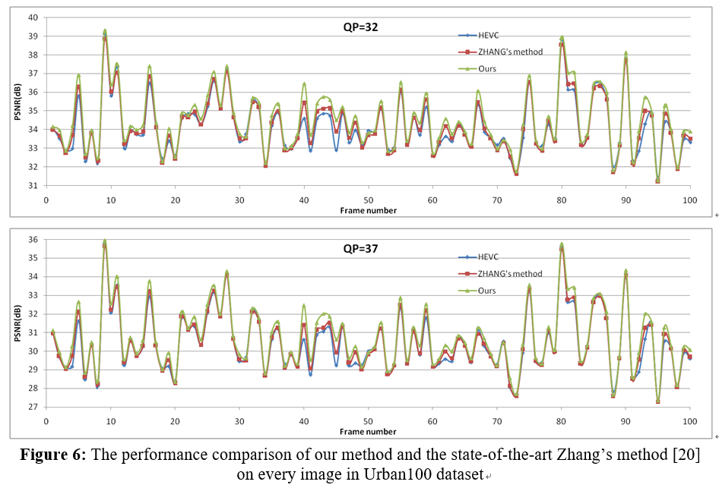
Experimental Results

