Slide 1
Improving Visual Quality and Transferability of Adversarial Attacks on Face Recognition Simultaneously with Adversarial Restoration
Huazhong University of Science & Technology
Fengfan Zhou, Hefei Ling, Yuxuan Shi, Jiazhong Chen, Ping Li
Huazhong University of Science & Technology

Slide 2
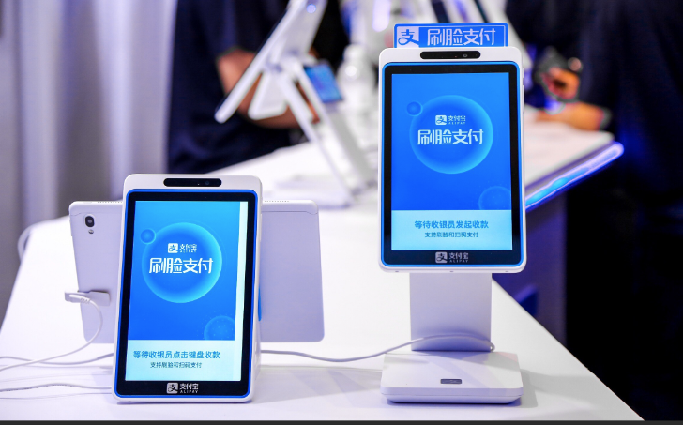
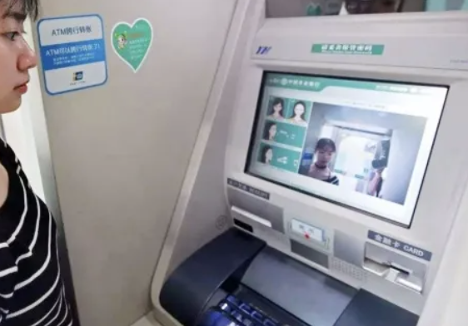
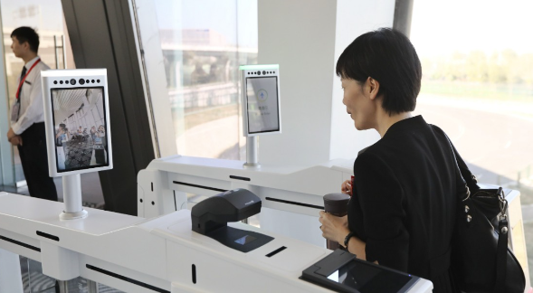
Background
Face Recognition (FR) has been widely used.

Slide 3
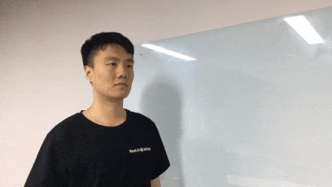
Background
Challenge: FR models can be easily fooled by adversarial examples, which are crafted by adding imperceptible perturbations on benign face images.

Slide 4
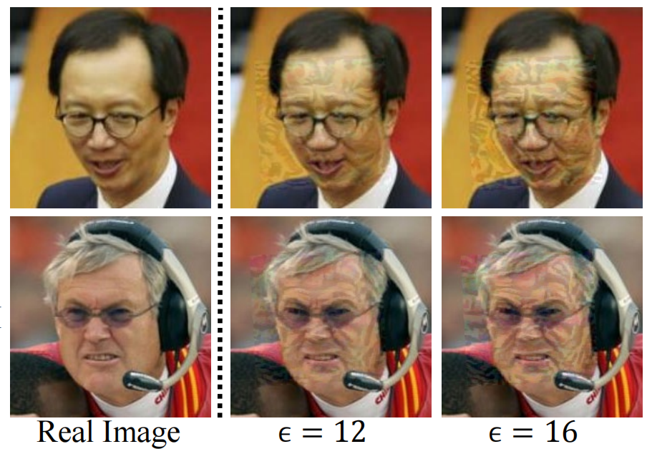
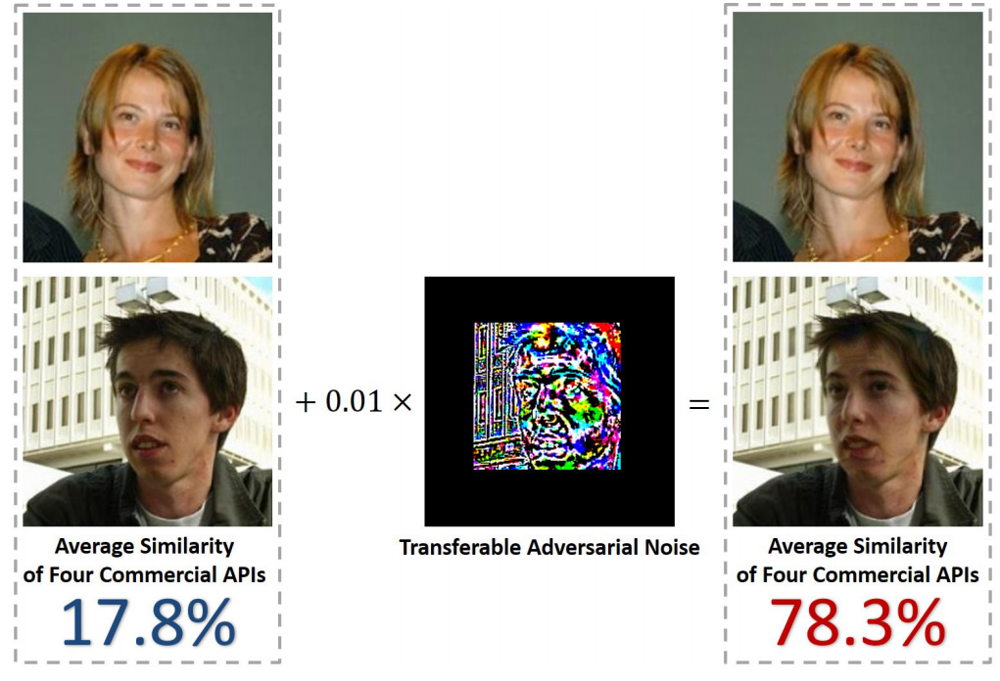
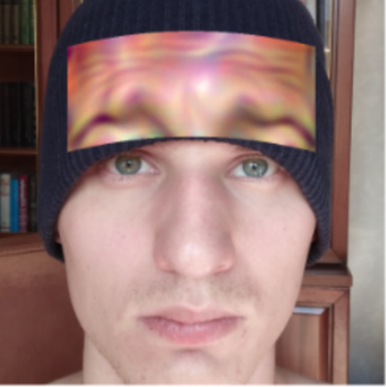
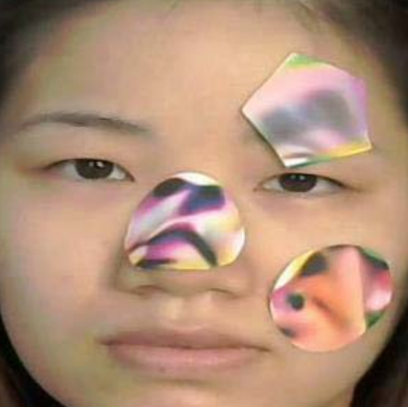
Related Works
Attacks in the Digital World
Attacks in the Physical World

Slide 5
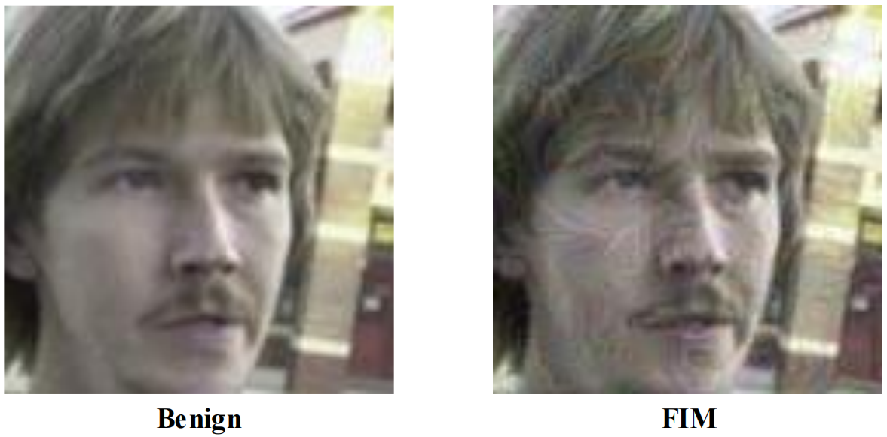
Related Works
Weakness of Traditional Adversarial Attacks on FR

Slide 6
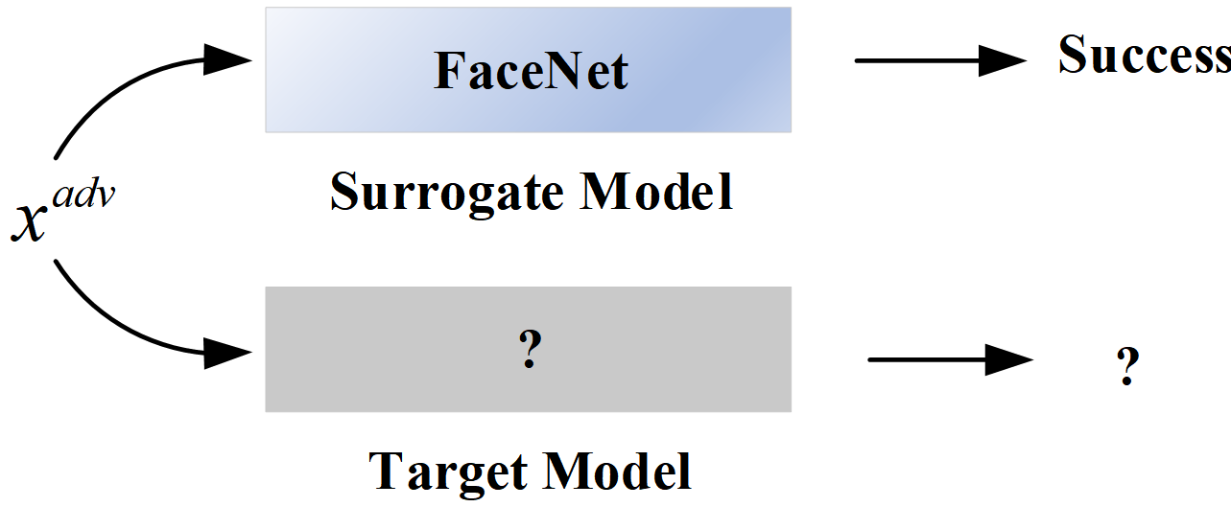
Related Works
Weakness of Traditional Adversarial Attacks on FR

Slide 7
Methodology
To this end, we propose a novel attack method using the Face Restoration task as the Sibling Task to enhance Visual Quality and Transferability simultaneously.
The framework of the proposed Restoration Latent Diffusion Model (RLDM)

Slide 8
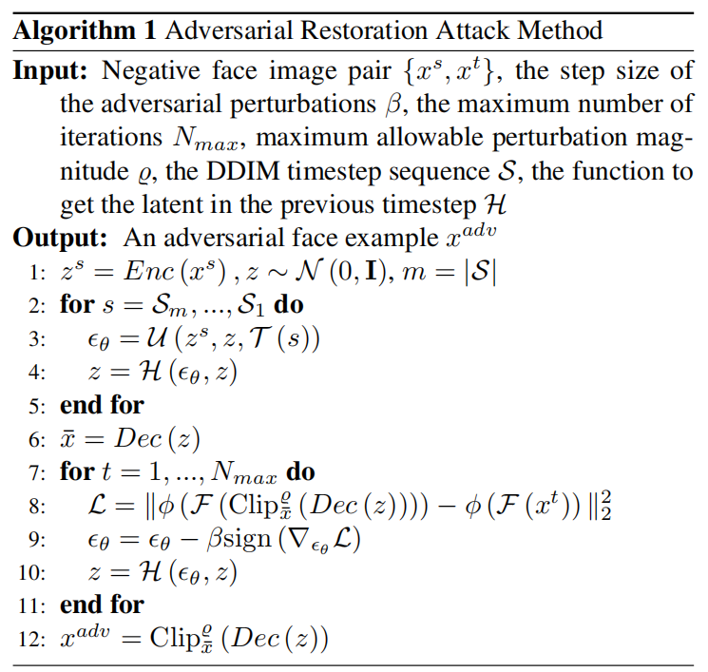
Methodology

Slide 9
Experiments
Illustration of the benign image, adversarial face example crafted by FIM, and adversarial face example crafted by our proposed attack method. From the figure, it is evident that our proposed method enhances the visual quality of the original benign image, in contrast to the traditional attack method which degrades it.

Slide 10
Experiments
The visual quality of adversarial face examples crafted by our proposed method and the baseline. The first column represents the various image types in which Benign means the attacker image without adding adversarial perturbations.

Slide 11
Experiments
The attack success rates on LFW with normal trained models as the victim models. The first column demonstrates the attacks. The second to forth columns in the first row demonstrate the victim models.

Slide 12
Experiments
The attack success rates on LFW with adversarial robust models as the victim models. The first column demonstrates the attacks. The second to forth columns in the first row demonstrate the victim models.

Slide 13
Thank you

