Slide 1
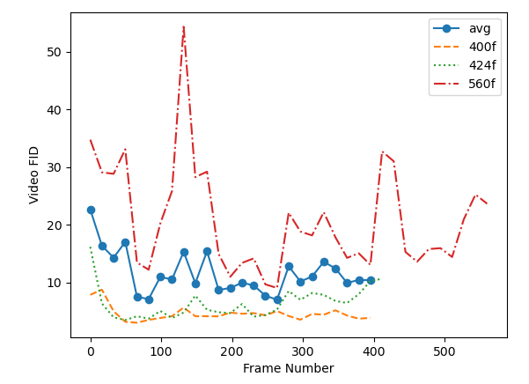
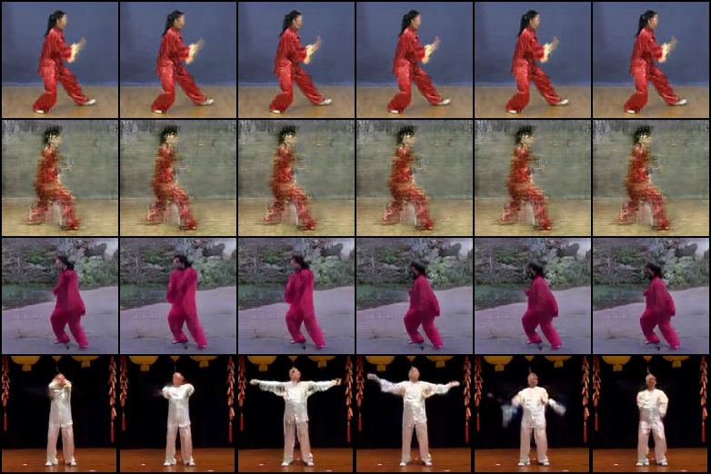
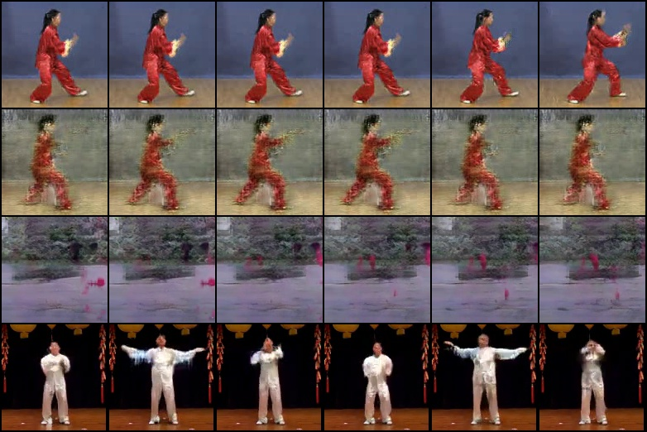
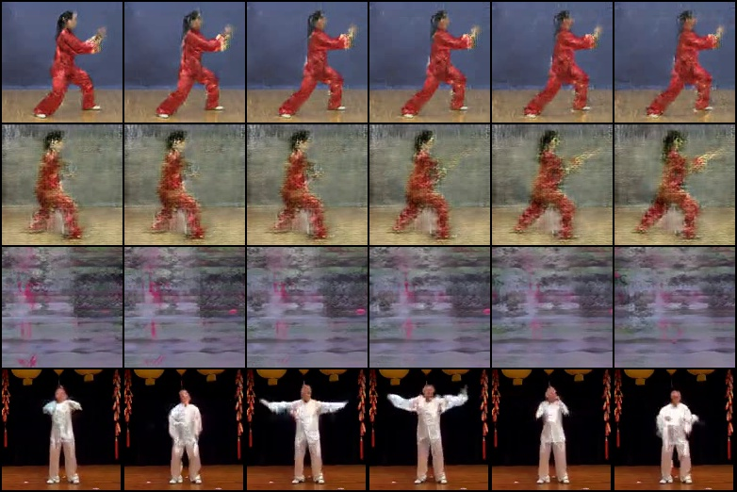
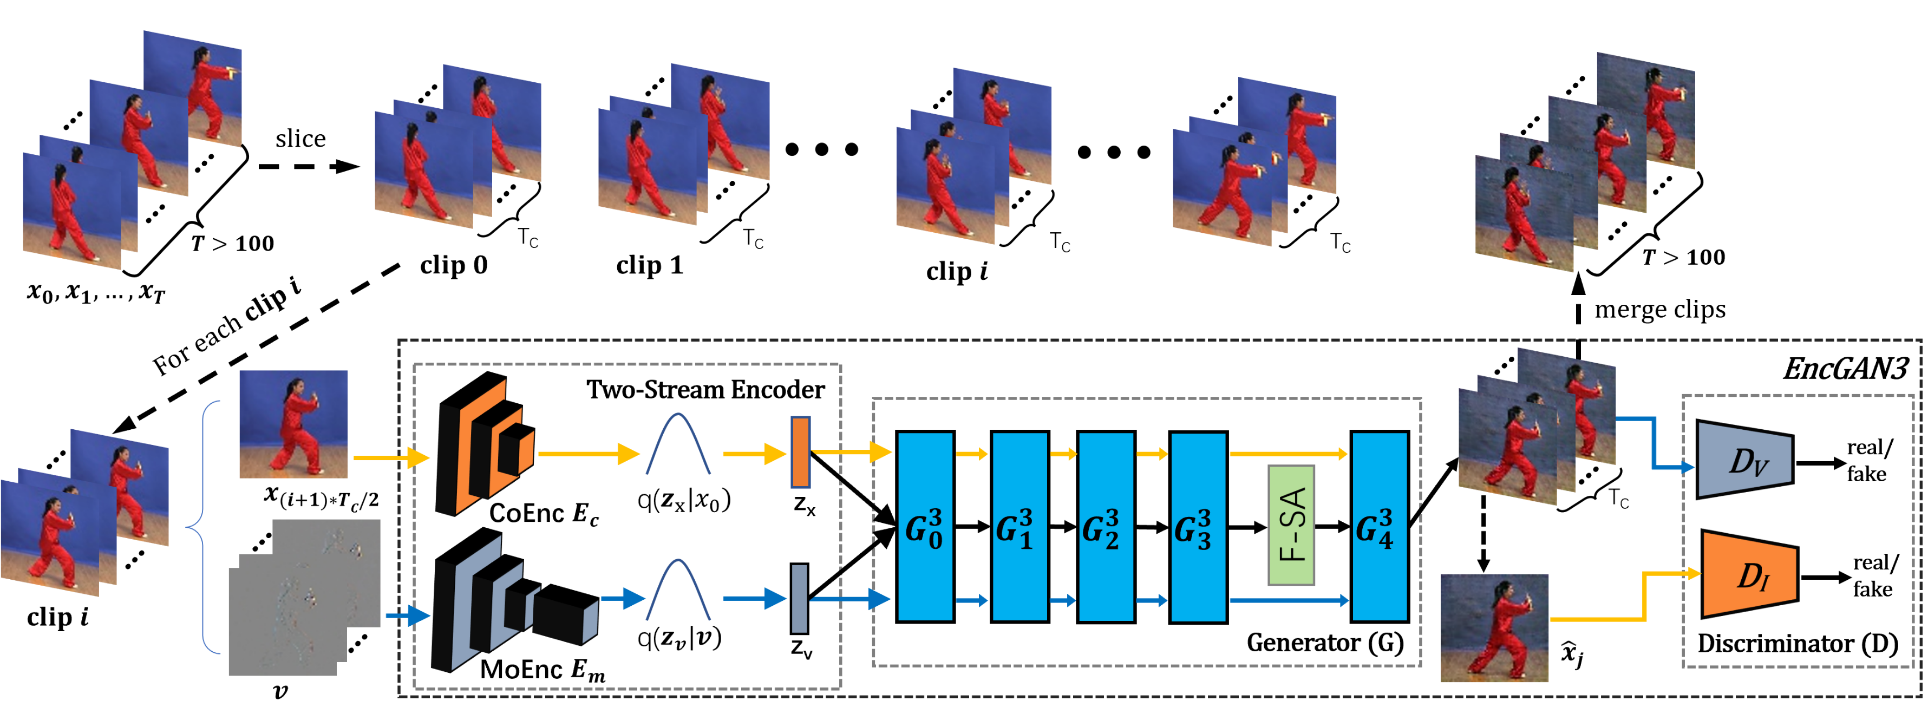
ENABLING THE ENCODER-EMPOWERED GAN-BASED VIDEO GENERATORS FOR LONG VIDEO GENERATION
Jingbo Yang and Adrian G. Bors
Department of Computer Science, University of York, York YO10 5GH, UK
Experiments
Generated Frames
Introduction
This work is to generate long temporally consistent and dynamic videos.
We propose Recall Encoder-empowered GAN3 (REncGAN3),
It employs the recall mechanism to a short video (16-frame) generator EncGAN3*.
Enabling the generation of long videos of hundreds of frames.
Video FID scores of non-overlapping 16-frame clips split from long videos generated by REncGAN3.
Video FID score measures the temporal consistency and frame quality.
Smaller is better.
(new loss)
REncGAN3
(old loss)
DIGAN
TATS
Methodology
(1) 0~130 frames
REncGAN3: EncGAN3 + the recall mechanism.
EncGAN3: hybrid VAE-GAN with dual-stream processing of the video content and motion.
The recall mechanism: feed the EncGAN3 with clip sequences that each inside clip has half-frame overlapped to its consecutive clips.
New loss Function: train Encoder and Generator jointly rather than separately as in original EncGAN3.
Fig.2 Quality degradation
Generated Videos
(2) 130~260 frames
(3) 260~400 frames
Conclusion
Idea: Enabling inter-clip relationship modeling to achieve long duration video representations.
Advance: With the same memory requirement, REncGAN3 could generate videos with hundreds of frames while EncGAN3* is just for 16-frame.
* Jingbo Yang and Adrian G. Bors, “Encoder enabled GAN-based video generators”, in ICIP 2022.
As observed, the long Taichi videos generated by REncGAN3 show better temporal consistency than those by DIGAN and better temporal dynamics than those by TATS.
Fig.1 model structure

