Slide 1
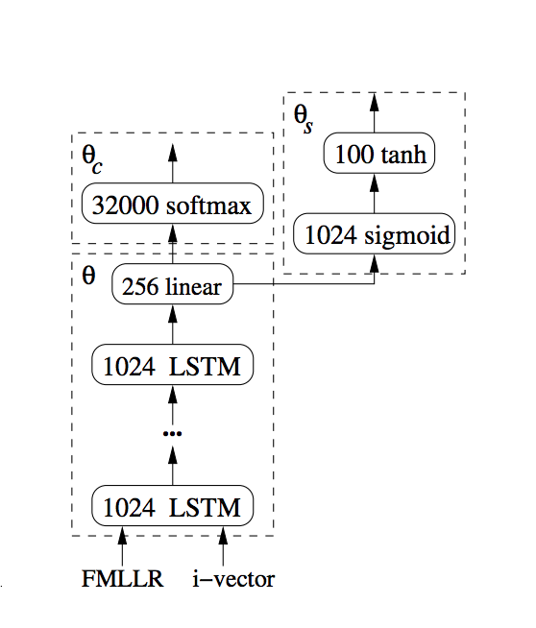
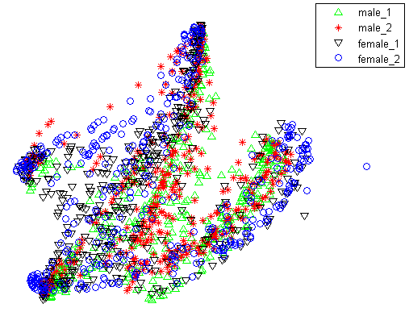
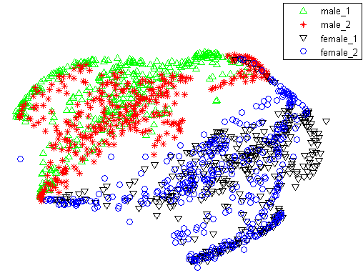
Speaker-Invariant Training via Adversarial Learning
Zhong Meng^{1, 2}, Jinyu Li ¹, Zhuo Chen ¹, Yong Zhao ¹, Vadim Mazalov ¹, Yifan Gong ¹, Biing-Hwang (Fred) Juang ²
¹Microsoft AI and Research, USA, ² Georgia Institute of Technology, USA
1. Introduction
3. Speaker-Invariant Training (SIT)
Problems with the speaker-independent (SI) acoustic model
Hidden and output units exhibit high variance.
Large overlap among distributions of different senones and reduced discriminatory capabilities.
Does not generalize well enough to the unseen speaker in the test data.
Adversarial Learning (GRL, DSN) [Ganin et al., 2015]
No parallel data from source and target domain is required
Effectively suppress the environment variability in speech signal
Gradient reversal layer (GRL): identity transform in the forward pass, multiply gradient with negative number ($−λ$) in the backward pass.
Learn a speaker-invariant and senone-discriminative deep feature
No need for any SI bases or SD representations during training or testing
SIT DNN acoustic model directly used in decoding.
One-pass online decoding to generate final transcription.
Senone Classifier $M_{y}(M_{f}\left(x\right))=p\left(\hat{y}=q | x;θ_{f},θ_{y}\right)$
Speaker Classifier $M_{d}(M_{f}\left(x\right))=p\left(\hat{d}=a | x;θ_{f},θ_{d}\right)$
Senone Loss $ℒ_{y}\left({θ_{f}, θ}_{y}\right)=−\sum_{i=1}^{N_{s}}{\log{p\left(y_{i} | x_{i};θ_{f}, θ_{y}\right)}}$
Speaker Loss $ℒ_{d}\left(θ_{f}, θ_{d}\right)=−\sum_{i=1}^{N}{\log{p\left(d_{i} | x_{i};θ_{f}, θ_{d}\right)}}$
Adversarial Multi-Task Learning
Senone-discriminative:$\min_{θ_{y},θ_{f}}{ℒ_{y}\left(θ_{y},θ_{f}\right)}$
Speaker-invariant: $\max_{θ_{f}}{\min_{{ θ}_{d}}{ℒ_{d}\left(θ_{d},θ_{f}\right)}}$
Senone
Loss $ℒ_{y}$
Speaker
Loss $ℒ_{d}$
Senone Label $\hat{y}$
SpeakerLabel $\hat{d}$
Senone Classifier $M_{y}$
Speaker Classifier $M_{d}$
GRL $R_{α}$
Deep Feature $f$
2. Related Work
SI bases interpolated by speaker-dependent (SD) representations [Tan et al., 2016]
Two passes of decoding to generate final transcription.
I-vector based speaker normalization [Saon et al., 2013]
One-pass decoding to generate final transcription.
Impossible to perform online decoding.
I-vector based speaker-adversarial multi-task learning [Saon et al., 2017]
Input to acoustic model: speech feature and i-vector
Reconstruction network predicts input i-vector
Mean-squared error loss of i-vector reconstruction
Online decoding is impossible
i-vector
Feature
Extractor $M_{f}$
Input Frame $x$
Table 1. WER (%) comparison of SI and SIT DNN acoustic models
System | Data | BUS | CAF | PED | STR | Avg. | RWERR
SI | Real | 24.77 | 16.12 | 13.39 | 17.27 | 17.84 | 0.00
 | Simu | 18.07 | 21.44 | 14.68 | 16.70 | 17.72 | 0.00
SIT | Real | 22.91 | 15.63 | 12.77 | 16.66 | 16.95 | 4.99
 | Simu | 16.64 | 20.23 | 13.53 | 15.96 | 16.54 | 6.66
Table 2. WER (%) comparison of speaker-adapted (SA) SI and SIT DNN acoustic models
4.Experiments and Conclusions
System | BUS | CAF | PED | STR | Avg. | RWERR
SA SI | 22.76 | 15.56 | 11.52 | 15.37 | 16.25 | 0.00
SA SIT | 21.42 | 14.79 | 11.11 | 14.70 | 15.46 | 4.86
Speaker-invariant training
Training data: 9137 labeled noisy utterances in CHiME-3 training set.
SI DNN acoustic model: 7 hidden layers, 2048 hidden units, 3012 output units representing senone labels
Feature Extractor: bottom 2 layers of DNN acoustic model.
29-dim log Mel filterbank feature with 1st and 2nd order deltas, $λ$is fixed at 3.0
Unsupervised speaker adaptation of SI and SIT acoustic models
Constrained re-training [Erdogan et al., 2016]
Test/adaptation data: CHiME-3 dev set with 4 noise conditions
Adapt both the SI and SIT DNNs to each of the speakers in the test data.
Adaptation target: 1-best path from first-pass decoding of the test data
Figure 3. t-SNE plots of deep features $f$ extracted from speech frames aligned with phoneme “ah” in CHiME-3.
(a) t-SNE of $f$ in SI model
(b) t-SNE of $f$ in SIT model

