Slide 1
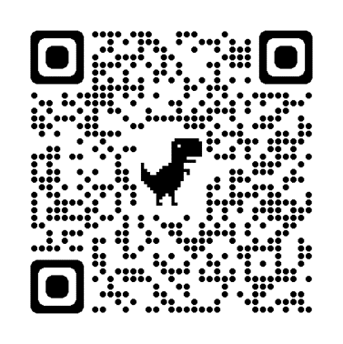
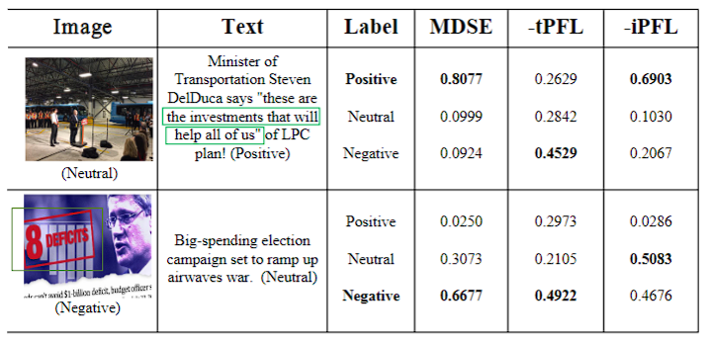
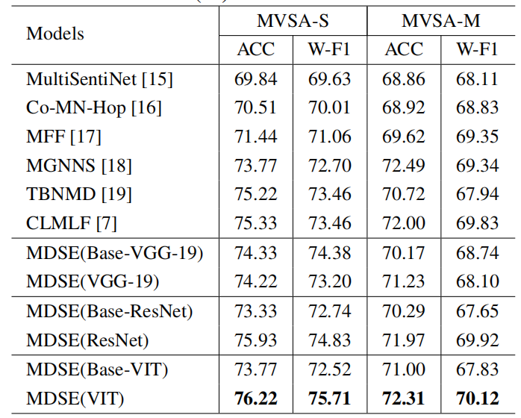
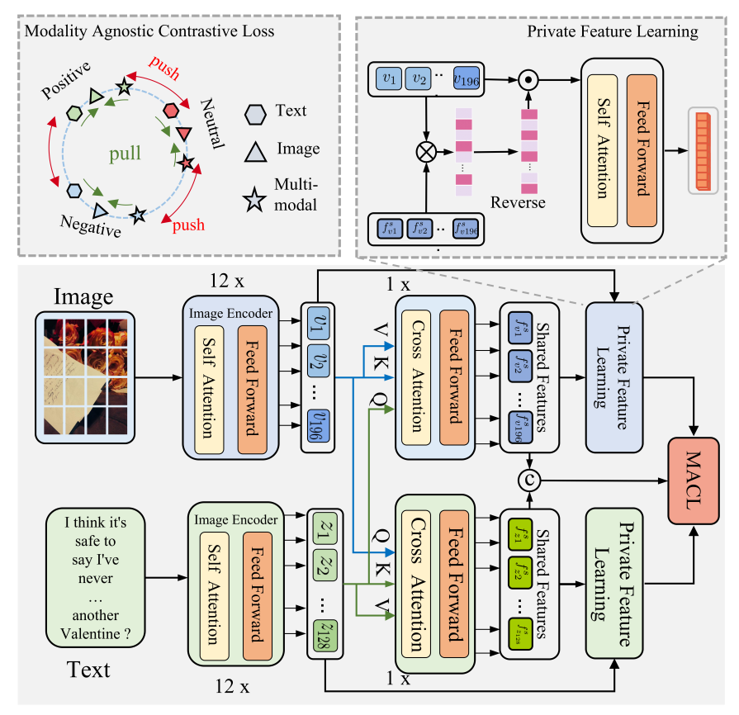
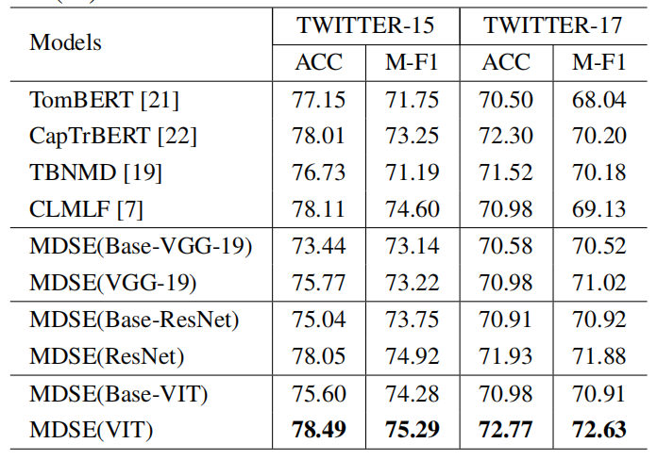
MODALITY-DEPENDENT SENTIMENTS EXPLORING FOR MULTI-MODAL SENTIMENT CLASSIFICATION
Jingzhe Li¹²³, Chenji Wang¹²³, Zhiming Luo⁴, Yuxian Wu¹²³, and Xingpeng Jiang¹²³
¹ Hubei Provincial Key Laboratory of Artificial Intelligence and Smart Learning
² National Language Resources Monitoring and Research Center for Network Media
³School of Computer Science, Central China Normal University, Wuhan, China
⁴Department of Artificial Intelligence, Xiamen University, Xiamen, China
https://github.com/royal-dargon/MDSE
lijingz@mails.ccnu.edu.cn wcj@ccnu.edu.cn
Abstract
Motivation
Recognizing human feelings from image and text is a core challenge of multi-modal data analysis, often applied in personalized advertising. Previous works aim at exploring the shared features, which are the matched contents between images and texts. However, the modality-dependent sentiment information (private features) in each modality is usually ignored by cross-modal interactions, the real sentiment is often reflected in one modality. In this paper, we propose a Modality-Dependent Sentiment Exploring framework (MDSE). First, to exploit the private features, we compare shared features with original image or text features, identifying previously overlooked unimodal features. Fusing the private and shared features can make the model more robust. Second, in order to obtain unified sentiment representations, we treat unimodal features and multi-modal fused features equally. We introduce a Modality-Agnostic Contrastive Loss (MACL) that performs contrastive learning between unimodal features and multi-modal fused features. The MACL can fully exploit sentiment information from multi-modal data and reduce the modality gap.
Cross-modal interaction usually employs a cross-attention mechanism, but it ignore the private feature.
The modal gap is a major challenge for multi-modal sentiment analysis; the representation of individual modalities and multi-modal representations should have the same ability to represent sentiments.
Experimental Results
Results on MVSA datasets
Method
Overview of the proposed MDSE framework
Results on TWITTER datasets
Dual Cross-Modal Interaction
The dual cross-modal interaction module utilizes the cross-attention block to extract multi-modal shared features. The dual cross-modal interaction module has one co-attentional transformer layer. A co-attentional transformer layer contains a cross-attention block (CA) and a feed-forward layer (FF).
Private Feature Learning
We propose a private feature learning module (PFL). Given unimodal image embeddings and the intermediate features, we obtain the similarity matrix by computing the similarities between every image patch embedding and intermediate image patch feature. Then, we reverse the importance vector and multiply it with the original image embeddings to obtain the ignored features.
Modality-Agnostic Contrastive Loss
We propose a modality-agnostic contrastive loss to learn modality-invariant sentiment representations. MACL considers the image, text, and image-text pair as three samples; it performs contrastive learning among them.
Conclusion
In this paper, we introduce modality-dependent sentiments exploring a framework for multi-modal sentiment classification(MDSE). MDSE aims to address the issue of overlooking modality-dependent private features in previous methods, resulting in learning of unrobust multi-modal sentiment representations. To address the issue, we propose a private feature learning module. It extracts modality-dependent private features by mining unfocused unimodal features. We further propose a modality-agnostic contrastive loss to perform contrastive learning among unimodal features and multi-modal features. These modules collaborate to learn robust multimodal sentiment representations.

