Slide 1
Low-Complexity Recursive Convolutional Precoding for OFDM-based Large-Scale Antenna Systems
Yinsheng Liu, Beijing Jiaotong University, China
Geoffrey Ye Li, Georgia Institute of Technology, USA

Slide 2
Authors
Yinsheng Liu
Beijing Jiaotong University, China
Email: ys.liu@bjtu.edu.cn.
Geoffrey Ye Li
Georgia Institute of Technology, USA
Email: liye@ece.gatech.edu.

Slide 3
Outlines
Introduction
System Model
Recursive Convolutional Precoding
Performances
Conclusions

Slide 4
Introduction
Large-Scale Antenna (LSA) system
Key technology for 5G
Large amount of antennas at the base-station
Improved spectrum- and energy-efficiencies
LSA-OFDM: combination of LSA and OFDM
Straightforward evolution from MIMO-OFDM
Provide frequency-selective channels for LSA systems
Notes:
LSA is the key technology for the coming 5G mobile communication system. In an LSA system, the base-station is equipped with a lot of antennas. The large amount of antennas can help to improve the spectrum and energy efficiencies of the wireless network. As a natural evolution from MIMO-OFDM, LSA can be also combined with OFDM where the latter is used to convert the frequency selective channel into a group of frequency-flat channels.

Slide 5
Introduction
Drawback: large complexity of LSA-OFDM due to
Huge number of IFFT/FFT modules
Matrix inverse for ZF/MMSE precodings
Our Solution: recursive convolutional precoding
Recursive: no need of matrix inverse
Convolutional: reduce the number of IFFT/FFTs
Notes:
Although the evolution from MIMO-OFDM to LSA-OFDM is straightforward, such combination suffers from large complexity.
First, the precoding is conducted in the frequency domain for traditional MIMO-OFDM. In this case, each antenna at the BS requires an IFFT for OFDM modulation and the number of IFFTs is equal to the antenna number. Therefore, the number of IFFTs will increase substantially as the rising of the antenna number in LSA systems, leading to a huge computational burden.
Second, ZF precoding is required to support more users in LSA systems. Although the MF precoding can perform as well as the ZF precoding in LSA
if the antenna number is large enough and the channels at different antennas and different users are independent. In practical systems, however, the antenna number is always finite. Moreover, the channels at different antennas will be correlated when placing so many antennas in a small area. In this sense, there will be residual IUI for the MF precoding, and the ZF precoding is thus still required. As a result, the matrix inversion of the ZF precoding will substantially increase the complexity, especially when the user number is large.
To address the complexity issue, we propose a recursive convolutional precoding scheme. The proposed approach is conducted recursively so that the matrix inverse can be aoivded, and convolutional precoding can also significantly reduce the number of IFFT at the BS.

Slide 6
System Model
Scenario: Downlink multiuser precoding
M antennas at the BS
P users with single antenna for each user
Received signal at n-th OFDM block and k-th subcarrier
Channel statistics with different large-scale gain
P-by-1
receive vector
M-by-P
precoding matrix
P-by-1
noise vector
P-by-M
channel matrix
P-by-1
transmit vector
Notes:
For the system model, we consider the scenario of downlink multiuser precoding in a cell. The BS has M antennas to serve P users with single antenna for each user.
The received signal at the k-th subcarrier of the n-th OFDM block can be represented by the following equation. In this slides, we assume the channels at different antennas for different users are independent, and different users have different large-scale gain, denoted by g_p.

Slide 7
Recursive Convolutional Precoding
Low-complexity of recursive convolutional precoding
Recursive: no need of matrix inverse
Convolutional: reduce the number of IFFT/FFTs
From traditional to recursive convolutional precoding
Step I: conversion from traditional frequency-domain (FD)
precoding to recursive FD precoding
Step II: conversion from recursive FD precoding to
convolutional precoding in time domain (TD)
Notes:
There are two reasons because of which the complexity can be reduced. First, the proposed approach is conducted recursively so that the matrix inverse can be avoided. Second, the proposed approach is conducted in the time domain through convolutional filters such that the number of IFFT can be greatly reduced. To derive the recursive convolutional precoding, we need to follow two steps: the fist step is to convert the traditional FD precoding into the recursive FD precoding, and the second step is to convert the recursive FD precoding to the convolutional precoding in the time domain.

Slide 8
Step I
Traditional FD precoding (e.g. ZF)
Taylor expansion (matrix form)
Taylor expansion (vector form)
Recursive FD precoding
Taylor expression
Q+1-th order Taylor expression of
Matrix form to vector form
p-th column of
From order recursion to time recursion
Notes:
In Step I, we begin the traditional ZF precoding which is conducted in the frequency domain. Using Taylor expansion, we can obtain a order-recursion version of the ZF precoding. Then, we can rewrite the matrix form Taylor expansion in a vector form. From the Taylor expansion in vector from, we note that the recursion is actually driven by the expansion order Q, Mathematically, the expansion order can be viewed as a recursion counter, which increases as the recursion
proceeds. In this sense, the OFDM block index can be also used as that recursion counter. In other words, we can obtain recursive FD precoding driven by the OFDM block index if replacing expansion order, Q, with OFDM block index, n.

Slide 9
Step II
Recursive FD precoding
Re-arrang vector representation
Converted to convolutional precoding
vector includes precoding coefficients on al l antennas
vector re-arrange
vector includes precoding coefficients on al l subcarriers
DFT
CIR
Estimation error for adaptive control
Notes:
Although the recursive FD precoding has been driven by the OFDM symbol index, the actual precoding operation is still conducted in the FD. We need to convert the FD precoding into the TD precoding to derive the structure of the convolutional precoding. For this purpose, re-arrange the vector representation, that is , let u_{m,p}[n] contains the precoding coefficients on all subcarriers. Then, perform DFT on both sides, leading to the adaptive updating of the coefficients of the precoding filter.

Slide 10
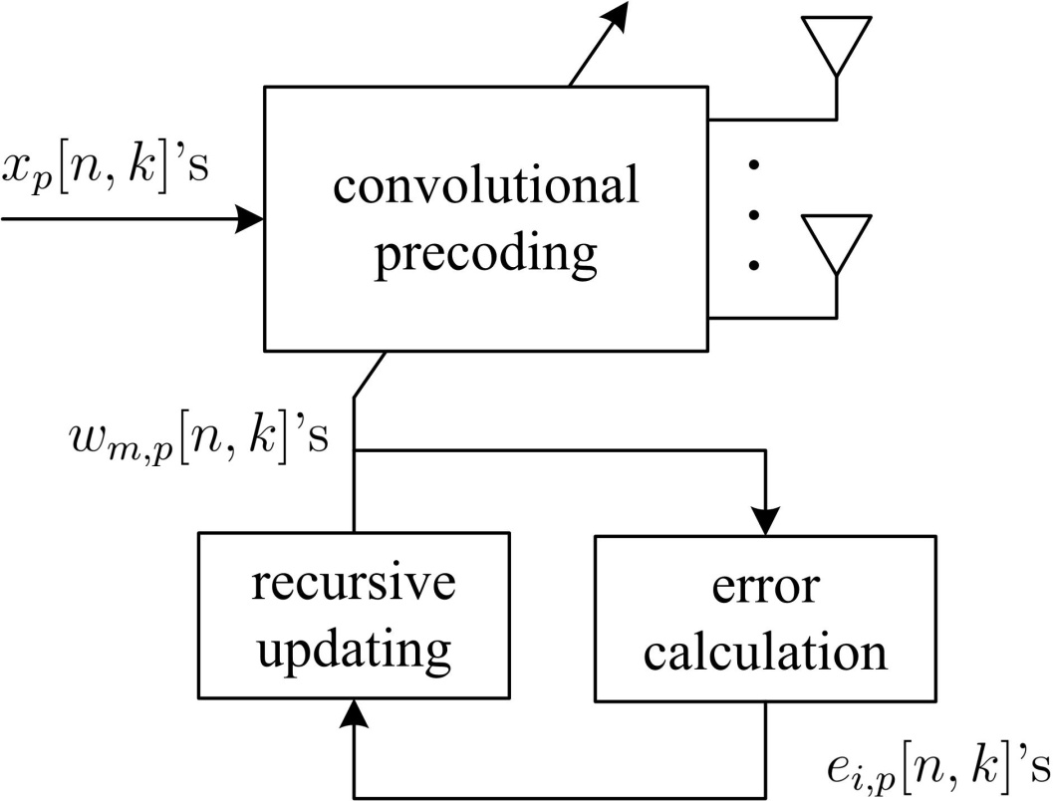
Structure
Recursive convolutional precoding includes
convolutional precoding
recursive updating
error calculation
Notes:
The proposed recursive convolutional precoding includes three parts. The first one the actual precoding which is conducted in the time domain through convolutional filter. The second one is the recursive updating which is used to update the coefficients of the convolutional filter. The third one is the error calculation which is used to update the coefficients and tracking the time variation of the channel.

Slide 11
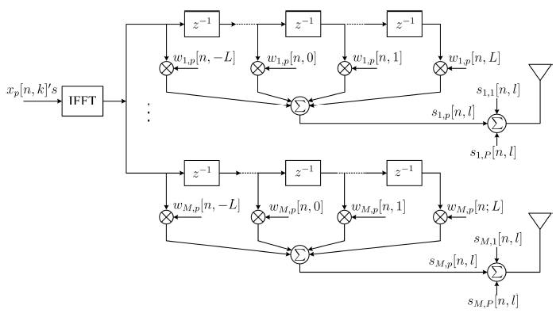
Convolutional precoding
Notes:
The precoding is carried out in the time domain via the precoding filter. In this case, only one
IFFT is required for each user no matter how many antennas there are at the BS. Therefore, the
number of IFFTs is equal to the number of users, which is much smaller than the antenna number
in LSA systems. By exploiting the correlation of frequency-domain precoding coefficients, the
coefficients of the precoding filter is sparse and thus can be truncated. For the single user case,
the precoding filter is exactly the conjugate of the CIR and thus 0 ≤ l ≤ L − 1. In the case
of multiple users, we use one more tap, as a rule of thumb, for the positive taps and another
L taps to include the significant coefficients on the negative taps. As a result, the length of the precoding filter can
be truncated within the range −L ≤ l ≤ L

Slide 12
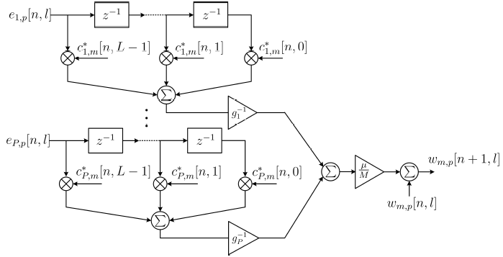
Recursive updating

Slide 13
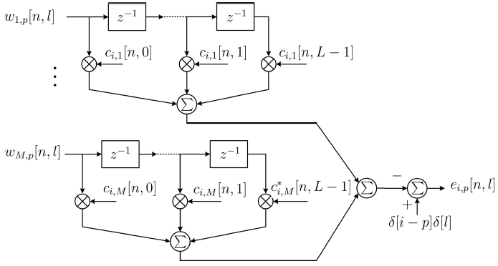
Error Calculation

Slide 14
Performances
Complexity comparison among
Proposed approach
Truncated polynomial expansion (TPE) (Q iterations)
Traditional FD ZF
(B subcarriers share same precoding matrix)
Symbol-error-rate (SER) simulation
ETU channel with equal large gains for different users
QPSK modulation
5MHz LTE bandwidth
(512 FFT size and 300 data subcarriers)
100 antennas and 10 users

Slide 15
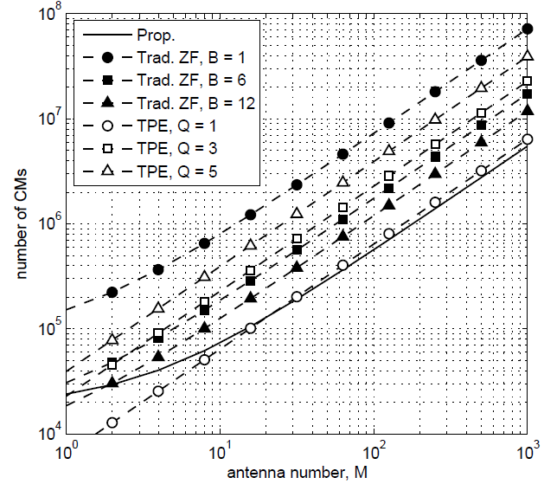
Complexity comparison
Significant complexity reduction

Slide 16
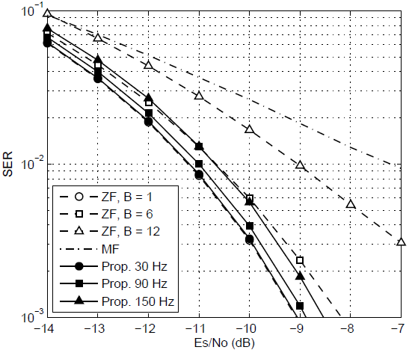
SER Simulation
Significant improvement than MF
Better performance than ZF with similar complexity

Slide 17
Conclusions
Recursive convolutional precoding can achieve lower complexity than traditional LSA-OFDM while maintaining satisfied performance

