Slide 1
End-to-End Speech Recognition from Federated Acoustic Models
IEEE ICASSP 2022
Yan Gao, Titouan Parcollet, Salah Zaiem, Javier Fernandez-Marques, Pedro P. B. de Gusmão, Daniel J. Beutel, Nicholas D. Lane

Slide 2
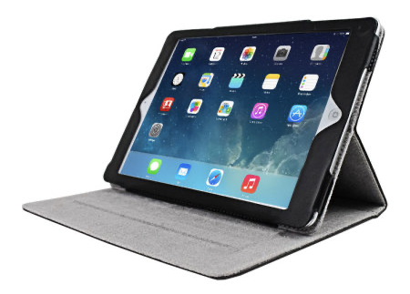
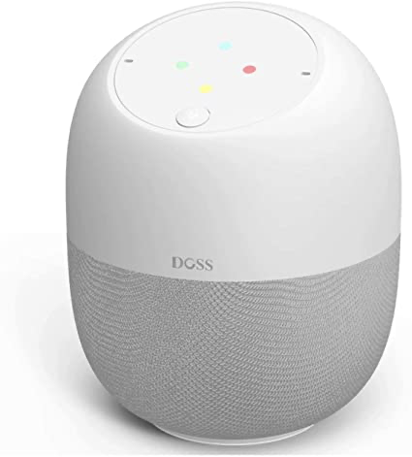
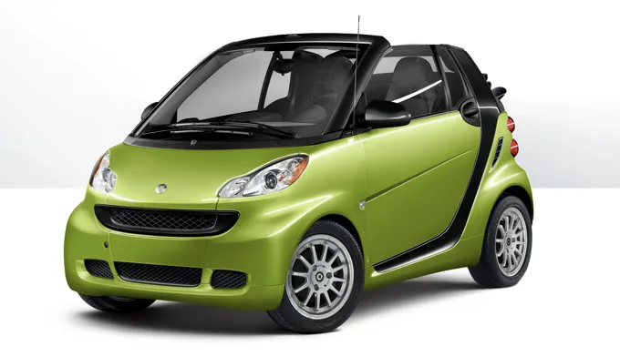
Motivations
IEEE ICASSP 2022
A lot of audio data generated from edge devices everyday…
1

Slide 3
Motivations
IEEE ICASSP 2022
A lot of audio data generated from edge devices everyday…
User data is of private nature.
1

Slide 4
Motivations
IEEE ICASSP 2022
A lot of audio data generated from edge devices everyday…
User data is of private nature.
How to make use of this kind of data for more robust ASR model training without breaking user’s privacy?
1

Slide 5
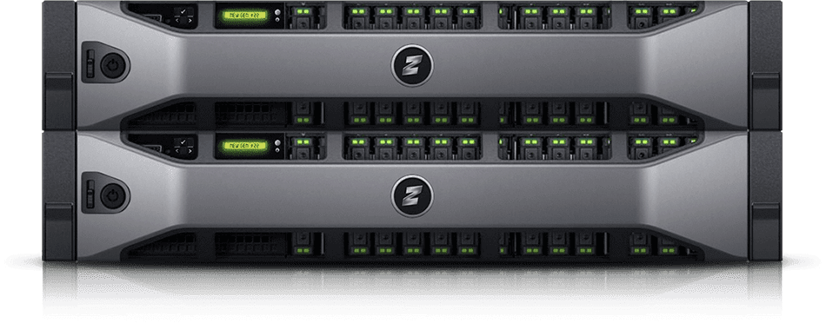
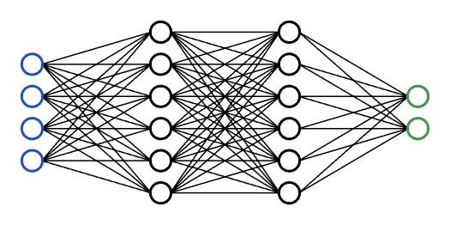
Federated Learning
IEEE ICASSP 2022
Server
Aggregation
Global model
2

Slide 6
Federated Learning
IEEE ICASSP 2022
FL is a form of distributed ML.
Server
Aggregation
Global model
2

Slide 7
Federated Learning
IEEE ICASSP 2022
FL is a form of distributed ML.
FL clients (i.e. compute nodes) are embedded devices.
Server
Aggregation
Global model
2

Slide 8
Federated Learning
IEEE ICASSP 2022
FL is a form of distributed ML.
FL clients (i.e. compute nodes) are embedded devices.
FL clients collaboratively learn a single global model.
Server
Aggregation
Global model
2

Slide 9
Federated Learning
IEEE ICASSP 2022
FL is a form of distributed ML.
FL clients (i.e. compute nodes) are embedded devices.
FL clients collaboratively learn a single global model.
Data stays in the client.
Server
Aggregation
Global model
2

Slide 10
IEEE ICASSP 2022
What are the Challenges of ASR in FL?
3

Slide 11
Challenges of ASR in FL
IEEE ICASSP 2022
Non independent and identically distributed data (non-IID) in FL environments.
3

Slide 12
Challenges of ASR in FL
IEEE ICASSP 2022
Non independent and identically distributed data (non-IID) in FL environments.
— different acoustic environments, words being spoken, microphones.
3

Slide 13
Challenges of ASR in FL
IEEE ICASSP 2022
Non independent and identically distributed data (non-IID) in FL environments.
SOTA ASR models are computationally intensive and not suited for the on-device training phases of FL.
— different acoustic environments, words being spoken, microphones.
3

Slide 14
Challenges of ASR in FL
IEEE ICASSP 2022
Non independent and identically distributed data (non-IID) in FL environments.
SOTA ASR models are computationally intensive and not suited for the on-device training phases of FL.
ASR training is difficult and very sensitive during early stages of optimisation.
— different acoustic environments, words being spoken, microphones.
3

Slide 15
Challenges of ASR in FL
IEEE ICASSP 2022
Non independent and identically distributed data (non-IID) in FL environments.
SOTA ASR models are computationally intensive and not suited for the on-device training phases of FL.
ASR training is difficult and very sensitive during early stages of optimisation.
— different acoustic environments, words being spoken, microphones.
— due to the complexity of learning a proper alignment.
3

Slide 16
Challenges of ASR in FL
IEEE ICASSP 2022
Non independent and identically distributed data (non-IID) in FL environments.
SOTA ASR models are computationally intensive and not suited for the on-device training phases of FL.
ASR training is difficult and very sensitive during early stages of optimisation.
— different acoustic environments, words being spoken, microphones.
— due to the complexity of learning a proper alignment.
— Very challenging to train ASR models in FL from scratch.
3

Slide 17
Speech Recognition from Federated Acoustic Model
IEEE ICASSP 2022
Initialization
Server
Centralized pre-trained model
Aggregation
Global model
4

Slide 18
Speech Recognition from Federated Acoustic Model
IEEE ICASSP 2022
Initialization
Server
Centralized pre-trained model
Weighted Aggregation
(FedAvg, loss-based, WER-based)
WER-based method is proposed by integrating the specificity of ASR to FL.
5
Global model

Slide 19
Speech Recognition from Federated Acoustic Model
IEEE ICASSP 2022
FedAvg
Initialization
Server
Centralized pre-trained model
2) Loss-based
Weighted Aggregation
(FedAvg, loss-based, WER-based)
3) WER-based
α^{(k)} is the weighting for client k;
n_{k} is the number of samples on client k.
6
Global model

Slide 20
Building Realistic FL Environments
IEEE ICASSP 2022
Dataset: Common Voice (CV) French and Italian set — more suitable for FL
Most existing work using LibriSpeech (LS)
7

Slide 21
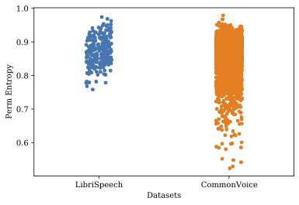
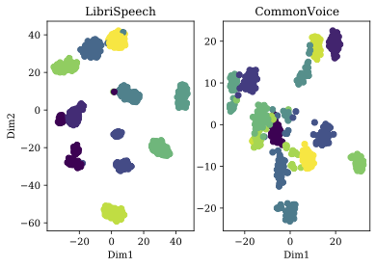
Building Realistic FL Environments
IEEE ICASSP 2022
Dataset: Common Voice (CV) French and Italian set — more suitable for FL
Most existing work using LibriSpeech (LS)
Comparison between CV and LS
Permutation entropy mean values
TSNE representation of embedded speech utterances
7

Slide 22
Building Realistic FL Environments
IEEE ICASSP 2022
Partition
Centralized pre-training: Train on half of the data samples with a small subset of speakers (warm-up).
8

Slide 23
Building Realistic FL Environments
IEEE ICASSP 2022
Partition
Centralized pre-training: Train on half of the data samples with a small subset of speakers (warm-up).
Cross-silo FL: Few clients, similar data distribution, high availability during all rounds.
8

Slide 24
Building Realistic FL Environments
IEEE ICASSP 2022
Partition
Centralized pre-training: Train on half of the data samples with a small subset of speakers (warm-up).
Cross-silo FL: Few clients, similar data distribution, high availability during all rounds.
— Splitting dataset in 10 random partitions with no overlapping speakers.
8

Slide 25
Building Realistic FL Environments
IEEE ICASSP 2022
Partition
Centralized pre-training: Train on half of the data samples with a small subset of speakers (warm-up).
Cross-silo FL: Few clients, similar data distribution, high availability during all rounds.
— Splitting dataset in 10 random partitions with no overlapping speakers.
Cross-device FL: Thousands of clients, very different data distributions (non-IID), each
participating in just a few rounds.
8

Slide 26
Building Realistic FL Environments
IEEE ICASSP 2022
Partition
Centralized pre-training: Train on half of the data samples with a small subset of speakers (warm-up).
Cross-silo FL: Few clients, similar data distribution, high availability during all rounds.
— Splitting dataset in 10 random partitions with no overlapping speakers.
Cross-device FL: Thousands of clients, very different data distributions (non-IID), each
— Single speaker using their individual devices.
Dividing datasets based on users ID into 4095 and 649 partitions for Fr & It.
participating in just a few rounds.
8

Slide 27
Building Realistic FL Environments
IEEE ICASSP 2022
Partition
Centralized pre-training: Train on half of the data samples with a small subset of speakers (warm-up).
Cross-silo FL: Few clients, similar data distribution, high availability during all rounds.
— Splitting dataset in 10 random partitions with no overlapping speakers.
Cross-device FL: Thousands of clients, very different data distributions (non-IID), each
— Single speaker using their individual devices.
Dividing datasets based on users ID into 4095 and 649 partitions for Fr & It.
— Two users per device. splitting 2036 clients for Fr.
participating in just a few rounds.
8

Slide 28
Building Realistic FL Environments
IEEE ICASSP 2022
Partition
Centralized pre-training: Train on half of the data samples with a small subset of speakers (warm-up).
Cross-silo FL: Few clients, similar data distribution, high availability during all rounds.
— Splitting dataset in 10 random partitions with no overlapping speakers.
Cross-device FL: Thousands of clients, very different data distributions (non-IID), each
— Single speaker using their individual devices.
Dividing datasets based on users ID into 4095 and 649 partitions for Fr & It.
— Two users per device. splitting 2036 clients for Fr.
participating in just a few rounds.
Model
Seq2Seq model trained with the joint CTC-attention objective.
8

Slide 29
Experimental Results
IEEE ICASSP 2022
Training Scenario |  | Fr WER(%) | It WER (%)
Centralized | All data (lower bound) | 20.18 | 17.40
 | 1st half (warm-up) | 25.26 | 25.90
 | 2nd half (post warm-up) | 20.94 | 24.86
10-clients FL Cross-silo | Standard FedAvg | 21.26 | 20.97
 | Loss-based aggregation | 21.10 | 20.86
 | WER-based aggregation | 20.99 | 19.98
2k-clients FL Cross-device | Standard FedAvg | 22.83 | —
 | Loss-based aggregation | 22.67 | —
 | WER-based aggregation | 22.42 | —
4k-clients FL Cross-device | Standard FedAvg | 23.24 | 24.32
 | Loss-based aggregation | 23.16 | 24.23
 | WER-based aggregation | 22.82 | 23.86
From scratch | FedAvg, FedAdam | 100+ | 100+
9

Slide 30
Experimental Results
IEEE ICASSP 2022
Training Scenario |  | Fr WER(%) | It WER (%)
Centralized | All data (lower bound) | 20.18 | 17.40
 | 1st half (warm-up) | 25.26 | 25.90
 | 2nd half (post warm-up) | 20.94 | 24.86
10-clients FL Cross-silo | Standard FedAvg | 21.26 | 20.97
 | Loss-based aggregation | 21.10 | 20.86
 | WER-based aggregation | 20.99 | 19.98
2k-clients FL Cross-device | Standard FedAvg | 22.83 | —
 | Loss-based aggregation | 22.67 | —
 | WER-based aggregation | 22.42 | —
4k-clients FL Cross-device | Standard FedAvg | 23.24 | 24.32
 | Loss-based aggregation | 23.16 | 24.23
 | WER-based aggregation | 22.82 | 23.86
From scratch | FedAvg, FedAdam | 100+ | 100+
9

Slide 31
Experimental Results
IEEE ICASSP 2022
Training Scenario |  | Fr WER(%) | It WER (%)
Centralized | All data (lower bound) | 20.18 | 17.40
 | 1st half (warm-up) | 25.26 | 25.90
 | 2nd half (post warm-up) | 20.94 | 24.86
10-clients FL Cross-silo | Standard FedAvg | 21.26 | 20.97
 | Loss-based aggregation | 21.10 | 20.86
 | WER-based aggregation | 20.99 | 19.98
2k-clients FL Cross-device | Standard FedAvg | 22.83 | —
 | Loss-based aggregation | 22.67 | —
 | WER-based aggregation | 22.42 | —
4k-clients FL Cross-device | Standard FedAvg | 23.24 | 24.32
 | Loss-based aggregation | 23.16 | 24.23
 | WER-based aggregation | 22.82 | 23.86
From scratch | FedAvg, FedAdam | 100+ | 100+
9

Slide 32
Experimental Results
IEEE ICASSP 2022
Training Scenario |  | Fr WER(%) | It WER (%)
Centralized | All data (lower bound) | 20.18 | 17.40
 | 1st half (warm-up) | 25.26 | 25.90
 | 2nd half (post warm-up) | 20.94 | 24.86
10-clients FL Cross-silo | Standard FedAvg | 21.26 | 20.97
 | Loss-based aggregation | 21.10 | 20.86
 | WER-based aggregation | 20.99 | 19.98
2k-clients FL Cross-device | Standard FedAvg | 22.83 | —
 | Loss-based aggregation | 22.67 | —
 | WER-based aggregation | 22.42 | —
4k-clients FL Cross-device | Standard FedAvg | 23.24 | 24.32
 | Loss-based aggregation | 23.16 | 24.23
 | WER-based aggregation | 22.82 | 23.86
From scratch | FedAvg, FedAdam | 100+ | 100+
9

Slide 33
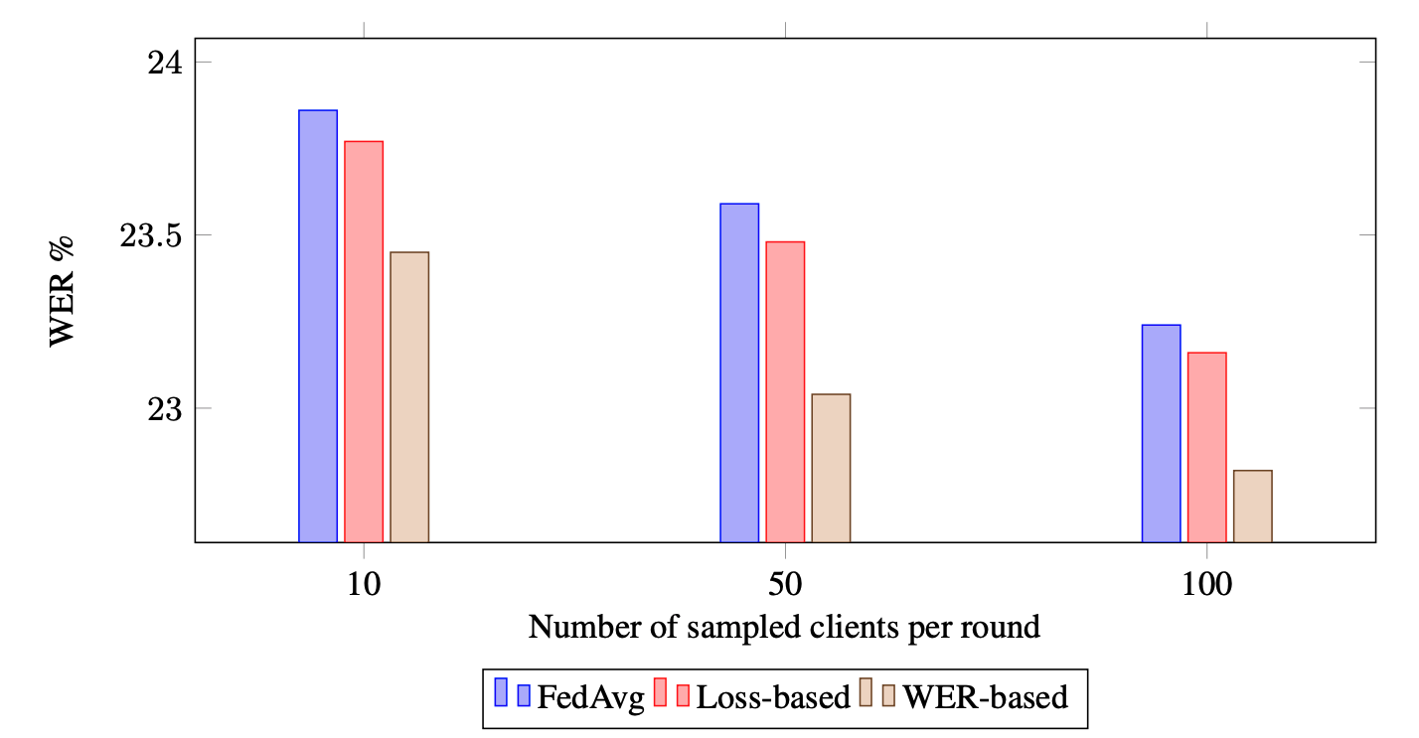
Experimental Results
IEEE ICASSP 2022
Speech recognition performance when varying the number of sampled clients per round for the 4k-client setting on CV French.
10

Slide 34
End-to-End Speech Recognition from Federated Acoustic Models
Thanks! Any questions?
IEEE ICASSP 2022
Email: yg381@cam.ac.uk

