Slide 1
BUPT
BEIJING UNIVERSITY OF
POSTS & TELECOMMUNICATIONS
A BP Neural Network Based Punctured Scheduling Scheme Within Mini-slots for Joint URLLC and eMBB Traffic
Qingqing Shang, Fangfang Liu, Chunyan Feng，Ruiyi Zhang and Shulun Zhao
Beijing Key Laboratory of Network System Architecture and Convergence
School of Information and Communication Engineering
Beijing University of Posts and Telecommunications, Beijing, China
Nov. 12, 2019

Slide 2
BUPT
BEIJING UNIVERSITY OF
POSTS & TELECOMMUNICATIONS
01
Background
02
System Model
OUTLINE
03
The Proposed Scheme
04
Simulation Results
05
Conclusion

Slide 3
01
Background
Higher priority
Ultra Reliable Low Latency Communications
Ultra High Definition Video
enhanced Mobile roadband
Auto Driving
URLLC
eMBB
High throughput
High spectral efficiency
Long transmission time and high resource utilization
Ultra reliable
Low latency
Sporadic and bursty
Tactile Internet
Cloud Gaming
URLLC Traffic demands more radio resources, but resource reservation would lead to a significant loss in the network SE due to its sporadic and bursty characteristics.

Slide 4
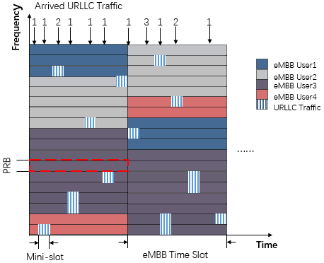
01
Background
Utilization of spectrum resources
Advantages:
Satisfy reliability and latency requirements
Avoid waste of spectrum resources
Disadvantages:
impact the decoding procedure of eMBB and lead to potential throughput loss
Punctured scheduling (PS)
Challenges:
Reduce the degradation of eMBB performance

Slide 5
01
Background
Reduce the degradation of eMBB performance
Existing Solutions:
Preemption indication (PI)
Optimized retransmissions
Signal space diversity
Opportunistic spatial preemptive
URLLC placement strategy (Important, can effectively reduce eMBB throughput loss)
Shortage: existing placement strategy is based on slot and linear rate loss model of eMBB.
In this paper:
We propose a novel BPNN based punctured scheduling scheme within mini-slots considering more general convex model of eMBB rate loss.

Slide 6
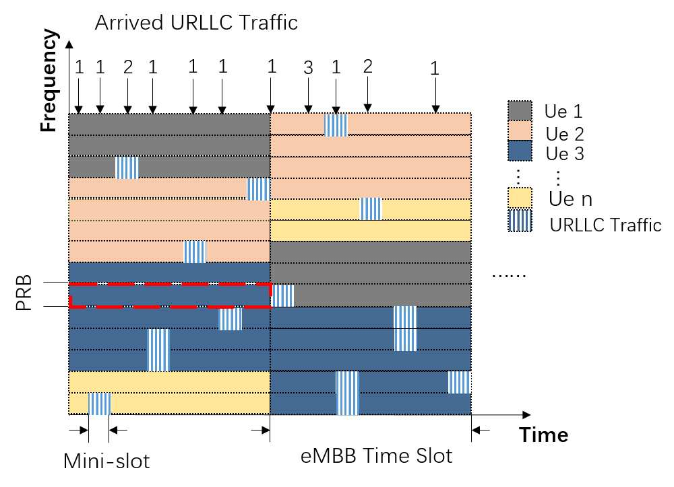
02
System model
Four types of interference:
A set of eMBB users:
A set of URLLC users:
A set of PRBs:
A set of mini-slots:
The supported MCS index of eMBB user:
transport block(TB) size :

Slide 7
02
System model
The number of PRBs allocated to User i:
Under a scheduling policy π the URLLC traffic load on eMBB user i:
The decoding probability of eMBB user i under URLLC load:
The throughput loss of eMBB user i:
The aggregate system throughput loss of eMBB users in the TTI:
find best urllc
placement policy
within mini-slots
Optimization Problem:

Slide 8
03
The Proposed Scheme
BP Neural Network Based Punctured Scheduling Scheme
Two steps:
BP Neural Network Predicting Decoding Probability
URLLC Placement Strategy on eMBB Users

Slide 9
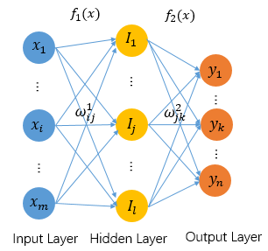
03
The Proposed Scheme
S1: BP Neural Network Predicting Decoding Probability
1) Input Layer:
MCS mode, the number of allocated PRBs and the number of punctures. So the number of input layer neurons should be 3.
2) Hidden Layer:
When it is too small, the model does
not learn well. Instead, it is easy to overfit. After experimentation, we set the number of hidden layer neurons to be 3 according to formulas below.
3) Output Layer:
The output value is the decoding probability of eMBB transport block (TB) with puncturing (output ∈ [0, 1]). The number of neurons in the output layer is 1.

Slide 10
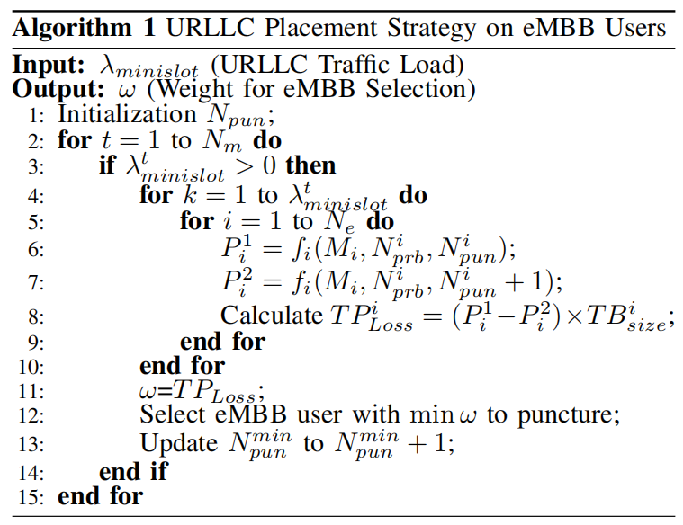
03
The Proposed Scheme
S2: URLLC Placement Strategy on eMBB Users
The decoding probability predicted by BPNN under completed placement situation of URLLC before current puncture:
The decoding probability predicted by BPNN under completed placement situation of URLLC after current puncture:
The throughput loss caused by puncturing：
Scheduler selects eMBB users with the least throughput loss to puncture. Then update the number of punctures of all eMBB users for the next scheduling decision.

Slide 11
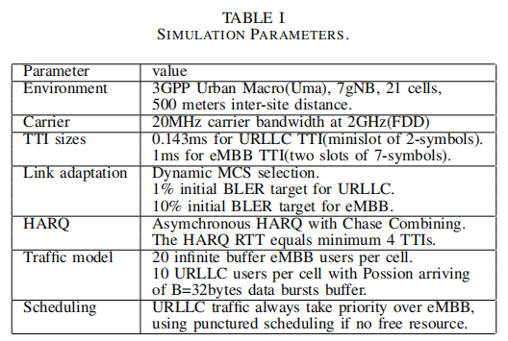
Simulation Results
Simulation parameters
EMBB Traffic：full buffer traffic is used to model the eMBB best effort traffic.
URLLC Traffic：A bursty traffic model is used following a Poisson arrival process.
Aassuming that all URLLC packets are the same size and can be transmitted on a PRB for the sake of simplicity.
The punctured sub-carrier symbols contain no useful information for the receiver, and hence are modelled as information-less.
04

Slide 12
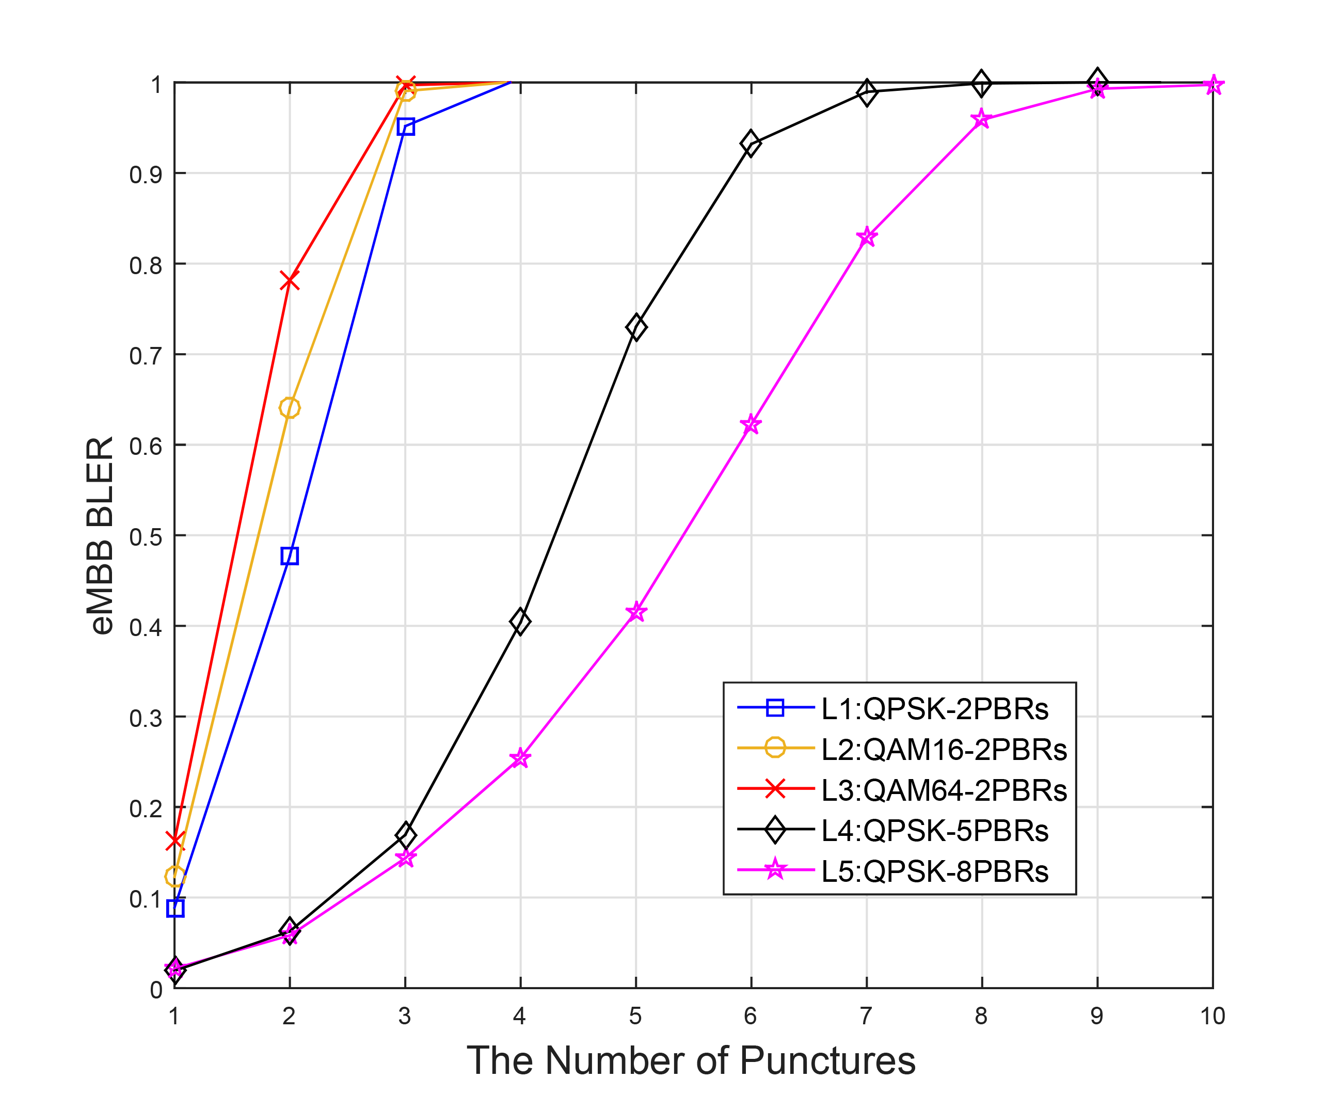
04
Simulation Results
Influence of Different Factors on BLER
These three factors as input vector
Under the same PRBs allocation and MCS, users punctured more frequently suffer more severely;
Under the same PRBs allocation and punctures, users with higher MCS suffer more severely;
Under the same MCS and punctures,users with less PRBs suffer more severely.
The meaning of BPNN output
The BPNN predicts an output value between 0 and 1 which can represent decoding probability.

Slide 13
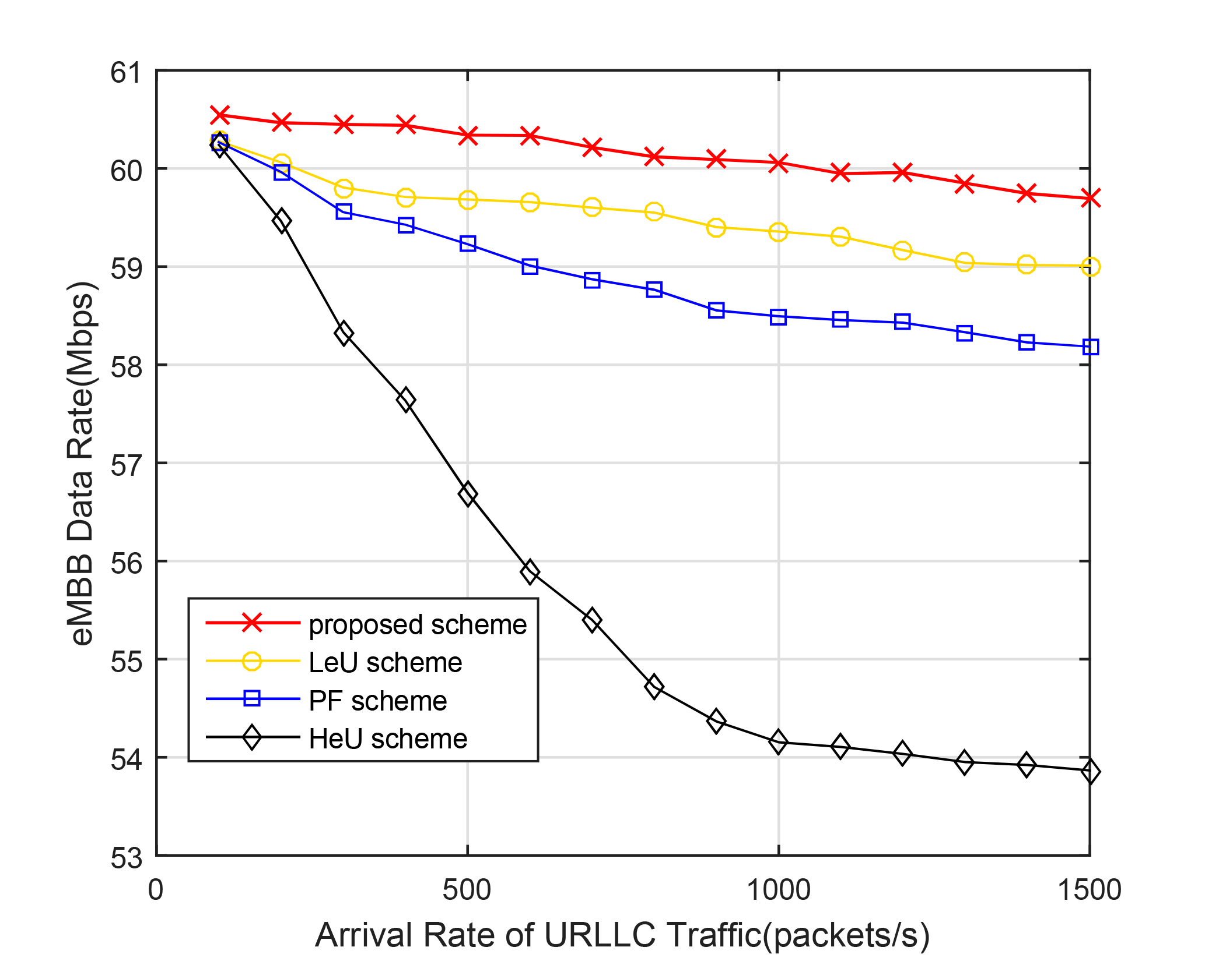
04
Simulation Results
eMBB Data Rate for Different Arrival Rate of URLLC Traffic
The proposed scheme offers the best throughput performance among four methods as expected.
eMBB throughput declines with increased URLLC traffic due to more frequently puncturing. With the help of BPNN prediction, every URLLC packet punctures the eMBB user with the least loss of throughput, thereby effectively reducing throughput loss.

Slide 14
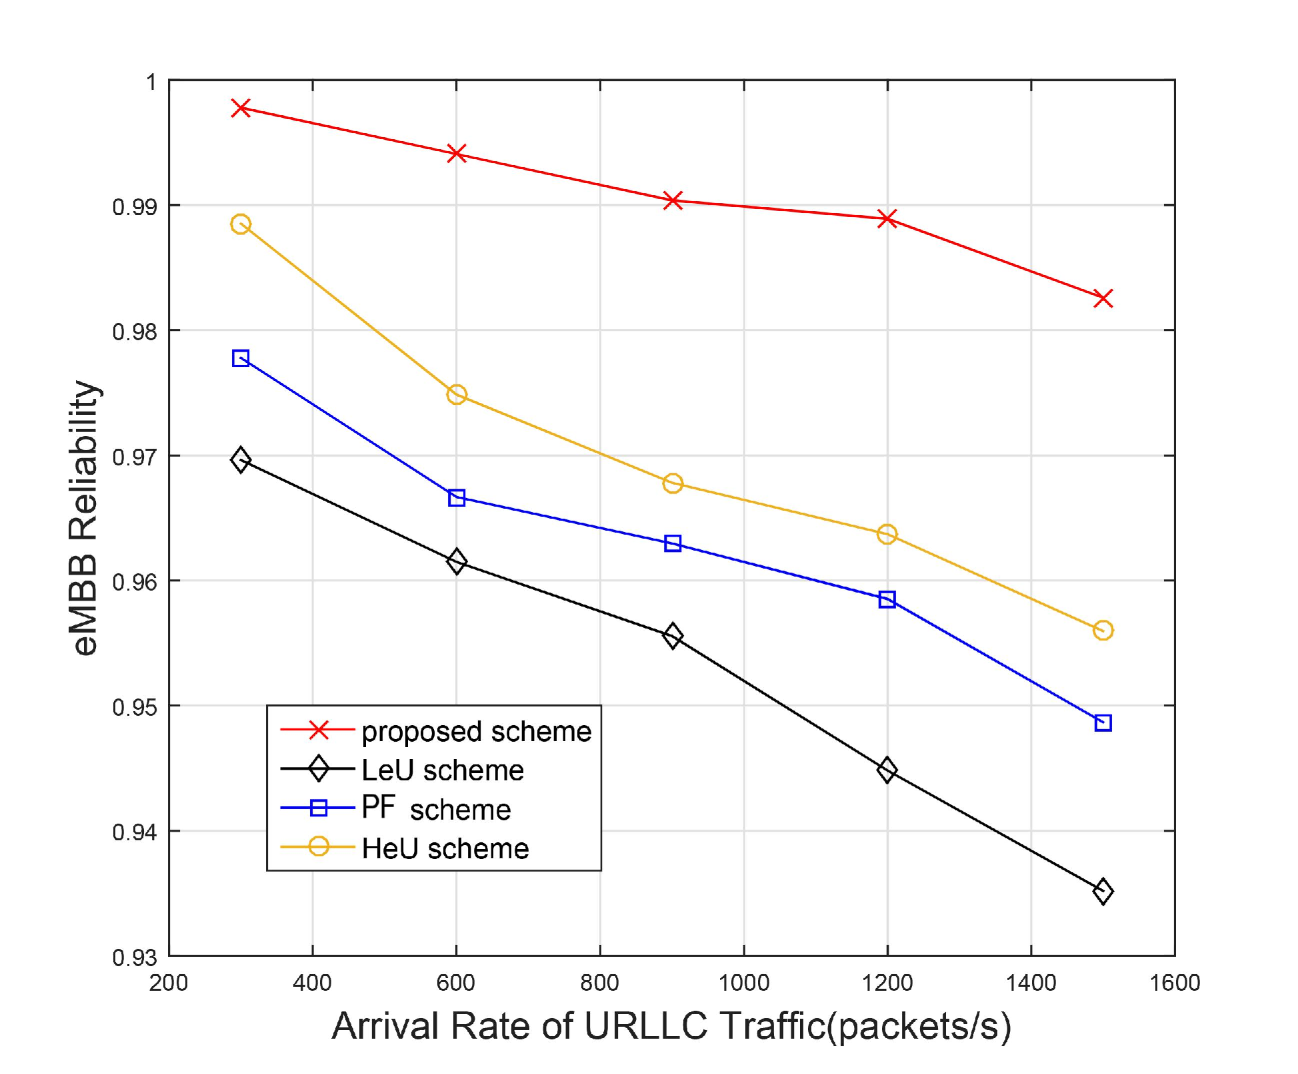
04
Simulation Results
eMBB Reliability for Different Arrival Rate of URLLC Traffic
The proposed scheme guarantees higher reliability among four methods.
The proposed scheme always selects different eMBB users with the least loss to puncture, thus protecting users to a certain extent and ensuring their reliability. Three contrast schemes tend to puncture the same eMBB users, which makes it easier to fail decoding.

Slide 15
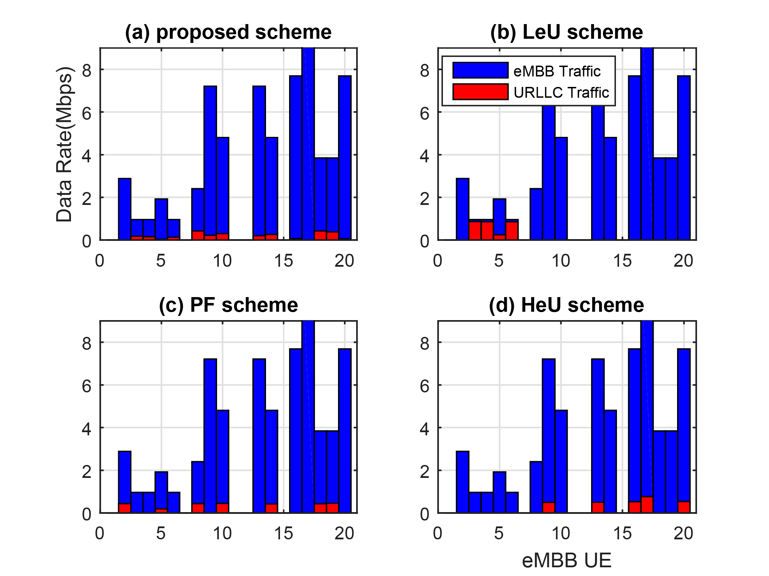
04
Simulation Results
Data Rate of eMBB Users and Distributed URLLC Traffic
The proposed scheme gives a relatively uniform distribution of puncture, both in
terms of eMBB users and time.
Combined with the principle of the proposed scheme and the distribution of URLLC traffic on eMBB users, the proposed scheme tends to puncture different eMBB users in a slot, and lower puncture ratio of eMBB users reduces the
error probability to some extent.

Slide 16
05
Conclusion
Contrtbutions
Present a flexible mini-slot based scheduling method to puncture.
Designed a BP Neural Network to predict decoding probability of different puncture conditions, with the help of which scheduler can calculate and compare the throughput of each eMBB user caused by current puncturing. Then the eMBB user with the least potential throughput loss will be punctured.
The proposed scheme allows scheduler to puncture different eMBB users within mini-slots and select eMBB candidate with throughput-loss-least principle.The proposed scheme improved the throughtput and reliability of eMBB users.

Slide 17
BUPT
BEIJING UNIVERSITY OF
POSTS & TELECOMMUNICATIONS
Thank You!

