Slide 1
Distributional padding
Duc Nguyen
Seonghwa Choi
Woojae Kim
Sewoong Ahn
Jinwoo Kim
Sanghoon Lee
Yonsei University

Slide 2
Why padding matters?
“In addition to the aforementioned benefit of keeping the spatial sizes constant after CONV, doing this actually improves performance. If the CONV layers were to not zero-pad the inputs and only perform valid convolutions, then the size of the volumes would reduce by a small amount after each CONV, and the information at the borders would be “washed away” too quickly.” - http://cs231n.github.io/convolutional-networks/

Slide 3
Related work
Most famous padding scheme: zero-padding
Pad zeros to the border of an image
Works well in image classification
Most famous alternative: reflection padding
Reuse the border values to pad the image
Works well in image generation tasks
Most recently proposed method: partial-convolution padding
Does not actually pad anything
Performs convolution as if the image is padded with zeros, and then rescale the output border according to the window size
Works well in image inpainting

Slide 4
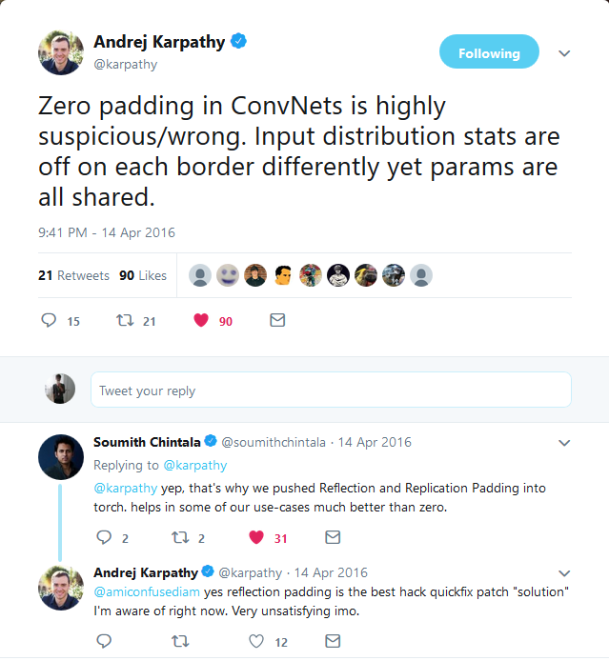
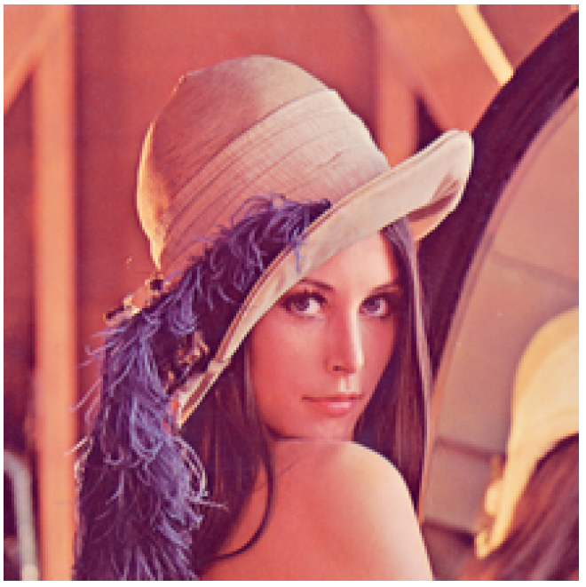
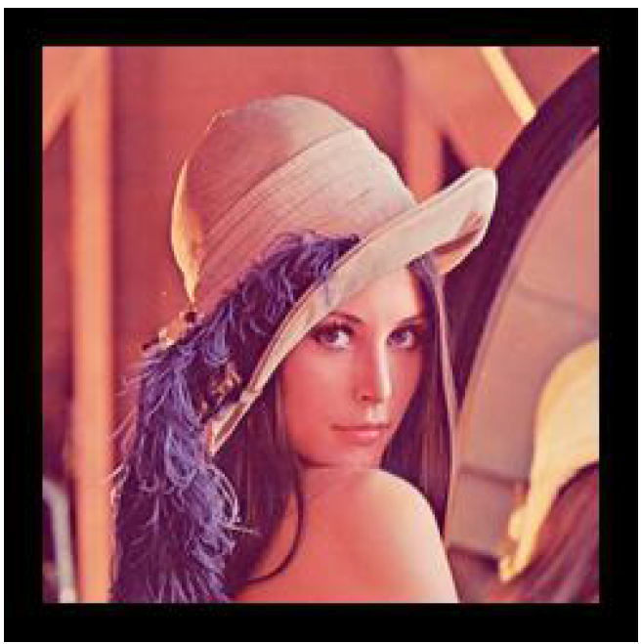
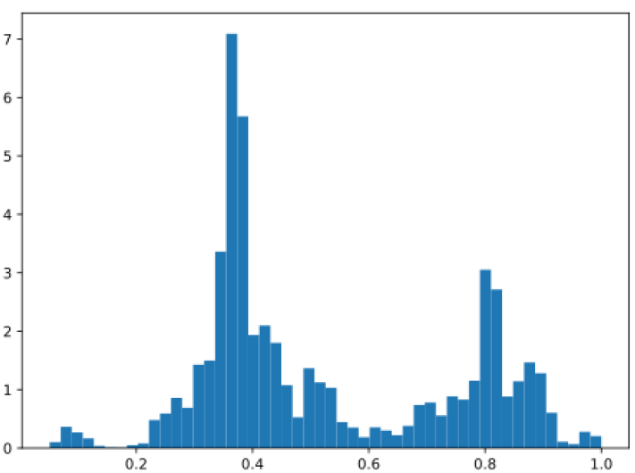
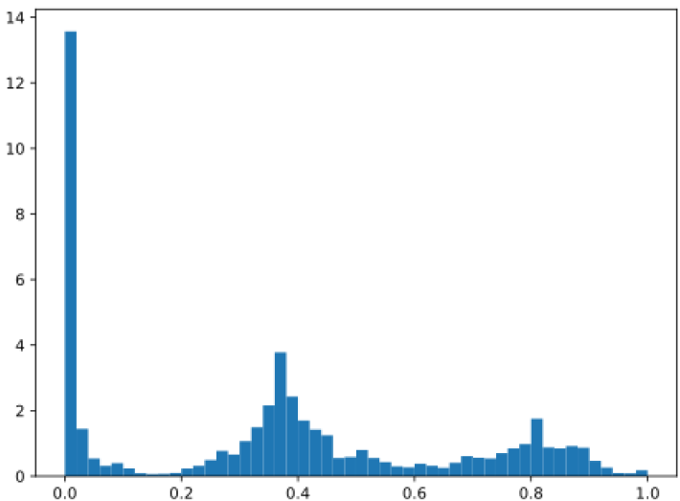
Zero padding is wrong
Lena image
Lena image with zero padding
https://twitter.com/karpathy/status/720622989289644033?lang=en

Slide 5
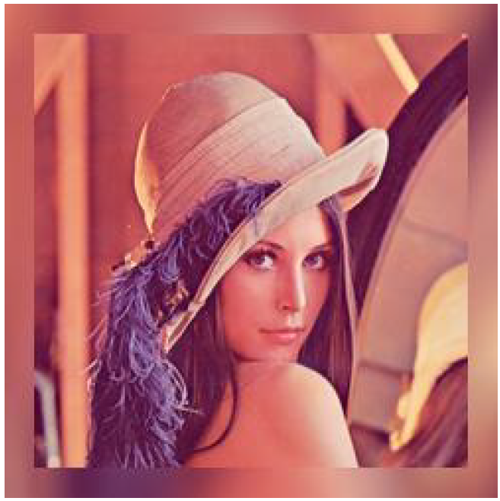
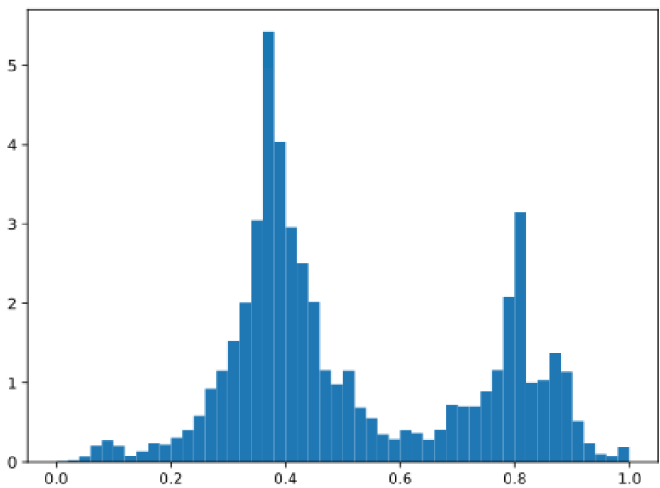
Zero padding is wrong
Why?
The input distribution at the borders are highly different from other regions
The pre-activation magnitudes at the border are much smaller than other regions
The filters are shared, which means they are required to be used to the weird statistics at the borders as well as other regions
In practice, image generation related tasks are most affected by zero-padding
Expectation

Slide 6
Distributional padding
2 variants
Mean interpolation padding
The padded parts are the interpolations of the means of the border regions
Mean reflection padding
The padded parts are the reflections of the means of the border regions
Inspired by reflection padding
Maintain roughly the means near the border regions
However, the variance is underestimated
Noise can be added to retain the variance but this would complicate the method (padding should be simple)
Because of the bilinear interpolation, the padded border also accounts for the statistics of the neighboring regions

Slide 7
Mean interpolation padding
Calculate the means of the input using a sliding Windows of the same size as the filters
Resize the mean map to the padded size by billinear interpolation
Replace the non-border regions with the input
Grads are not backprop-ed through the padded parts

Slide 8
Mean reflection padding
Calculate the means of the input using a sliding Windows of the same size as the filters
Resize the mean map to the input size by billinear interpolation
Use reflection padding on the result with the provided padding size
Replace the non-border regions with the input
Grads are not backprop-ed through the padded parts

Slide 9
Experiments: classification
Train two architectures: ResNet34 and VGG19
CIFAR10
Adam 1e-4
l2 regularization 5e-4
100 epochs
Validate the model every 1000 iterations
Train each 5 times
Benchmarking: zero padding and reflection padding
Except for padding, all the setups are the same

Slide 10
Experiments: classification
Classification errors on the test set

Slide 11
Experiments: classification
Classification errors on the test set (magnified)

Slide 12
Experiments: classification
Mean error over the last 5 validation times
VGG benefits more from the proposed padding
This can be explained by the fact that the residual connection adds the original signal to the output of a res block, which helps reduce the bad effect of zero padding
Mean interpolation is better in residual model while mean reflection, which is an extension of reflection padding, is better in a straightforward model.
Padding type (Resnet) | Error (%)
Zero | 11.9
Reflection | 11.7
Mean interpolation | 11.7
Mean reflection | 11.8
Padding type (VGG) | Error (%)
Zero | 10.97
Reflection | 10.80
Mean interpolation | 10.54
Mean reflection | 10.67

Slide 13
Experiments: style transfer
Setup
Architecture: WCT network
Training data: MS COCO
Test data: random images on Internet
Training duration is 3 epochs
padding schemes: zero padding vs reflection padding
We failed to train the largest decoder using partial convolution padding
It may suggest the method is not versatile

Slide 14
Experiments: style transfer
Reflection padding
Zero padding

Slide 15
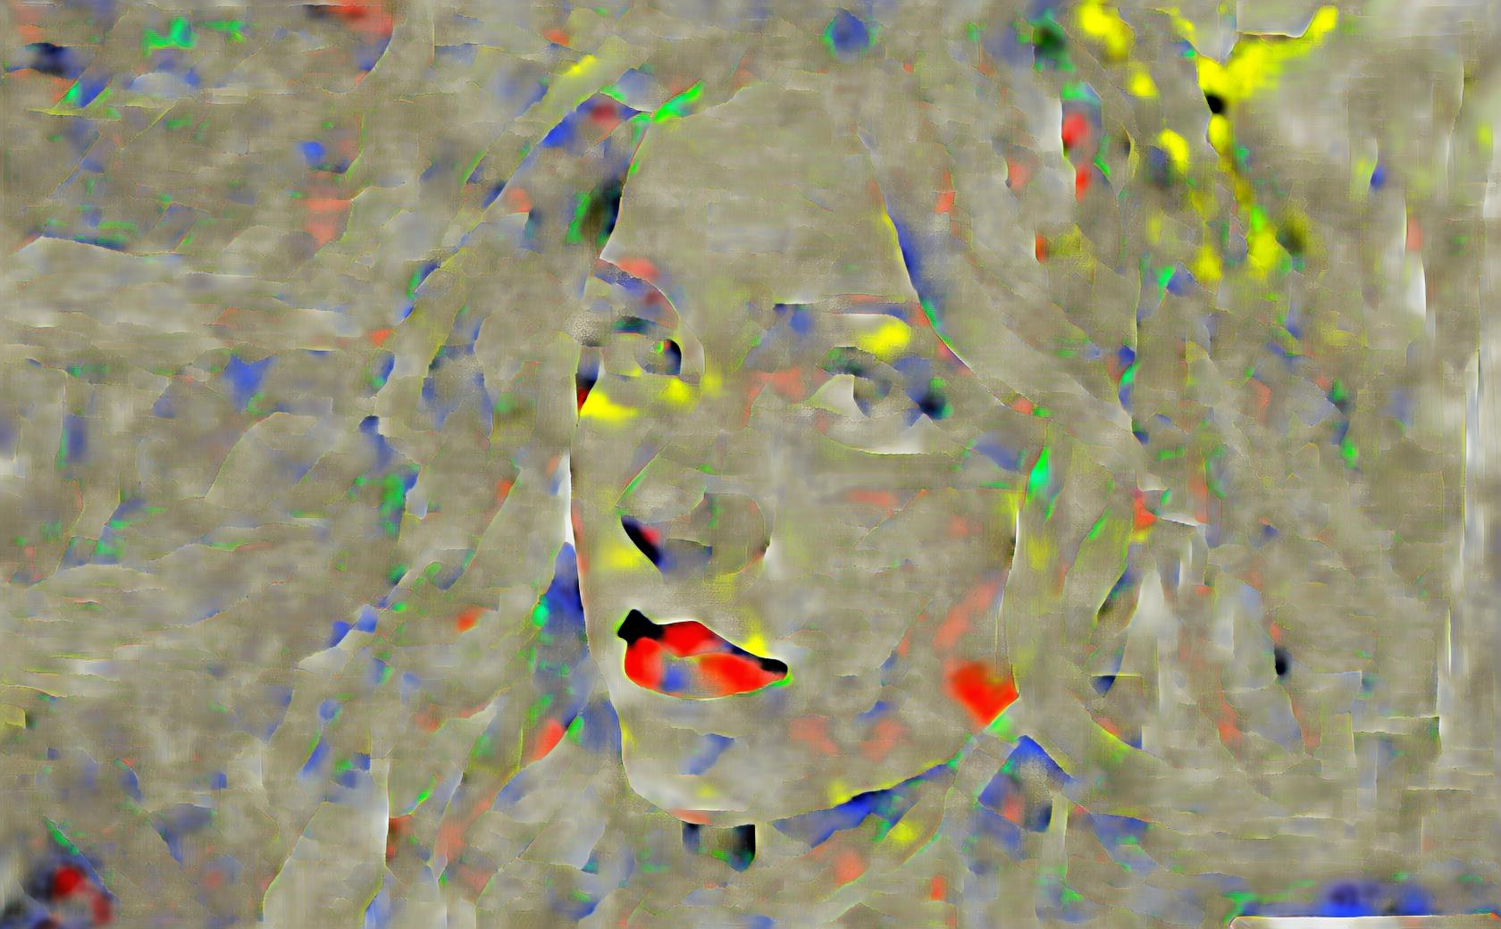
Experiments: style transfer
Reflection padding
Zero
padding

