Slide 1
High Order Intra Prediction for Future Video Coding
Kai Lin, Jiaqi Zhang, Junru Li, Chuanmin Jia and Wen Gao
Peking University,
University of Chinese Academy of Sciences,
Peng Cheng Laboratory.

Slide 2
Contents
Introduction
The Proposed Method
Experimental Results
Conclusion

Slide 3
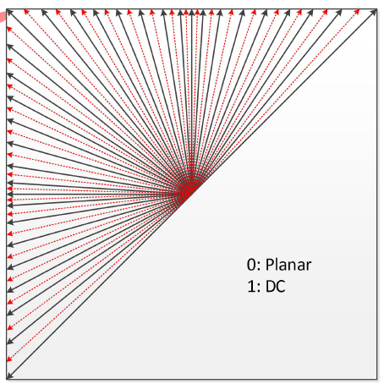
Introduction
Intra prediction scheme
The number of intra prediction modes is extended to 67 from 35
DC, Planar and other 65 directional modes
Stronger ability to approximate linear texture
(3)
(66)
(18)
(50)
The distribution of directional modes in VVC, and each corresponds to an angle from -135° to 45°
Typical patterns generated by the intra modes of 3, 66, 18 and 50

Slide 4
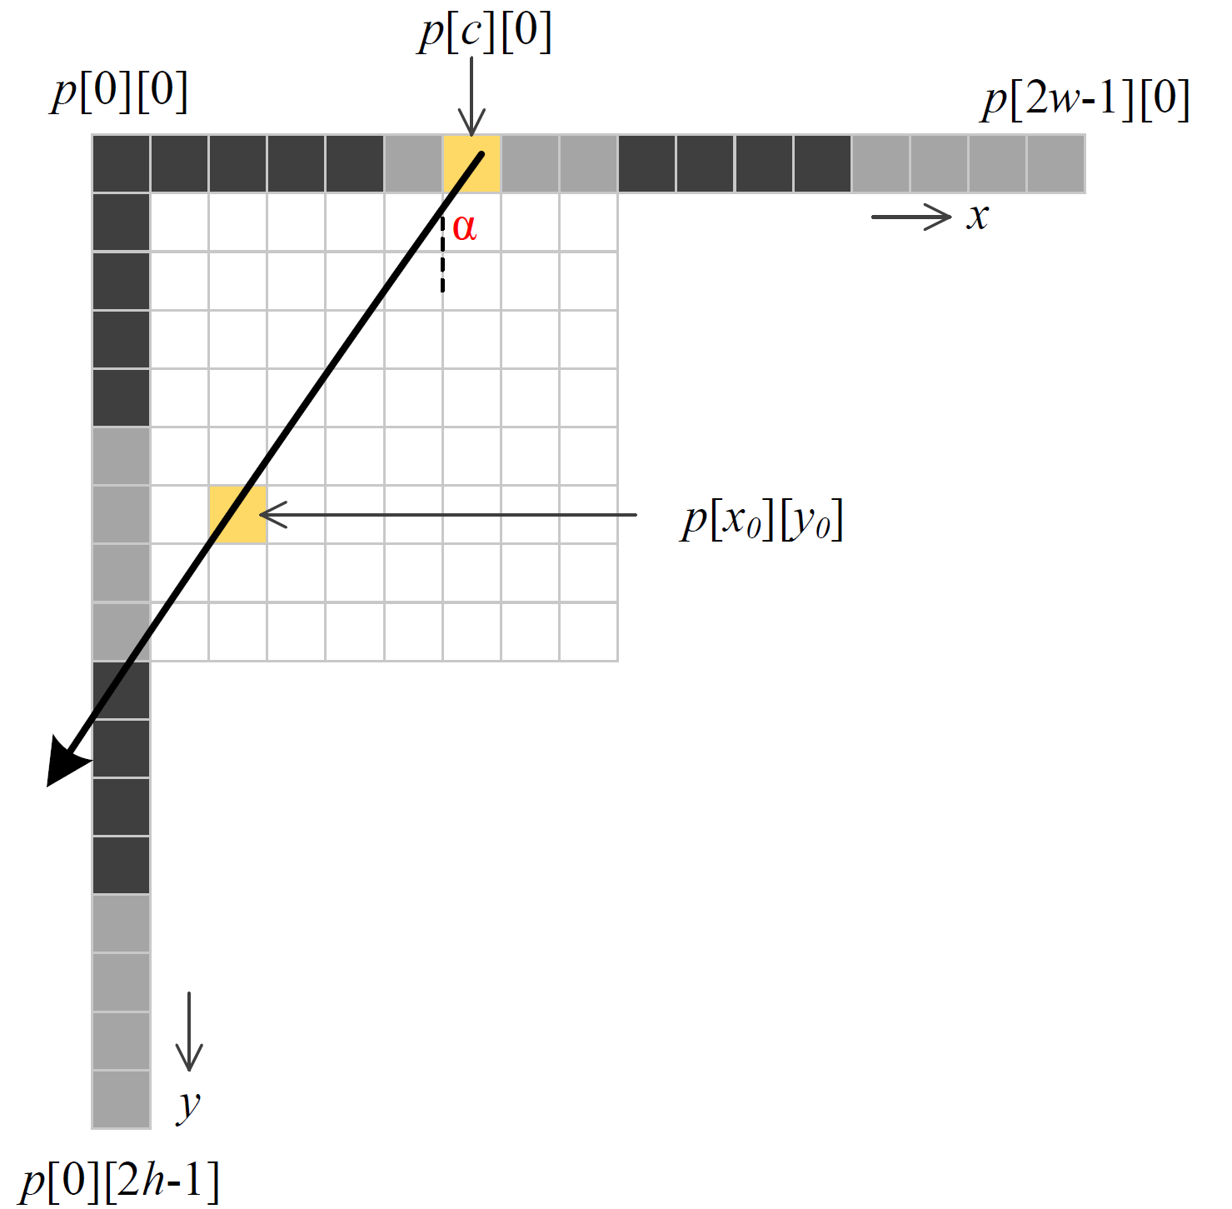
Introduction
Directional intra prediction modes
Reference sample array construction
Extrapolating sample values from the reference samples along the given mode
The linear formulation:
For each pixel located at

Slide 5
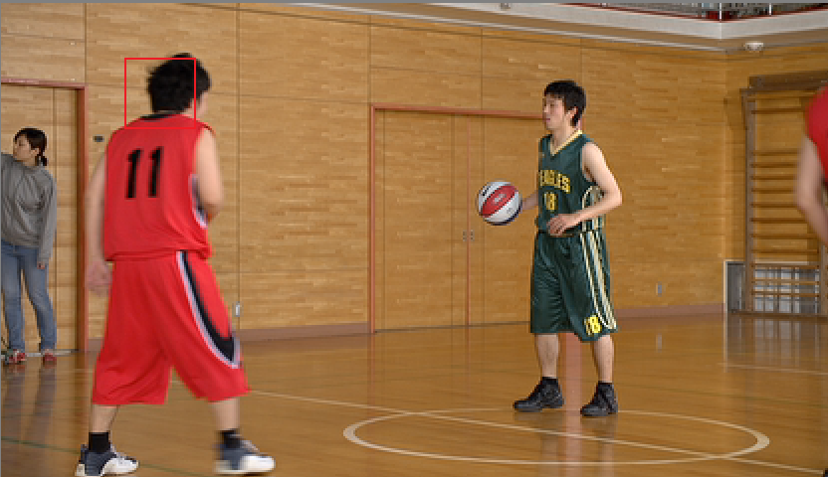
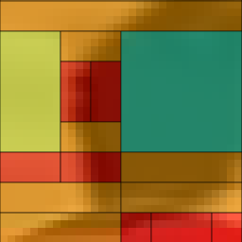
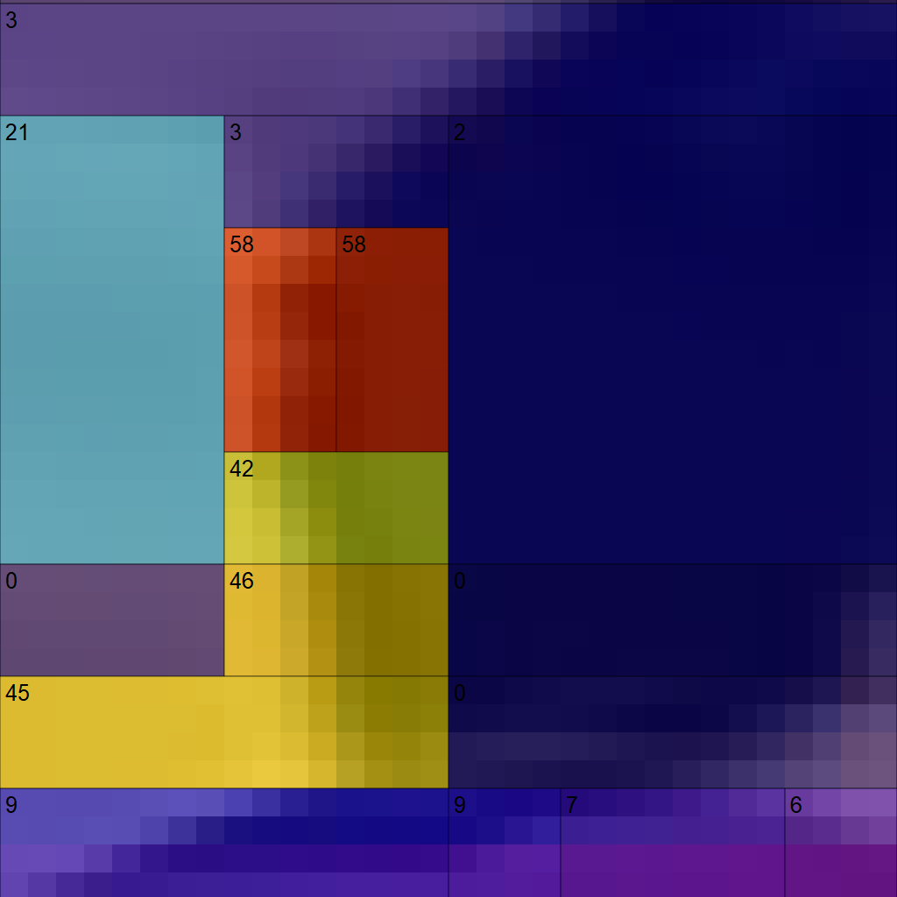
Introduction
Limitation
The present predictor cannot provide high fidelity patterns with curved edges
Towards the next generation video coding standard
HEVC: 35 directional modes (per 5.1° )
VVC: 65 direction modes (per 2.7°)
Deep coding unit partition
Approximating the curved patterns by multiple directional modes

Slide 6
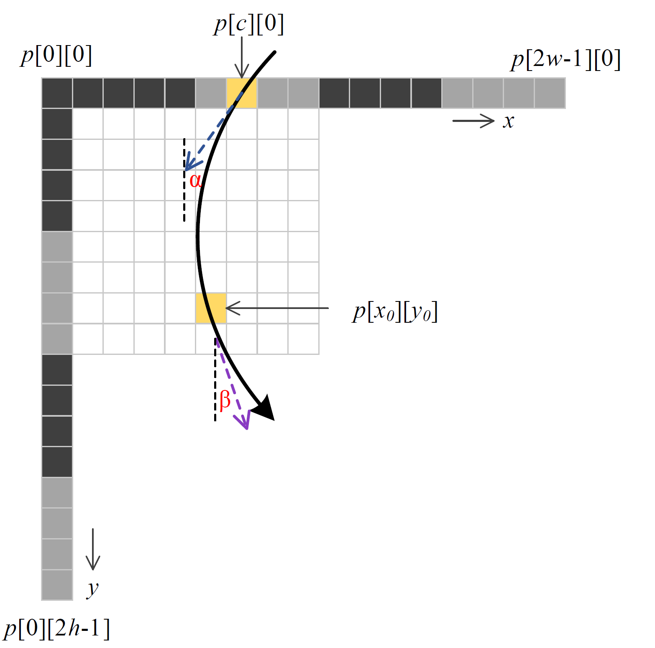
High-Order Intra Prediction
A quadratic function by two intra prediction modes
For vertical modes:
is the quadratic function with respect to
Passing
The intra mode corresponding to angle
The other mode with angle
$$c=x_{0}−\frac{tanβ−tanα}{2∗h}∗{y_{0}}^{2}−tanα∗y_{0}$$

Slide 7
Integration
Find the most appropriate pair-wise intra modes (A, B)
The optional range:
If A [35, 66], then B [35, 66] (Vertical Modes)
If A [2, 34], then B [2, 34] (Horizontal Modes)
Remove unallowed pairs:
A = B (Regular Intra Prediction)
Neither A nor B is DC or Planar mode
Combined with Wide Angle Intra Prediction (WAIP)
2048 combinations！

Slide 8
Low Complexity HOIP
Derive the searching pairs
Reduce the searching space
Select the m regular mode from the MPM list
Signal the regular mode with few bits
Reduce the candidates of the regular mode
Create a lookup table (LUT) for the extend mode
Collect the four most frequent extend modes (MFEMs)
Perform independently for different CU size
Select the n extend mode from the MFEM list
Rank the pairs by SAD and SATD
Append the pairs to RD list
n×m!

Slide 9
High Efficiency HOIP
Expand the searching space
Extend the top k modes from the RD list as the regular modes
Extend the number of extend mode
Append the top 3 candidates to RD checking list

Slide 10
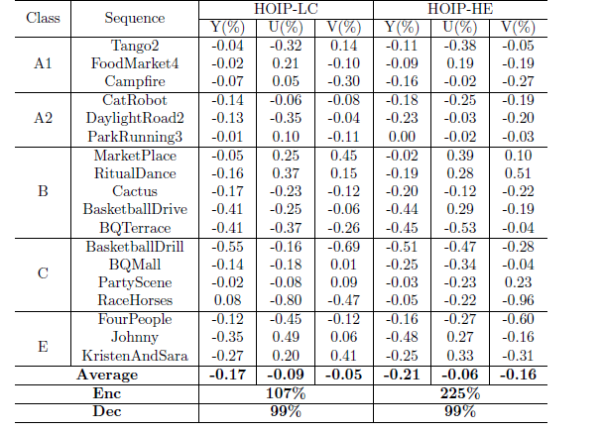
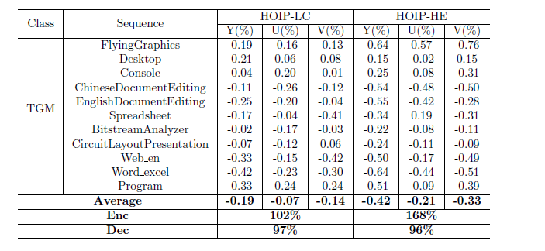
Experimental Results

Slide 11
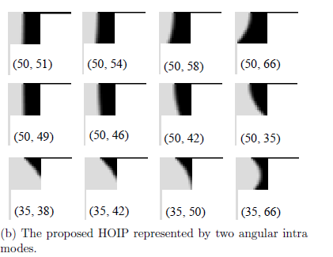
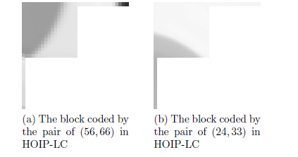

Slide 12
Thanks!

