Slide 1
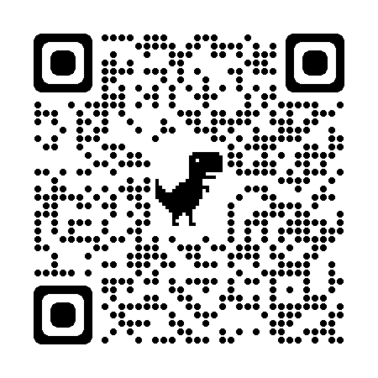
VT-ReID: Learning Discriminative Visual-Text Representation for Polyp Re-Identification
Suncheng Xiang¹*, Cang Liu², Jiacheng Ruan³, Shilun Cai¹, Sijia Du¹, Dahong Qian¹
¹School of Biomedical Engineering, Shanghai Jiao Tong University
²National Key Laboratory of Electromagnetic Energy, Naval University of Engineering
³School of Electronic Information and Electrical Engineering, Shanghai Jiao Tong University
⁴Zhongshan Hospital of Fudan University
https://JeremyXSC.github.io/
https://github.com/JeremyXSC/VT-ReID

Slide 2
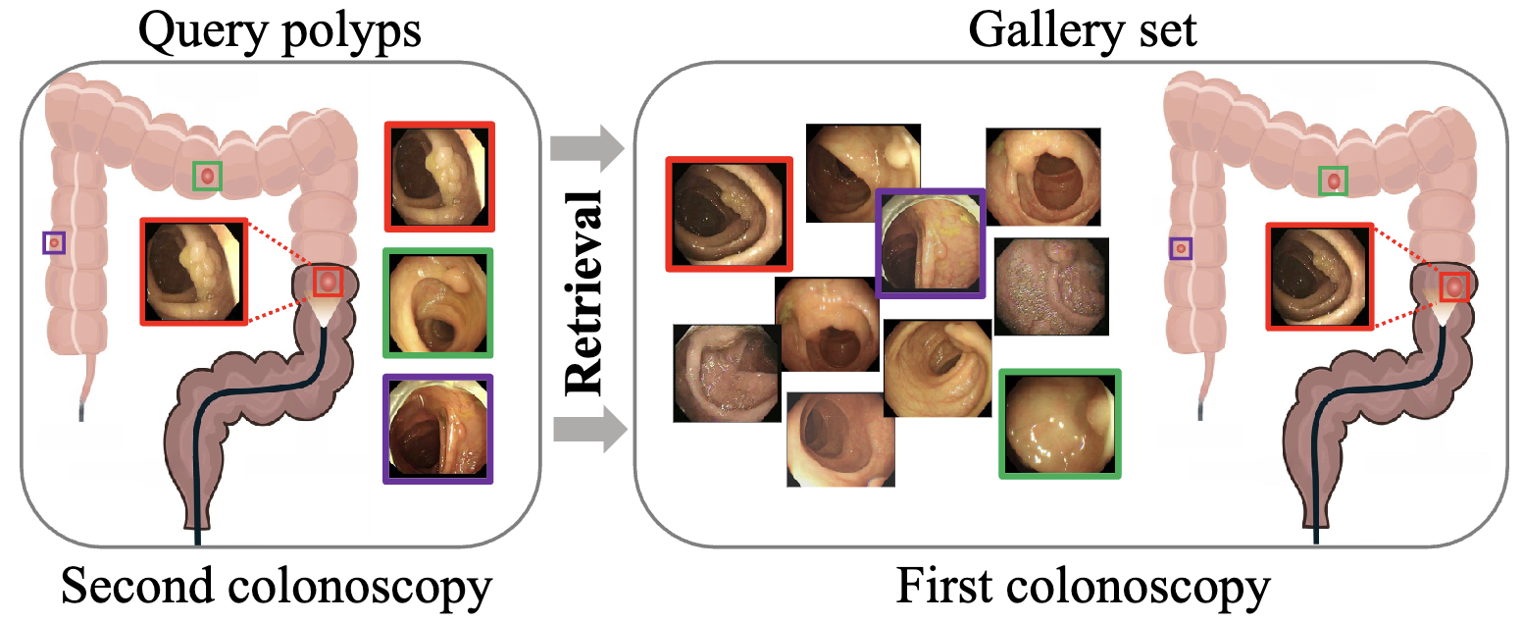
Introduction
Task: Colonoscopic Polyp Re-Identification

Slide 3
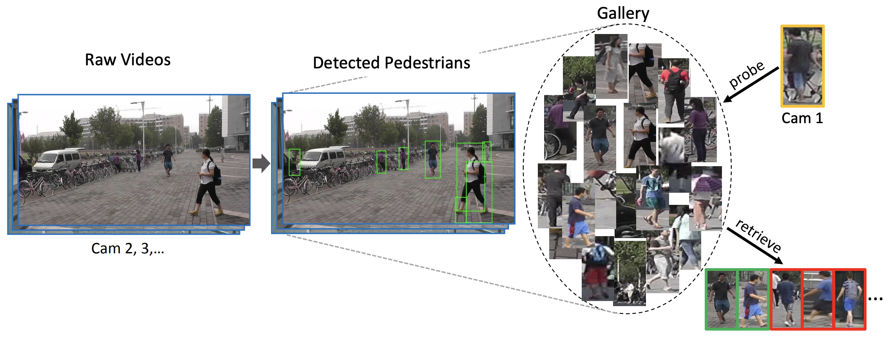
Introduction
Similar to Person Re-Identification
https://arxiv.org/pdf/1610.02984.pdf

Slide 4
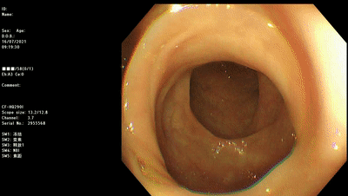
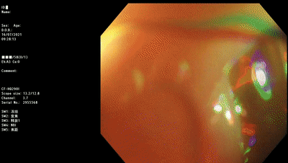
Challenge
Same scene #2
Same polyp video with different viewpoints

Slide 5
Background
Manually labeling pairwise polyp area data is labor-intensive
Existing methods rely heavily on visual feature
Semantic information is always ignored during training
Challenges

Slide 6
Motivation
Compared to the conventional person ReID, Polyp ReID is confronted with more challenges, such as variation in terms of backgrounds, viewpoint, and illumination, etc.
The performance deeply relies on the visual feature of training dataset, other rich information in semantic level is always ignored.
visual feature
semantic feature

Slide 7
Contribution
A VT-ReID method is proposed to help model learn general visual-text representation based on the multimodal feature.
Based on it, a dynamic clustering mechanism is introduced to further enhance the clustering performance of text data in an unsupervised manner.
Comprehensive experiments demonstrate the effectiveness of our method, surpassing existing methods with a clear margin.

Slide 8
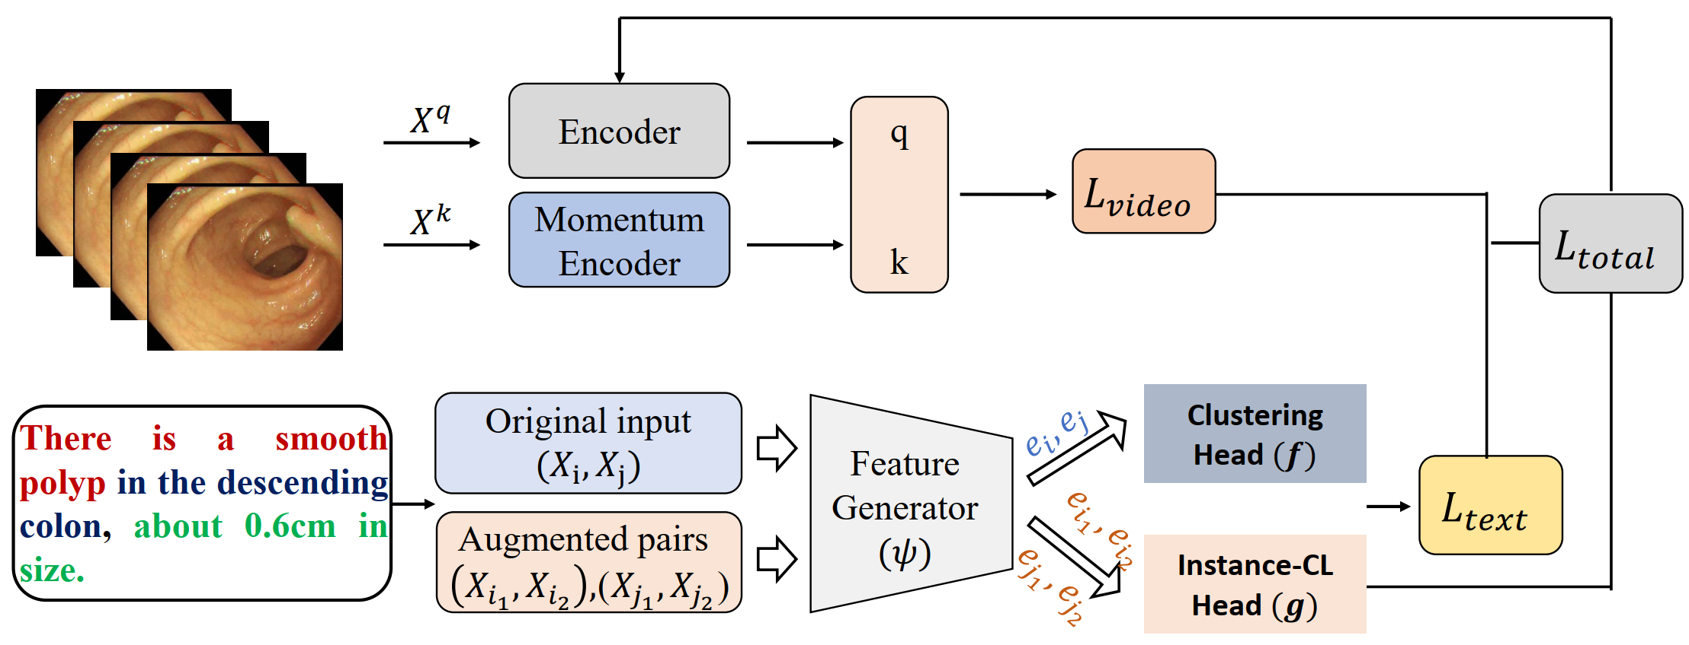
Method
Our VT-ReID Network architecture

Slide 9
Method
Visual feature backbone is composed of a vision transformer.
Our VT-ReID Network architecture

Slide 10
Method
Visual feature backbone is composed of a vision transformer.
Texture feature backbone is composed of deep CNN

Slide 11
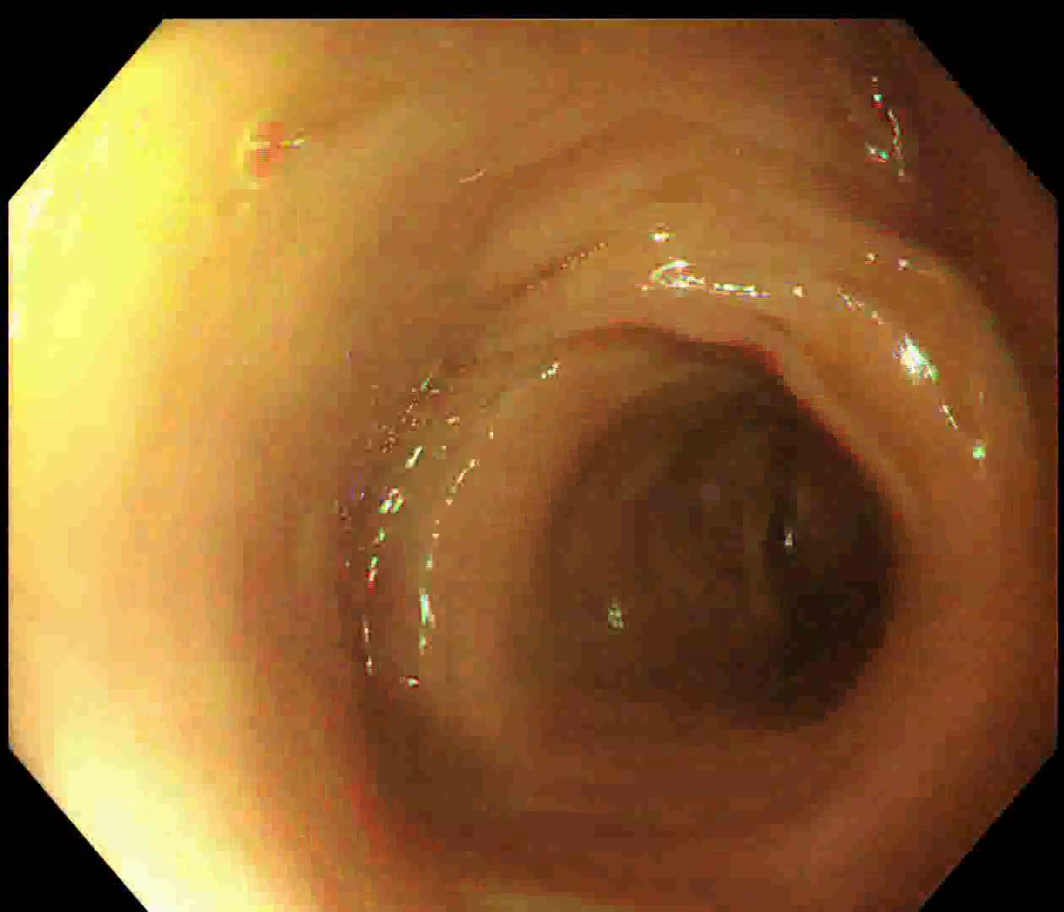
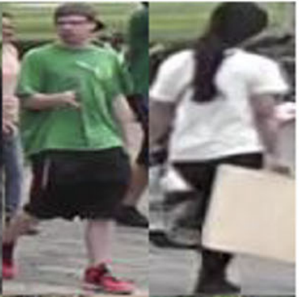
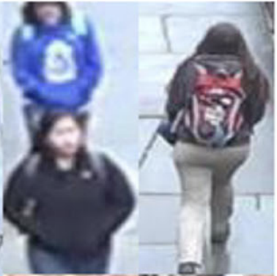
Implementation Details
Vision-Transformer is regarded as the backbone.
Random flipping and random cropping for data augmentation.
$L_{video}$ and $L_{text}$ functions to train the model for 180 iterations.
Nvidia GeForce RTX 2080Ti GPU & Intel Xeon Gold 6130T CPU.
Colo-Pair
Market-1501
DukeMTMC-reID
CUHK03
Polyp Re-ID
Person Re-ID

Slide 12
Ablation Study
Ablation study of different components of our VT-ReID.
$$L_{text}$$
$$L_{video}$$
$$L_{total}$$
$$L_{text}$$
$$L_{video}$$

Slide 13
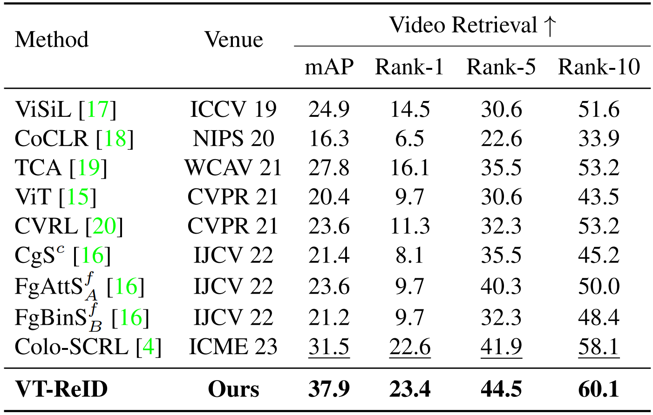
Comparison with SOTAs
Performance comparison with SOTAs on Colo-Pair dataset

Slide 14
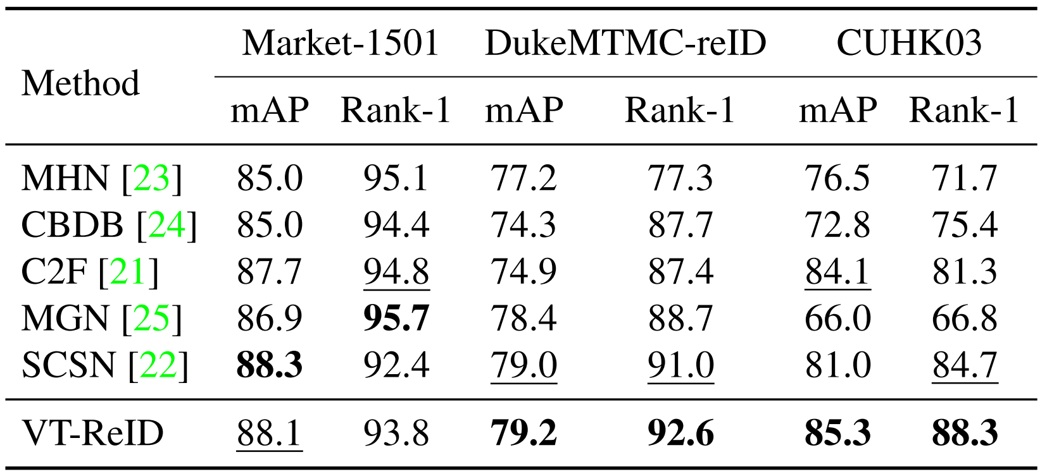
Comparison with SOTAs
Performance comparison with SOTAs on Person ReID dataset

Slide 15
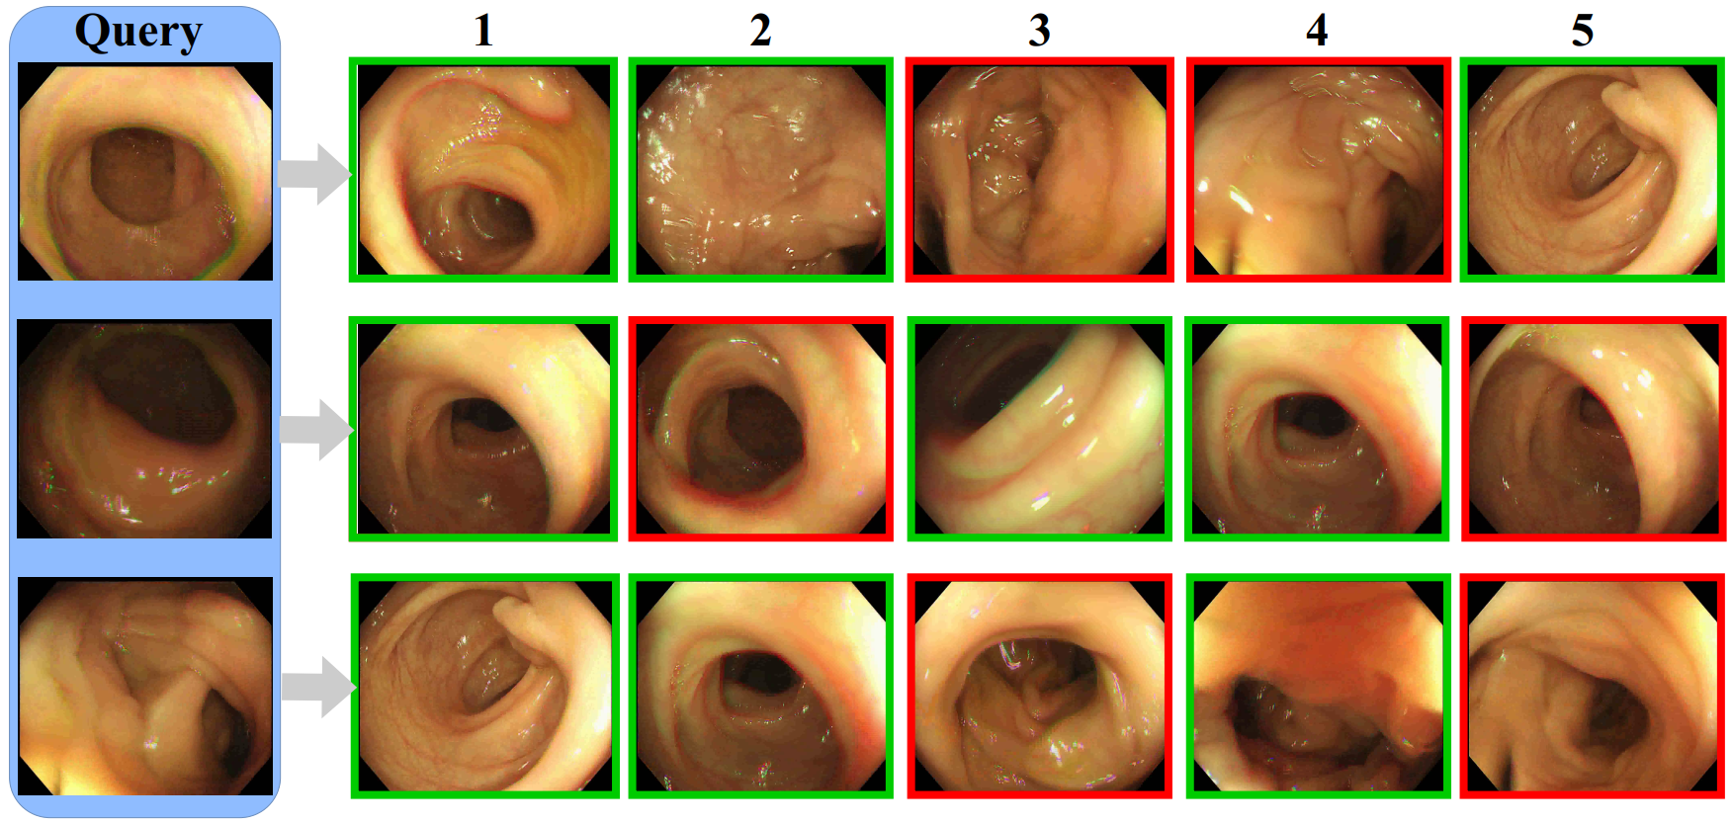
Qualitative Analysis
Top-5 ranking list for some query images on Colo-Pair dataset
From left to right, a query image, a true match, and a false match (distractor).

Slide 16
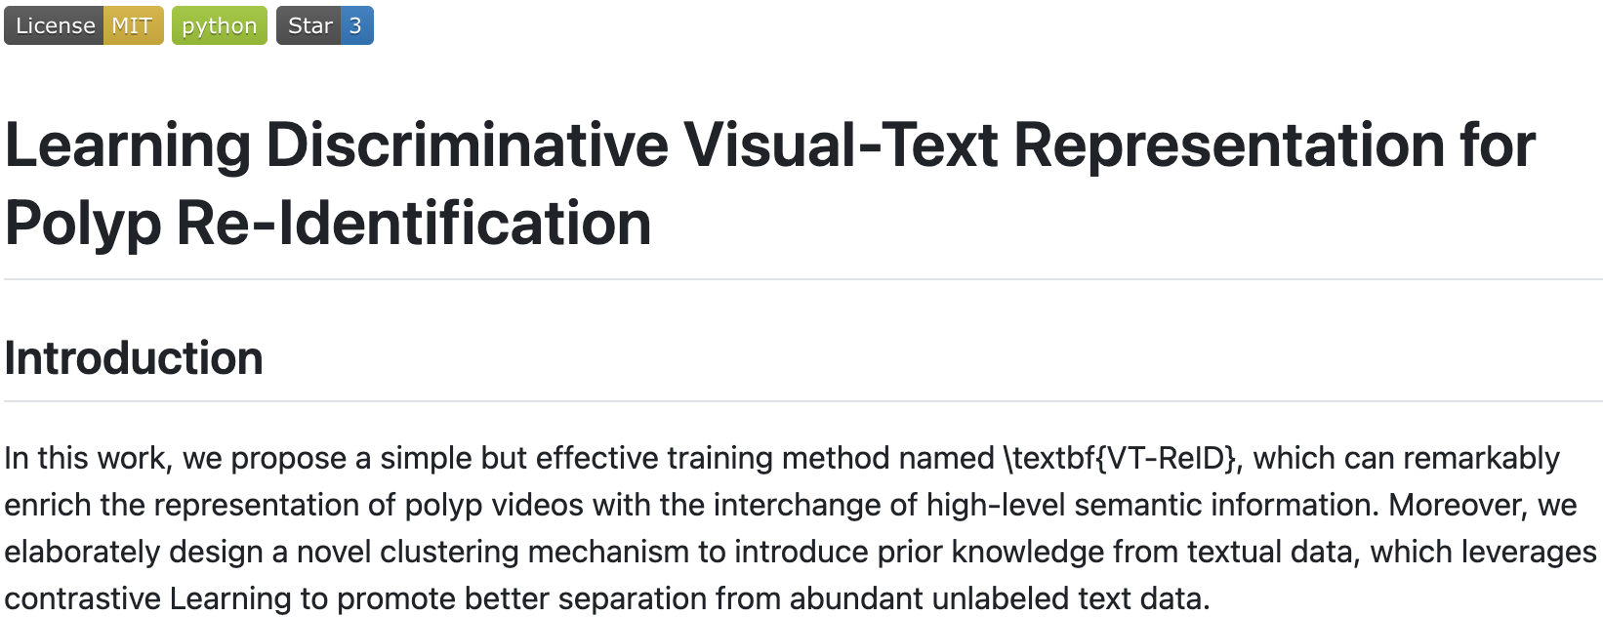
Conclusion and Future Work
We propose a simple but effective multimodal training method VT-ReID.
A dynamic clustering-based mechanism called DCM is introduced to further boost the performance of colonoscopic polyp ReID task.
Comprehensive experiments also demonstrate the effectiveness of our method.
Open-sourced！

Slide 17
THANKS

