Slide 1
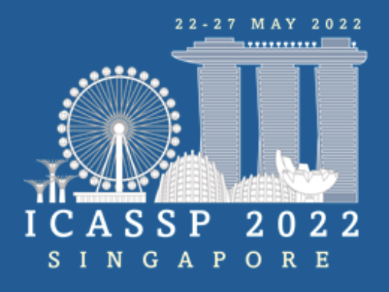
Improving Cross-lingual Speech Synthesis
with Triplet Training Scheme
Jianhao Ye, Hongbin Zhou, Zhiba Su, Wendi He, Kaimeng Ren, Lin Li, Heng Lu
Ximalaya Inc., China

Slide 2
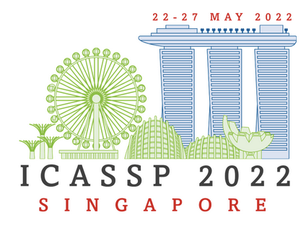
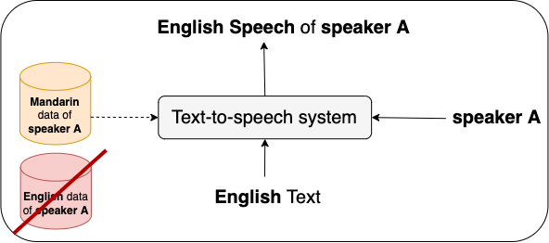
Introduction
Building a cross-lingual text-to-speech (TTS) system is a task that requires the
system to synthesize speech of a language foreign to a target speaker.

Slide 3
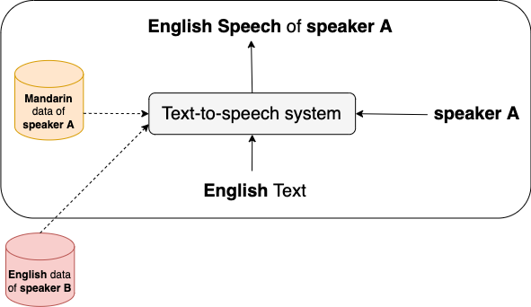
Introduction

Slide 4
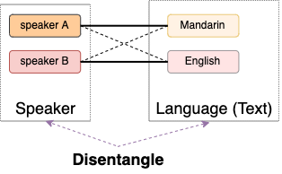
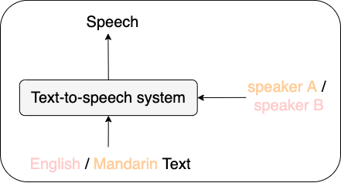
Current Methods
[1] uses adversarial training to remove speaker identity from phonetic representations.
[2] employs mutual information minimization and domain adaptation to disentangle the learned language and speaker embedding, which improves naturalness and speaker similarity of the synthesized cross-lingual speech.
[3,4] convert all the graphemes of different languages into a same International Phonetic Alphabet (IPA) set to facilitate cross-lingual modeling and the experiments in [4] show the privilege of IPA over language-dependent phonemes.

Slide 5
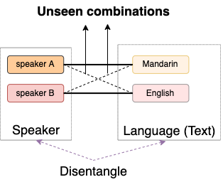
Limitation
Seen combinations during training:
Speaker A + Mandarin Text
Speaker B + English Text
Unseen combinations during training:
Speaker A + English Text
Speaker B + Mandarin Text

Slide 6
Motivation
Recent developments in TTS style transfer start to cover unseen
speaker-style Combinations in training.
Multi-reference based style transfer cover unseen cases by introducing cycle consistency [5].
[6] introduces speaker cycle consistency into cross-speaker speech synthesis.
Triplet loss can be employed to represent unseen combinations and
optimize them during training.
[7] first applies triplet loss into face recognition and clustering.
Maximize the distance
Minimize the distance
$$f(∙)$$
Encoding function of a sample

Slide 7
Triplet Training Scheme – Triplets Construction
Phoneme level
Generated Mel-spectrogram of unseen cases
Sentence level
For instance, the triplet construction when speaker A synthesize English (foreign to speaker A):

Slide 8
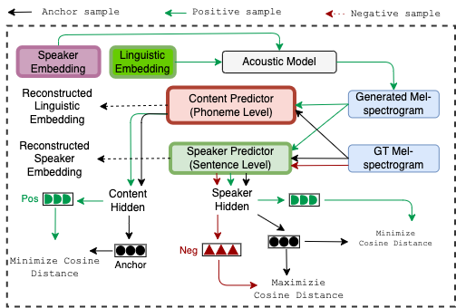
Triplet Training Scheme – Triplet Loss
D$(∙)$
Cosine distance

Slide 9
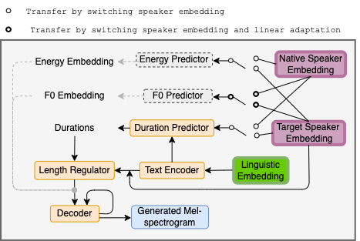
Triplet Training Scheme – Two-stage training

Slide 10
Experimental Setup
Dataset
A public female Mandarin dataset: Data-baker Chinese Standard Mandarin Speech Corpus (CSMSC) [8]
A public female English dataset: LJSpeech [9]
An extra internal male Mandarin dataset. (for balanced evaluation)
Model Architecture
Base: DurIAN model using IPA as text representation [10].
Base_FE: constructed by adding two extra prosody predictors of phoneme-level f0 and energy to Base, similar as in Fastspeech2 [11].
Base_FE_DFE: the transfer of duration, f0, energy are implemented by replacing target speaker embedding with the native one in duration model, f0 predictor, energy predictor, only in the inference phase of cross-lingual cases.
Experiments
The experiments are conducted by training the introduced models with the above datasets, with and without triplet training scheme. The results are evaluated subjectively and objectively.

Slide 11
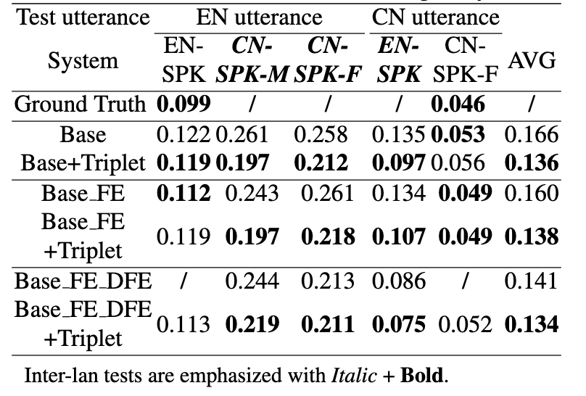
Experimental Results – Objective Evaluation
Word Error Rate (WER) results
Base_FE_DFE < Base_FE < Base
All models with +Triplet achieve lower WER than the counterparts without triplet training scheme.
(Especially for inter-lan cases)
Further improvement is consistently achieved by combining the fine-grained explicit prosody transfer with the proposed method, though the improvement of cross-gender cross-lingual test is relatively smaller

Slide 12
Experimental Results – Subjective Evaluation
Mean Opinion Score (MOS) results: naturalness & speaker similarity
Similarity corresponds to Speaker Similarity
Both Base+Triplet and Base_FE_DFE+Triplet gain improvements in naturalness and speaker similarity from the proposed triplet training scheme.
Prosody feature transfer from native speaker + Triplet achieves the best results which is consistent with objective evaluations.

Slide 13
Demo
CN Text: 假语村言别再拥抱我。
EN Text: The various grades were distinguished
by cockades and bows of different colors.
Speaker A:
native Mandarin speaker (CSMSC)
Speaker B:
native English speaker (LJSpeech)
Recording
EN Text: the site of the present Sessions House of the Old Bailey, and the operation was witnessed by students and a number of curious spectators.
English
Utterance
Speaker A from Base
Speaker A from Base_FE_DFE
Speaker A from Base + Triplet
Speaker A from Base_FE_DFE + Triplet
Demo: https://jianhaoye2.github.io/icassp2022triplet.github.io/

Slide 14
Conclusion and Future Work
Conclusion
This paper proposed a method that employs triplet loss to cover unseen combinations of target speaker and foreign text in cross-lingual TTS.
The experimental results show the proposed method significantly enhances the intelligibility as well as naturalness of cross-lingual speech, while maintaining the target speaker identity.
Moreover, we also find the proposed method can be combined with fine-grained explicit prosody transfer to further improve the performance of cross-lingual TTS, though the improvement to cross-gender cross-lingual cases is relatively small.
Future Work
Although the triplets in this work are constructed to narrow the gap between training and inference stages for cross-lingual purpose, the triplets can be redesigned to form a triplet loss for unseen cases in other tasks (e.g., style transfer in speech synthesis), which will be explored in the future.
Although code-switch cases are not studied in this work, those cases can also be regarded as unseen cases which can covered by triplet training scheme and might get improved as well using the proposed method.

Slide 15
References
[1] Yu Zhang, Ron J Weiss, Heiga Zen, Yonghui Wu, Zhifeng Chen, RJ Skerry-Ryan, Ye Jia, Andrew Rosen- berg, and Bhuvana Ramabhadran, “Learning to speak fluently in a foreign language: Multilingual speech syn- thesis and cross-language voice cloning,” arXiv preprint arXiv:1907.04448, 2019.]
[2] Detai Xin, Tatsuya Komatsu, Shinnosuke Takamichi, and Hiroshi Saruwatari, “Disentangled speaker and language representations using mutual information minimization and domain adaptation for cross-lingual TTS,”in ICASSP 2021 - 2021 IEEE International Conference on Acoustics, Speech and Signal Processing (ICASSP). pp. 6608–6612, IEEE.
[3] Hamed Hemati and Damian Borth, “Using ipa-based tacotron for data efficient cross-lingual speaker adaptation and pronunciation enhancement,” arXiv preprint arXiv:2011.06392, 2020.
[4] Haoyue Zhan, Haitong Zhang, Wenjie Ou, and Yue Lin, “Improve cross-lingual text-to-speech synthesis on monolingual corpora with pitch contour information,” in Interspeech 2021. pp. 1599–1603, ISCA.
[5] Matt Whitehill, Shuang Ma, Daniel McDuff, and Yale Song, “Multi-reference neural TTS stylization with ad- versarial cycle consistency,” in Interspeech 2020. pp.4442–4446, ISCA.

Slide 16
References
[6] Detai Xin, Yuki Saito, Shinnosuke Takamichi, Tomoki Koriyama, and Hiroshi Saruwatari, “Cross-lingual speaker adaptation using domain adaptation and speaker consistency loss for text-to-speech synthesis,” in Interspeech 2021. pp. 1614–1618, ISCA.
[7] Florian Schroff, Dmitry Kalenichenko, and James Philbin, “Facenet: A unified embedding for face recog- nition and clustering,” in Proceedings of the IEEE conference on computer vision and pattern recognition, 2015, pp. 815–823.
[8] D. B. China, “Chinese standard mandarin speech corpus,” https://www.data-baker.com/open source.html, 2017.
[9] Keith Ito and Linda Johnson, “The lj speech dataset,”https://keithito.com/LJ-Speech-Dataset/, 2017.
[10] hengzhu Yu, Heng Lu, Na Hu, Meng Yu, Chao Weng, Kun Xu, Peng Liu, Deyi Tuo, Shiyin Kang, Guangzhi Lei, et al., “Durian: Duration informed attention network for speech synthesis.,” in INTERSPEECH, 2020, pp. 2027–2031.
[11] i Ren, Chenxu Hu, Xu Tan, Tao Qin, Sheng Zhao, Zhou Zhao, and Tie-Yan Liu, “Fastspeech 2: Fast and high-quality end-to-end text to speech,” arXiv preprint arXiv:2006.04558, 2020.

Slide 17
Thank you

