Slide 1
Fast Vehicle Detection with Lateral Convolutional Neural Network
Billy C.H. HE, Kenneth K.M. LAM
Centre of Multimedia Signal Processing
Department of Electronic and Information Engineering
The Hong Kong Polytechnic University
ICASSP 2018, Calgary, Canada

Slide 2
Outline
Two detection paradigms
Localization-classification trade-off
Lateral CNN
Training & Results
Conclusion

Slide 3
Two object detection paradigms
Region-based detection
E.g. Fast/er RCNN
Region-based classification
High accuracy but slow
Regression-based detection
E.g. SSD/YOLO
Anchor-based regression
Fast but relatively low accuracy

Slide 4
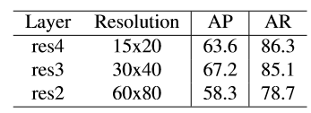
Exploratory analysis
We apply different feature layers from ResNet-101 to perform YOLO detection and evaluate its precision and recall on the DETRAC dataset respectively.
ResNet-101
score
ResX
NMS
Which features give good detection result?
bbox

Slide 5
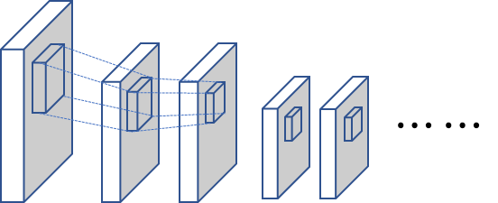
Localization-classification trade-off
Early feature maps
High-resolution/low-level features
Good to determine the boundary
More false positives
Deep feature maps
Low-resolution/high-level features
Strong semantics
Region-based: Proposal(early) + classification(deep)
Regression-based: Localization (deep) + classification (deep)
Semantics
Fine-grained details

Slide 6
Lateral Convolutional Neural Network
-ResNet101 as backbone network
-Deep features: Object classification & Coarse localization
-Early features: Localization refinement (Residual)
-Lateral transition layer: Squash & L2-normalization

Slide 7
Bounding-box encoding
Multi-cell encoding
Good to handle occlusion
For each cell $i$:
$t_{i}^{cls}=(1,0) if IoU>0.5$
$t_{i}^{cls} =(0,1) if IoU<0.2$
$t_{i}^{loc} =({∆C}_{x},{∆C}_{x},W,H)$
Positive cell indicator $c_{i}=1 if IoU>0.5$
If more than one bounding box intersects with the anchor, the one with the highest IoU is selected
Multi-cell encoding in our method
Single-cell encoding in YOLO

Slide 8
Multi-stage training
Stage-I (Coarse detection):
Stage-II (Fine-grained residual):
Total loss:
$$ℒ_{1}=L_{loc}\left(p, t, c\right)+{αL}_{cls}\left(p, c\right)$$
$$ℒ_{2}=L_{loc}\left(p+Δp, t, c\right)$$
$$ℒ=ℒ_{1}+βℒ_{2}$$

Slide 9
Localization loss:
Focal loss for dense classification:
$$L_{loc}\left(p, t, c\right)=\frac{1}{N}\sum_{i=1}^{N}{c_{i}{\left\|p_{i}^{loc}−t_{i}^{loc}\right\|}_{l_{1}}}$$
$$L_{cls}\left(p, c\right)=−\frac{1}{N}\sum_{i=1}^{N}{ω{\left(1−p_{i}^{∗}\right)}^{γ}\log\left(p_{i}^{∗}\right)},$$
where
$p_{i}^{∗}=\left\{\begin{aligned}sigmoid\left(p_{i}^{cls}\right) if c_{i}=1, \\ 1−sigmoid\left(p_{i}^{cls}\right) otherwise.\end{aligned}\right.$

Slide 10
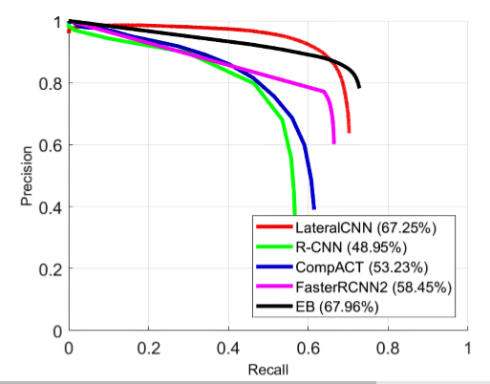
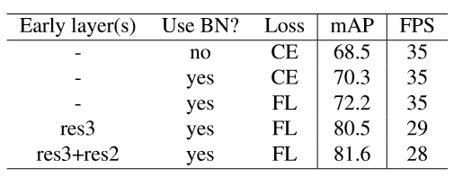
Results on DETRAC
Ablation study

Slide 11
Conclusion
Lateral network & Two-stage training
Decouple the classification and localization predictions from single layer
Same accuracy as the region-based approaches but fast

Slide 12
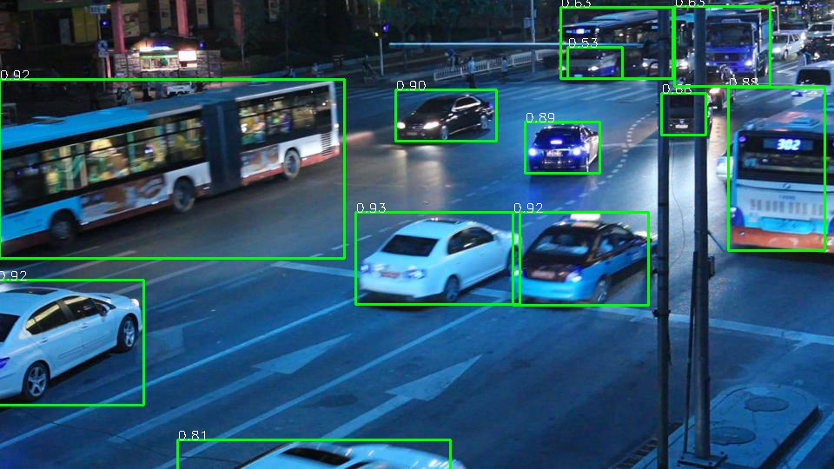
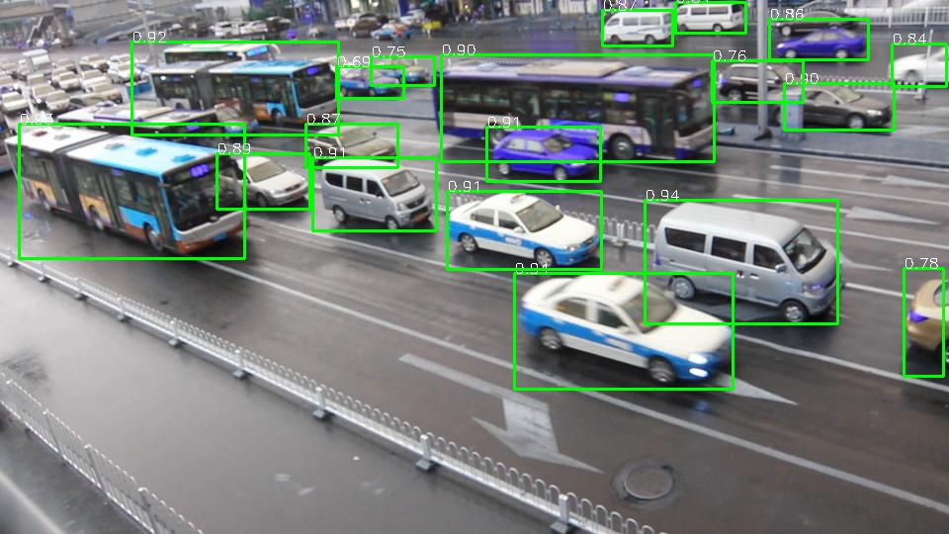
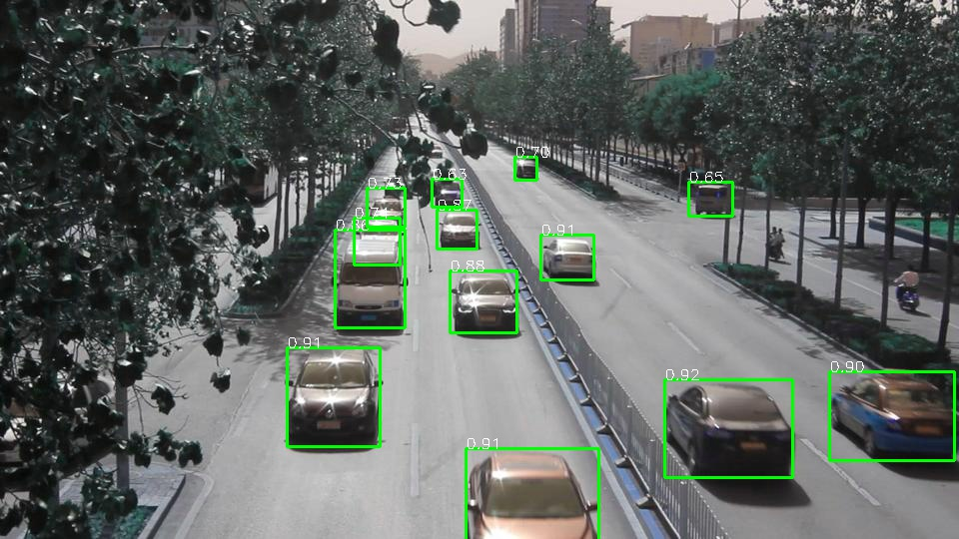
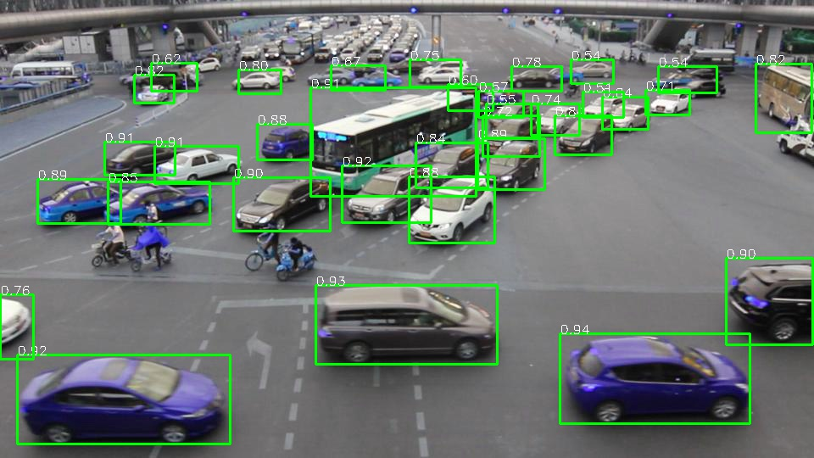
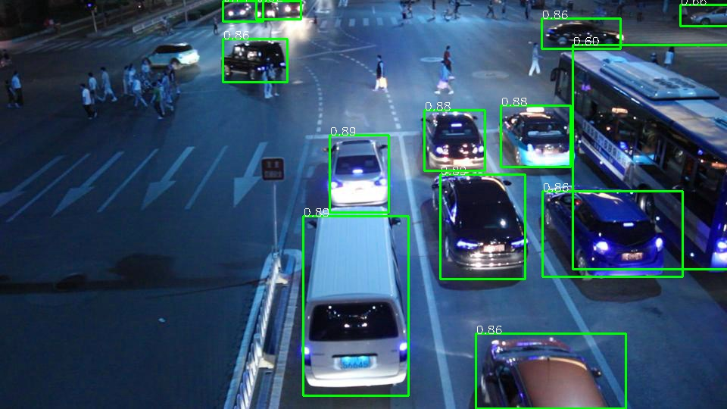
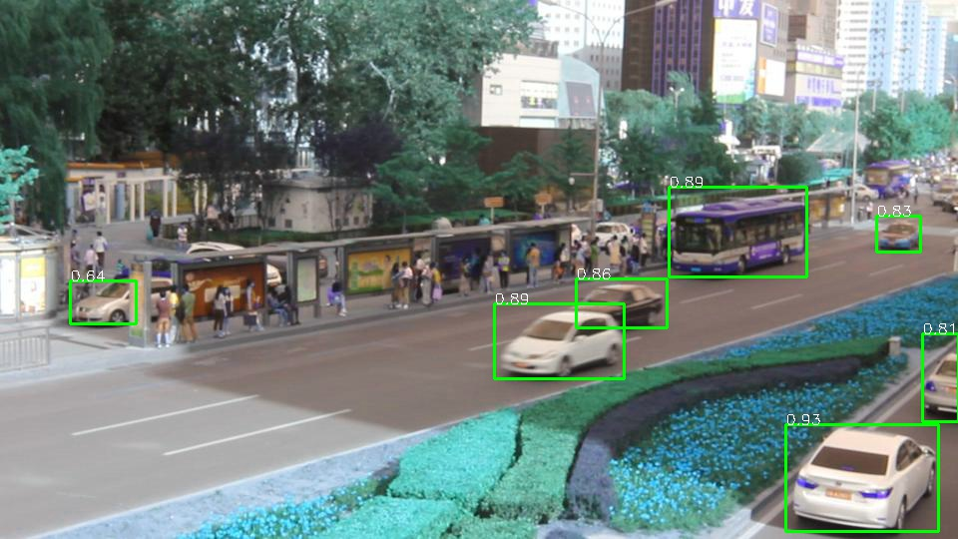
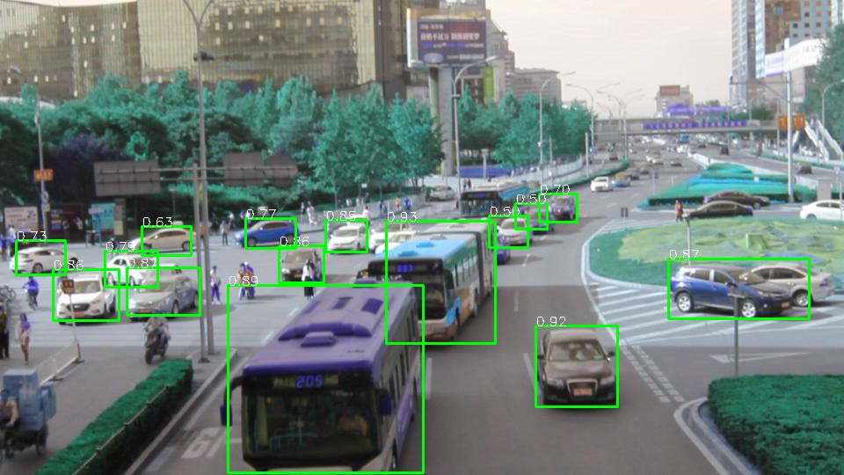
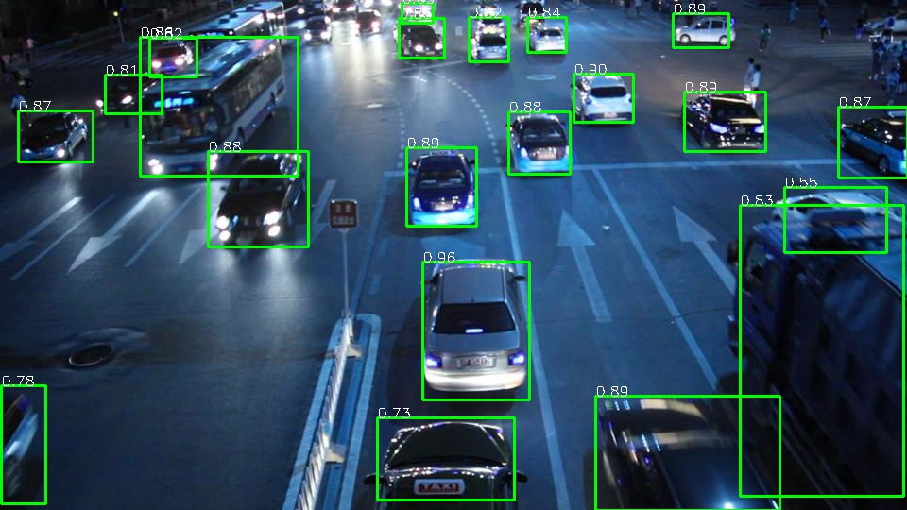

Slide 13
Thank You!

