Slide 1
A Dual-Critic Reinforcement Learning Framework for Frame-level Bit Allocation in HEVC/H.265
Yung-Han Ho*, Guo-Lun Jin*, Yun Liang*,
Wen-Hsiao Peng* and Xiaobo Li⁺
*National Chiao Tung University (NCTU), Taiwan
⁺Alibaba Group
Notes:
The topic of this presentation is A Dual-Critic Reinforcement Learning Framework for Frame-level Bit Allocation in HEVC/H.265.

Slide 2
Outline
Introduction
Reinforcement learning (RL) basics
Proposed method
Experimental results
Concluding remarks
Notes:
This is the outline
I will begin with the introduction.
Then I will briefly introduce you the RL basics.
After that, I will go through how we address video encoder control from the RL perspective.
Next, I will show you our experimental results
Lastly, I will conclude with few concluding remarks.

Slide 3
Introduction
This work presents an AI-assisted video compression
It addresses frame-level bit allocation for video rate control
We apply for the first time RL to constrained optimization
It outperforms significantly the rate control scheme in x265
Notes:
This work presents an AI-assisted video compression for frame-level bit allocation of video rate control.
It also reflects the potential that how could modern video codecs benefit from machine learning.
We apply the reinforcement learning technique, which lends itself to dependent decision making,
with the aim of maximizing a long-term reward on constrained optimization.
In this talk, I shall address the often-asked question in the video coding community; that is, how could modern video codecs benefit from machine learning?
I shall present three early attempts at applying RL to …
As you will see shortly, RL lends itself to dependent decision making ,with the aim of maximizing a long-term reward.
These applications can be formulated as problems of exactly this type.

Slide 4
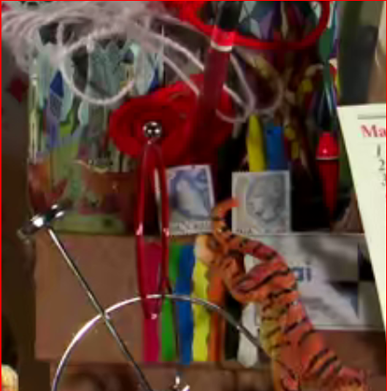
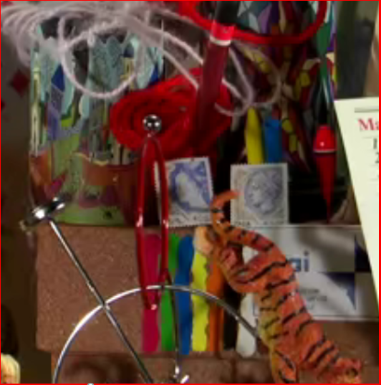
How good is our scheme?
x265
Ours
Frame size : 512x320
Seq. bitrate: 247 Kbps
Frame PSNR: 35.207 dB
Frame size : 512x320
Seq. bitrate: 250.67 Kbps
Frame PSNR: 35.773 dB
Notes:
This slice shows how good of our scheme.
As you can see, it achieves better visual quality with a similar bitrate compared with x265

Slide 5
http://mapl.nctu.edu.tw/RL_Rate_Control/
Notes:
You can visit our project website for more examples

Slide 6
Frame-level Bit Allocation
Task: To allocate coding bits to video frames in a group of pictures by choosing their quantization parameters (QP)
Group of Pictures (GOP)
$${ F}_{1}$$
$${ F}_{2}$$
$${ F}_{3}$$
$${ F}_{N}$$
$${QP}_{1}$$
$${QP}_{2}$$
$${QP}_{3}$$
$${QP}_{N}$$
Notes:
Our task is to encode a group of video frames subject to a rate constraint.
The question is how to perform bit allocation among these video frames such that the sum of their distortions is minimized while satisfying the rate constraint.
In fact, we allocate bits by choosing their quantization parameters

Slide 7
Objective
To minimize sum of distortions in a GOP
subject to a rate constraint $T_{GOP}$
Typical of constrained optimization problems
Notes:
the objective function can be written as arge min the sum of the distortion of a GOP subject to the rate constraint.
And it is a constrained optimization problems

Slide 8
Challenges
Frames in a GOP are related by inter-frame prediction
QP chosen for a frame would affect QPs of the remaining frames → Dependent decision-making!
GOP
$${ F}_{1}$$
$${ F}_{N}$$
$${ F}_{2}$$
$${ F}_{3}$$
$${QP}_{1}$$
$${QP}_{N}$$
$${QP}_{2}$$
$${QP}_{3}$$
Notes:
What really complicates this task is the inter-frame prediction.
This turns the bit allocation among video frames into a dependent decision making process.

Slide 9
Outline
Introduction
Reinforcement learning (RL) basics
Proposed method
Frame-level bit allocation as RL problem
State and reward signals
Dual-critic RL framework
Experimental results
Concluding remarks

Slide 10
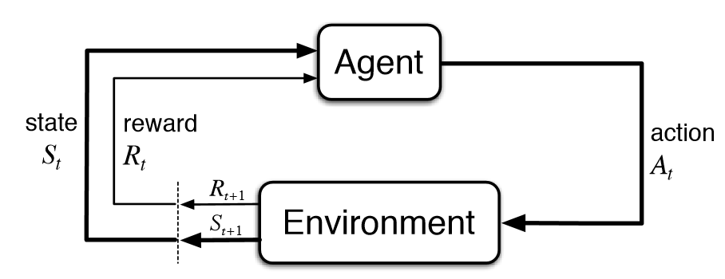
Reinforcement Learning (RL)
Idea: To learn dependent decision-making from experiences
To learn a policy that maximizes expected total reward
Notes:
This is the basic setup of reinforcement learning.
It involves an agent and an environment.
The agent is the one that we hope it can learn to do decision making for us.
The training starts with the agent taking an action based on observing some state signal from the environment.
Given this action and the state, the environment responds with a reward signal indicating how good the action is.
At the same time, it also outputs a new state for the agent to take its next action.
The process repeats until a terminal state is reached.
In particular, the agent is governed by its policy, which is a conditional probability distribution over actions given the state.
And the dynamics of the environment is specified by this transition probability distribution p(r_{t+1},s_{t+1}|s_t,a_t).

Slide 11
Reinforcement Learning (RL)
Trial and error: to take action A in state S if this leads empirically to a high reward-to-go
Efficient exploration of various experiences is critical!
Notes:
RL learns the policy from trial and error.
Let us assume that the policy is just some function parametrized by \theta.
This function takes state as input and outputs a probability distribution over actions.
The trial and error learning is to train \theta in such a way that it encourages the agent to take action A in state S when this leads empirically to a high long-term reward (or reward to go).
For each state (s0 or s1), the agent should be encouraged to take action a_0 or a_1 if the reward to go is high.

Slide 12
Deep Deterministic Policy Gradient (DDPG)
RL framework that trains Actor by learning Critic
Critic learns the reward-to-go Q(s,a)
Actor learns to maximize the reward-to-go
Notes:
DDPG is one of the useful algorithm of RL and it is a actor-critic approach.
The critic is used to learn to estimate the value of reward to go and explore to find the highest reward to go if possible.
Than, the actor update its parameters to output the action that toward to the highest reward to go.

Slide 13
Outline
Introduction
Reinforcement learning (RL) basics
Proposed method
Frame-level bit allocation as RL problem
State and reward signals
Dual-critic RL framework
Experimental results
Concluding remarks

Slide 14
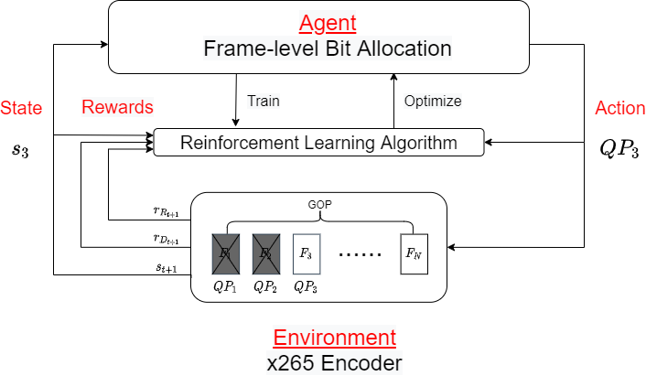
Frame-level Bit Allocation as RL Problem
Notes:
This slice shows how we formulate the frame level bit allocation as an RL problem.
Here we have the agent play the role of our bit allocation algorithm, and the environment be the encoder.
The agent begins with observing some state signal for the first video frame.
It then decides the QP for the current coding frame.
The encoder then follows this QP to do the encoding.
The process then repeats until a terminal state is reached.

Slide 15
Hand-crafted State Signals
Intra-frame features of the coding frame
Inter-frame features of the coding frame
Average of intra-frame features over the remaining frames
Average of inter-frame features over the remaining frames
Number of remaining bits & frames
Temporal identification
Rate constraint
Notes:
In this work, our state signal involves 8 hand crafted signals.
The first two are the intra and inter features of the current coding frame
The third and the forth are the intra and inter features of the remaining frames
The rest are the remaining bits, remaining frames, frame types and the rate constraint information
An estimate of texture complexity of a current coding block.
An estimate of the average texture complexity of future coding blocks.
The number of remaining bits.
The number of remaining blocks.
In short, when making a local decision, the agent is provided with not only information related to the current coding block but also information about the blocks to be encoded down the road.

Slide 16
Intra-frame Features
Reflect texture complexity of a video frame
Evaluate the mean and variance of its pixel values
GOP
$${ F}_{1}$$
$${ F}_{2}$$
$${ F}_{3}$$
$${ F}_{4}$$
$${ F}_{5}$$
$${ F}_{14}$$
$${ F}_{15}$$
$${ F}_{16}$$
Coded Frames
Coding Frame
Remaining Frames

Slide 17
Inter-frame Features
Reflect texture complexity resulting from inter prediction
Evaluate means and variances of frame differences
Evaluation based on uni-prediction and bi-prediction
GOP
$${ F}_{1}$$
$${ F}_{2}$$
$${ F}_{3}$$
$${ F}_{4}$$
$${ F}_{5}$$
$${ F}_{14}$$
$${ F}_{15}$$
$${ F}_{16}$$
Coded Frames
Coding Frame
Remaining Frames

Slide 18
Features over Remaining Frames
Average intra- and inter-frame features over the remaining frames (look-ahead!)
GOP
$${ F}_{1}$$
$${ F}_{2}$$
$${ F}_{3}$$
$${ F}_{4}$$
$${ F}_{5}$$
$${ F}_{14}$$
$${ F}_{15}$$
$${ F}_{16}$$
Coded Frames
Coding Frame
Remaining Frames

Slide 19
Immediate Distortion Reward
Negative mean square error (MSE) evaluated upon encoding every video frame with QP chosen by the agent
$${ F}_{1}$$
$${ F}_{2}$$
$${ F}_{3}$$
$${ F}_{4}$$
$${ F}_{5}$$
$${ F}_{14}$$
$${ F}_{15}$$
$${ F}_{16}$$
Notes:
Now let me turn to the reward signal.
Reward is the score given to the agent for the action it takes.
And how the reward signal is designed would crucially determine how the agent behaves.
For the immediate distortion reward, the goal is to minimize the sum of distortions of a GOP.
Here, the MSEqp0 and the MSEqp51 are the two extreme GOP level MSE values to normalize the MSE of current frame. And it is divided by the GOP size that limits the cumulative reward between 0 to 1
The negative sign suggests that our intent is to minimize the distortion by maximizing the reward.

Slide 20
Immediate Rate Reward
Negative rate bias evaluated upon encoding the last video frame in a GOP
$${ F}_{1}$$
$${ F}_{2}$$
$${ F}_{3}$$
$${ F}_{4}$$
$${ F}_{5}$$
$${ F}_{14}$$
$${ F}_{15}$$
$${ F}_{16}$$
Negative
Rate Bias
Notes:
For the immediate rate reward, the goal is to minimize the encoding bitrate error.
We set a negative rate bias at the last video frame in a GOP, and zeros otherwise.

Slide 21
Dual-Critic RL Framework
Learns two separate critics to predict
Distortion reward-to-go
Rate reward-to-go
Updates actor with these critics in an alternate manner
Notes:
Since we have two separate rewards, we proposed a dual critic RL framework for frame level bit allocation.
We introduce two separate critics. The distortion critic learns to predict the distortion reward-to-go while rate critic learns to predict the rate reward-to-go.
And the actor will choose one the critic to update itself.

Slide 22
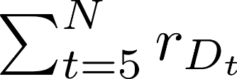
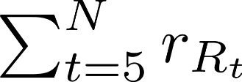
Reward-to-go
Distortion reward-to-go QD(s,a)
Rate reward-to-go QR(s,a)
$${ F}_{1}$$
$${ F}_{2}$$
$${ F}_{3}$$
$${ F}_{4}$$
$${ F}_{5}$$
$${ F}_{14}$$
$${ F}_{15}$$
$${ F}_{16}$$
$${ F}_{1}$$
$${ F}_{2}$$
$${ F}_{3}$$
$${ F}_{4}$$
$${ F}_{5}$$
$${ F}_{14}$$
$${ F}_{15}$$
$${ F}_{16}$$
Notes:
This slice reminds you what the distortion reward to go and rate reward to go that distortion and rate critics are learned to predict

Slide 23
Updating the Actor
Encode a GOP with the learned agent
Update with QR critic to minimize rate bias, if
Update with QD critic to minimize distortion, if
Notes:
Once the the critics can well predict the reward to go, the next question is how the dual critic algorithm updates the actor?
We use the latest policy to encode a GOP. If the actual encoding bit is greater than the target bit (Rgop), we use rate critic to update the actor to minimize the rate bias.
If the actual encoding bit is less than the target bit , we use distortion critic to update the actor to minimize the distortion.

Slide 24
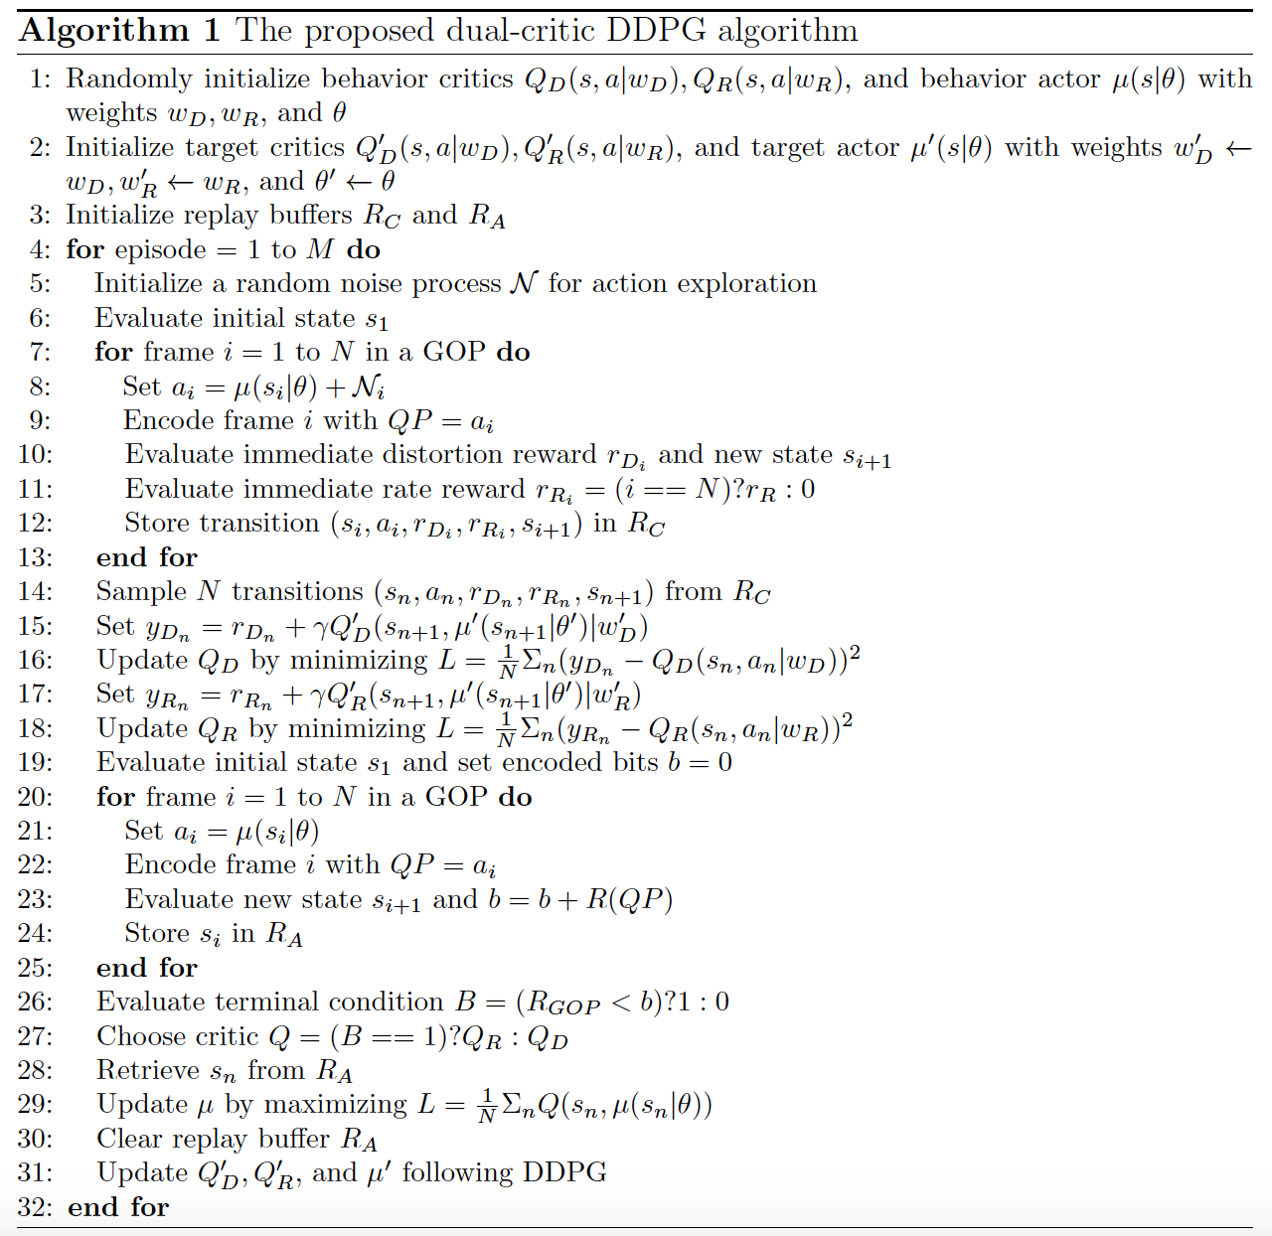
Initialization
Noise exploration
Train critics
Current policy
Train actor
Underflow : Q_{D}
Overflow : Q_{R}
Notes:
this is our dual critic algorithm. The first three lines are the initialization. From line 5 to line 18, we update the rate and distortion critics. And we use noise to explore the best rate and distortion reward to go.
After line 20, we update the actor. In order to choose the correct critic for training the actor, we encode the GOP by using the latest current policy to check it is underflow or overflow. If it is underflow, we use distortion critic and if it is underflow, we use rate critic

Slide 25
Dual vs. Single Critic (1/2)
Rate reward-to-go
Distortion reward-to-go
Mixture of rate and distortion reward-to-go
Notes:
This slice compares the single critic with dual critic. Different from our dual critic, single critic will mix the rate reward and distortion reward into a single reward function

Slide 26
Dual vs. Single Critic (2/2)
Dual-critic Design
Pros -- better generalization to various test sequences
Cons -- no convergence guarantee
Single-critic Design
Pros -- better convergence (ordinary DDPG)
Cons -- poorer generalization due to ad-hoc mixture of distortion and rate reward-to-go
How to choose a lambda that works well on every test sequence?
Notes:
For single reward approach, it is common to introduce a hyper-parameter lambda to balance the rate and distortion. However, How to choose a lambda that works well on every test sequence? Is a non trivial problem.
For a overall comparison. Single critic has better convergence but shows poorer generalization due to ad-hoc mixture of distortion and rate reward-to-go.
As for Dual critic, it has better generalization to various test sequences, but it dose not guarantee to have convergence

Slide 27
Base Module
Limits exploration space for better convergence
Clones approximately rate control of x265 using its QP choices as supervisions
[0,51]
[-10,10]
Notes:
To improve the convergence, we apply a base module into our agent to limits the exploration space. The base module is supervisely trained by using the QP value of x265 as target.
And our actor module only need to explore in a limited rage to find the optimal solution

Slide 28
Outline
Introduction
Reinforcement learning (RL) basics
Proposed method
Experimental results
Settings
Rate-distortion performance
Runtime
QP Assignment
Concluding remarks

Slide 29
Hierarchical-B Coding Structure
Experiment on x265 using a 3-level hierarchical-B structure
GOP size = 16
Notes:
We Experiment on x265 using a 3-level hierarchical-B structure with GOP size 16

Slide 30
Target Bitrates
Follow the same GOP-level bit allocation as x265
Encode every sequence with fixed QP’s (22,27,32,37) to get sequence-level bitrates
Turn on rate control of x265 (1-pass vs. 2-pass ABR)
Observe the GOP-level bitrates of x265
Use these bitrates as our GOP target bitrates
VBV condition: --bitrate : --vbv-bufsize : --vbv-maxrate = 1:2:1
Notes:
This slice shows how we get our target bitrate
First, we Encode every sequence with fixed QP’s (22,27,32,37) to get sequence-level bitrates
Second, we turn on rate control of x265 (1-pass and 2-pass)
Finally, we Observe the GOP-level bitrates of x265 and use these bitrates as our GOP target bitrates

Slide 31
Other Details
Separate models for four target bitrates
Both our method and the single-critic method [1] operate with the same base module
Performance metrics: BD-PSNR and rate deviations
[1] Chen et al. “Reinforcement Learning for HEVC/H.265 Frame-level Bit Allocation,” IEEE DSP, 2018.
Notes:
For more details, we use 4 separate models for four target bitrates
For a fair comparison, Both our dual critic method and the single-critic method [1] operate with the same base module
We appy BD-PSNR and rate deviations as our evaluation metrics

Slide 32
Datasets
Training datasets (32 videos): UVG [2], MCL-JCV [3], and Class A sequences in JCT-VC dataset
Test datasets (9 videos): Class B and Class C sequences in JCT-VC dataset
To speed up training, all videos are rescaled to 512 × 320
[2] Mercat et al. “UVG dataset: 50/120fps 4k sequences for video codec analysis and development”. ACM Multimedia Systems Conference, 2020
[3] H. Wang et al. “MCL-JCV: A jnd-based H.264/AVC video quality assessment dataset”. IEEE ICIP, 2016
Notes:
Our training dataset has 32 videos and we test on another 9 test videos.
To speed up training, all videos are down-sized to 512 × 320

Slide 33
Outline
Introduction
Reinforcement learning (RL) basics
Proposed method
Experimental results
Settings
Rate-distortion performance
Encoding runtime
QP assignment
Concluding remarks

Slide 34
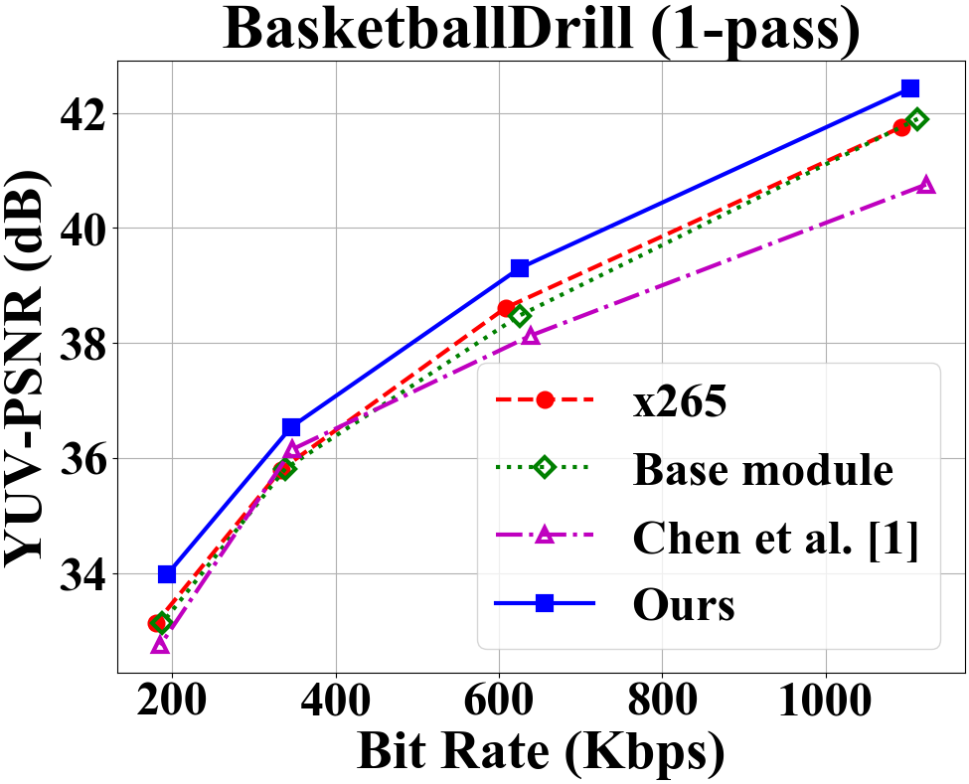
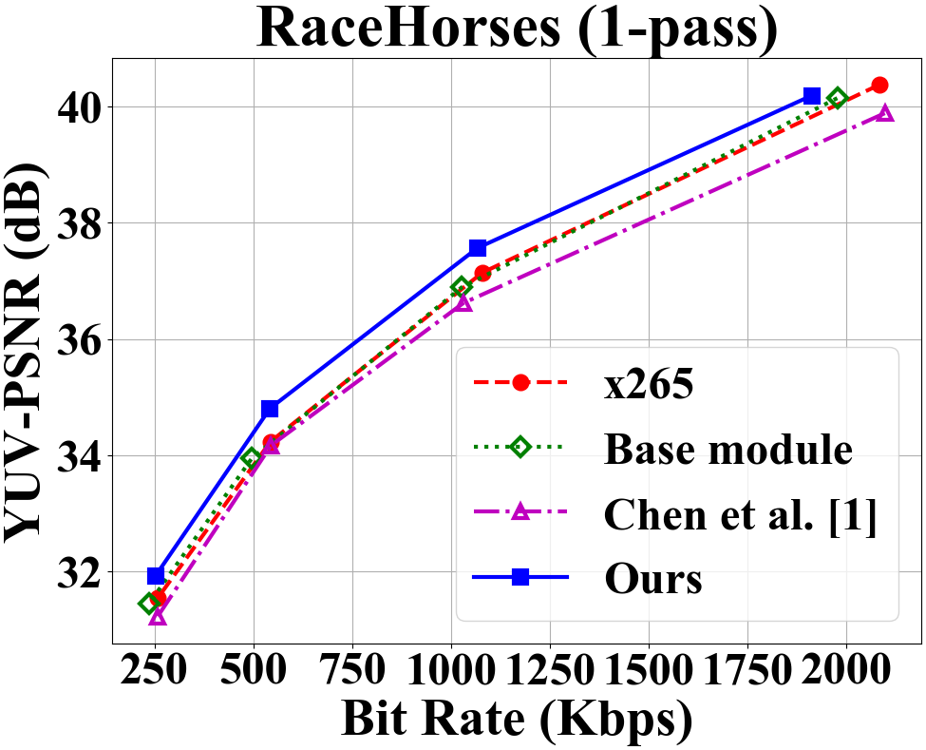
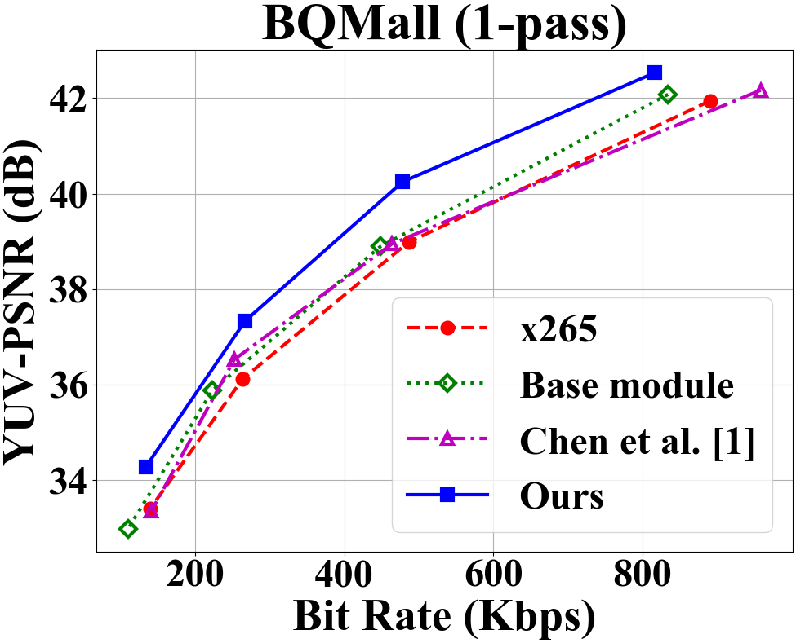
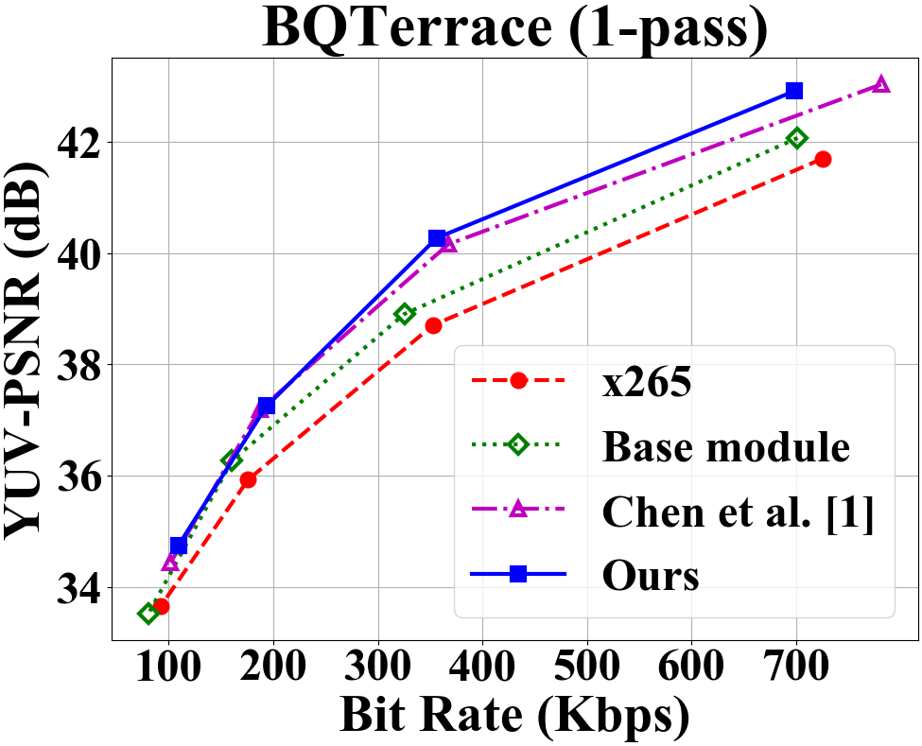
Rate-Distortion Comparison
Notes:
This slice shows the RD performance compared with our dual critic, single critic method and x265 1-pass approach. It can be observed that our approach outperform other methods.
Besides, single critic approach shows good results on more static sequences but poor results on more dynamic sequences. It is because Chen and others use a fixed hyper-parameter lambda for all the videos, which can not be generalized well to all videos

Slide 35
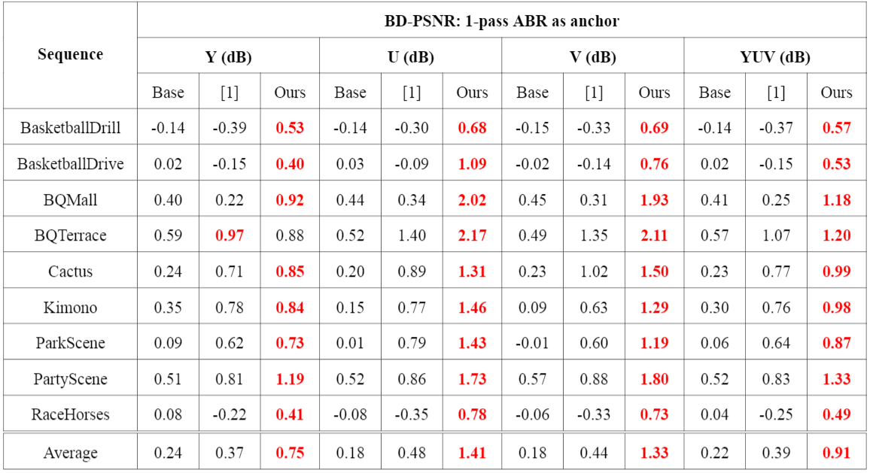
BD-PSNR with 1-pass ABR as anchor
[1] Chen et al., “Reinforcement Learning for HEVC/H.265 Frame-level Bit Allocation,” IEEE DSP, 2018.
Notes:
The BD-PSNR double confirms the RD performance, our method has a 0.91 dB gain compared with 1-pass x265. While single critic only has 0.39dB gain

Slide 36
Rate Deviations
 | Seq.-level Target Bit Rates | 1-pass ABR as anchor
 |  | Base | [1] | Ours
 |  | Err. (%) | Err. (%) | Err. (%)
Sequence Average | 1218 | 15.2 | 5.6 | 7.4
 | 639 | 14.4 | 6.8 | 6.2
 | 328 | 14.3 | 7.1 | 5.9
 | 164 | 16.9 | 4.8 | 8.2
[1] Chen et al., “Reinforcement Learning for HEVC/H.265 Frame-level Bit Allocation,” IEEE DSP, 2018.
Notes:
For rate deviation, our dual approach show comparable number compared with single critic method.

Slide 37
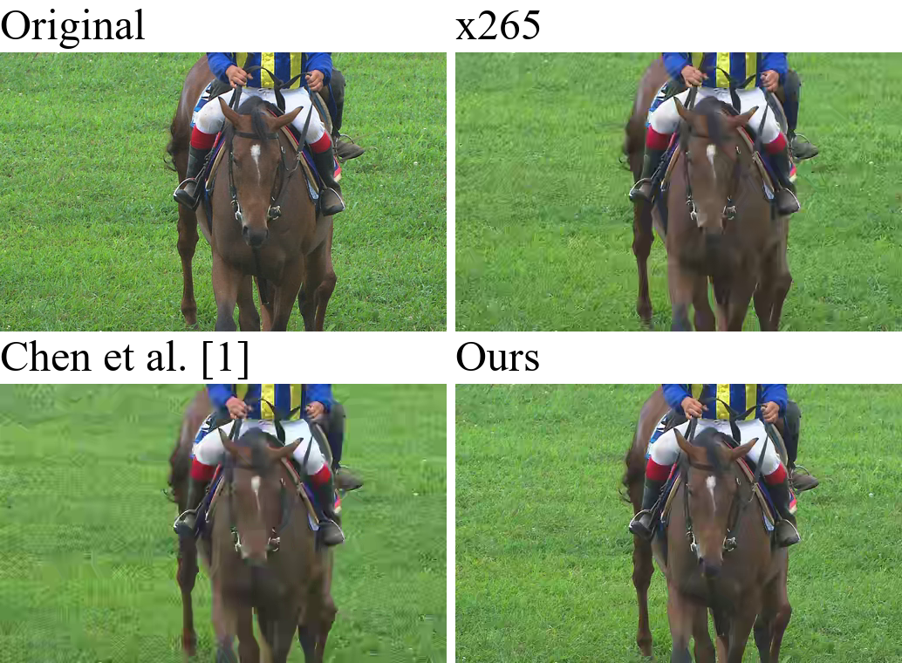
Subjective Quality Comparison
Notes:
This slice shows the subjective quality comparison.

Slide 38
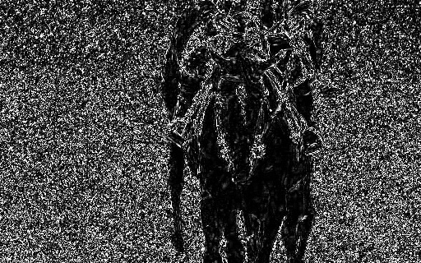
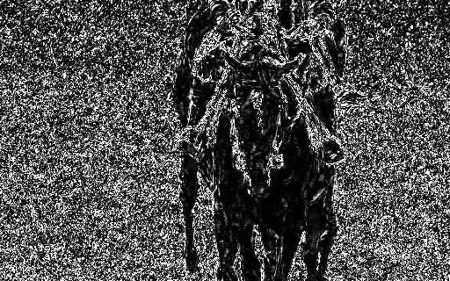
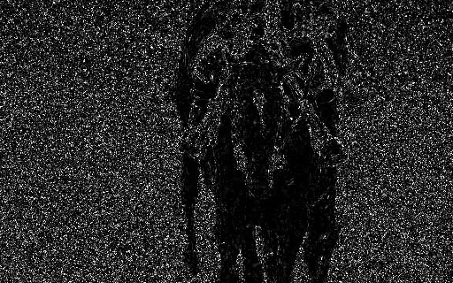
Subjective Quality Comparison (Residual)
Notes:
As you can see, our scheme has the lowest residual compared with other methods.

Slide 39
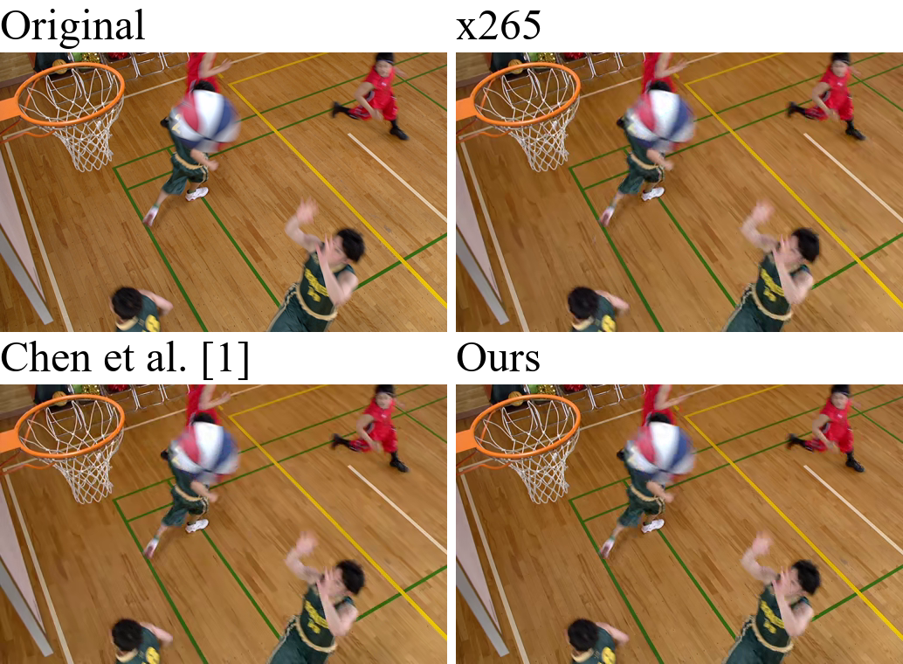
Subjective Quality Comparison

Slide 40
Subjective Quality Comparison (Residual)

Slide 41
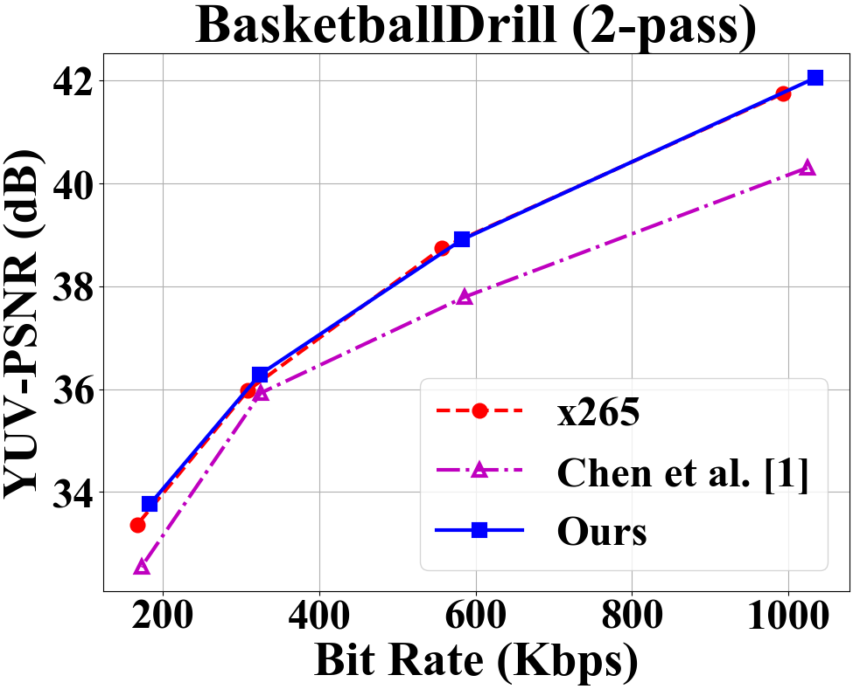
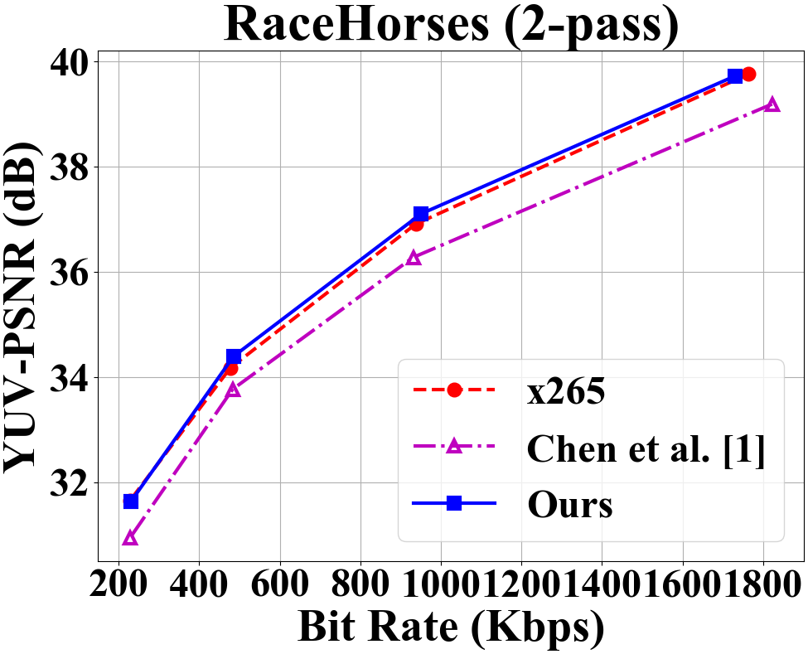
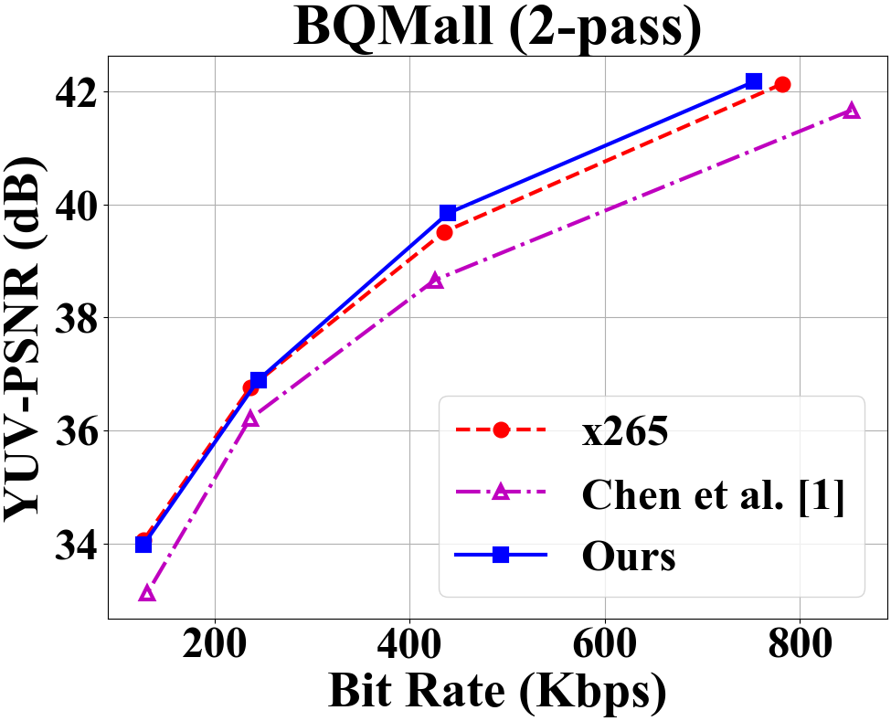
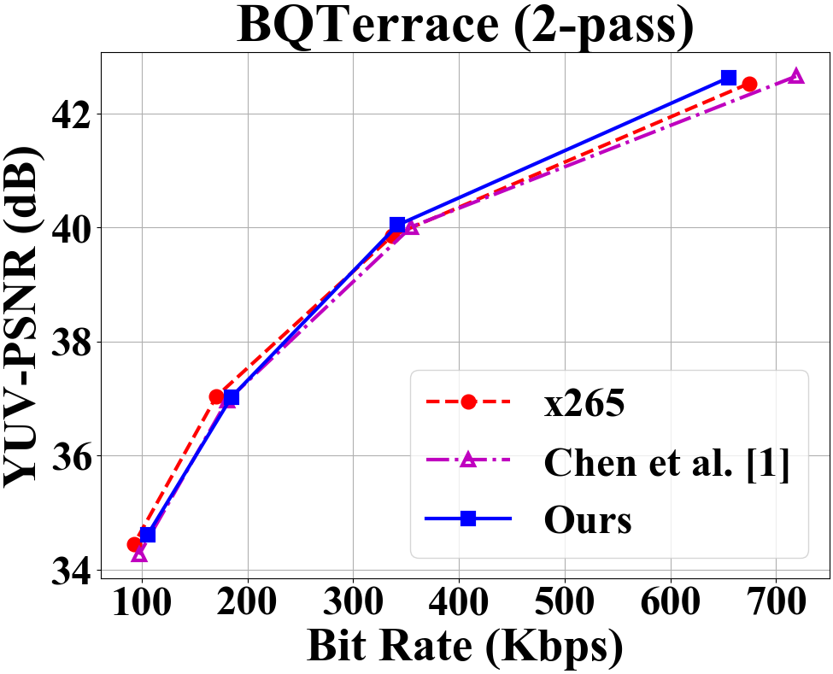
Rate-Distortion Comparison
Notes:
This slice shows the RD performance compared with our dual critic, single critic method and x265 2-pass approach.
Since 2-pass is a more stronger approach, this time, our dual critic method shows a comparable result compared with the 2-pass x265

Slide 42
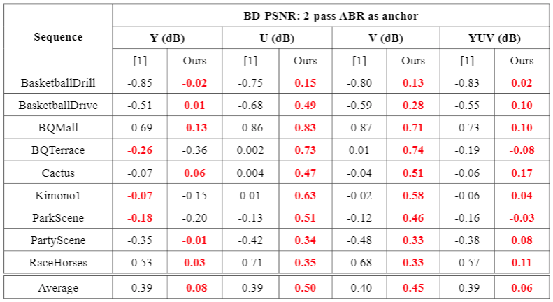
BD-PSNR with 2-pass ABR as anchor
Notes:
From the BD-PSNR, our model only has 0.06 dB gain compared with 2-pass x265

Slide 43
Outline
Introduction
Reinforcement learning (RL) basics
Proposed method
Experimental results
Settings
Rate-distortion performance
Encoding runtime
QP assignment
Concluding remarks

Slide 44
Encoding Runtime
Sequence | X265 1-pass (sec) | X265 2-pass (sec) | Ours (sec)
BasketballDrill | 31.62 | 64.16 | 32.75
BasketballDrive | 36.70 | 73.44 | 37.84
BQMall | 39.21 | 77.81 | 40.56
BQTerrace | 35.20 | 72.45 | 36.55
Cactus | 33.20 | 65.82 | 34.32
Kimono | 15.00 | 30.97 | 15.44
ParkScene | 14.61 | 31.43 | 15.11
PartyScene | 40.78 | 82.72 | 41.92
RaceHorses | 24.68 | 50.39 | 25.36
Total | 271.21 | 549.19 | 280.07
Notes:
This slice shows the encoding run time.
The run time of our model is comparable with x265 1-pass and half of the run time compared with x265 2-pass.

Slide 45
Outline
Introduction
Reinforcement learning (RL) basics
Proposed method
Experimental results
Settings
Rate-distortion performance
Encoding runtime
QP assignment
Concluding remarks

Slide 46
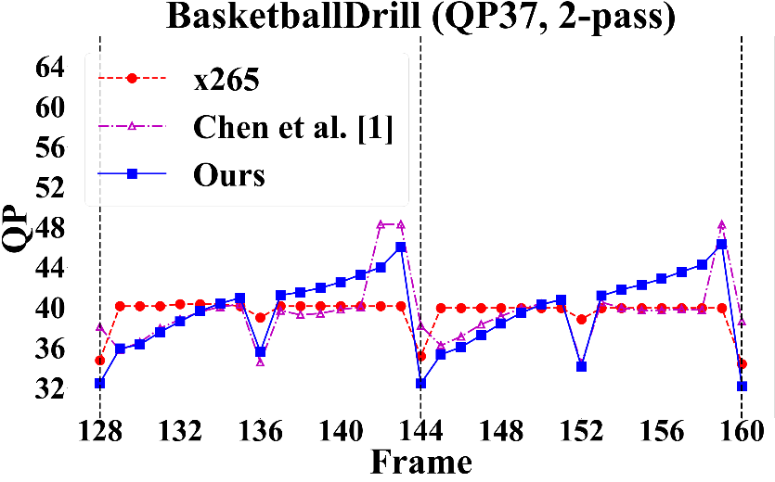
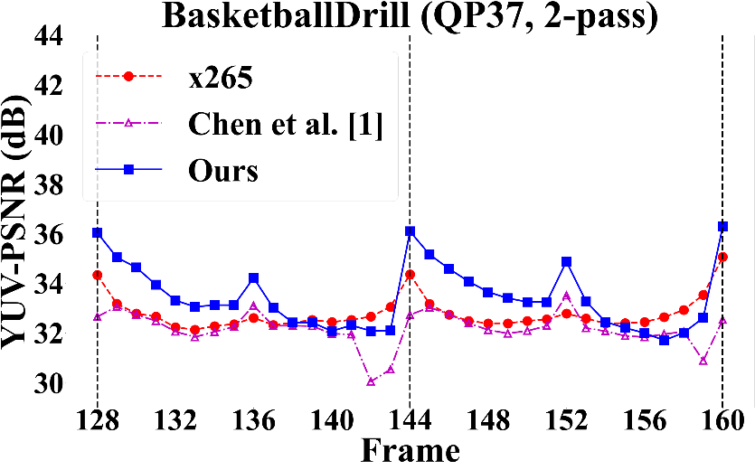
QP Assignment: Fast-motion Seq. (1/2)
Our model chooses smaller QP for I- and B-frames
Notes:
This slice shows the QP assignment for the fast motion sequences.
Our model tend to use smaller QP for I and B frames and higher QP for b frames. It is quite reasonable since I and B frames are the reference frames.

Slide 47
QP Assignment: Fast-motion Seq. (2/2)
Our model chooses larger QP for the second half of b-frames
b-frames are non-reference frames
No constraint imposed on their quality distribution
Notes:
One of a interesting observation is that our model tend to choose larger QP for the second half of b-frame
Since we do not imposed any constraint on their quality distribution, and the b-frames are non-reference frames. This behavior turns out to be one of a good solution that the model learned

Slide 48
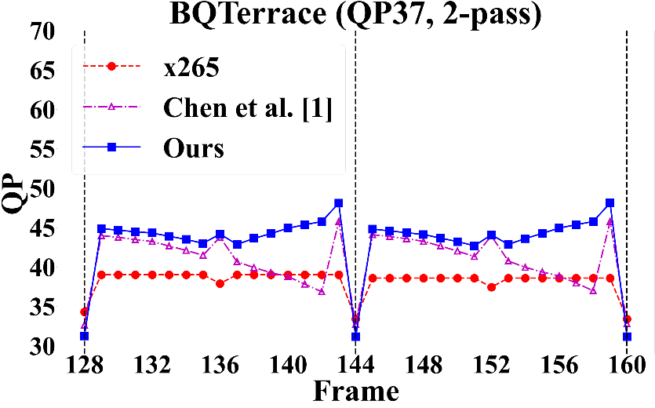
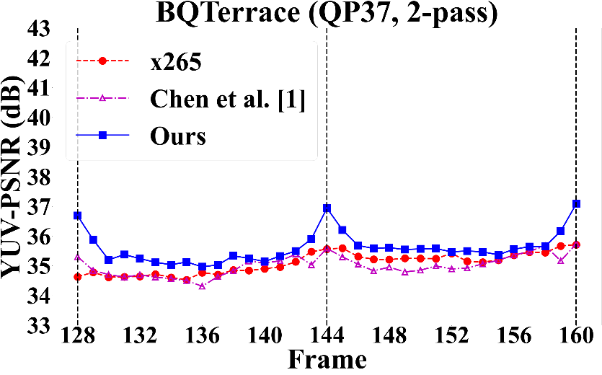
QP Assignment: Slow-motion Seq.
Our method chooses much smaller QP for I-frames
Notes:
This slice shows the QP assignment for the slow motion sequences.
Our model tend to use smaller QP for If frame and larger QP for the capital B and b frames

Slide 49
Outline
Introduction
Reinforcement learning (RL) basics
Proposed method
Experimental results
Concluding remarks
Notes:
The coclussions

Slide 50
Concluding Remarks
This work introduces a dual-critic RL framework for frame-level bit allocation
It overcomes the need of combining the rate and distortion rewards in a heuristic manner
Our method achieves promising R-D performance and fairly precise rate control accuracy
Notes:
thank you for your attention

Slide 52
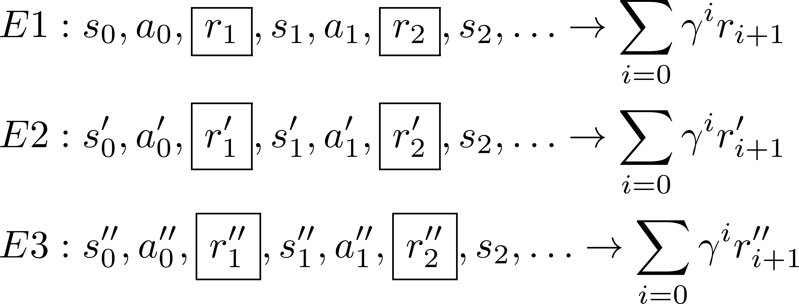
RL in a Nutshell (1/3)
To learn a policy that maximizes expected total reward
Notes:
Now, when the agent interacts with the environment many times, this will produce many state-action-reward sequences.
Each of these sequences has a probability that can be computed as the product of the initial state distribution, the policy, and the environment dynamics.
Here we have no control of the environment, but the policy is something we can optimize.
The goal of RL is to learn a policy that assign high probabilities to those sequences with large cumulative rewards in the long run.

Slide 53
RL in a Nutshell (2/3)
Our work employs model-free (trial and error) learning
Notes:
In this talk, I shall focus on the model-free learning.
That is, I do not assume any knowledge about the environment.
Or you can say, we have no access to this transition probability.
We thus need to learn the policy through trial and error.

Slide 54
State Signals
Task: To evaluate the state signal for a coding frame (e.g. F5) given the GOP prediction structure
GOP
$${ F}_{1}$$
$${ F}_{2}$$
$${ F}_{3}$$
$${ F}_{4}$$
$${ F}_{5}$$
$${ F}_{14}$$
$${ F}_{15}$$
$${ F}_{16}$$
Coded Frames
Coding Frame
Remaining Frames

Slide 55
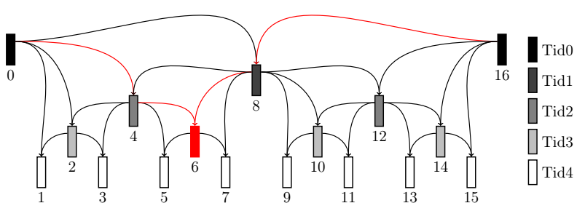
Example: Uni-prediction
Means and variances of frame differences by uni-prediction
6
- → (mean, variance)
- → (mean, variance)
- → (mean, variance)
- → (mean, variance)
Current frame
Reference list L0 [ ]
Reference list L1 [ ]
4
6
6
0
4
0
6
8
8
16
6
16
Notes:
This slide illustrates how we actually estimate the complexity of a video frame.
To put simply, we evaluate the mean and variance of a video frame to characterize its complexity.
For example, let us say frame 6 is to be predicted uni-directionally from one of the frames 4, 8, 0 and 16.
We compute the mean and variance of the prediction residual for each of these cases.
Moreover, we repeat the same process for the case when frame 6 is predicted bi-directionally or with intra coding.
These means and variances form part of the state signal.

Slide 56
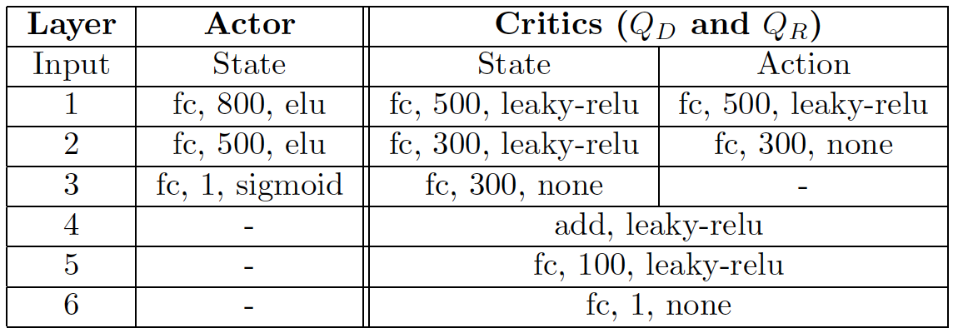
Network Architecture
$Q_{D}$ and $Q_{R}$ are separate networks with the same architecture
The base module shares the same architecture as the actor

Slide 57
Rate Deviations
 | Seq.-level Target Bit Rates | 2-pass ABR as anchor
 |  | [1] | Ours
 |  | Err. (%) | Err. (%)
Sequence Average | 1218 | 6.5 | 8.9
 | 639 | 7.9 | 7.4
 | 328 | 8.1 | 7.5
 | 164 | 5.5 | 11.6

Slide 58
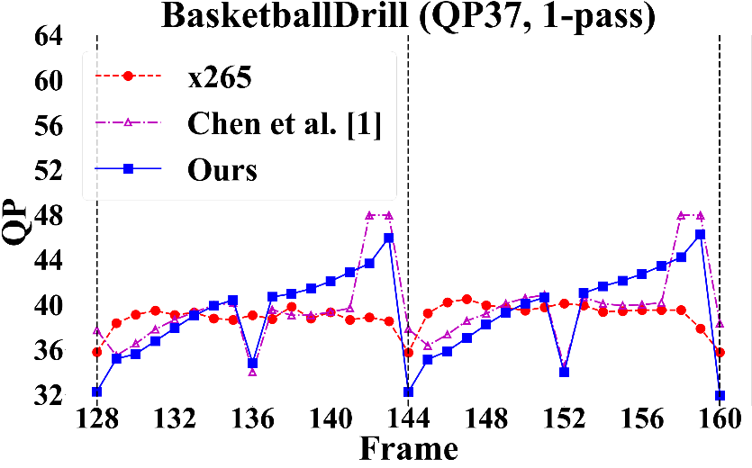
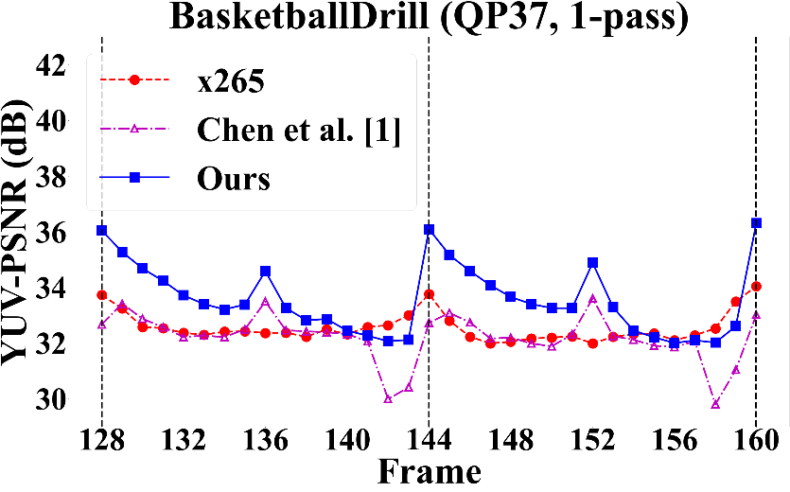
QP Assignment: Fast-motion Seq. (1/2)
Our model chooses smaller QP for I- and B-frames
Notes:
This slice shows the QP assignment for the fast motion sequences.
Our model tend to use smaller QP for I and B frames and higher QP for b frames. It is quite reasonable since I and B frames are the reference frames.

Slide 59
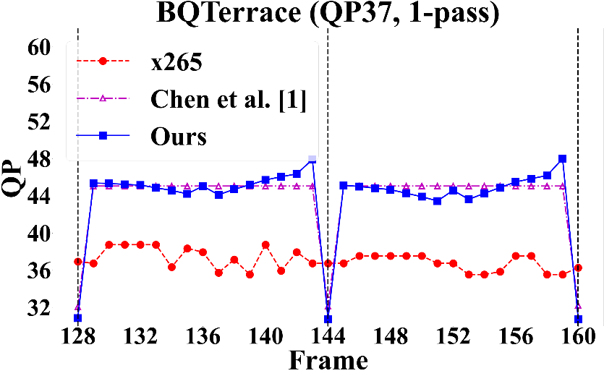
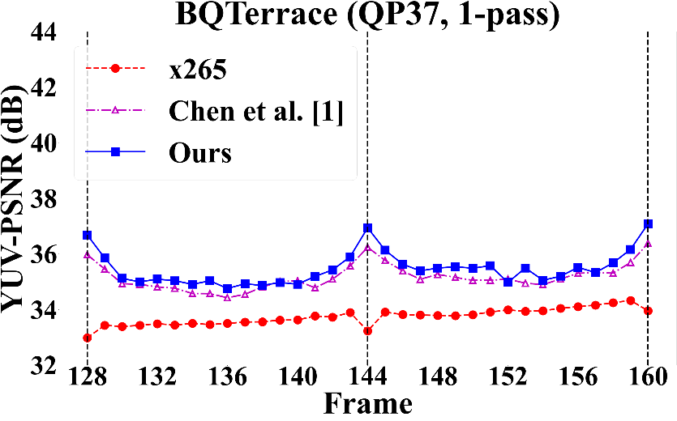
QP Assignment: Slow-motion Seq.
Our method chooses much smaller QP for I-frames
Notes:
This slice shows the QP assignment for the slow motion sequences.
Our model tend to use smaller QP for I.

Slide 60
QP Assignment: Ours vs. 2-pass X265
Notes:
Use learnable downscaling model.

Slide 61
YUV-PSNR Profile: Ours vs. 2-pass X265
Notes:
Use learnable downscaling model.

Slide 62
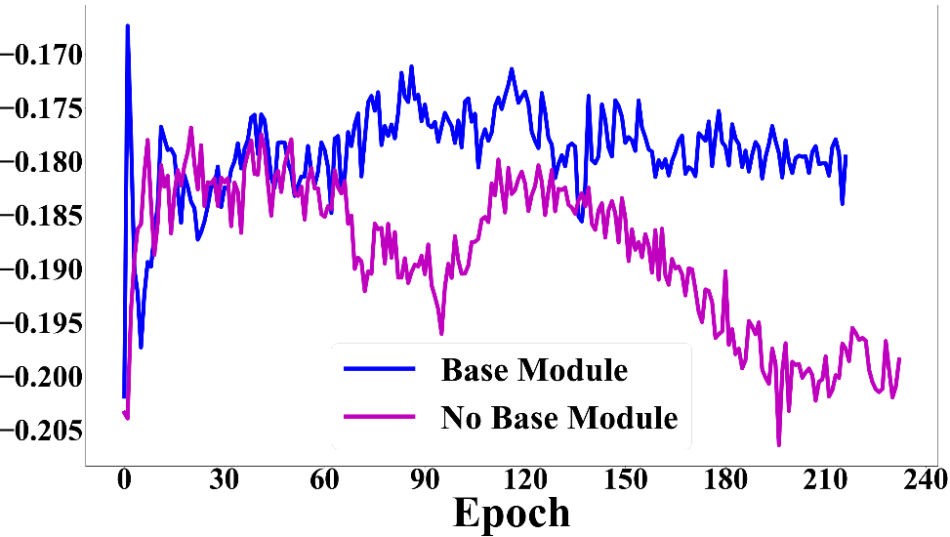
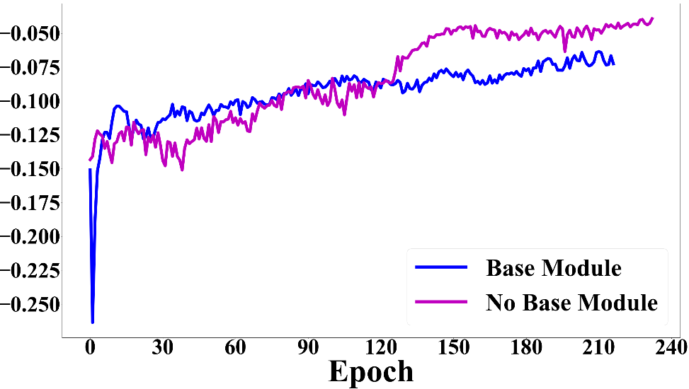
Convergence Problem
When updating the rate, the distortion is completely ignored
The distortion may increase rapidly when the agent tries to meet the rate constraint
The base module serves as a prior to limit the search space
Distortion reward
Rate reward
Notes:
Use learnable downscaling model.

