Slide 1
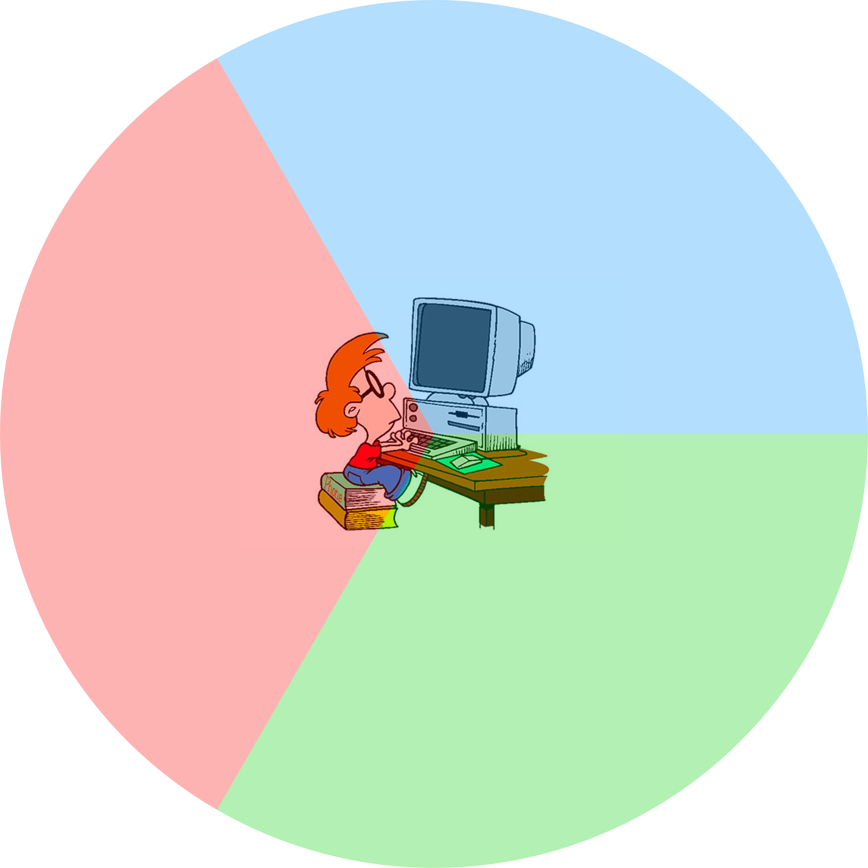
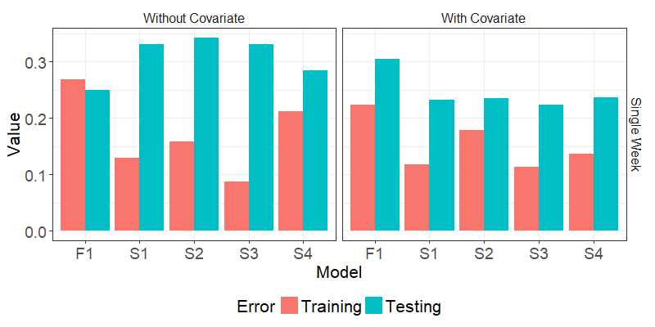
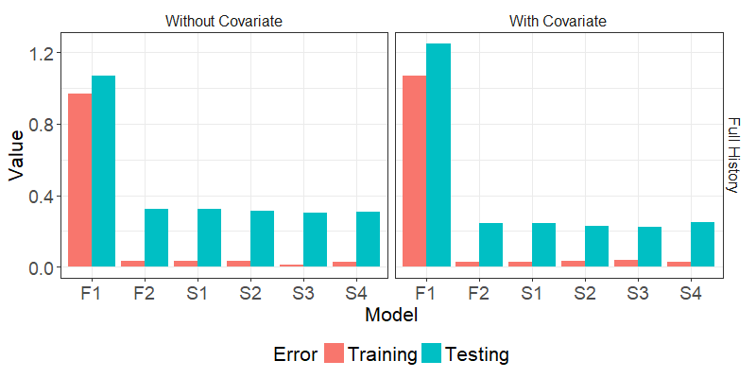
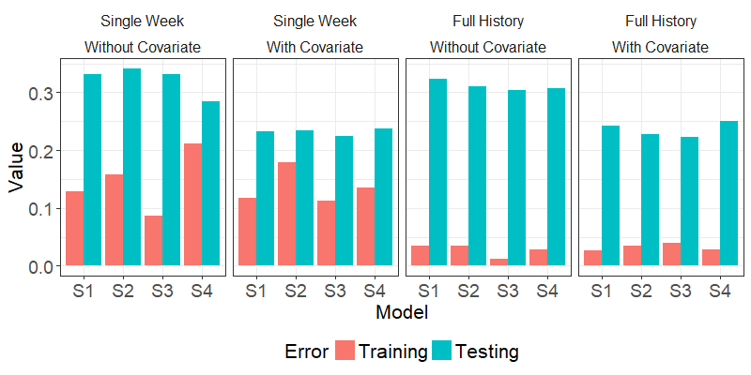
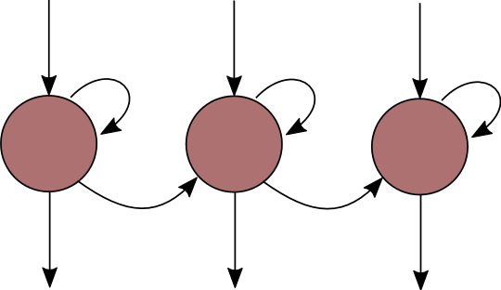
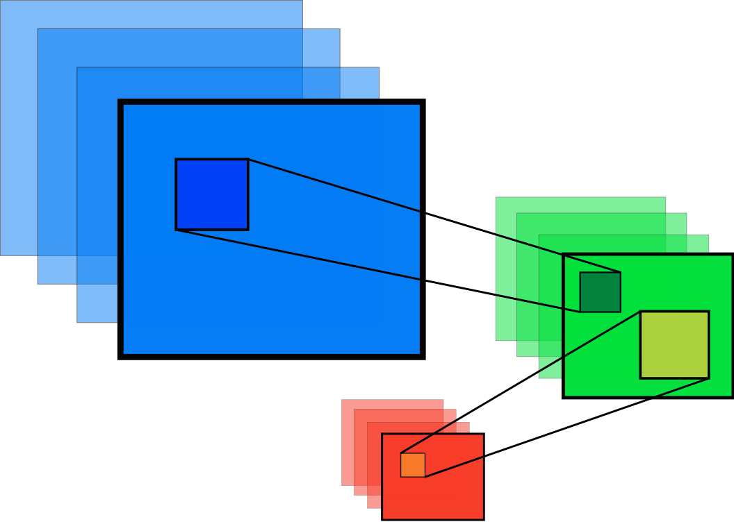
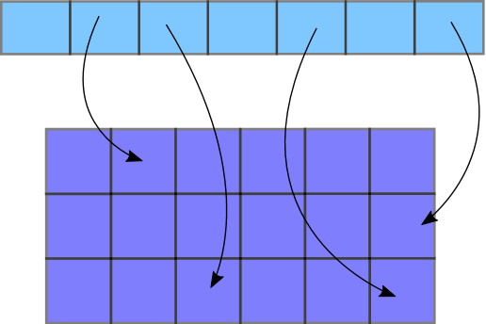
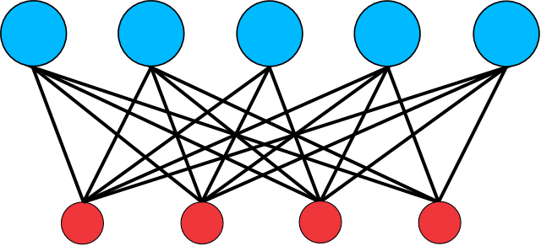
Online Education Evaluation for Signal Processing Course
Through Student Learning Pathways
Kelvin H. R. Ng¹, Sivanagaraja Tatinati, Andy W. H. Khong³
Overview
Models
Existing methods use frequency-based features to forecast course performances.
A multi-modal learning schema based on deep-learning techniques with learning sequences, psychometric measures and personality traits is designed to study the impact of online learning sequences to forecast course outcomes.
Sequences vs Frequencies
We demonstrate that sequence-based models have better consistencies when duration of analysis (weekly, topical, pre/post-tests, semester) is varied.
Limited Observation Behind Computer Screens
Observations in online learning environment is limited. Many assumptions are required to be made. One such example is assuming that students are paying attention to ongoing video materials.
Observation limitations restrict prediction performance but assumptions can be soften with the knowledge of user characteristics.
Pseudo-stationary psychometrics can inform models to achieve better prediction performances.
Frequency-based Models
Fully-connected 100 nodes
Fully-connected 100 nodes
Fully-connected 100 nodes
F1
Fully-connected Layer
Linear/Non-linear weighted relationship
Auto-encoding/ Embedding Layer
Principle feature extraction
Convolution Layer
Spatial numeric features
Discrete-to-continuous mapping
Long Short-term Memory
Remember temporal patterns
Convolution 500 3x3
Convolution 300 3x3
Convolution 100 3x3
F2
Sequence-
based
Models
Auto-encoding 50 nodes
LSTM 100 nodes
S1
Embedding 50 nodes
LSTM 100 nodes
S2
Auto-encoding 50 nodes
Convolution 32 7x7 filters
LSTM 100 nodes
S3
Embedding 50 nodes
Convolution 32 7x7 filters
LSTM 100 nodes
S4
Data & Process Flow
Results
Observable Variables (Measurable at any instance)
Video Activity
Frequency-based Features
Start activity
Play
Pause
Scrub Forward
Play
Pause
Scrub Back
End
End activity
Latent
Variables
(At most measurable at fixed intervals)
Practice Activity
Start Practice
Select answer(Q1)
Select answer(Q2)
Select answer(Q3)
Edit answer(Q1)
Submit answers
End Practice
Online Log of Resource Usage
Sequence-based Features
Learning
Outcomes
Without covariates, frequency-based model generalize better.
Sequence-based model benefit from additional information from covariates and surpass frequency-based models with limited information.
Frequency-based models failed to train as analysis periods are increased. Under Central Limit Theorem, frequency-based features of individual students follow Gaussian distributions.
Performance-approach
goals
Fully-
connected
Layer
Fully-
connected
Layer
Long Short-term Memory
Layer
Convolution
Layer
Auto-encoding/
Embedding
Layer
Theory
of Intelligence
Grit
Mastery
goals
Performance-avoidance
goals
Academic Bouyancy
Authors
Acknowledgements
¹ Ph.D. Candidate, School of Electrical and Electronics Engineering, Nanyang Technological University, Singapore, SG, e140025@e.ntu.edu.sg
² Research Fellow, Delta-NTU Corporate Lab for Cyber-Physical Systems, Nanyang Technological University, Singapore, SG, tatinati@ntu.edu.sg
³Associate Professor, School of Electrical and Electronics Engineering, Nanyang Technological University, Singapore, SG, andykhong@ntu.edu.sg
This work was conducted within the Delta-NTU Corporate Lab for Cyber-Physical Systems with funding support from Delta Electronics Inc and the National Research Foundation (NRF) Singapore under the Corp Lab@University Scheme
Better results cannot be achieved with either full historical information or the inclusion of covariates. Only the combination of both achieve the best prediction performances for training and testing.
S3 achieve the best generalization performances. Without knowledge on domain features, auto-encoding layers extracts principle features while convolution layers provide abstraction of these principle features.

