Slide 1
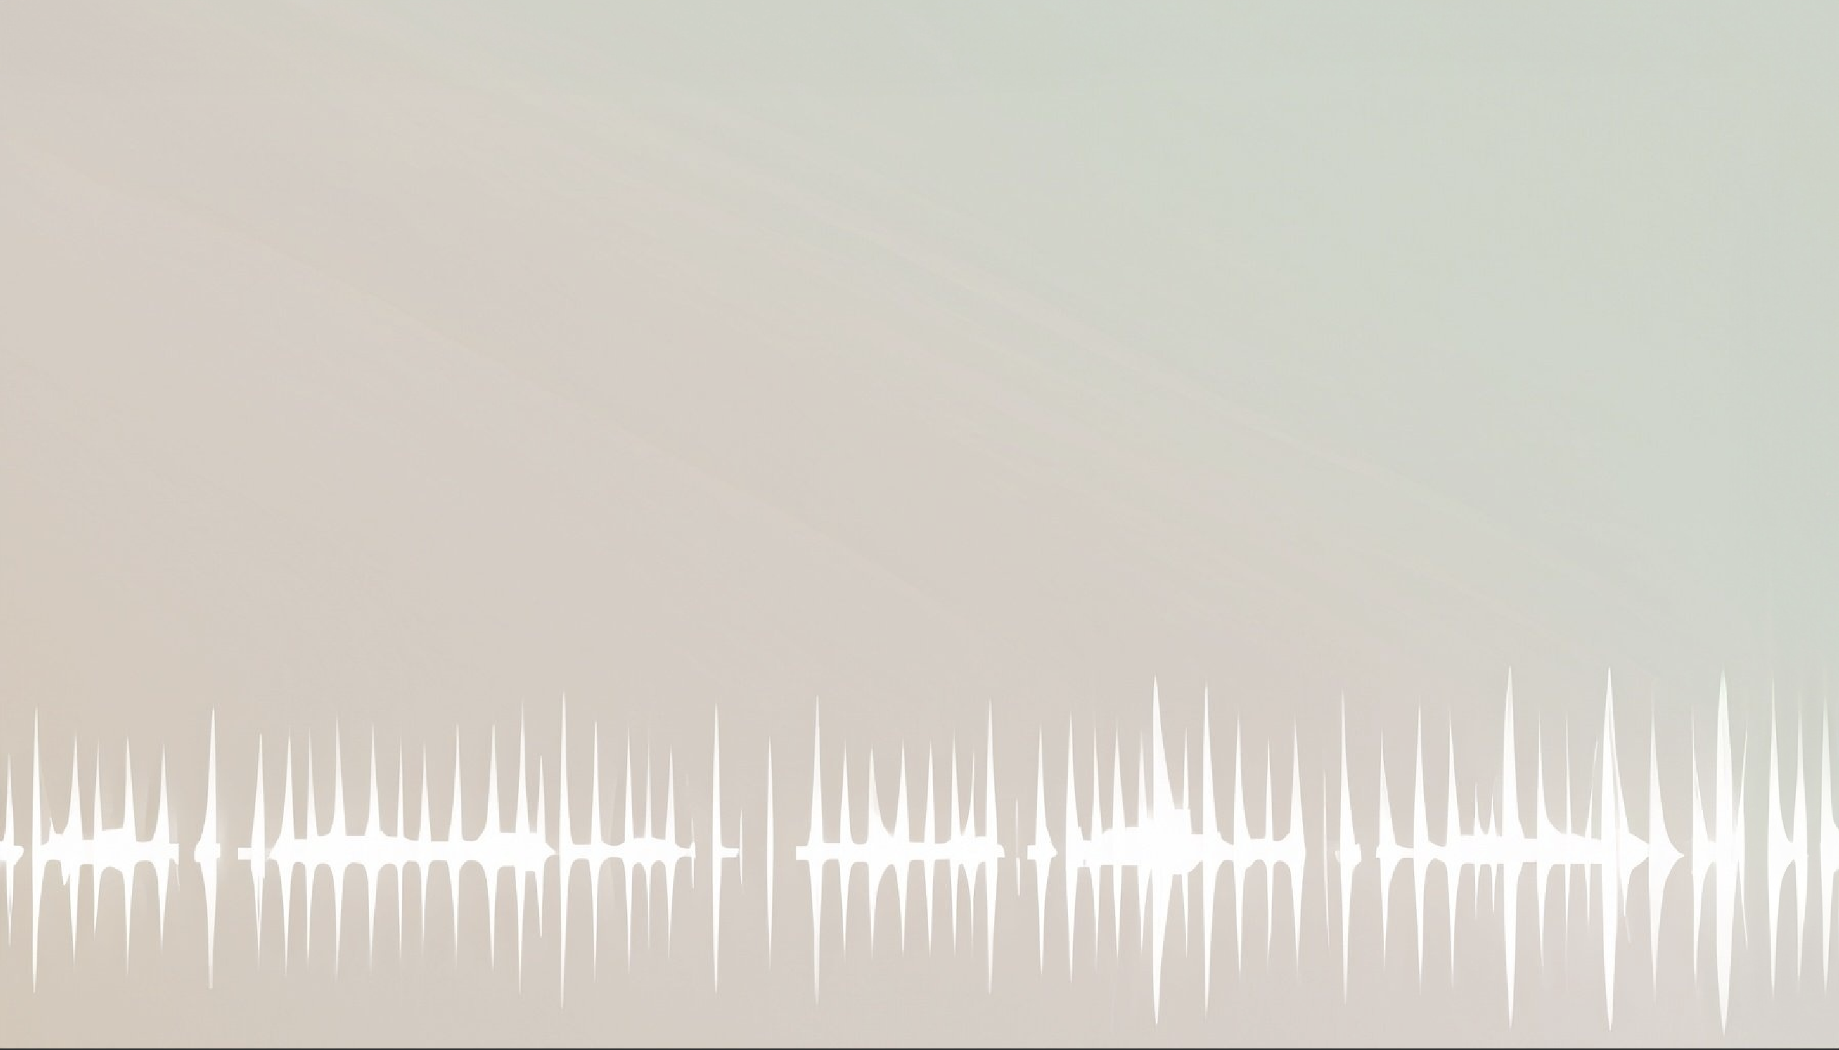
Improving Audio Captioning Models with Fine-grained Audio Features, Text Embedding Supervision, and LLM Mix-Up Augmentation
Winner, DCASE ’23 Challenge 6A on Audio Captioning
Shih-Lun Wu
MS Student @ Language Tech Inst (LTI), Carnegie Mellon University (CMU)
Xuankai Chang
^{CMU LTI}
Gordon Wichern
^{Mitsubishi Electric (MERL)}
Jee-weon Jung
^{CMU LTI}
François Germain
^{Mitsubishi Electric (MERL)}
Jonathan Le Roux
^{Mitsubishi Electric (MERL)}
Shinji Watanabe
^{CMU LTI}
Talk @ ICASSP ’24, AASP-L9 session April 18th, 2024
Notes:
Advertise we’re the winner in DCASE 2023.
Hello everybody, My name is Shih-Lun. I’m a Master’s student with the Language Technologies Institute at Carnegie Mellon University in the United States.
It’s my pleasure to be here today to present our study on deep-learning based audio encoders inside audio captioning models.
This project is a collaboration with my advisor---Prof. Shinji Watanabe, who is joining us virtually today, my lab mates at CMU---Xuankai and Jee-weon,
and my mentors, Gordon, Francois, and Jonathan at the Mitsubishi Electric Research Labs in Boston.

Slide 2
A Quick Task Overview
Automated audio captioning (AAC)
any sort of audio (x) → a text description (y)
a sequence-to-sequence (seq2seq) task
Audio
Encoder ϕ
Text
Decoder $θ$
“ Cars honk while people
shout in the background ”
audio
waveform
text
description
Learning objective – conditional language modeling (LM)
learned
audio features
max likelihood estimation
autoregressive (word-by-word)
text generation
Notes:
First of all, I’d like to give you a high-level overview of the task we’re tackling, and how it might be useful in autonomous driving.
(click)
So the task of automated audio captioning, or AAC in short, involves an audio input like this
(play audio)
(click)
And we want to use a machine learning model, typically a neural network, to generate a sentence that describes what’s happening in the audio.
Like in this case, there are cars honking and people shouting in the background.
(click)
An AAC model could serve as a safety assistance system in autonomous cars.
(click)
It can continuously monitor the acoustic environment around the car,
And caption audible emergency events, like children playing on the crosswalk or an ambulance approaching.
(click)
The captions can be sent both to the car’s control unit to trigger automated responses like braking or yielding,
(click)
And to the driver as an easy-to-understand explanation of the surrounding environment.

Slide 3
Motivation
& Our Contribution
“ Cars honk …”
Audio Enc
Text Dec
The landscape of AAC in early 2023 …
old CNN multilabel classifier (Kong et al., ’19) used as audio encoder
weak alignment of audio enc & text dec other than seq2seq
scarce AAC paired data (Kim et al., ’19; Drossos et al., ’19) (~50K samples total)
beam-search decoding, known to output overly generic text
large language models (LLMs) booming, can we leverage them?
👍
BEATs Audio Enc
Text Dec
We drop in BEATs (Chen et al., ’22) w/ better arch. & pretraining
We inject text knowledge to audio enc w/ Instructor LLM (Su et al., ’22)
We leverage ChatGPT to create diverse & complex data
We use nucleus sampling (Holtzman et al., ’19) + hybrid reranking
Instructor LLM
BEATs Audio Enc
Text Dec
ChatGPT LLM
Instructor LLM
BEATs Audio Enc
Text Dec
✓ Yes we can !
Notes:
First of all, I’d like to give you a high-level overview of the task we’re tackling, and how it might be useful in autonomous driving.
(click)
So the task of automated audio captioning, or AAC in short, involves an audio input like this
(play audio)
(click)
And we want to use a machine learning model, typically a neural network, to generate a sentence that describes what’s happening in the audio.
Like in this case, there are cars honking and people shouting in the background.
(click)
An AAC model could serve as a safety assistance system in autonomous cars.
(click)
It can continuously monitor the acoustic environment around the car,
And caption audible emergency events, like children playing on the crosswalk or an ambulance approaching.
(click)
The captions can be sent both to the car’s control unit to trigger automated responses like braking or yielding,
(click)
And to the driver as an easy-to-understand explanation of the surrounding environment.

Slide 4
Method (Part I) – A Better Audio Encoder
✅ alarm
✅ footsteps
❌ dogs …
< 1 Hz
Top AAC models pre-2023 used PANN (Kong et al., ’19) audio encoder
Issue(s) – What’s not great about the good-old PANN ?
CNN backbone → downsample to gather info → low feat resolution (< 1 Hz)
Multilabel classification → needs labels (labor), learning signal is sparse (1 label vec / audio)
BEATs (Chen et al., ’22) comes to our rescue !!
Transformer backbone → high-resolution feats (50 Hz), strong at long seqs
Self-supervised masked prediction → needs no labels, has dense learning signals
Multilabel classification can still be applied in continued training
PANN
mask uncovered
50 Hz
BEATs
tokenize + mask
Notes:
First of all, I’d like to give you a high-level overview of the task we’re tackling, and how it might be useful in autonomous driving.
(click)
So the task of automated audio captioning, or AAC in short, involves an audio input like this
(play audio)
(click)
And we want to use a machine learning model, typically a neural network, to generate a sentence that describes what’s happening in the audio.
Like in this case, there are cars honking and people shouting in the background.
(click)
An AAC model could serve as a safety assistance system in autonomous cars.
(click)
It can continuously monitor the acoustic environment around the car,
And caption audible emergency events, like children playing on the crosswalk or an ambulance approaching.
(click)
The captions can be sent both to the car’s control unit to trigger automated responses like braking or yielding,
(click)
And to the driver as an easy-to-understand explanation of the surrounding environment.

Slide 5
Method (Part II) – LLM Embeddings for Improved Alignment
Issue – AAC output is text, so we should help audio encoder learn about text
Previously, researchers had tried
keyword prediction loss on audio encoder (Ye et al, ’22) → label space is relatively sparse
contrastive loss (like ours) at pretraining (Xu et al., ’22) → why not also during AAC training?
We use text embeddings from 1.3B Instructor LLM (Su et al., ’22)
SoTA (as of early ’23) on Massive Text Embedding Benchmark (MTEB)
Use Instructor’s text emb to compute InfoNCE (Oord et al., ’18)
auxiliary loss during AAC training, aligning BEATs w/ text
Instructor
attract
paired
text &
audio
repel
unpaired ones
attract audio-text repr pair
BEATs ϕ
$$\text{ϕ}$$
a batch
repel ( for i $≠\text{j}\text{ )}$
Notes:
First of all, I’d like to give you a high-level overview of the task we’re tackling, and how it might be useful in autonomous driving.
(click)
So the task of automated audio captioning, or AAC in short, involves an audio input like this
(play audio)
(click)
And we want to use a machine learning model, typically a neural network, to generate a sentence that describes what’s happening in the audio.
Like in this case, there are cars honking and people shouting in the background.
(click)
An AAC model could serve as a safety assistance system in autonomous cars.
(click)
It can continuously monitor the acoustic environment around the car,
And caption audible emergency events, like children playing on the crosswalk or an ambulance approaching.
(click)
The captions can be sent both to the car’s control unit to trigger automated responses like braking or yielding,
(click)
And to the driver as an easy-to-understand explanation of the surrounding environment.

Slide 6
Method (Part III) – LLM for Mix-up Data Augmentation
Issue – Paired data for AAC are scarce, we need more pseudo-labeled data
Previously, researchers had tried
concatenate 2 captions & mix-up audios (Cho et al., ’23) → awkward & unconcise sentences
use LLM to rewrite tags to sentences (Mei et al., ’23) → does not mix-up audio for more complexity
Audio mix-up is simple – just sum 2 waveforms w/ varying loudness
For text mix-up, we prompt ChatGPT (3.5) to combine 2 captions concisely
prompt template – “Generate a mix of the following two audio captions, and keep the generation under 25 words: [caption A] [caption B] ”
“ water flowing over some rocks throughout a creek “
“a serene creek babbles over rocks as distant fireworks pop and crackle in celebration “
✓ concise
✓ faithful
✓ creative
ChatGPT
“in the distance fireworks pop and crackle constantly as they are set off “
Notes:
Explain “audio mix-up” first since its more straightforward, and then move to ChatGPT
Highlight content in the mixed-up generation to boost readability
Audio example here if we have time!
First of all, I’d like to give you a high-level overview of the task we’re tackling, and how it might be useful in autonomous driving.
(click)
So the task of automated audio captioning, or AAC in short, involves an audio input like this
(play audio)
(click)
And we want to use a machine learning model, typically a neural network, to generate a sentence that describes what’s happening in the audio.
Like in this case, there are cars honking and people shouting in the background.
(click)
An AAC model could serve as a safety assistance system in autonomous cars.
(click)
It can continuously monitor the acoustic environment around the car,
And caption audible emergency events, like children playing on the crosswalk or an ambulance approaching.
(click)
The captions can be sent both to the car’s control unit to trigger automated responses like braking or yielding,
(click)
And to the driver as an easy-to-understand explanation of the surrounding environment.

Slide 7
Method (Part IV) – Sampling Decoding & Hybrid Reranking
Issues with text decoding strategies
Beam search (commonly used): biased to probable text, often misses keywords in long tail
Nucleus sampling (Holtzman et al., ’19): less biased, but much noisier & performs worse by default
We use NS + hybrid reranking to get best of both worlds (probable & captures long tail)
on decoder side: text likelihood ($↑$) → filters out improbable candidates
on encoder side: audio-text cosine similarity ($↑$) → promotes cands that match audio well
Generate
N candidates
Decoder
reranking
p( y | x )
Encoder
reranking
Final
caption
Instructor LLM
BEATs Audio Enc
Text Dec
+
cos sim
( y, x )
BEATs Audio Enc
Notes:
Explain why important keywords in the long-tail
First of all, I’d like to give you a high-level overview of the task we’re tackling, and how it might be useful in autonomous driving.
(click)
So the task of automated audio captioning, or AAC in short, involves an audio input like this
(play audio)
(click)
And we want to use a machine learning model, typically a neural network, to generate a sentence that describes what’s happening in the audio.
Like in this case, there are cars honking and people shouting in the background.
(click)
An AAC model could serve as a safety assistance system in autonomous cars.
(click)
It can continuously monitor the acoustic environment around the car,
And caption audible emergency events, like children playing on the crosswalk or an ambulance approaching.
(click)
The captions can be sent both to the car’s control unit to trigger automated responses like braking or yielding,
(click)
And to the driver as an easy-to-understand explanation of the surrounding environment.

Slide 8
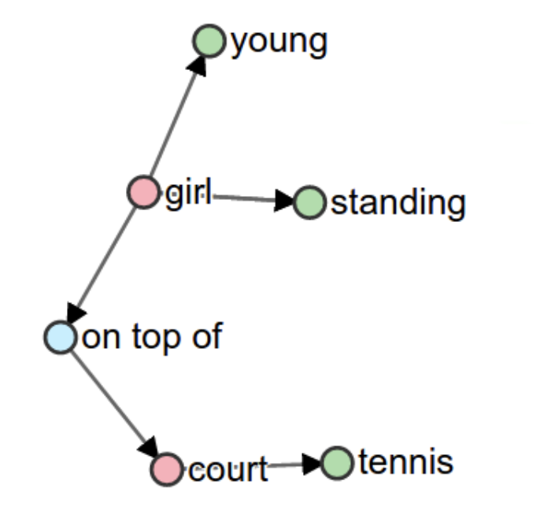
Experimental Setup
Text decoder: trained-from-scratch Transformer (BART-base w/ ~100M params)
Training: AudioCaps + ChatGPT Clotho mix-ups (90K samples) → Clotho train set (4K samples)
Sampling: 50 candidates per audio, w/ top-p = 0.95 and temperature = 0.50
Reranking weights: 0.3 for decoder side & 0.7 for encoder side
Evaluation data: Clotho evaluation set (1K samples)
Evaluation metric: SPIDEr-FL = Fluency * 0.5 * (CIDEr + SPICE)
CIDEr (Vedantam et al., ’14) — n-gram overlap w/ importance (TF-IDF) weighting
SPICE (Anderson et al., ’16) — similarity of semantic graphs (objs, attributes, relations)
Fluency (Zhou et al., ’21) — 0.1 if Sentence-BERT detects disfluency, else 1.0
TF-IDF 2-gram importance
“ cars honking on the street ”
“ cars honking on the street ”
SPICE semantic graph
e.g., repetition
“ cars honking and
cars honk ”
Notes:
Okay, moving on to our experiments,
there are a lot of details, and I just want to highlight the audio encoders we used,
the audio captions dataset, and the metric to evaluate audio captioning performance.
(click)
We experiment with 2 audio encoder models, PANN and BEATs, which were used in the winning submissions of past DCASE AAC challenges.
By the way, we were the first group of researchers to apply BEATs to the AAC task.
And our submission won this year's DCASE challenge a couple of months ago.
(click)
There are two variants for both PANN and BEATs in terms of pretraining tasks.
PANN was either pretrained on MLAC alone, or MLAC+ATCL,
while BEATs was either pretrained on just MALM, or MALM+MLAC.
All four models used here were open-sourced by prior research work,
so programmers or engineers who don't have the resources or expertise to perform pretraining
can also just directly download and use them in their projects or systems.
(click)
The audio captions dataset we used is called Clotho, in which there are 4 thousand training examples,
Each audio is 15~30 seconds long and paired with captions that are 8~20 words long.
(click)
The evaluation metric here is SPIDEr-FL, which is the simple mean of CIDEr and SPICE, multiplied by a fluency score.
(click)
CIDEr focuses on the surface text overlap between the predicted and true captions, and additionally considers the importance of different chunks, or n-grams, in the text.
(click)
Take this sentence "cars honking on the street" as an example,
(click)
the TF-iDF algorithm would tell us that the bi-gram "cars honking" is more important than the bi-gram "on the",
so during CIDEr calculation, the former will be upweighted, and the latter downweighted.
(click)
The SPICE score, on the other hand, computes the similarity of such semantic graphs
constructed from the predicted and true captions.
The nodes and edges of the graph contain objects, object attributes, and relations between objects in the caption.

Slide 9
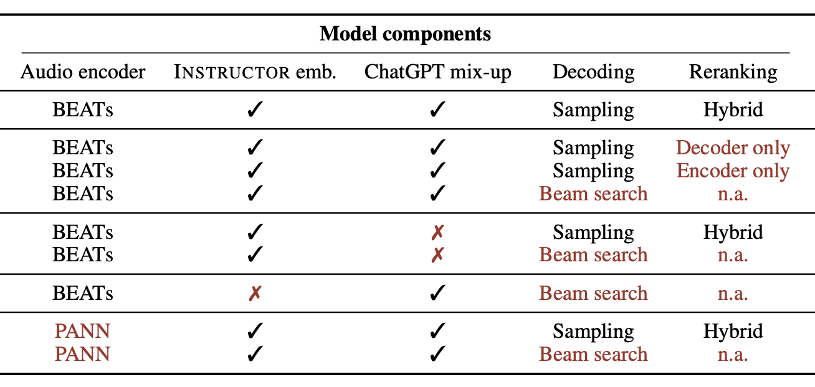
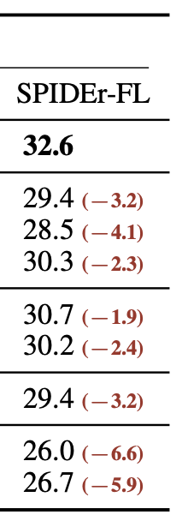
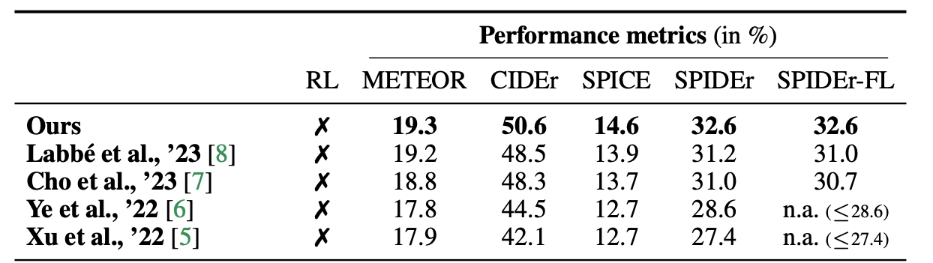
Results
Ablation study – all our proposals are helpful (ablated parts in brown)
We’re the SoTA on Clotho AAC (SPIDEr-FL = 32.6)
SPIDEr-FL
Instructor
(Part IV)
BEATs
BART
+2.3 pt ( 8 %)
(Part III)
ChatGPT
+1.9 pt ( 6 %)
(Part II)
BEATs
Instructor
+3.2 pt (11 %)
(Part I)
BEATs
+6.6 pt (25 %)
👑 Winner @ DCASE 2023
Notes:
(click)
By looking at the SPIDEr-FL scores across 4 settings,
we can see clearly that more pretraining tasks are helpful.
(click)
Specifically, for PANN, adding ATCL on top of MLAC gives a 6% boost,
(click)
While for BEATs, adding MLAC on top of MALM leads to a 10% gain
(click)
However, it's hard to directly compare PANN with BEATs because BEATs is a newer architecture
and outputs much higher-resolution features at 50 per second, while PANN is at 1 feature per second.
So, in the second experiment, we artificially downsample BEATs hidden and found that
(click)
with aggressive enough downsampling, BEATs performs almost equally to PANN.
(click)
Also, due to the architecture and higher resolution, BEATs is more than 2 times slower than PANN,
which is undesirable when we need quick computation and response.

Slide 10
Takeaway & Future Directions
ChatGPT
We built a SoTA audio captioning model
utilized self-supervised pretraining & LLMs extensively
improved audio encoder, audio-text alignment, data aug, & decoding
Ideas to follow-up
Augmentation for audios besides mix-up ?
audio generation models (Liu et al., ’23; Vyas et al., ’23) can produce unlimited data!
Decoder(s)-only framework for better scaling potential than encoder-decoder ?
need a modality bridge (Li et al., ’23; Zhang et al., ’23) between audio & text generative models
Instructor
BEATs
BART
Shih-Lun Wu MS Student @ CMU LTI
e-mail: shihlunw@andrew.cmu.edu
homepage: https://slseanwu.github.io
Scan for
GitHub
code 🧑‍💻
Thank you !
Notes:
Don’t present future ideas if no time (& keep ideas to ourselves, lol)
Ok, time to wrap up my presentation,
(click)
In this paper, we systematically analyzed 3 popular pretraining tasks
for deep audio encoders, namely, MALM, MLAC, and ATCL
(click)
And we studied the effect of individual pretraining tasks on audio captioning performance,
which was made possible by the publicly-available PANN and BEATs audio encoders
(click)
Last but not least,
for time-sensitive applications like autonomous driving,
(click)
we recommend that engineers use a simpler, faster audio encoder
with as much pretraining as possible,
and rely on rigorous testing and validation to make sure the model never fails on safety-critical cases
(click)
This is the end of my talk,
If you're interested, feel free to check out the captions generated by our models.
Thank you so much, and I’m happy to take your questions!

