Slide 1
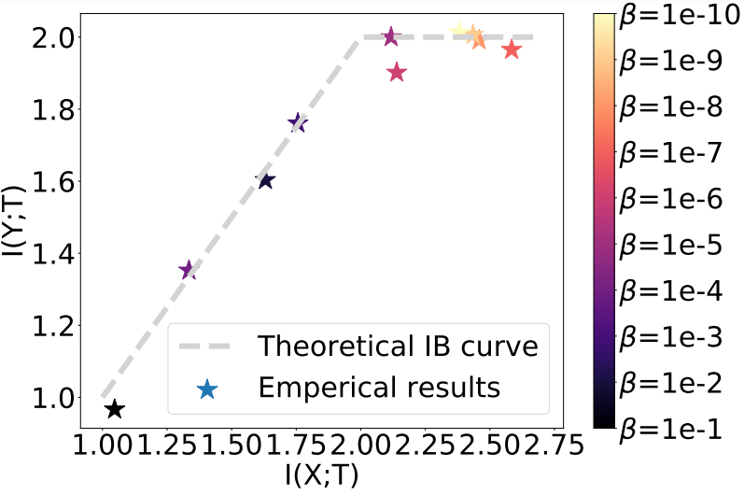
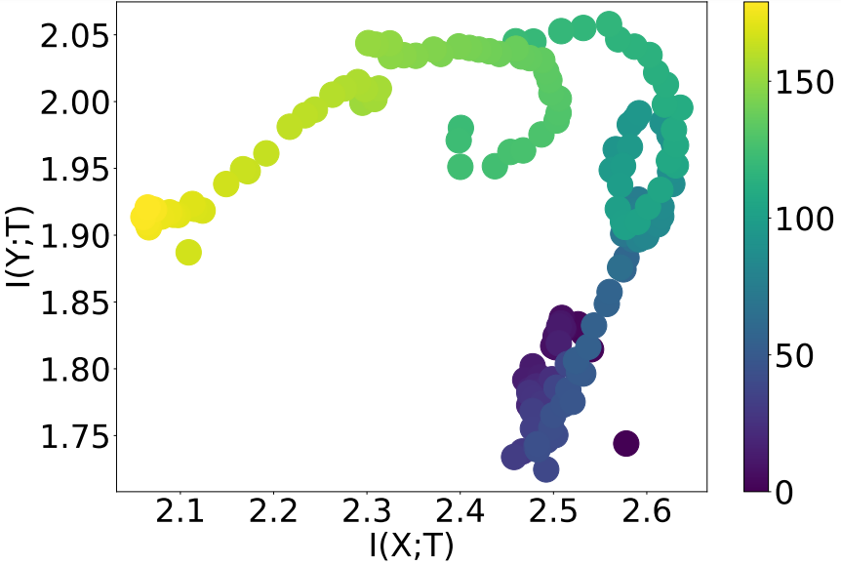
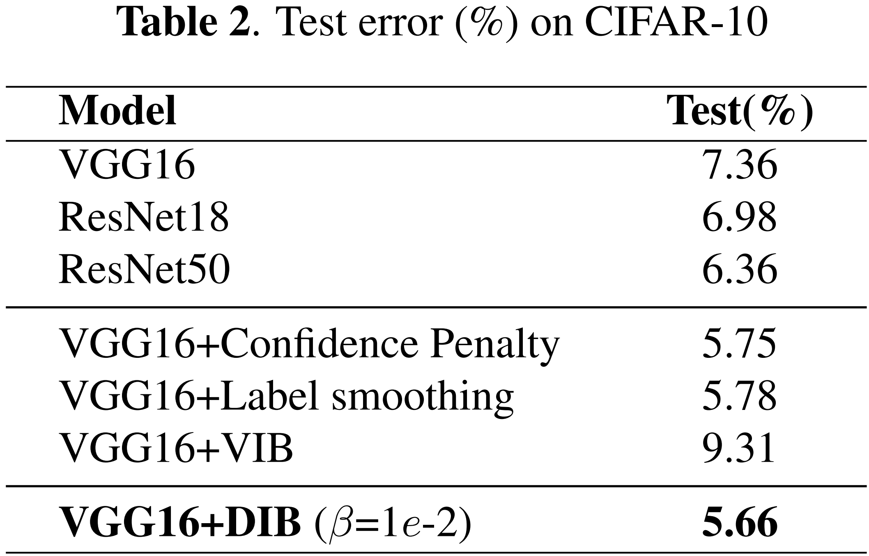
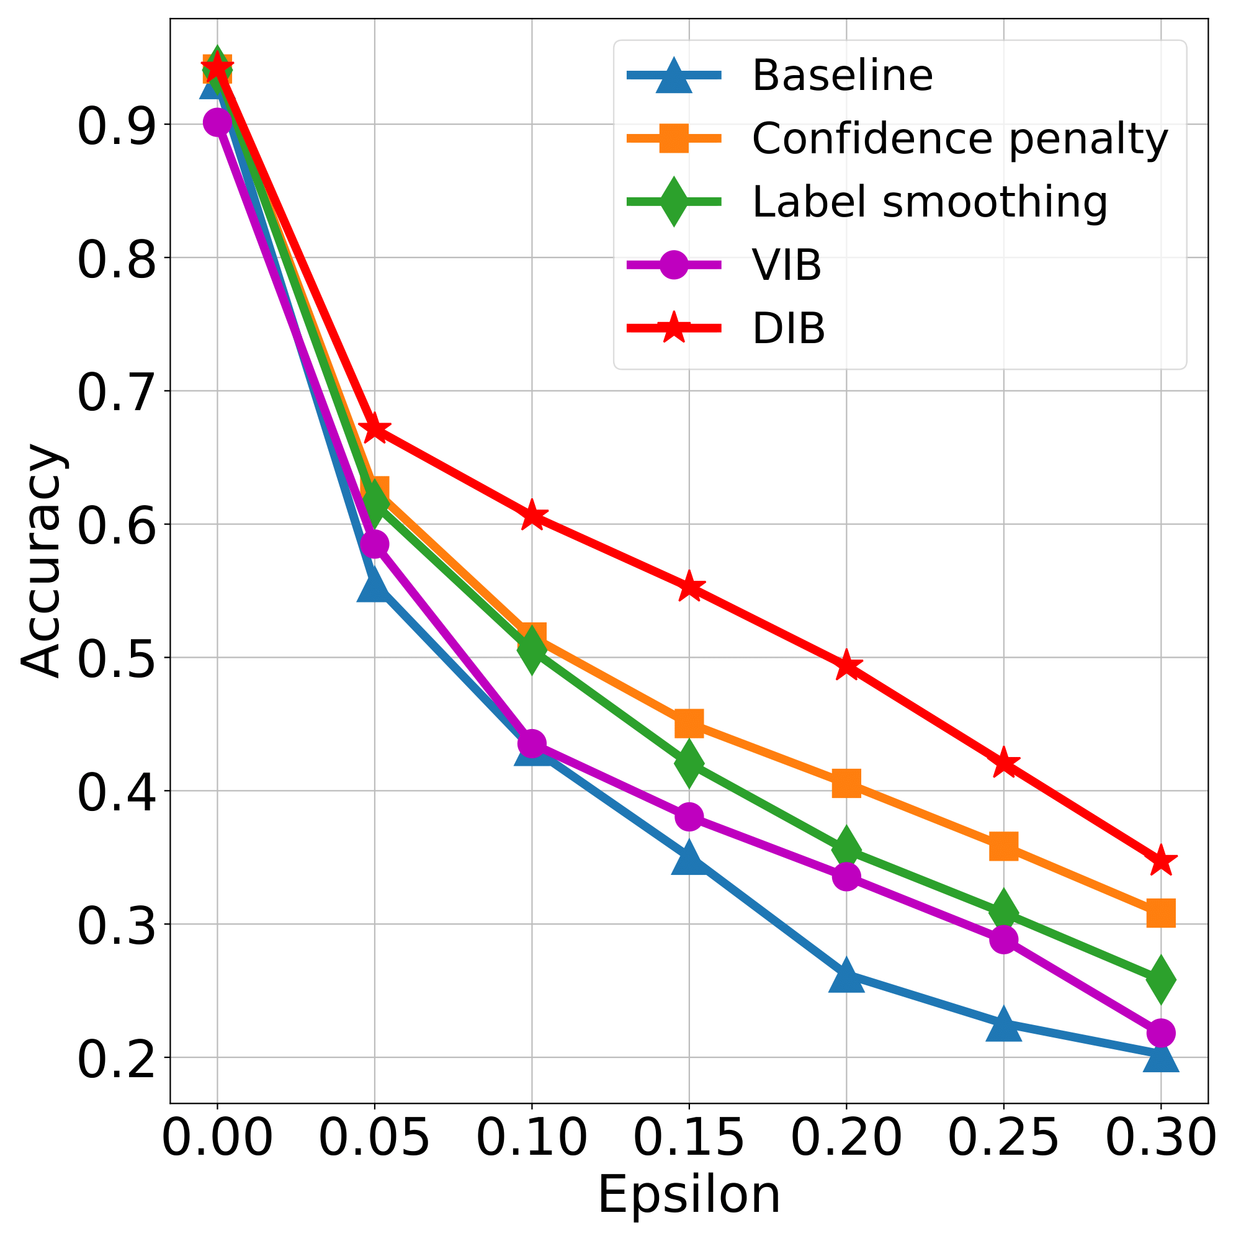
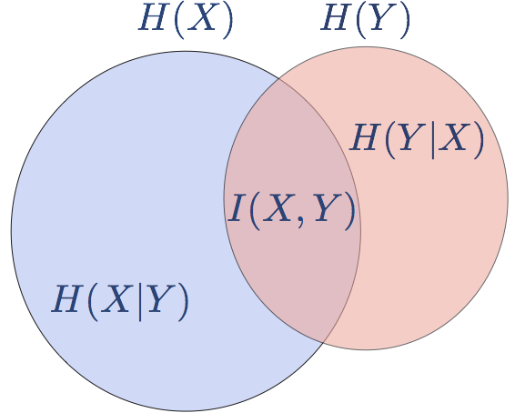
DEEP DETERMINISTIC INFORMATION BOTTLENECK WITH
MATRIX-BASED ENTROPY FUNCTIONAL
Xi Yu¹, Shujian Yu², Jose C. Principe¹
¹University of Florida, ²NEC Labs Europe
Abstract and Background
Experiments and Results
Abstract: We introduce the matrix-based Renyi’s $α$-order entropy functional to parameterize Tishby et al. information bottleneck (IB) principle [1] with a neural network. We term our methodology Deep Deterministic Information Bottleneck (DIB), as it avoids variational inference and distribution assumption. We show that deep neural networks trained with DIB outperform the variational objective counterpart and those that are trained with other forms of regularization, in terms of generalization performance and robustness to adversarial attack.
Background: The IB objective attempts to learn a representation $T$ that maximizes its predictive power to $Y$ subject to some constraints on the amount of information that it carries about $X$ ($I$ denotes mutual information, $β$ is a hyperparameter):
$$\max{ℒ_{IB}=I\left(Y;T\right)−βI(X;T)}$$
Information Plane
Fig. 1. Theoretical and empirical IB curve found by maximizing the IB Lagrangian with different values of $β$.
Fig. 2. Information plane for $β=1e−6$, different colors denote different training epochs. There are obvious “fitting” and “compression” phases.
Deep Deterministic Information Bottleneck
Generalization on CIFAR-10
Robustness to adversarial examples
Challenges: How to estimate mutual information (in high-dimensional space)?
Definition 1 [2]: Given ${\left\{x_{i}\right\}}_{i=1}^{n}∈𝒳$, each $x_{i}$ can be a real-valued scalar or vector, and the Gram matrix $K∈ℝ^{n×n}$ computed as $K_{ij}=κ(x_{i},x_{j})$, a matrix-based analogue to Renyi’s $α$-order entropy can be given by the following functional:
$H_{α}\left(A\right)=\frac{1}{1−α}\log_{2}\left(\operatorname{tr}\left(A^{α}\right)\right)=\frac{1}{1−α}\log_{2}\left(\sum_{i=1}^{n}{{λ_{i}(A)}^{α}}\right)$,
where $α∈(0,1)∪(1,∞)$, $A$ is the normalized version of $K$, i.e., $A=K/tr(K)$, $λ_{i}(A)$denotes the $i$-th eigenvalues of $A$.
Definition 2 [3]: Given $n$ pairs of samples ${\left\{x_{i},y_{i}\right\}}_{i=1}^{n}$, each sample contains two measurements $x∈𝒳$ and $y∈𝒴$ obtained from the same realization. Given positive definite kernels $κ_{1}:𝒳×𝒳↦ℝ$ and $κ_{2}:𝒴×𝒴↦ℝ$, a matrix-based analogue to Renyi’s $α$-order joint-entropy can be defined as:
$H_{α}\left(A,B\right)=H_{α}\left(\frac{A∘B}{\operatorname{tr}\left(A∘B\right)}\right)$,
where $A_{ij}=κ_{1}(x_{i},x_{j})$, $B_{ij}=κ_{2}(y_{i},y_{j})$, and $A∘B$ denotes the Hadamard product between the matrices $A$ and $B$.
Fig. 3. Test accuracy under Fast Gradient Sign Attack (FGSM) [4]: $\hat{x}=x+ε⋅\operatorname{sign}\left(∇_{x}J(θ,x,y)\right)$. Different values of $ε$ are evaluated.
Conclusion and Future work
Conclusion
We applied the matrix-based Renyi’s $α$-order entropy functional to parameterize the IB principle with a deterministic neural network.
We avoid variational approximation and distributional estimation to estimate mutual information.
The resulting deep deterministic IB (DIB) improves model’s generalization and robustness.
Future Work
Integrate the matrix-based Renyi’s $α$-order entropy functional with famed unsupervised representation learning principles, e.g., InfoMax [5].
Extend DIB as a greedy layer-wise training strategy, without error backpropagation.
Matrix-based Renyi’s $α$-order Mutual Information:
$$I_{α}\left(X;Y\right)=H_{α}\left(X\right)+H_{α}\left(Y\right)−H_{α}(X,Y)$$
Fig. 1. Venn Diagram of Mutual Information.
Deterministic Information Bottleneck (DIB) Objective
$$ℒ_{IB}=\max_{θ}{I(T;Y)} − βI(T;X)$$
References and Resources
$\max_{θ}{I(Z;Y)}⟺\min_{θ}{CE(\hat{Y};Y)}$
i.e., maximizing $I(T;Y)$ is equivalent to
minimizing cross-entropy loss
DIB is implemented by a standard cross entropy loss regularized by a mutual information term $I_{α}\left(T;X\right)$ estimated by the matrix-based Renyi’s $α$-order entropy functional.
[1] Tishby, Naftali, Fernando C. Pereira, and William Bialek. "The information bottleneck method.“ In Proc. of the 37-th Annual Allerton Conference on Communication, Control and Computing, pp. 368-377, 2000.
[2] Giraldo, Luis Gonzalo Sanchez, Murali Rao, and Jose C. Principe. "Measures of entropy from data using infinitely divisible kernels." IEEE Transactions on Information Theory 61.1 (2014): 535-548.
[3] Shujian Yu, Luis Gonzalo Sanchez Giraldo, Robert Jenssen, and Jose C. Principe. “Multivariate Extension of Matrix-based Renyi's α-order Entropy Functional.” IEEE Transactions on Pattern Analysis and Machine Intelligence, vol. 22, pp. 2960 - 2966, 2020.
[4] Goodfellow, Ian J., Jonathon Shlens, and Christian Szegedy. "Explaining and harnessing adversarial examples." in International Conference on Learning Representations, 2015.
[5] Hjelm, R. Devon, et al. "Learning deep representations by mutual information estimation and maximization." in International Conference on Learning Representations, 2018.
$$ℒ_{IB}=\min_{θ}{CE(\hat{Y};Y)}+ βI(T;X)$$
GitHub
WeChat

