Slide 1
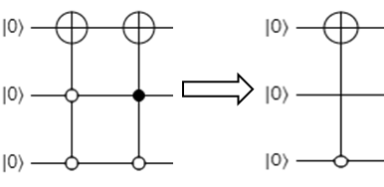
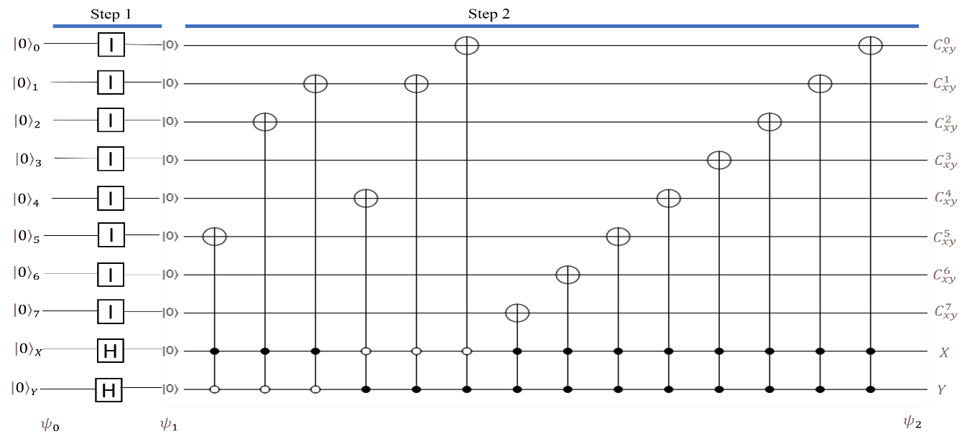
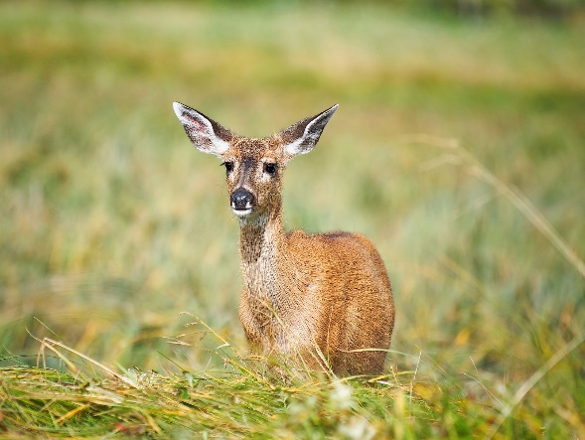
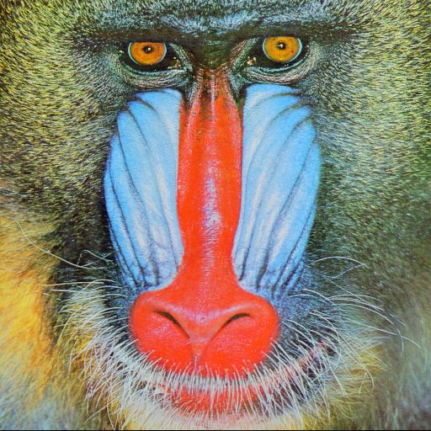
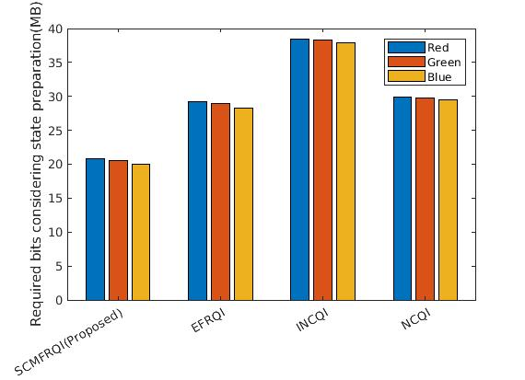
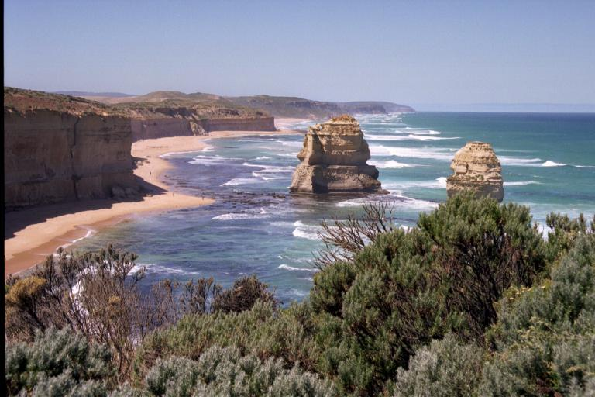
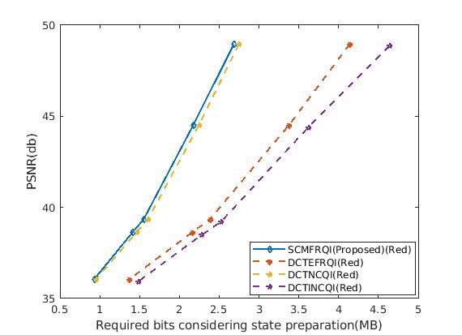
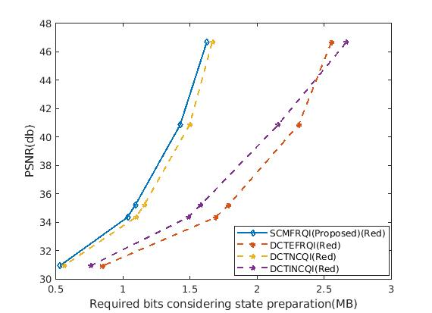
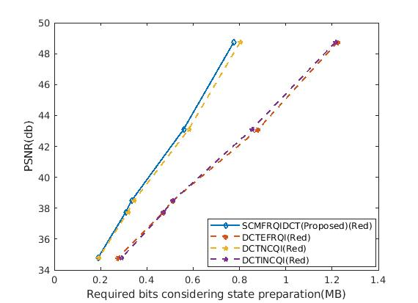
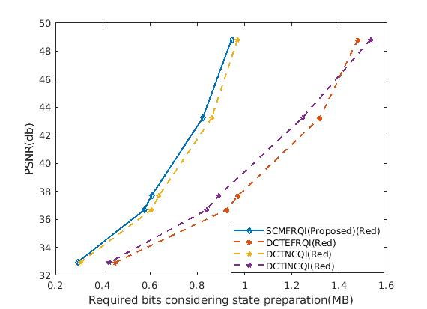
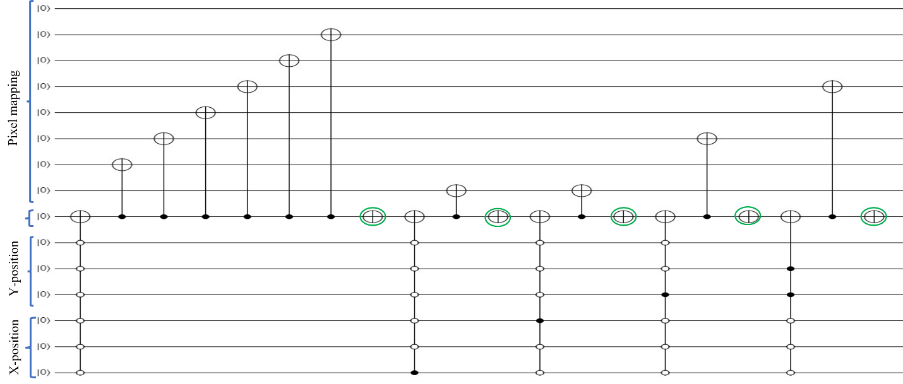
A novel state connection strategy for quantum computing to represent and compress digital images
Md Ershadul Haque¹, Manoranjan Paul¹, Anwaar Ulhaq², Tanmoy Debnath¹
¹ School of Computing and Mathematics, Charles Sturt University, Bathurst, Australia
² School of Computing and Mathematics, Charles Sturt University, Port Macquarie, Australia.
mhaque@csu.edu.au, mpaul@csu.edu.au,aulhaq@csu.edu.au, tdebnath@csu.edu.au
Abstract
Quantum image processing draws a lot of attention due to faster data computation and storage compared to classical data processing systems. Converting classical image data into the quantum domain and state label preparation complexity is still a challenging issue. The existing techniques normally connect the pixel values and the state position directly. Recently, the EFRQI (efficient flexible representation of the quantum image) approach uses an auxiliary qubit that connects the pixel-representing qubits to the state position qubits via Toffoli gates to reduce state connection. Due to the twice use of Toffoli gates for each pixel connection still it requires a significant number of bits to connect each pixel value. In this paper, we propose a new SCMFRQI (state connection modification FRQI) approach for further reducing the required bits by modifying the state connection using a reset gate rather than repeating the use of the same Toffoli gate connection as a reset gate. Moreover, unlike other existing methods, we compress images using block-level for further reduction of required qubits. The experimental results confirm that the proposed method outperforms the existing methods in terms of both image representation and compression points of view.
Literature Review
Every time, it needs to look up table.
Time complexity
$O($2n.q.2^4n).
3. Increase complexity rather than playing compression.
0 (Y=0, X=0), 100 (Y=0, X=1), 200 (Y=1, X=0), 255(Y=1, X=1).
Toffoli gate for state connection preparation
It’s fully quantum
Applicable for 2×2 size image
126 (X=0,Y=0), 1(X=1,Y=0), 1(X=4,Y=0), 4(X=0,Y=1), 16(Y=3,X=0)
Limited to square size image
BEC approach for quantum compression
Quantum image circuit for NEQR preparation for the image NEQR
EFRQI decomposition circuit using Toffoli gate
Experimental Results
Scenery I-result analysis of the direct approach
Required bits of the proposed SCMFRQI scheme using several benchmark images excluding the DCT approach.
Image name | Image size
Deer | 1024×1024
Baboon | 512×512
Scenery | 512×512
Peppers | 512×512
Required Bits (MB) |  |  |  | Image name | Channel
SCMFRQI | NCQI | INCQI | EFRQI
5.09 | 6.63 | 8.72 | 7.19 | Baboons | Red
5.02 | 6.59 | 8.69 | 7.11 |  | Green
4.97 | 6.55 | 8.64 | 7.06 |  | Blue
4.97 | 6.54 | 8.63 | 7.20 | Scenery | Red
4.99 | 6.55 | 8.63 | 7.07 |  | Green
4.93 | 6.50 | 8.57 | 7.00 |  | Blue
5.10 | 6.63 | 8.73 | 7.19 | Peppers | Red
4.76 | 6.32 | 8.35 | 6.79 |  | Green
4.54 | 6.19 | 8.21 | 6.55 |  | Blue
Introduction
Quantum image representation and compression got lots of attention in quantum image computing. Generally, it consists of three steps: 1) pre-processing the classical image using the preparation approach, and this step is known as a preparation step; 2) processing the quantum image using the quantum approach; 3) measuring the outcome using a measurement tool. Storage, faster computation, and computational complexity are the main limitations of classical computers.
Benchmark images from the database
Required bits of the proposed SCMFRQI for deer image without preparation approach
Scenery II-result analysis of the Red channel
(a) Deer
(b) Baboon
(c) Scenery
(d) Peppers
RDC of SCMFRQI against other existing methods via DCT approach for Red channel of Benchmark images.
Scenery III-result analysis of the Green channel
Scenery IV-result analysis of the Blue channel
Contribution & Proposed Method
This paper focuses on minimizing the state preparation bits to represent a real image inside the quantum domain. To achieve these goals, there are the following contributions:
Introducing a novel reset gate rather than using the Toffoli gate twice for each pixel or coefficient connection.
Using the DCT classical preparation approach further compression is taken.
Calculate the required number of bits and its corresponding PSNR in terms of quantum domain.
The proposed approach is able to represent high-resolution images also.
RDC of the proposed SCMFRQI scheme of Green channel via DCT and quantization approaches
RDC of the proposed SCMFRQI scheme of Blue channel via DCT and quantization approaches
PSNR (db) | Required bits (MB) |  |  |  | Image name
 | SCMFRQI | NCQI | INCQI | EFRQI
48.99 | 2.59 | 2.65 | 4.51 | 4.11 | Deer
39.29 | 1.56 | 1.62 | 2.55 | 2.41
47.06 | 1.62 | 2.10 | 1.66 | 2.65 | Baboon
35.23 | 1.10 | 1.49 | 1.59 | 1.80
48.99 | 0.94 | 1.22 | 1.52 | 1.54 | Scenery
37.75 | 0.60 | 0.79 | 0.88 | 1.01
49.54 | 0.77 | 1.00 | 1.21 | 1.27 | Peppers
38.67 | 0.34 | 0.44 | 0.52 | 0.57
PSNR(db) | Required bits (MB) |  |  |  | Image name
 | SCMFRQI | NCQI | INCQI | EFRQI
49.00 | 2.66 | 3.42 | 4.29 | 4.35 | Deer
46.53 | 1.63 | 2.12 | 2.68 | 2.67 | Baboon
48.49 | 0.94 | 1.22 | 1.53 | 1.55 | Scenery
48.68 | 0.77 | 1.02 | 1.20 | 1.29 | Peppers
Conclusions
In this work, a novel SCMEFRQI approach has been proposed for representation and compression purposes which is the latest and best existing model for state connection preparation. It stores and compresses all pixels’ color image information or transfer coefficient values. Unlike the traditional image representation, the quantum representation requires pixel positions i.e., state preparation to be encoded together with pixel intensities. Thus, any quantum representation including the existing and proposed methods requires huge bits for the higher-resolution images. Although we have used a block-based strategy to minimize the impact of the larger-resolution image.
Reset gate
The proposed SCMFRQI circuit diagram for pixel values representation where a reset gate (marked as green)
DCT as a preparation approach
www.csu.edu.au

