Slide 1
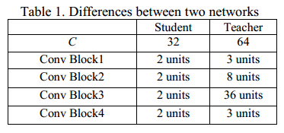
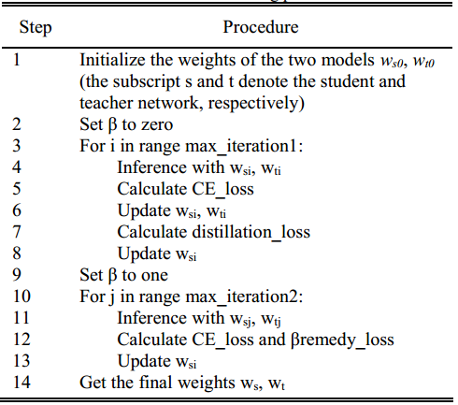
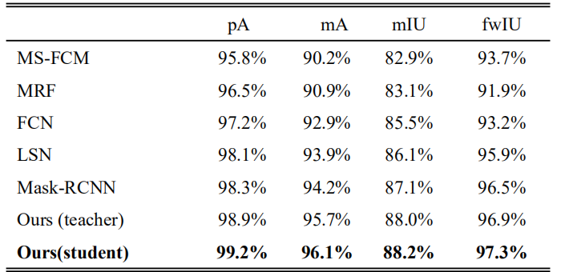
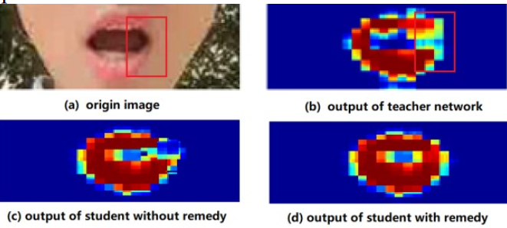
LIP IMAGE SEGMENTATION IN MOBILE DEVICES BASED ON ALTERNATIVE KNOWLEDGE DISTILLATION
Cheng Guan, Shilin Wang, Gongshen Liu and Alan Wee-Chung Liew
School of IEEE, Shanghai Jiaotong University, School of ICT, Griffith University
Introduction
Detailed Training process
Lip image segmentation, as the first step in many lip-related tasks (e.g. automatic lipreading), is of vital significance for the subsequent procedures. Nowadays, mobile applications become more and more popular. In this paper, a new approach is proposed, which is able to segment the lip region in natural scenes and is of acceptable computational complexity to be implemented in mobile devices.
Loss Function Design
Contributions
To successfully transfer useful knowledge in lip image from the teacher network to the student network, a proposed loss function taking both the ground truth information and the guidance information from the teacher network into consideration is proposed.The first term is the loss for against the ground truth. The second term is the distillation loss. The last term in our loss funciton is the referred to as the remedy loss, which aims to solve the imperfection problem of the teacher network.
Facing the increasing demands of mobile applications, a teacher (full) network and a student (compact) network with the same network structure have been adopted and a new learning scheme is proposed to equip the compact network with high segmentation performance, which well suits the requirements of mobile applications.The maincontributions of our work are three folds:
i) A new network compression scheme is proposed for lip segmentation;
ii) A remedy strategy is proposed to avoid the segmentation errors in the teacher network;
iii) An alternative knowledge distillation approach is designed to improve the segmentation performance of the student network
Comparison and Conclusion
Effectiveness of Remedy Loss
Network Structure
Experiments on the lip images in the wild have shown the effectiveness of the proposed network. Compared with some state-of-the art approaches, our compact network achieves the best performance.
The whole architecture can produce a pixel-wise result and it is also a light and flexible network. The differences between the teacher and student networks are summarized in Table 1.

