Slide 1
Weighted Speech Distortion Losses for Neural-network-based Real-time Speech Enhancement
Yangyang Raymond Xia, Sebastian Braun, Chandan K. A. Reddy, Harishchandra Dubey, Ross Cutler, Ivan Tashev

Slide 2
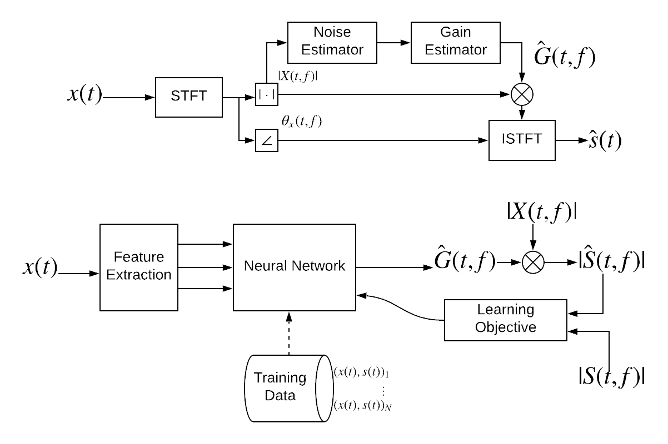
Single-channel Real-time Speech Enhancement
Classical
Assumptions
Additive noise
Noise attributes change slower than speech (classical only)
Goal​s
Suppress noise​ and retain speech​ without look-ahead
Improve human or/and machine perception
Our goal: enhancing speech quality for human listeners in real time
Deep-learning-based

Slide 3
SP vs. DL for Online Enhancement
Name | Method related to Online Processing | Data-driven? | Online? | Approximate Complexity (space & time)
Decision-directed [Ephraim1984] | Estimate SNRs by smoothing instantaneous SNR | No | Yes | Negligible
LSTM [Weninger2015] | Recurrent units output one frame from one input frame | Yes | Yes | Medium
Deep clustering [Hershey2016] | Each feature embedding is generated from a 100-frame spectrogram | Yes | No | High
Fully convolutional [Park2017] | Use fixed number (7) of past frames as input | Yes | Yes | High
SEGAN [Pascual2017] | Generate enhanced speech from a waveform segment (1 second) | Yes | Maybe | High
CNN+LSTM [Tan2018] | Use fixed number (10) of past frames as input | Yes | Yes | High
Audio-visual speech separation [Ephrat2018] | 2-D convolution cross time and frequency of a spectrogram | Yes | No | High
RNNoise [Valin2018] | Recurrent units output one frame from one input frame | Yes | Yes | Low
Consistency-constrained network [Wisdom2019] | Causal convolution and unidirectional LSTM [Wilson2018] | Yes | Yes | High
Notes:
Will check again and fill in blanks

Slide 4
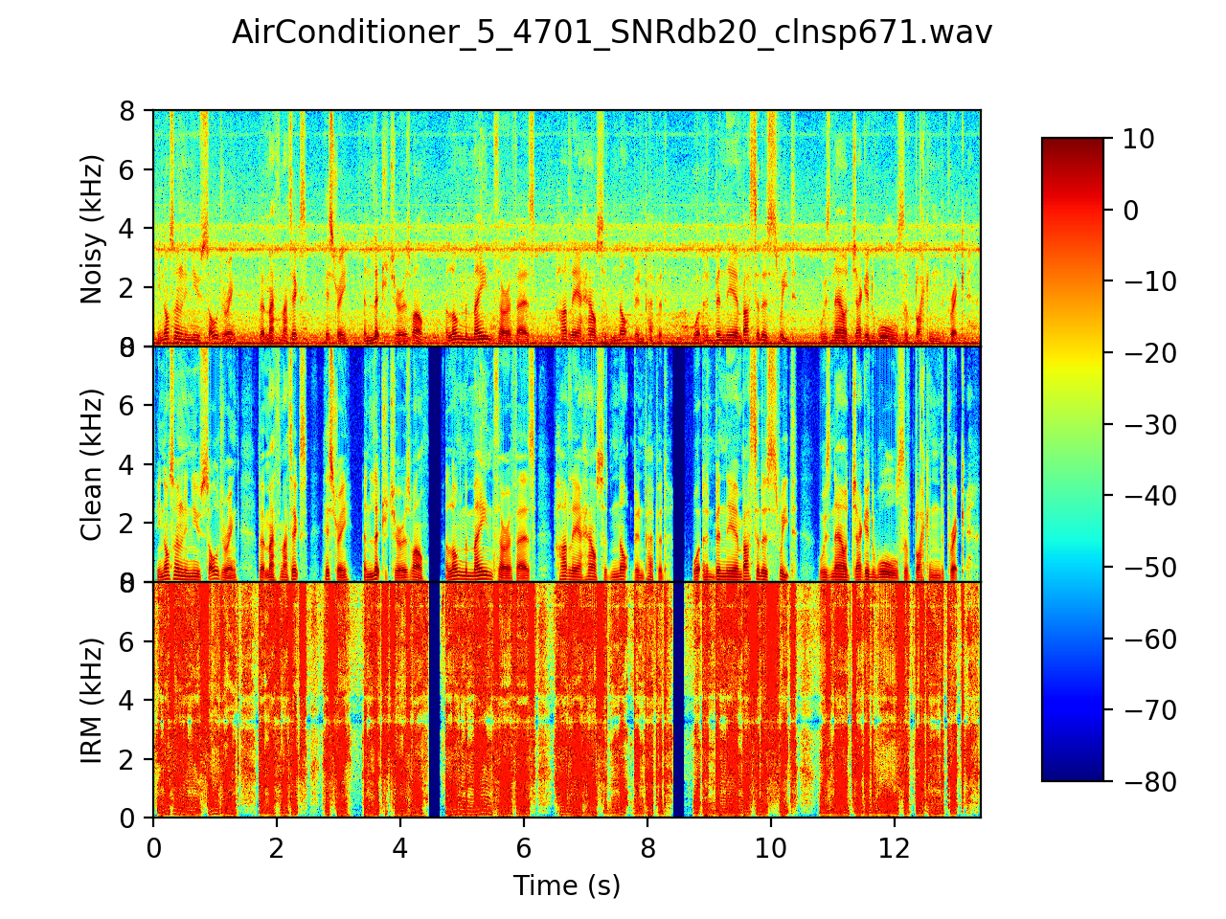
Method: Input (Feature) & Output (Target)
(In) Short-time Fourier transform magnitude (STFTM)
(In) Short-time log power spectra (LPS) with -80 dB floor
(Out) Real magnitude gain function in [0, 1]
Normalization
Global mean & variance
Frequency-dependent or frequency-independent online mean & variance
3-second exponential smoothing

Slide 5
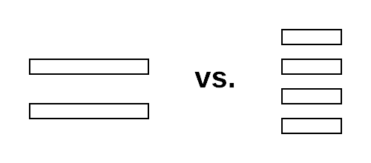
Method: Proposed Learning Framework
Network: stacked gated recurrent unit (GRU) [Bahdanau2014]
Training: Variable-length training for backpropagation-through-time [Werbos1990]
We want to compare a small batch of long sequences to a large batch of short sequences, given the same amount of information per batch.
Objective: weighted speech distortion and residual noise error
The speech vs. noise error trade-off
Our goal: separate speech distortion error from residual noise error
Speech distortion error in speech-active (SA) frames
Residual noise error everywhere
Similar to the component loss approach [Xu2019]
No context!

Slide 6
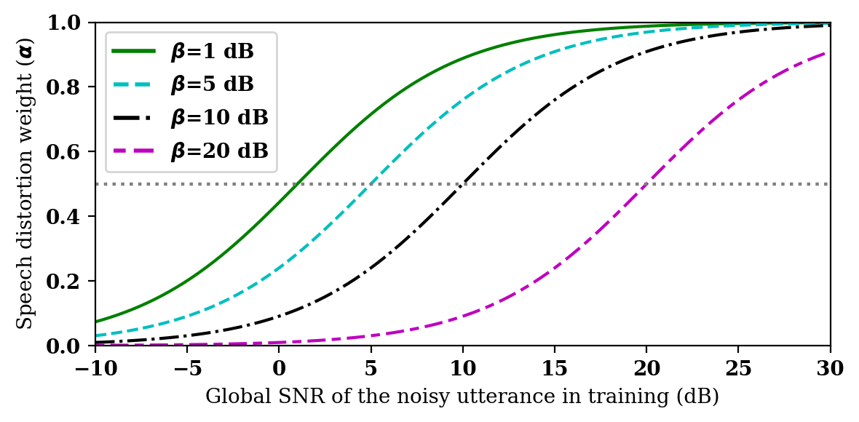
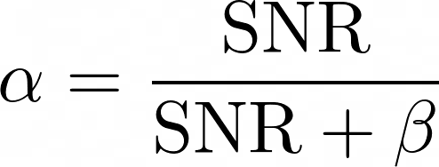
Weighting of Objectives
Fixed weighting (0 < alpha < 1, determined empirically)
SNR weighting (of each training instance)

Slide 7
System Overview

Slide 8
Data
The Microsoft Scalable Noisy Speech Dataset (https://github.com/microsoft/MS-SNSD)
84 hours of training data
Speech: Edinburgh 56 Speakers Corpus
Noise: 14 noise types from DEMAND Database and Freesound
Air Conditioner, airport announcements, appliances, car noise, copy machine, door shutting, eating, multi-talker babble, neighbor speaking, squeaky chair, traffic, road, typing, vacuum cleaner.
During training, each noisy speech segment is formed by randomly sampling a speech and noise segment, respectively, and remix.
18 hours of test data in 5500 clips
Speech: Graz University 20 Speakers Corpus
Noise: 9 challenging classes from DEMAND and Freesound
Air conditioner, airport announcements, babble, copy machine, munching, neighbor, shutting door, typing, vacuum cleaner.
All clips are unseen in training
SNR: {40, 30, 20, 10, 0} dB
All clips sampled at 16 kHz

Slide 9
Evaluation Metrics
Classical speech quality/intelligibility measures
Scale-invariant signal-to-distortion ratio (SI-SDR) [LeRoux2019]
Cepstral distance (CD) [Hu2008]
Short-time objective intelligibility (STOI) [Taal2010]
Perceptual evaluation of speech quality (PESQ) [Rix2001]
Subjective mean opinion score (MOS)
Each clip is rated by 20 crowd-sourced listeners
Discrete rating from 1 (very poor quality) to 5 (excellent quality)
Microsoft’s open-source framework (https://github.com/microsoft/MS-SNSD) [Reddy2019]

Slide 10
Systems to be Compared
Noisy
MSR’s statistical-based [Tashev2009]
Proposed
Log spectra with FD online normalization; Twelve 5-second segments/batch; various objectives
Improved RNNoise [Valin2018, Reddy2019]
Online enhancement of 22-dimensional energy envelope with 42-dimensional features [Valin2018]
Adapted to 16-KHz and improved by [Reddy2019]
RNNoise257
Linear frequency band (257) enhancement; same network architecture as RNNoise
Oracle information + Wiener filter rule

Slide 11
Results: “Best” from each Category
Name | # Trainable Parameters | SI-SDR (dB) | CD | STOI (%) | PESQ (MOS)
Noisy | 0 | 9.81 | 4.56 | 88.0 | 2.22
Statistical-based | 0 | 6.10 | 4.64 | 84.7 | 2.33
Improved RNNoise | 61.2 K | 10.4 | 3.83 | 88.0 | 2.55
RNNoise257 | 2.64 M | 13.0 | 3.88 | 89.3 | 2.56
Proposed (Fixed wt.; a = 0.35) | 1.26 M | 14.3 | 3.83 | 90.7 | 2.65
Oracle Wiener | Oracle | 20.5 | 2.13 | 98.1 | 3.82
Babble @20dB
Enhanced 1-second audio in 39.6 milliseconds on a single CPU
Intel(R) Xeon(R) CPU E5-2690 v4 @ 2.60GHz, Python 3.6.8

Slide 12
Results: Optimal Objective Weighting
Air conditioner noise @ 20dB

Slide 13
Results: Subjective Evaluation
Air conditioner noise @ 20dB
Method | MOS (mean +- std.)
Noisy | 2.63 +- 0.03
Improved RNNoise | 3.26 +- 0.03
Proposed (a = 0.05) | 3.93 +- 0.03
Proposed (a = 0.1) | 3.92 +- 0.03
Proposed (a = 0.2) | 3.74 +- 0.03
Proposed (a = 0.3) | 3.65 +- 0.03

Slide 14
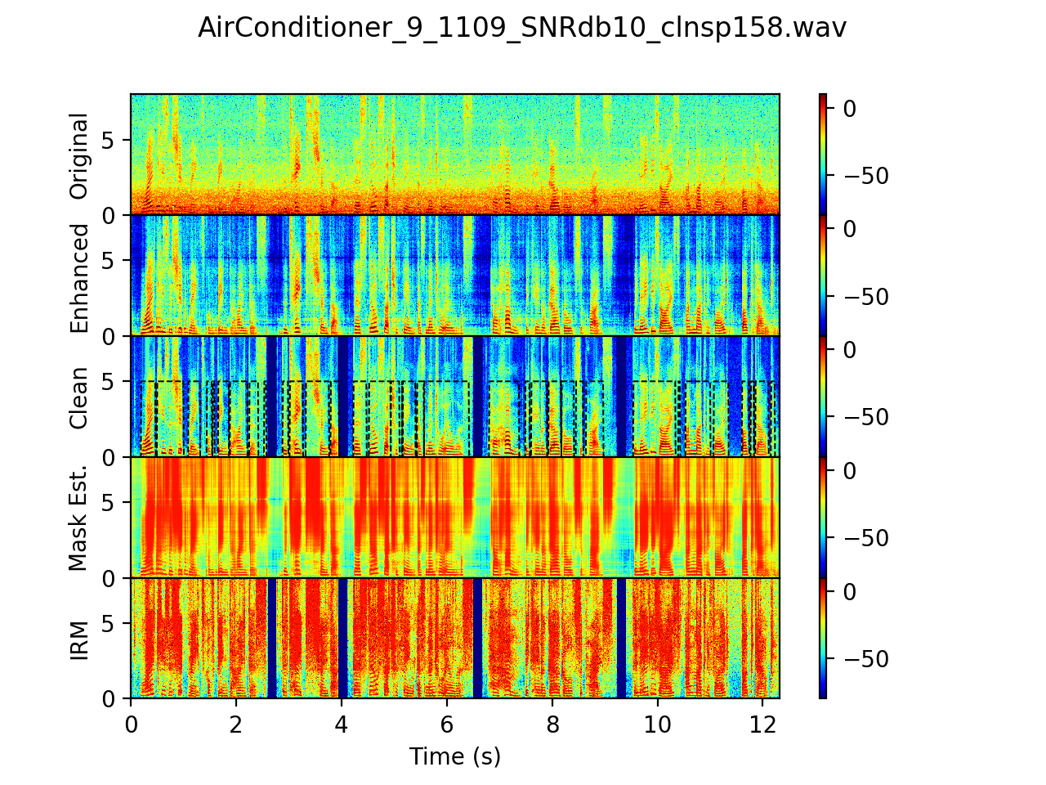
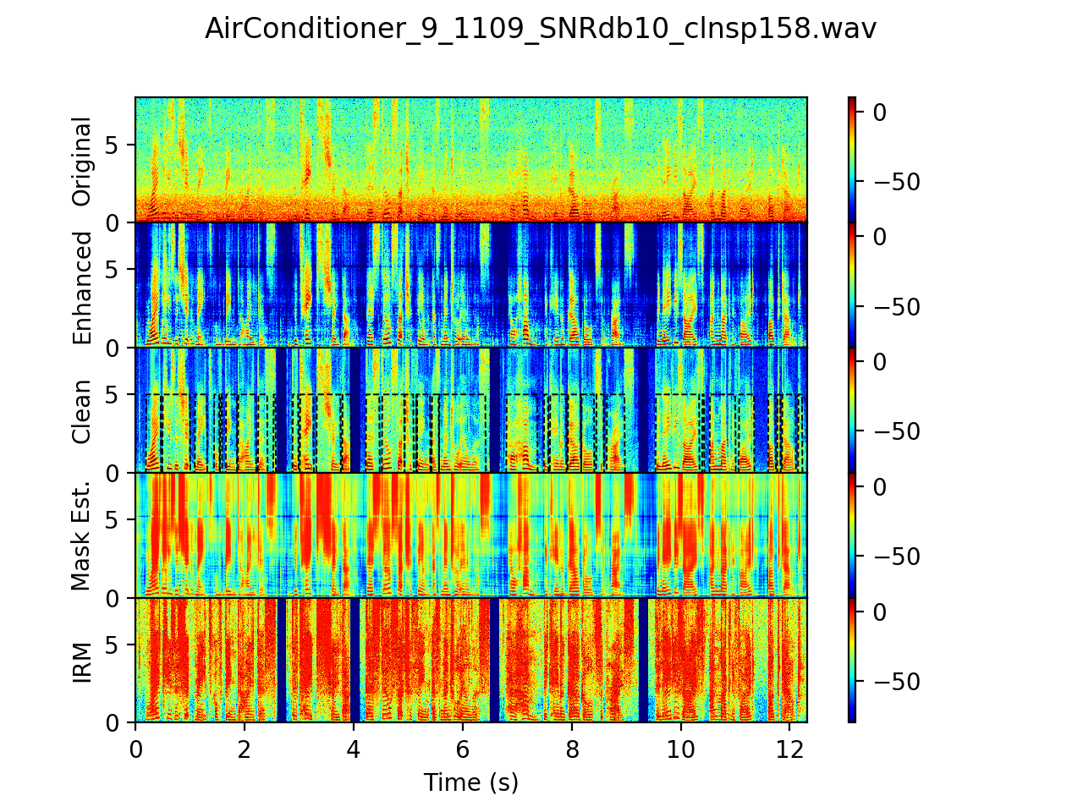
Loss functions influence frequency selectivity
MSE
Proposed

Slide 15
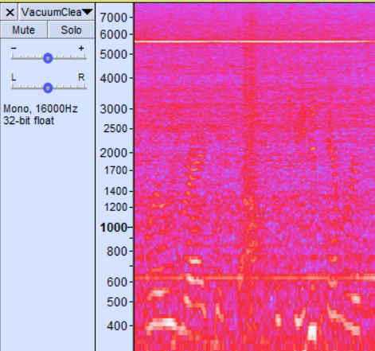
Effect of Sequence Length
GRUs are able to learn extremely long temporal patterns, potentially “memorizing” and removing transient noise.
5-second waveform = 625 frames of 257-point spectra
Overfitting becomes an issue…
NN learned to always strongly suppress ~6 kHz
Sec./seg. | Seg./batch | SI-SDR (dB) | CD | STOI (%) | PESQ (MOS)
1 | 60 | 13.7 | 3.78 | 90.1 | 2.58
2 | 30 | 13.7 | 3.80 | 90.3 | 2.57
5 | 12 | 14.1 | 3.72 | 90.5 | 2.59
10 | 6 | 14.1 | 3.73 | 90.7 | 2.64
20 | 3 | 14.0 | 3.73 | 90.6 | 2.64
~6KHz-tone

Slide 16
Conclusions
We proposed two novel loss functions for DNN-based online speech enhancement.
We studied the impact of multiple factors on speech quality.
Feature normalization, sequence length, weighting of the objectives
We compared multiple competitive SP and DL-based online systems.
Future work
Analysis of speech quality improvement by SNR
Frequency-dependent SNR weighting in the objective function
Explore speech synthesis models for low-SNR conditions
Filtering the noisy signal can only go so far!

Slide 17
References (1)
Park, S. R., & Lee, J. W. (2017). A Fully Convolutional Neural Network for Speech Enhancement. Proc. Interspeech 2017, 1993-1997.
Ephraim, Yariv, and David Malah. "Speech enhancement using a minimum-mean square error short-time spectral amplitude estimator." IEEE Transactions on acoustics, speech, and signal processing 32.6 (1984): 1109-1121.
Valin, Jean-Marc. "A hybrid DSP/deep learning approach to real-time full-band speech enhancement." 2018 IEEE 20th International Workshop on Multimedia Signal Processing (MMSP). IEEE, 2018.
Taal, Cees H., et al. "A short-time objective intelligibility measure for time-frequency weighted noisy speech." 2010 IEEE International Conference on Acoustics, Speech and Signal Processing. IEEE, 2010.
Rix, Antony W., et al. "Perceptual evaluation of speech quality (PESQ)-a new method for speech quality assessment of telephone networks and codecs." 2001 IEEE International Conference on Acoustics, Speech, and Signal Processing. Proceedings (Cat. No. 01CH37221). Vol. 2. IEEE, 2001.
Le Roux, Jonathan, et al. "SDR–half-baked or well done?." ICASSP 2019-2019 IEEE International Conference on Acoustics, Speech and Signal Processing (ICASSP). IEEE, 2019.
Bahdanau, Dzmitry, Kyunghyun Cho, and Yoshua Bengio. "Neural machine translation by jointly learning to align and translate." arXiv preprint arXiv:1409.0473 (2014).
Tan, K., & Wang, D. (2018, September). A Convolutional Recurrent Neural Network for Real-Time Speech Enhancement. In Interspeech (Vol. 2018, pp. 3229-3233).
Wisdom, S., Hershey, J. R., Wilson, K., Thorpe, J., Chinen, M., Patton, B., & Saurous, R. A. (2019, May). Differentiable consistency constraints for improved deep speech enhancement. In ICASSP 2019-2019 IEEE International Conference on Acoustics, Speech and Signal Processing (ICASSP) (pp. 900-904). IEEE.

Slide 18
References (2)
Y Hu, PC Loizou, Evaluation of objective quality measures for speech enhancement. IEEE Trans. Audio, Speech, Lang. Process. 16(1), 229–238 (2008)
Pascual, Santiago, Antonio Bonafonte, and Joan Serra. "SEGAN: Speech enhancement generative adversarial network." arXiv preprint arXiv:1703.09452 (2017).
Ephrat, Ariel, et al. "Looking to listen at the cocktail party: A speaker-independent audio-visual model for speech separation." arXiv preprint arXiv:1804.03619 (2018).
Hershey, John R., et al. "Deep clustering: Discriminative embeddings for segmentation and separation." 2016 IEEE International Conference on Acoustics, Speech and Signal Processing (ICASSP). IEEE, 2016.
Werbos, Paul J. "Backpropagation through time: what it does and how to do it." Proceedings of the IEEE 78.10 (1990): 1550-1560.
Xu, Z., Elshamy, S., Zhao, Z., & Fingscheidt, T. (2019). Components Loss for Neural Networks in Mask-Based Speech Enhancement. arXiv preprint arXiv:1908.05087.
C. K. Reddy, E. Beyrami, J. Pool, R. Cutler, S. Srinivasan, and J. Gehrke, “A Scalable Noisy Speech Dataset and Online Subjective Test Framework,” in ISCA INTERSPEECH 2019, 2019, pp. 1816–1820.
I. J. Tashev, Sound capture and processing: practical approaches, John Wiley & Sons, 2009.
Weninger, F., Erdogan, H., Watanabe, S., Vincent, E., Le Roux, J., Hershey, J. R., & Schuller, B. (2015, August). Speech enhancement with LSTM recurrent neural networks and its application to noise-robust ASR. In International Conference on Latent Variable Analysis and Signal Separation (pp. 91-99). Springer, Cham.
K. Wilson, M. Chinen, J. Thorpe, B. Patton, J. Hershey, R. A. Saurous, J. Skoglund, and R. F. Lyon, “Exploring trade-offs in models for low-latency speech enhancement,” inProc.IWAENC, Sep. 2018.

Slide 19
Thank you!

