Slide 1
EXPLOITATION OF OPEN SOURCE DATASETS AND DEEP LEARNING MODELS FOR THE DETECTION OF OBJECTS IN URBAN AREAS
Elpida Gkouvra, Thodoris Betsas, Maria Pateraki
School of Rural, Surveying and Geoinformatics Engineering
National Technical University of Athens, Greece
IEEE ICIP 2024 - Workshop 5: 2nd Workshop on 3D Computer Vision and Photogrammetry (3DCVP)

Slide 2
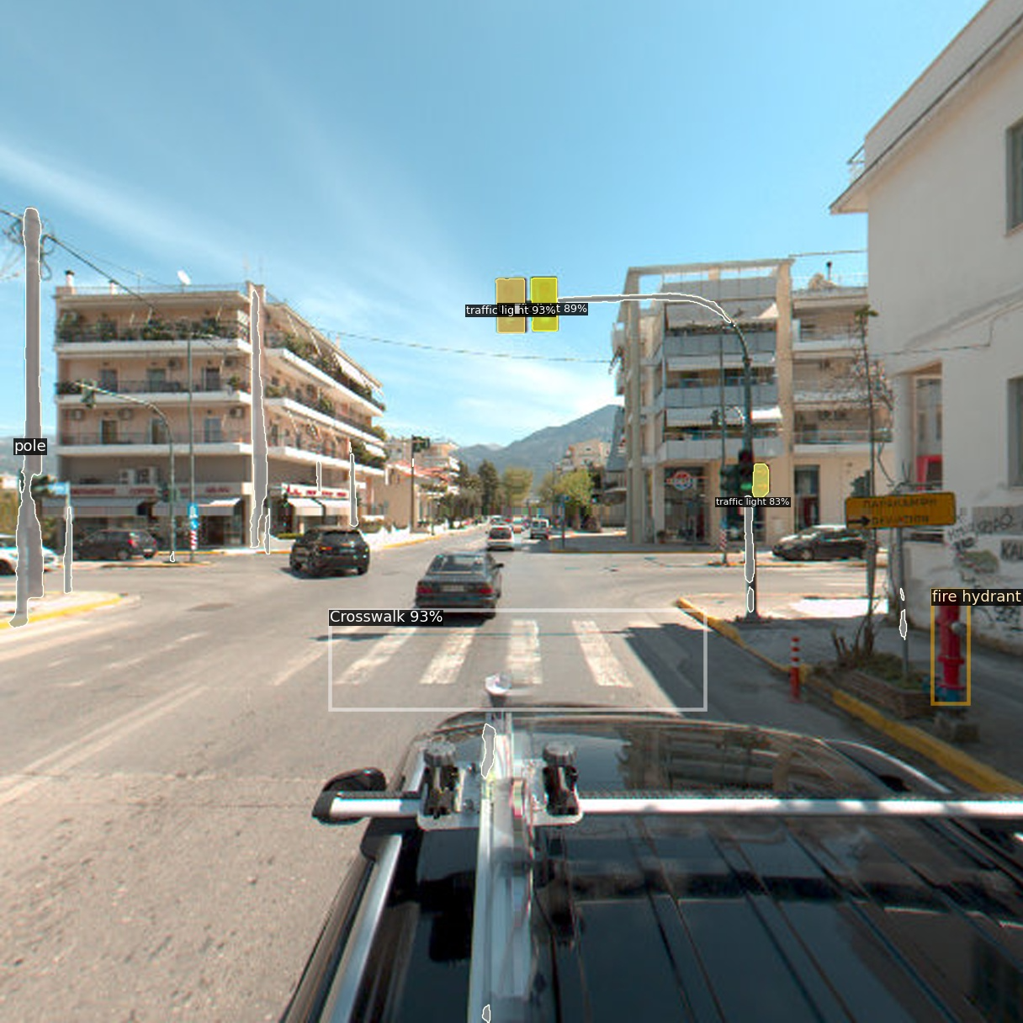
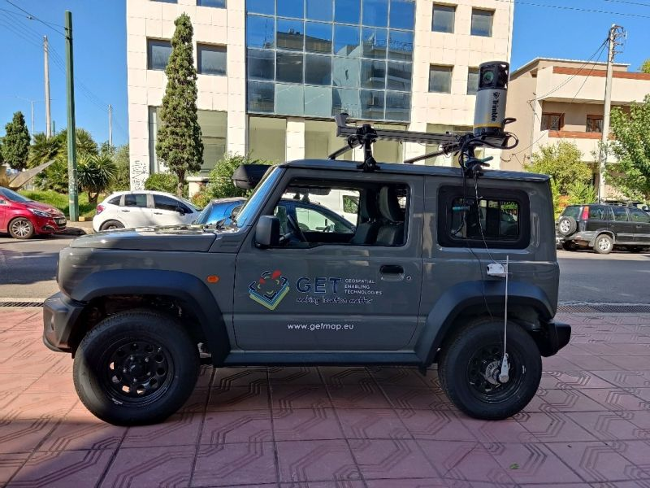
Motivation
What :
Detect objects (such as benches, traffic signs, traffic lights etc.) on images captured in an urban area by a mobile mapping system integrating a multi-camera Ladybug 5+
Why :
Automate the process of creating and updating maps for urban planning, road maintenance or navigation of autonomous vehicles
How :
Exploit open-source datasets and pre-trained deep learning models
Deep Learning in Mobile Mapping & Autonomous Driving
The Mobile Mapping System (MMS)¹ integrating the multi-camera Ladybug 5+ ²
¹https://www.getmap.eu
²https://www.flir.com/products/ladybug5plus/

Slide 3
Objectives
Assess inference with image data from a different context and sensor to those used in training
Utilize various open-source datasets and deep learning models to assess the detection of objects met in urban scenes.
Identify potential limitations in using pre-trained models and available open-source datasets to automate the process of map updating
Offer a cost-effectiveness solution for various applications such as city mapping, autonomous driving, and road maintenance

Slide 4
Methodology
Exploit open-source datasets & pre-trained models
Fine tune Faster-RCNN training via transfer learning
Multi-model inference on Ladybug 5+ images

Slide 5
Methodology : Obtaining open-source data
Open-source annotated datasets with common urban objects (traffic signs, traffic lights, crosswalks, etc.)
Standard datasets such as COCO ³ and Cityscapes ⁴
3 datasets from Roboflow dataset collection ⁵
Dataset | Method | Useful Classes | # Images
COCO | OD,IS,PS | t.light,fire hydrant,stop, bench | 123K
Cityscapes | PS,SS | pole,t.sign, t.light | 3475
Crosswalk | OD | crosswalk | 4844
Saf. Cones | OD | safety cone | 1529
Traf. Sign | OD | 24 traffic signs | 6301
³ https://cocodataset.org/
⁴https://www.cityscapes-dataset.com/
⁵ https://universe.roboflow.com/

Slide 6
Methodology : Obtaining open-source data
Pre-trained models
3 pre-trained models from Detectron 2 framework ⁶ based on COCO and Cityscapes datasets
Dataset | Model | Method
COCO | Faster-RCNN | OD
COCO | Panoptic-FPN | PS
Cityscapes | Panoptic-DeepLab | PS
⁶ https://ai.meta.com/tools/detectron2/

Slide 7
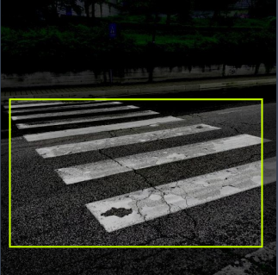
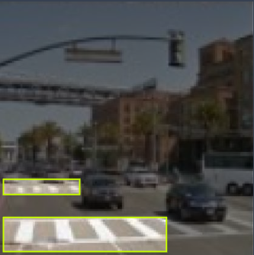
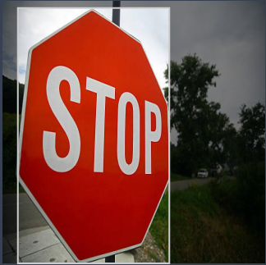
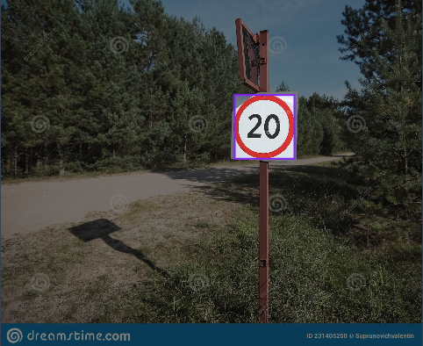
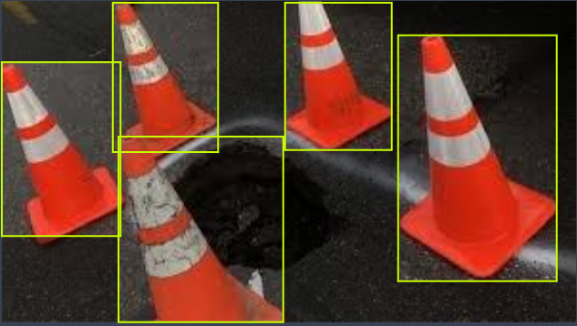
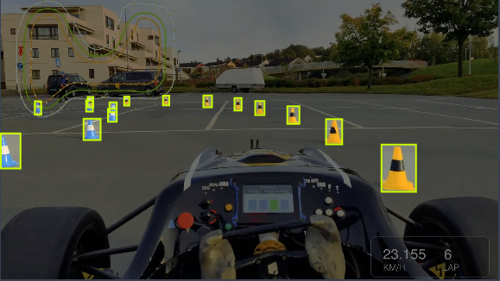
Methodology : Training framework
Exploitation of the Faster-RCNN model with transfer learning techniques for the three Roboflow datasets
Dataset | Training | Validation | Test
Crosswalk | 4293 (82%) | 551 (11%) | 357 (7%)
Saf. Cones | 5960 (92%) | 341 (5%) | 170 (3%)
Traf. Sign | 1194 (70%) | 335 (20%) | 175 (10%)
Training data of the three Roboflow datasets.

Slide 8
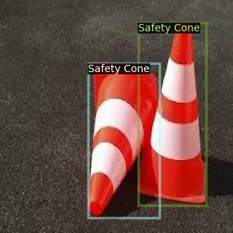
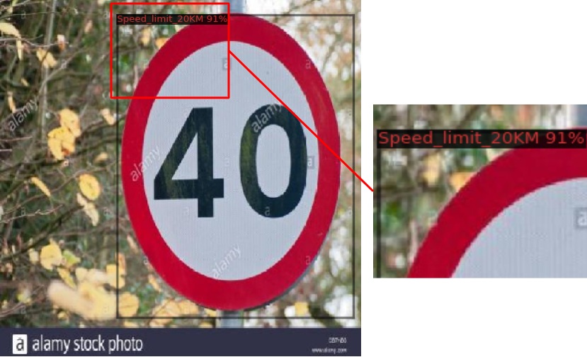
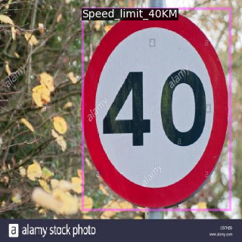
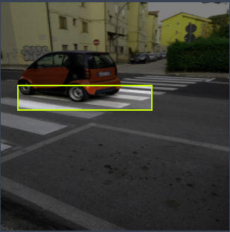
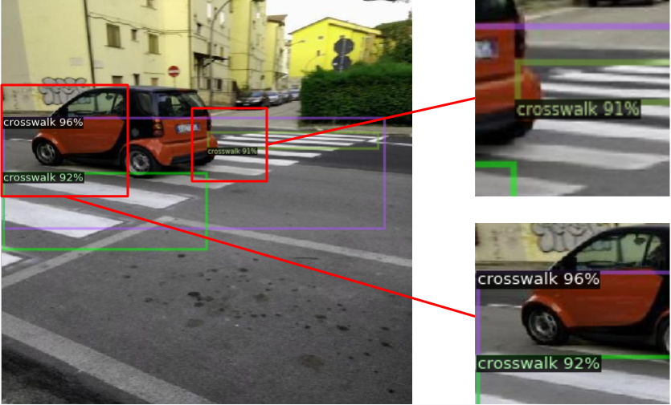
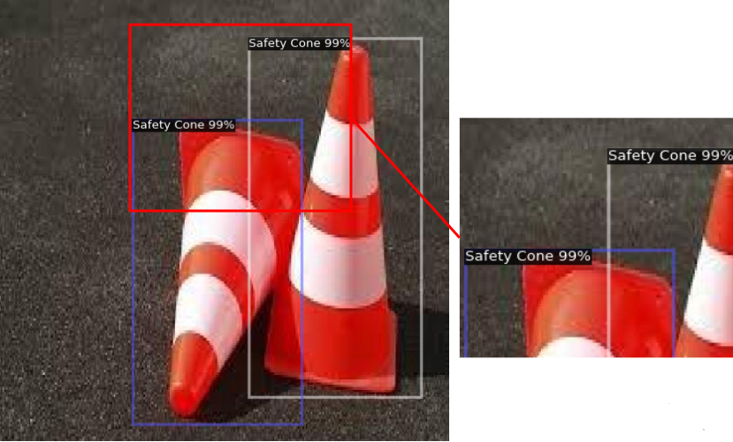
Results : Faster-RCNN training evaluation
Quantitative and qualitative results from the Faster-RCNN training on the three Roboflow datasets
Dataset | Metric | Final Cross Vali- dation Check | Evaluation
Crosswalk | AP | 40.0% | 35.4%
Saf. Cones | AP | 32.4% | 27.4%
Traf. Sign | mAP | 63.9% | 45.9%
Ground truth
Inference result

Slide 9
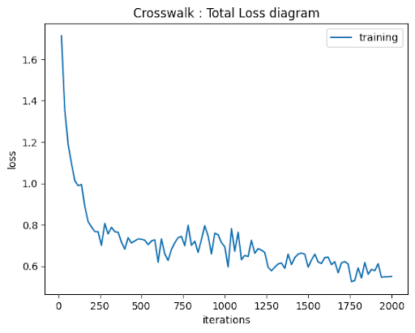
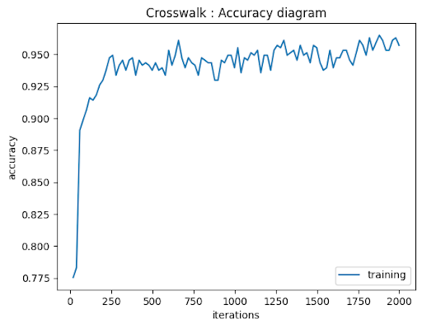
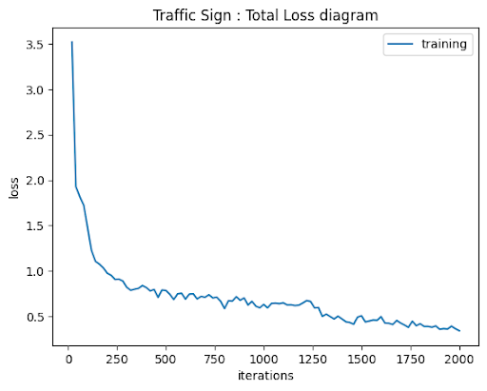
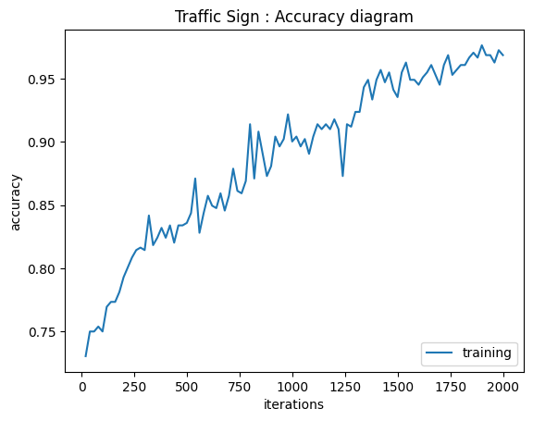
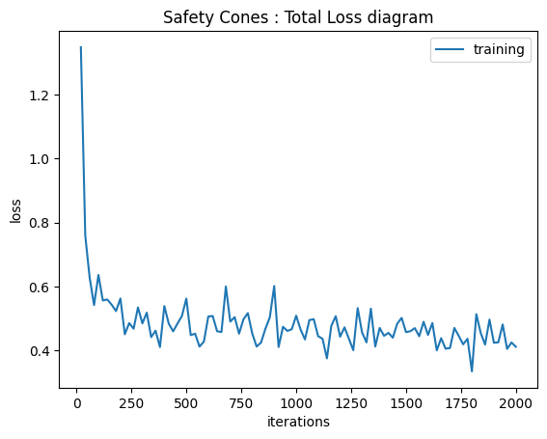
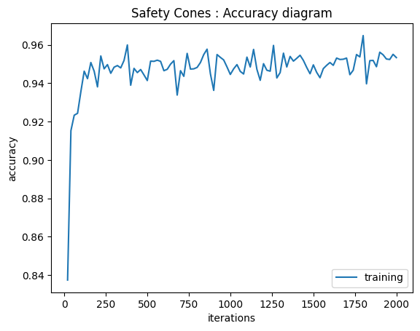
Results : Faster-RCNN training evaluation
Understanding the results by observing the learning curves
The learning curves (total loss over time (left) and classification accuracy over time (right)) of the training on Crosswalk dataset.
The learning curves (total loss over time (left) and classification accuracy over time (right)) of the training on Traffic Sign dataset.
The learning curves (total loss over time (left) and classification accuracy over time (right)) of the training on Safety Cones dataset.

Slide 10
Results : Multi-model inference on Ladybug 5+ images

Slide 11
Conclusions
A set of pre-trained models and open source datasets for detecting common objects in an urban area
Well-trained Faster-RCNN via transfer learning on available open source datasets
Promising inference results with image data from the multi-camera Ladybug 5+
Enable to convert image coordinates to spatial coordinates by incorporating additional sensor measurements (IMU, GNSS receiver, etc.)
A potentially cost-effectiveness solution for applications such as mobile mapping, road maintenance, autonomous driving, etc.

Slide 12
Thank you !

Slide 13
Questions ??

