Slide 1
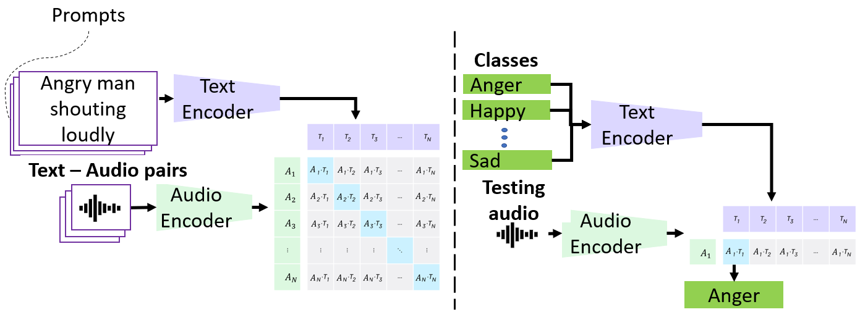
Prompting Audios Using Acoustic Properties for Emotion Representation
Hira Dhamyal, Benjamin Elizalde, Soham Deshmukh, Huaming Wang, Bhiksha Raj, Rita Singh
Introduction
MODEL
Emotions lie on a continuum, but current models treat emotions as a finite valued discrete variable. This representation does not capture the diversity in the expression of emotion. To better represent them, we propose the use of natural language descriptions (or prompts).
In this work, we address the challenge of automatically generating these prompts and training a model to better learn emotion representations from audio and prompt pairs.
We use acoustic properties that are correlated to emotion like pitch, intensity, speech rate, and articulation rate to automatically generate prompts, i.e., ‘acoustic prompts’.
DATASETS
Ref: [3]
Dataset | # Files | # Classes | Emotions
CMU-MOSEI | 23K | 9 | ang, exc, fear, sad, frus, neu, sur, hap, dis
IEMOCAP | 10K | 9 | hap, fear, sad, sur, exc, ang, neu, disappoint, frus
MELD | 10K | 7 | neu, sur, fear, sad, joy, disgust, ang
CREMA-D | 7K | 6 | ang, dis, fear, hap, neu, sad
RAVDESS | 2.5K | 8 | neu, calm, hap, sad, ang, fear, disgust, sur
CMU-MOSI | 2.2K | 3 | neu, positive, negative
RESULTS – Emotion Audio Retrieval
Precision@K
MOTIVATION
RESULTS – Speech Emotion Recognition
Pitch
Low pitch is associated generally with negative emotions like fear.
High pitch associated with positive emotion like happiness, surprise.
Ref: [1]
The performance is shown on RAVDESS dataset. The dataset is not included in the training datasets.
Intensity
Low intensity is associated with negative emotion like sadness melancholy.
High intensity is associated with emotion like joy, excitement, happiness.
Ref: [2]
Audio
Speech rate
Fast spoken speech associated with emotions such as anger, happiness
Slow speech rate associated with emotions like sadness, disgust and boredom.
Ref: [2]
Articulation rate
Fast articulation rate associated with emotions of interest, fear, happiness.
Slow articulation rate associated with emotions like sadness, disgust.
The model is finetuned on the training subset of RAVDESS and performance shown on testing subset.
METHODOLOGY
Ref: [2]
132.5 Hz
180 Hz
210 Hz
Pitch
Low male pitch
High male pitch
Low female pitch
high female pitch
Intensity
Low intensity
60 dB
ANALYSIS – which Prompt is better?
High intensity
Performance shown when the model is finetuned on RAVDESS dataset using different acoustic prompts paired with the audio.
3.12 syllables per sec
Audio
Speech rate
Low speech rate
High speech rate
4 syllables per sec
Articulation rate
Low articulation rate
High articulation rate
EXAMPLE PROMPTS
Property | Prompt
Class Label | {emotion}
Pitch | High female pitch {emotion} High male pitch {emotion}
Intensity | High intensity {emotion}
Speech Rate | High speech rate {emotion}
Articulation Rate | High articulation rate {emotion}
CONCLUSION
We find that among the acoustic prompts, pitch prompt is the best performing one.
Emotion Audio Retrieval - acoustic prompt augmentation achieves consistently better Precision@K metric.
Speech Emotion Recognition - shows performance improvement by 3.8% absolute in RAVDESS.
1.
[1] Scherer, Klaus R. Acoustic concomitants of emotional dimensions: Judging affect from synthesized tone sequences. (1972).
[2] Pavlenko, Aneta. Emotions and multilingualism. Cambridge University Press, 2005.
[3] Benjamin Elizalde, et al “Clap: Learning audio concepts from natural language supervision,” arXiv preprint arXiv:2206.04769, 2022.
Notes:
1

