Slide 1
Breast Cancer Detection Based on Merging Four Modes MRI Using Convolutional Neural Networks
Wenhuan Lu$⋆$, Zhe Wang$⋆$, Yuqing He$†$, Hong Yu$‡$, Naixue Xiong$\text{§}$, Jianguo Wei $⋆$
$⋆$School of Computer Software, Tianjin University, Tianjin, China $†$School of Electrical and Information Engineering, Tianjin University, Tianjin, China
$‡$Center Obstetrics and Gynecology Hospital, Tianjin, China
$\text{§}$Department of Computer Science, Colorado Technical University, Colorado, USA

Slide 2
Outline
Introduction
Experimental Methodology
Dataset
Classification in Breast Cancer Detection
Segmentation in Breast Cancer Detection
Results
Conclusions
Notes:
Detailed introduction of the proposed RE-CNN model is given in this section.

Slide 3
Introduction
Background:
Breast cancer is the most prevalent type of cancer in women worldwide.
MRI becomes the most important method for the detection of breast cancer.
Deep convolutional neural networks have become effective models for tackling a variety of visual tasks.
Using Computer Aided Diagnosis (CAD) systems is an usual method for breast cancer detection now.

Slide 4
Introduction
Disadvantages:
The breast cancer detection performance may vary due to subjective observations by radiologists and clinicians.
Through Computer Aided Diagnosis (CAD) systems, examiners usually study images from a single sequence imaging mode at a time.
Tumor delineation is affected by variations and uncertainties in the automated lesion segmentation process. These variations of the intensity, texture, and morphology of the tumor lead to inconsistency in diagnostic outcome.

Slide 5
Outline
Introduction
Experimental Methodology
Dataset
Classification in Breast Cancer Detection
Segmentation in Breast Cancer Detection
Results
Conclusions

Slide 6
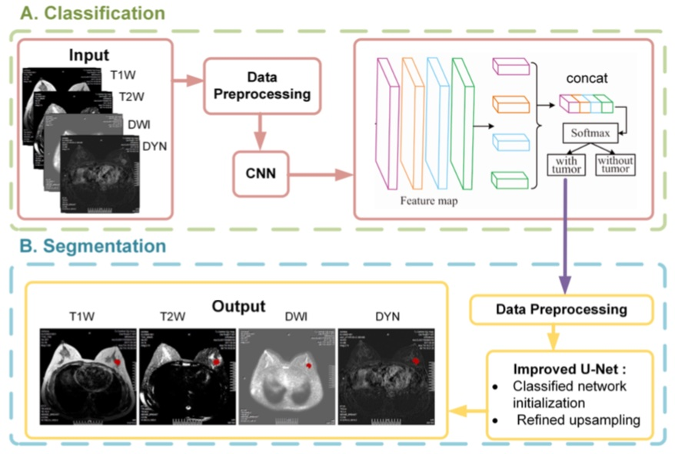
Experimental Methodology
The detection backbone based on four sets of images with different imaging modes (T1W, T2W, DWI, and SYN) can combine features from each mode.
The upsampling process in the segmentation network can obtain clear edges of tumors.

Slide 7
Outline
Introduction
Experimental Methodology
Dataset
Classification in Breast Cancer Detection
Segmentation in Breast Cancer Detection
Results
Conclusions

Slide 8
Dataset
Dataset
A total of 67 MRI breast examinations from high-risk patients from the Tianjin Center Obstetrics and Gynecology Hospital are included, containing 8,132 images. After a selection process, 6,000 images were used for classification, and 1,800 images are used for segmentation.
Data augmentation
We only focus on effective information related to the tumor. The chest portion in the images is removed, leaving only the breast tissue, the subphrenic region where often shows lymph nodes, and the wall of the thoracic cavity that often adhered to the tumor.
Multiple patches are selected in the images. The methods here are random-size cropping and random horizontal flipping.

Slide 9
Outline
Introduction
Experimental Methodology
Dataset
Classification in Breast Cancer Detection
Segmentation in Breast Cancer Detection
Results
Conclusions

Slide 10
Classification in Breast Cancer Detection
In the proposed backbone, the images of the four sequences are passed through the convolutional neural network in order. Then, four types of feature maps are acquired as the output of the CNN models.
The dataset used in our experiment is an MRI database built at the radiology department of the Tianjin Center Obstetrics and Gynecology Hospital. The T2W_SPARI, T1W_TSE, DWI_SSh, and DYN_eTHRIVE+C images are mainly to be considered in this experiment.
The multiple patches are selected in the image. The method here use random-size cropping and random horizontal flipping.

Slide 11
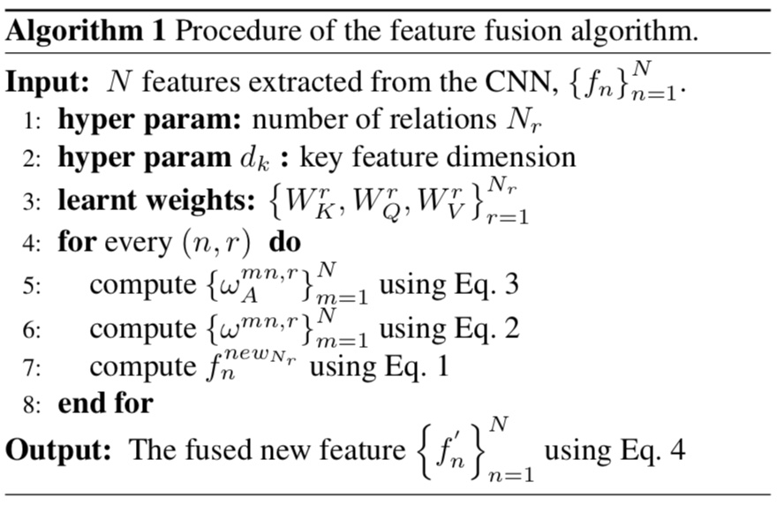
Classification in Breast Cancer Detection
The thickness is denoted by t here. Next, we concatenate the features $F_{1}$, $F_{2}$, $F_{3}$, and $F_{4}$extracted from each feature map, and convert them into a higher-dimensional feature. The algorithm of the feature fusion before concatenation can be explained in detail as shown in Algorithm 1.

Slide 12
Classification in Breast Cancer Detection
After four images pass through the CNN, the features are $f_{1}$, $f_{2}$, $f_{3}$, and $f_{4}$. Then, in order to merge the features of each image into the features of the other three images, for the n-th feature $f_{n}$, we calculate the new feature as
Where $f_{m}$ is the feature of the m-th image, $W_{v}$ indicates that the feature is linearly transformed to a low dimension, and $ω_{mn}$ represents the weight of the linear sum, the weight can be calculated as
$W_{K}$, $W_{Q}$ are matrices and play the same roles as $W_{v}$, they all represent linearly transform the features. Appearance weight $ω_{mn}$ is computed as dot product. $d_{k}$ is the dimension of the feature after being transformed.

Slide 13
Classification in Breast Cancer Detection
After doing the calculation, for the n-th feature $f_{n}$, there are $N_{r}$ features like${ f}_{n}^{{new}_{1}}, { f}_{n}^{{new}_{2}},$… $f_{n}^{{new}_{N_{r}}}.$Then, the feature of the n-th image can be transformed as
$\text{Four} \text{new} \text{features}$ $f_{1}^{′},f_{2}^{′},$ $f_{3}^{′},$ and $f_{4}^{′}$ are obtained after the transformation, we can simply concatenate them^{[1]}. Generally, we set $N_{r}$ = 8.

Slide 14
Classification in Breast Cancer Detection
Finally, the 4t dimension feature that can be expressed as $F$=[$F_{1}$, $F_{2}$, $F_{3}$, $F_{4}$] is put into the softmax process for the classification work. In the softmax regression, we solve the multi-classification problem (as opposed to the binary problem solved by logistic regression).
In the training, four types of convolutional neural net- works, Vgg16^{[2]}, ResNet-50^{[3]}, Inception V3^{[4]} and DenseNet^{[5]}, are selected as different network architectures for the verification procedure. All the networks are trained using the stochastic gradient descent (SGD) method.

Slide 15
Outline
Introduction
Experimental Methodology
Dataset
Classification in Breast Cancer Detection
Segmentation in Breast Cancer Detection
Results
Conclusions

Slide 16
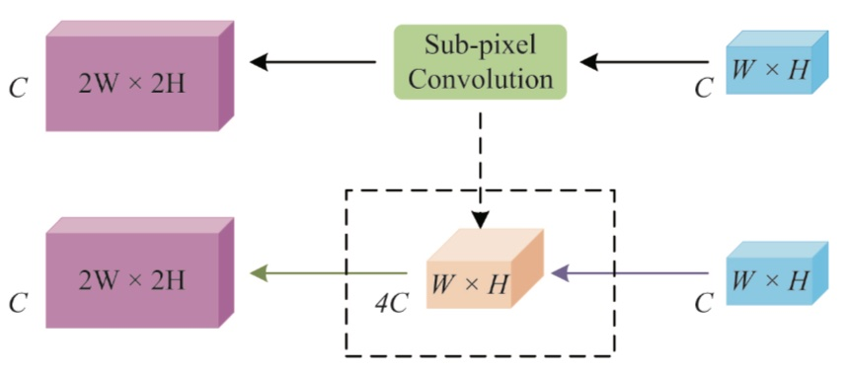
Segmentation in Breast Cancer Detection
The upsampling process in the traditional U-Net ^{[6]} architecture is refined, using the sub-pixel method, and the U-Net is initialized using the classified network.
The process of upsampling is to put the feature map into a layer convolution in which the length and width are in 1×1, and the number of channels is 4C. The feature map becomes H×W×4C. Then, it is reshaped into 2H×2W×C, as shown in following figure.

Slide 17
Outline
Introduction
Experimental Methodology
Dataset
Classification in Breast Cancer Detection
Segmentation in Breast Cancer Detection
Results
Conclusions

Slide 18
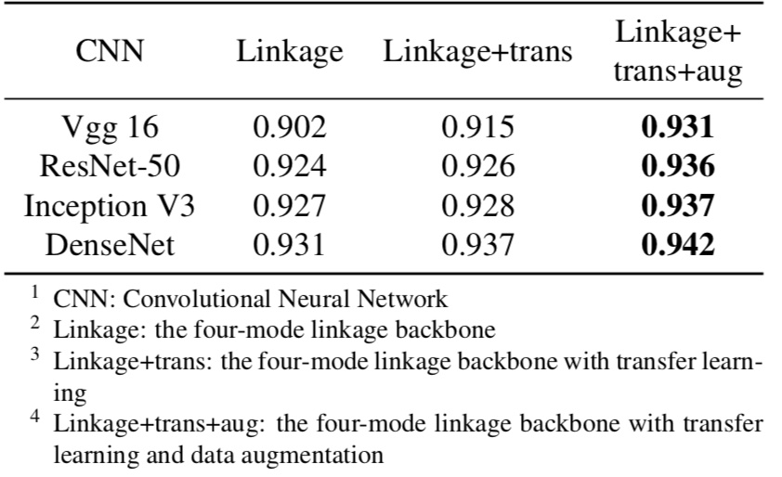
Results
The four-mode linkage backbone reaches the accuracy of 94.2%.

Slide 19
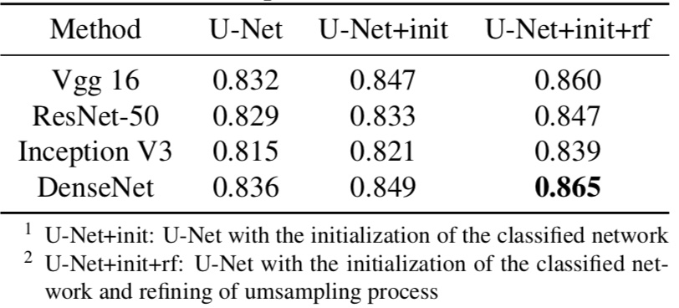
Results
Combining classified network initialization and the refined upsampling process, the segmentation can be more accurate. The best dice coefficient value reaches 0.865.

Slide 20
Outline
Introduction
Experimental Methodology
Dataset
Classification in Breast Cancer Detection
Segmentation in Breast Cancer Detection
Results
Conclusions

Slide 21
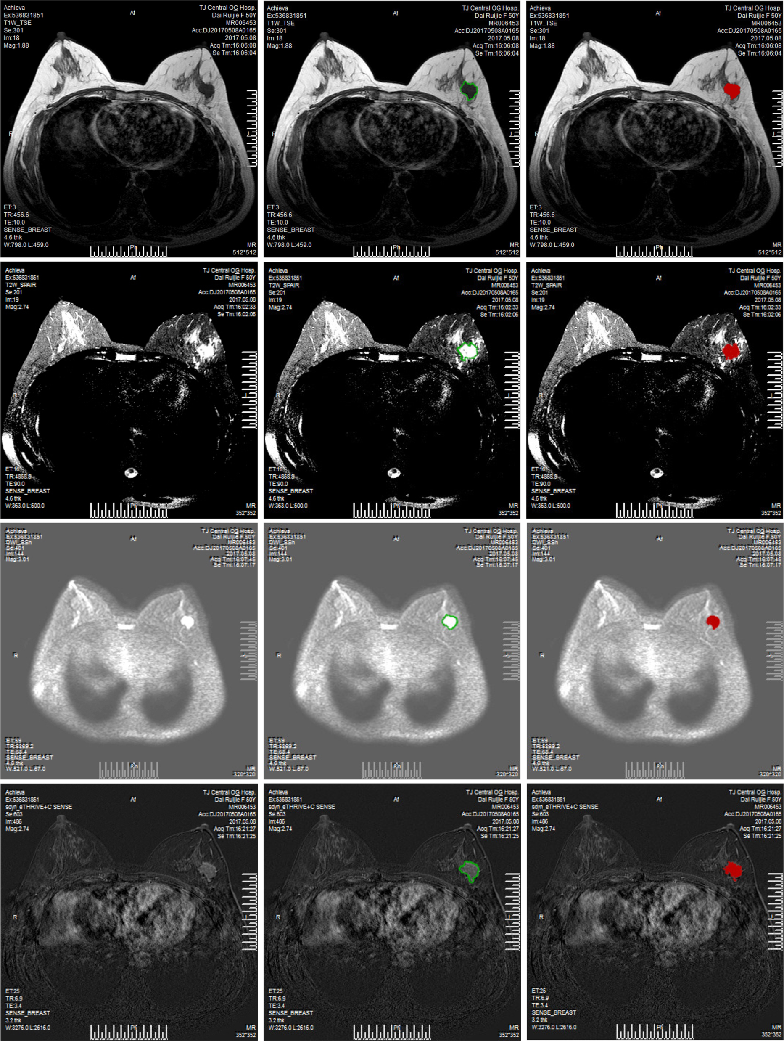
Conclusions
The images in the first row are T1W, second are T2W. The first column shows initial images in datasets, the second column shows the ground truth, and the third column shows the segmentation results from the proposed backbone. Red color indicate segmentation results.

Slide 22
Conclusions
The images in the first row are DWI, second are DYN. The first column shows initial images in datasets, the second column shows the ground truth, and the third column shows the segmentation results from the proposed backbone. Red color indicate segmentation results.

Slide 23
Conclusions
The proposed four-mode linkage backbone for the classification task in tumor detection considers different imaging modalities for detecting tumors in multiple signal-weighted imaging sequences. It reaches the accuracy of 94.2%.
The eﬀective results show that the optimized U-Net architecture for segmentation get the best dice coefficient value of 0.865.

Slide 24
References
Parts:
Han Hu, Jiayuan Gu, Zheng Zhang, Jifeng Dai, and Yichen Wei, “Relation networks for object detection,” 2017.
Karen Simonyan and Andrew Zisserman, “Very deep convolutional networks for large-scale image recogni- tion,” Computer Science, 2014.
Kaiming He, Xiangyu Zhang, Shaoqing Ren, and Jian Sun, “Deep residual learning for image recognition,” pp. 770–778, 2015.
Christian Szegedy, Vincent Vanhoucke, Sergey Ioffe, Jonathon Shlens, and Zbigniew Wojna, “Rethinking the inception architecture for computer vision,” Computer Science, pp. 2818–2826, 2015.
Ilya Sutskever, James Martens, George Dahl, and Ge- offrey Hinton, “On the importance of initialization and momentum in deep learning,” in International Confer- ence on International Conference on Machine Learning, 2013, pp. III–1139.
Olaf Ronneberger, Philipp Fischer, and Thomas Brox, “U-net: Convolutional networks for biomedical image segmentation,” in International Conference on Medical Image Computing and Computer-Assisted Intervention, 2015, pp. 234–241.

Slide 25
THANKS
Jianguo Wei:
jianguo@tju.edu.cn
Notes:
Thanks for your attention! And you are welcome to email me for any questions or further discussion.

