Slide 1
A UNIFIED SEQUENCE-TO-SEQUENCE FRONT-END MODEL FOR MANDARIN TEXT-TO-SPEECH SYNTHESIS
Junjie Pan, Xiang Yin, Zhiling Zhang, Shichao Liu,
Yang Zhang, Zejun Ma, Yuxuan Wang
ICASSP 2020
Speaker: Junjie Pan

Slide 2
How can this paper help?
What is the aim of this paper?
To provide a unified FE model for companies/researchers who want to build a customized FE but have no much time to optimize the complex typical FE pipeline.
What can the proposed model benefit to TTS?
Generate more accurate phoneme and prosody for backend
Improve the naturalness of the synthesized waves
Can it be applied to other languages?
Yes.

Slide 3
Background
Frontend model is essential for Mandarin TTS
Intelligibility and Naturalness
Typical frontend model is pipeline-based
Error accumulation
Complex feature engineering
Mismatches between training and inference

Slide 4
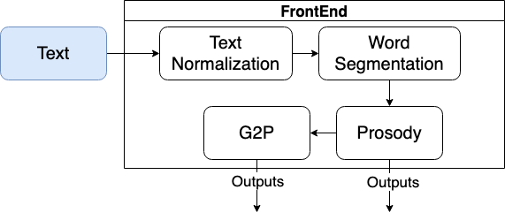
Typical Mandarin TTS Pipeline

Slide 5
Proposed Model

Slide 6
Proposed Model

Slide 7
Evaluation of Proposed Model

Slide 8
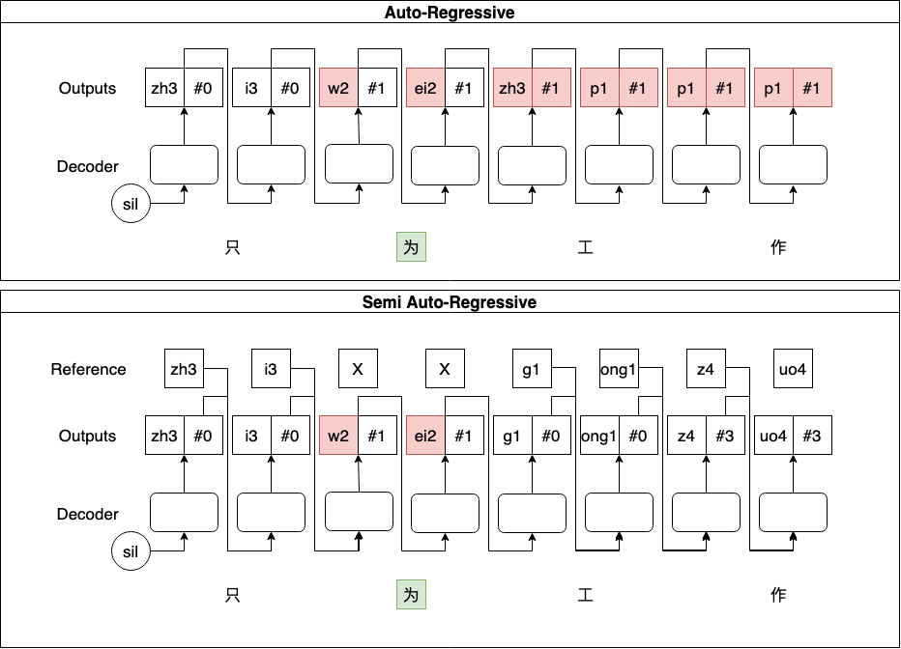
Semi-AR

Slide 9
Semi-AR

Slide 10
Evaluation of Proposed Model
P-System
U-System

Slide 11
Thanks for Watching

