Slide 1
Fast Dynamic magnetic resonance imaging using linear dynamical system model
Vimal Singh, Ahmed H. Tewfik
The University of Texas at Austin
Notes:
Now I will move on to my third contribution where I propose a novel dynamic MRI formulation using linear dynamical system model.

Slide 2
Outline
Introduction
Algorithm
Results
Conclusions
Introduction
Algorithm
Results
Conclusions

Slide 3
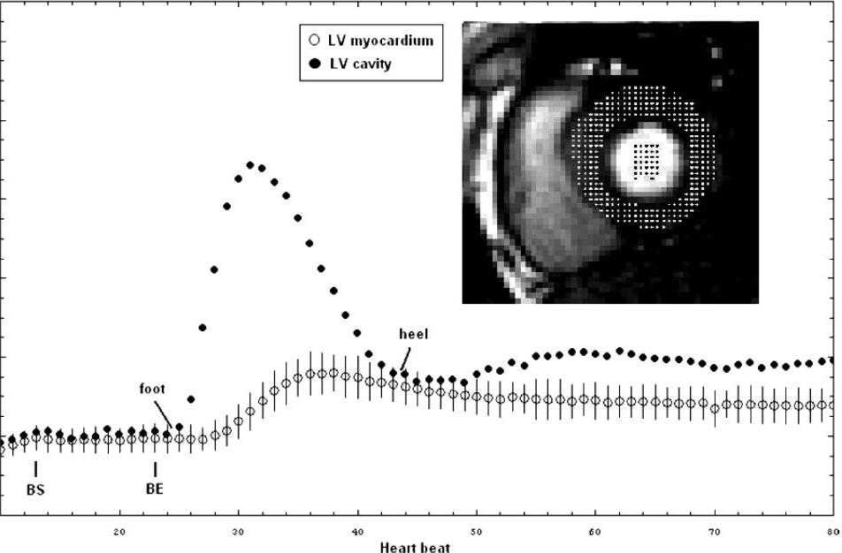
Significance
Fast magnetic resonance imaging (MRI) of physiological functions
high temporal and/or spatial resolution
improved sensitivity and specificity of the diagnosis
Perfusion studies: brain, myocardial
less enhanced hypo-perfused tissue
relative enhancement changes in image time-series
Linear dynamical systems (LDS) based dynamic MRI formulation
using true physical evolution model ($A_{i}$)
sparse innovations ($x_{i}− A_{i} x_{i−1}$)
$\min_{x_{1}, x_{2}, …, x_{k}}{\sum_{i=1}^{k}{ λ_{i}{\left\|x_{i}−A_{i}x_{i−1}\right\|}_{1}}+ \frac{1}{2} \sum_{i=1}^{k}{{\left\|H_{i}x_{i} − y_{i}\right\|}_{2}^{2}}}$
Mean signal intensity curves from myocardial perfusion MRI test of a normal subject
http://www.ncbi.nlm.nih.gov/pubmed/17578718
Notes:
The proposed formulation is an attempt to define a general model for improving speeds in dynamic MRI applications. And thus the significance of the problem can change depending on which application it is applied to. In this contribution I will present results on myocardial perfusion studies and also the Cardiac CINE studies. So, I will briefly state the need for improved imaging speeds in myocardial perfusion imaging.
In Myocardial perfusion imaging
a contrast enhancing agent is injected in the blood pool
The dead tissue is hypo-perfused which is less enhanced
thus to detect the affected tissue the relative enhancement changes are observed by acquiring a time-series.
more precise information can be derived by measuring parameters of the signal intensity time curve such as mean transit time, time-to-peak, upslope, downslope, and delay before reaching maximum signal intensity.
However, due to magnetization decay and mixing of contrast agent, the relative difference vanishes quickly
Thus, we only have to rely on the first pass of the bolus agent.

Slide 4
Prior work
Parallel imaging: SENSE, GRAPPA
Exploiting data redundancy
spatial : partial Fourier, reduced FOV
temporal : k-t BLAST, HYPR, k-t FOCUSS
Compressed sensing
sparsity priors: wavelets, total-variational norm, dictionaries
sensing/sampling: signal encoding formulation
Low-rank matrix completion
Low-rank plus sparse matrix completion
Notes:
In the past two decades, various techniques have been proposed for improving MR imaging speeds. These techniques can be loosely classified into the following categories.
Parallel imaging methods such as SENSE and GRAPPA, where multiple receiver coils are used to reduce the data acquired in k-space. These methods are based on using the inherent variable spatial sensitivity of the coils to perform spatial encoding. There by reducing the gradient-switching based spatial encoding required for image recovery.
SENSE: Sensitivity Encoding
GRAPPA: Generalized Auto-Calibration Partial Parallel Acquisition
The second group of techniques is based on exploiting the data redundancy in the k-space either the spatial dimension or in the temporal dimension. These techniques relying on extrapolating the missing k-space data from the sampled location using smart data-sharing formulations.
The third group of techniques are the ones that are based on the theory of Compressed sensing theory. In these methods a transform of the underlying image in recovered in a sparsifying basis which exhibits high incoherency with the sensing basis. Much of the late research in these techniques has been based on identifying new sparsifying to improve the compressibility of the images being recovered or identifying novel signal encoding formulations such that the sensing basis is less coherent with the sparsifying basis.
Lastly, are the low-rank matrix completion techniques which stack each time-frame as columns of a large matrix and recover a low-rank matrix from its under-sampled version based on the assumption of high temporal correlations between consecutive time-points.

Slide 5
Innovation
The novelty of the fast MRI technique is based on the insight of using measurable system dynamics
combines linear dynamical system model with sparse recovery techniques
explicitly uses the available physical dynamical models
improved redundancy encoding results in high compressibility of images to be recovered using sparse recovery methods
unifies prior information based methods which implicitly use the dynamics of underlying physiological functions
Notes:
The innovation of the proposed technique lies in combining linear dynamical system model with spare recovery techniques
Linear dynamical system models can be used for redundancy encoding using available prior physical model which result in high compressibility of images which can be recovered with high fidelity using sparse recovery techniques
In addition, the proposed the model does make any assumptions on the image however its requires the knowledge of an available time evolution model for the physiological function

Slide 6
Background
Classic dynamical system
$$x_{k}= f_{k}\left(x_{k−1}\right)+ u_{k}$$
$$y_{k}= H_{k}x_{k}+ v_{k}$$
$x_{k}$: $N×1$ dynamic state at $k^{th}$ time point
$f_{k}\left(.\right)$ time-evolution function of the underlying states
$u_{k}$: modeling error or innovations
$y_{k}$: $M×1$ k-space measurements for the $k^{th}$ state
$H_{k}$: linear measurement matrix
$v_{k}$: measurement noise
Linear dynamical systems (LDS) based dynamic MRI formulation
$x_{k}$: underlying evolving images
$y_{k}$: k-space samples
$f_{k}\left(.\right)= A_{k}$, a linear image evolution model
Notes:
The equation represents the classical dynamical system model
Where x_k represent the underlying evolving state which are usually un-observable, f_k represents the time-evolution function and y_k represent a linear

Slide 7
Outline
Introduction
Algorithm
Results
Conclusions
Introduction
Algorithm
Results
Conclusions

Slide 8
LDS based fast dynamic MRI
Proposed formulation
under-sampled acquisitions, i.e., $M≪N$
sparse/compressible innovations, i.e., ${\left\|u_{k}\right\|}_{0}≤T$
prior knowledge of $A_{k}$’s
solve:
$\min_{x_{1}, x_{2}, …, x_{k}}{\sum_{i=1}^{k}{ λ_{i}{\left\|x_{i}−A_{i}x_{i−1}\right\|}_{1}}+ \frac{1}{2} \sum_{i=1}^{k}{{\left\|H_{i}x_{i} − y_{i}\right\|}_{2}^{2}}}$
versus Kalman filter which solves:
$\min_{x_{1}, x_{2}, …, x_{k}}{\sum_{i=1}^{k}{{ λ_{i}\left\|x_{i}−A_{i}x_{i−1}\right\|}_{2}^{2}}+\frac{1}{2} \sum_{i=1}^{k}{{\left\|H_{i}x_{i}−y_{i}\right\|}_{2}^{2}}}$
Notes:
Estimation of the evolving states x_k from their observations y_k has been a topic of research for various studies. One important and well studied case is the Kalman filter which assumes the state innovations and measurement noise to be zero-mean Gaussian distributed. A fixed interval Kalman filter solution finds the optimal least squares solution for the problem 1
In the proposed linear dynamical system based fast MRI formulation we assume that it the model errors which are sparse and the observations y_k are much smaller in dimensionality of the state x_k’s. The x_k are the evolving underlying images. Note, however we do assume the knowledge of the linear time evolution functions A_k

Slide 9
LDS based fast dynamic MRI
State transition matrices $A_{k}$’s
based on true physical evolution models
perfusion, angiography
contrast changes between time frames
temporal difference: $A_{k}=I$
$$x_{k}= x_{k−1}+u_{k}$$
cardiac CINE MRI
pseudo-periodic cardiac motion
second order Autoregressive (AR2) model
$$x_{k}= A_{1}x_{k−1}+ A_{2}x_{k−2}+u_{k}$$

Slide 10
LDS based fast dynamic MRI
Solution
solve for innovations ${\left\{u_{i}\right\}}_{i=1 }^{k}$
use them to explicitly estimate ${\left\{x_{i}\right\}}_{i=1}^{k}$
rearrange the innovations as
$\left[\begin{matrix}\begin{matrix}u_{1} \\ u_{2}\end{matrix} \\ ⋮ \\ u_{k}\end{matrix}\right]= \left[\begin{matrix}\begin{matrix}I \\ {−A}_{1}\end{matrix} & \begin{matrix}\begin{matrix}0 & …\end{matrix} \\ \begin{matrix}I & …\end{matrix}\end{matrix} & \begin{matrix}0 \\ 0\end{matrix} \\ ⋮ & \begin{matrix}⋮ & ⋱\end{matrix} & ⋮ \\ 0 & \begin{matrix}0 & {−A}_{k}\end{matrix} & I\end{matrix}\right]\left[\begin{matrix}\begin{matrix}x_{1} \\ x_{2}\end{matrix} \\ ⋮ \\ x_{k}\end{matrix}\right]− \left[\begin{matrix}\begin{matrix}A_{0}{\hat{x}}_{0} \\ 0\end{matrix} \\ 0 \\ 0\end{matrix}\right]$ $u =𝔸 x − z$
l₂-norm fidelity term as
$$\sum_{i=1}^{k}{{\left\|H_{i}x_{i}−y_{i}\right\|}_{2}^{2}}= {\left\|ℍx −y\right\|}_{2}^{2}= {\left\|ℍ𝔸^{−1}u−(y − ℍ 𝔸^{−1}z)\right\|}_{2}^{2}$$
reformulate the problem to recover the sparse innovations
$$\min_{u_{1}, u_{2}, ⋯, u_{k}}{\sum_{i=1}^{k}{{λ_{i} \left\|u_{i}\right\|}_{1}}+ \frac{1}{2}{\left\|ℍ𝔸^{−1}u− \tilde{y}\right\|}_{2}^{2}}$$
Notes:
What is interesting in the optimization program (6) is that under a change of variables and given a known sparsity on the innovations, the innovations is then recoverable with CS guarantees, given the typical constraints on H. Thus with perfect knowledge of the previous state, the new state is recoverable with the same guarantees. What is not assured is the convergence of this algorithm from an erroneous initialization to a steady-state estimation error, as would be desired from a tracking algorithm

Slide 11
LDS based fast dynamic MRI
Recover the sparse innovations
$$\min_{u }{{ λ \left\|u\right\|}_{1}+ \frac{1}{2}{\left\|ℍ𝔸^{−1}u− \tilde{y}\right\|}_{2}^{2}}$$
sliding window with size $k$
using previous estimates to calculate $\tilde{y}$
Numerical method
non-linear conjugate gradient descent algorithm with backtracking line search [Lustig et al., 2008]
converges for diagonal $A_{i}$’s
error-propagation for non-diagonal $A_{i}$’s
M. Lustig, D. Donoho, and J. M. Pauly, “Sparse MRI: The application of compressed sensing for rapid MR imaging,” Magnetic Resonance in Medicine, vol. 58, no. 6, pp. 1182–1195, 2007.

Slide 12
Outline
Introduction
Algorithm
Results
Conclusions
Introduction
Algorithm
Results
Conclusions

Slide 13
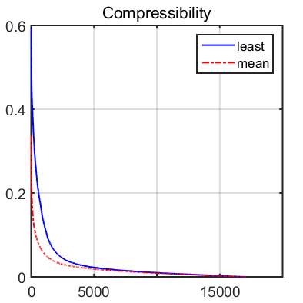
Myocardial perfusion imaging (MPI)
Dataset
in-vivo data
90 (phase) x 190 (frequency) x 70 (time)
Saturation-recovery sequence
TR/TE: 2.5/1 ms
saturation recovery:100 ms
Evolution function
contrast changes between timeframes
temporal difference: $A_{k}=I$
→ $x_{k}=x_{k−1}+ u_{k}$
Abs. innovation
Samples
Notes:
Talk about the model we will use – A will be simply the Identity matrix
i.e., temporal difference between the images will be assumed to be sparse
Add the zoomed figure for the power law decay of coefficients for the difference images ?

Slide 14
Under-sampled MPI experiment
Acceleration (R) : 4
Window size ($k$): 4
Initialization (${\hat{x}}_{0}$): sliding window
$$x_{0}$$
$$u_{1}$$
$$u_{1}$$
$$x_{1}$$
$$u_{2}$$
$$x_{2}$$
$$u_{3}$$
$$x_{3}$$
$$x_{1}$$
$$u_{2}$$
$${\hat{x}}_{0}$$
$${\hat{u}}_{1}$$
$${\hat{u}}_{1}$$
$${\hat{x}}_{1}$$
$${\hat{x}}_{1}$$
$${\hat{u}}_{2}$$
$${\hat{u}}_{2}$$
$${\hat{x}}_{2}$$
$${\hat{u}}_{3}$$
$${\hat{x}}_{3}$$
$$x_{0}−{\hat{x}}_{0}$$
$$x_{1}−{\hat{x}}_{1}$$
$$x_{1}−{\hat{x}}_{1}$$
$$x_{2}−{\hat{x}}_{2}$$
$$x_{3}−{\hat{x}}_{3}$$
Notes:
Initialization using the sliding window technique
Show an acceleration at R = 4

Slide 15
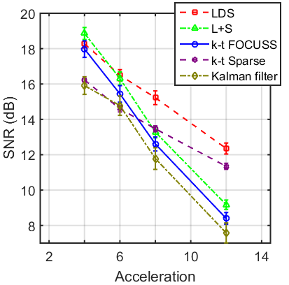
Comparison – MPI
Kalman filter
innovation $u_{k}\sim N(0, Q_{k})$
k-t FOCUSS
prediction + residual
prediction: temporal average
residual: sparse image
k-t Sparse
dual sparsity
spatial dimension – Wavelets
temporal dimension – 1D Fourier
Low-rank plus sparse matrix
low-rank: temporal correlations
sparse: temporally varying
Signal-to-noise
Notes:
Myocardial perfusion imaging Comparison with other techniques
1. with k-t FOCUSS – show difference in compressibility between k-t FOCUSS and LDS
2. with Kalman Filtering – simple temporal modeling
3. with k-t Sparse - wavelet sparsity +
Add a SNR/SSIM vs Acceleration graph for this dataset – will have to generate those….

Slide 16
Comparison - MPI
Kalman filter
Reference
#17
Innovation
#18
Zoom Ref.
#18
13.4 dB, 0.84
15.6 dB, 0.88
k-t Sparse
15.8 dB, 0.78
16.6 dB, 0.81
k-t FOCUSS
16.4 dB, 0.88
17.6 dB, 0.91
Low-rank plus sparse matrix
18.0 dB, 0.89
19.0 dB, 0.92
Linear dynamical system
19.1 dB, 0.88
19.6 dB, 0.91
Notes:
Add the comparison images for the Four Schemes
Think about adding the reference images and then adding animations to replace reference images with recovered images

Slide 17
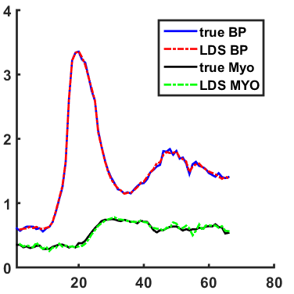
MPI time-series plots
Time-series plot
averaged signal intensity
acceleration R = 6
Red : Blood Pool (BP)
Green: Myocardium (MYO)
signal intensity
time frames
Notes:
Maybe add another the same curve for another technique… k-t FOCUSS ?

Slide 18
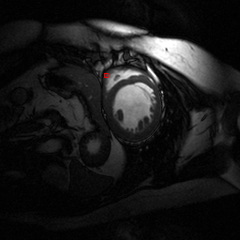
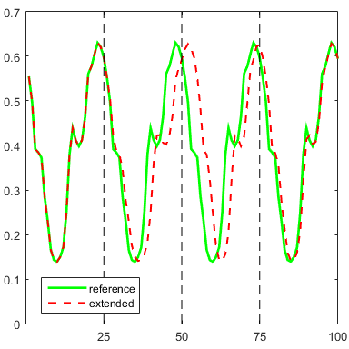
Cardiac CINE MRI
Dataset
in-vivo data
256 (phase) x 256 (frequency) x 25 (time)
balanced steady-state free precession
flip angle: 50 deg
TR = 3.45 ms
Modification
extended to 100 time-points
interpolation, concatenation
added slow, fast & faster phases
Notes:
Talk about the Dataset
Talk about using an temporal AR2 model
Talk about using a Spatio temporal AR2 model
show the Compressibility results on the dataset

Slide 19
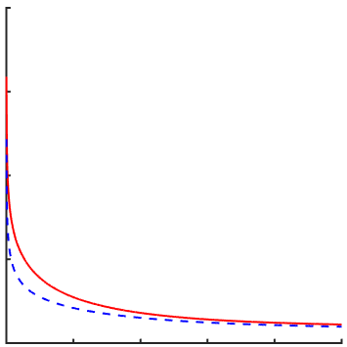
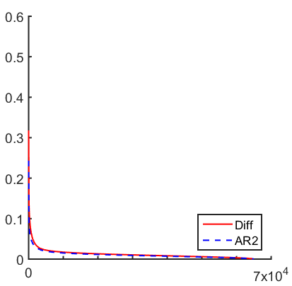
Cardiac CINE MRI
Evolution function
temporal difference
$$x_{k}=x_{k−1}+ u_{k}$$
second order Autoregressive (AR2) model
$$x_{k}= A_{1}x_{k−1}+ A_{2}x_{k−2}+u_{k}$$
Learn $A_{1}$ and $A_{2}$
first 25 samples of the modified dataset
least square estimate
Absolute innovation
Samples
Image
time-series
Temporal
difference
Temporal
AR2

Slide 20
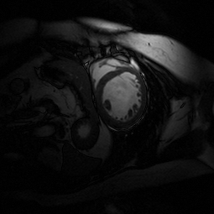
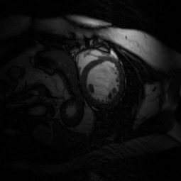
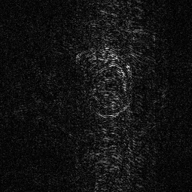
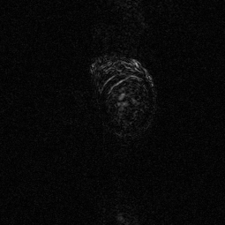
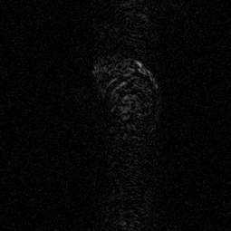
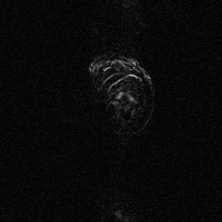
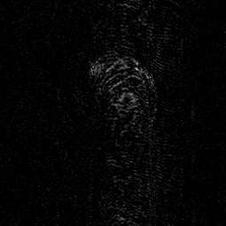
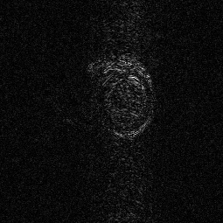
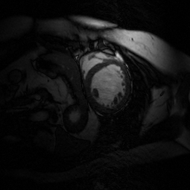
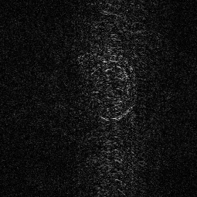
CINE results (R = 4)
Temporal AR2
Temporal Difference
Ref. #53
Ref. #53
24dB, 0.96
20.8dB, 0.96
Innv. #54
Innv. #54
Recovered (R)
Recovered (R)
Ref. #54
Ref. #54
24.5dB, 0.96
22.1dB, 0.96

Slide 21
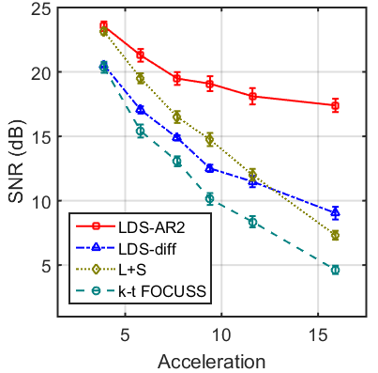
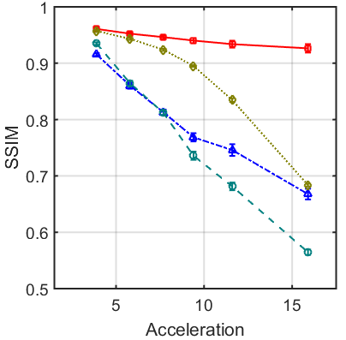
Comparison – cardiac CINE
Signal-to-noise
Structural Similarity Index Measure

Slide 22
Outline
Introduction
Algorithm
Results
Conclusions
Introduction
Algorithm
Results
Conclusions

Slide 23
Summary
Improving temporal resolution in dynamic MRI applications
perfusion studies: ischemia detection, tumour detection
cardiac cine MRI: cardiac function evaluation
A novel fast dynamic MRI formulation
combines a linear dynamical system model with sparse recovery techniques
unifies previous implicit spatio-temporal dynamics based formulation
Improved imaging speeds up to 6x
high temporal resolutions

Slide 24
Thank you
Questions ?

Slide 25
Significance
Perfusion studies
detect acute ischemia: brain, myocardial
less enhanced hypo-perfused tissue
relative enhancement changes in image time-series
mean transit time (MTT), time-to-peak (TTP), upslope, downslope
magnetization decay and contrast mixing
first pass of bolus agent
high temporal resolution
high spatial resolution
accurate localization
Mean signal intensity curves from myocardial perfusion MRI test of a normal subject
http://www.ncbi.nlm.nih.gov/pubmed/17578718
Notes:
The proposed formulation is an attempt to define a general model for improving speeds in dynamic MRI applications. And thus the significance of the problem can change depending on which application it is applied to. In this contribution I will present results on myocardial perfusion studies and also the Cardiac CINE studies. So, I will briefly state the need for improved imaging speeds in myocardial perfusion imaging.
In Myocardial perfusion imaging
a contrast enhancing agent is injected in the blood pool
The dead tissue is hypo-perfused which is less enhanced
thus to detect the affected tissue the relative enhancement changes are observed by acquiring a time-series.
more precise information can be derived by measuring parameters of the signal intensity time curve such as mean transit time, time-to-peak, upslope, downslope, and delay before reaching maximum signal intensity.
However, due to magnetization decay and mixing of contrast agent, the relative difference vanishes quickly
Thus, we only have to rely on the first pass of the bolus agent.

