Slide 1
CNN-Aided Factor Graphs with Estimated Mutual Information Features for Seizure Detection Bahareh Salafian¹, Eyal Fishel Ben², Nir Shlezinger², Sandrine de Ribaupierre³, and Nariman Farsad¹
1. Department of Computer Science at Ryerson University, Toronto, Canada.
2. School of Electrical and Computer Engineering, Ben-Gurion University of the Negev, Be’er Sheva, Israel.
3. Department of Clinical Neurological Sciences and the School of Biomedical Engineering, University of Western Ontario London, Canada.
2022 IEEE International Conference on Acoustics, Speech and Signal Processing (ICASSP)

Slide 2
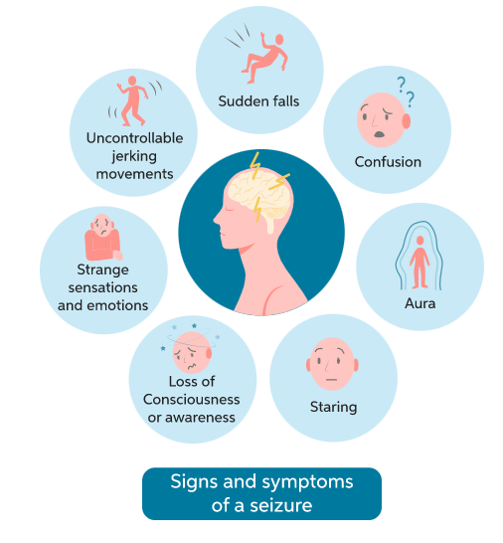
Epilepsy
Chronic neurological disorder
About 50 million people suffer from epilepsy in the world
Affects people of all ages
Epileptic Seizure
Recurrent, abnormal electrical activity in the brain
Affecting the patient’s quality of life
Image from : https://www.chegg.com/learn/biology/introduction-to-biology/epilepsy-in-introduction-to-biology

Slide 3
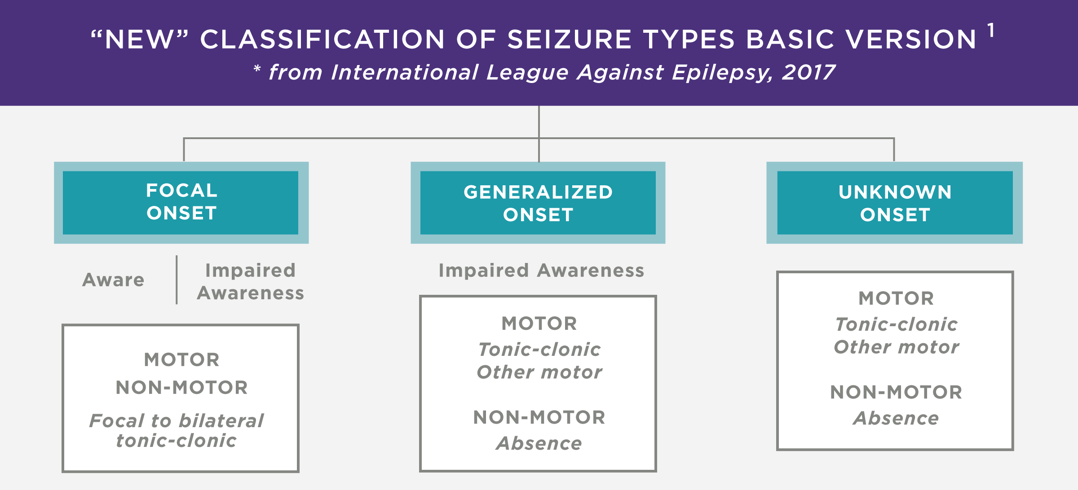
Diagnosis and Treatment Decisions
Electroencephalogram (EEG) is widely used
EEG recordings are highly contaminated
with physiological and non-physiological resources
Patient-to-patient variability can be large
There are many different types of seizures
Challenges with EEG signals
Image from: /figure/Sketch-of-how-to-record-an-Electroencephalogram-An-EEG-allows-measuring-the-electricalfrom : https://www.researchgate.net_fig1_338423585

Slide 4
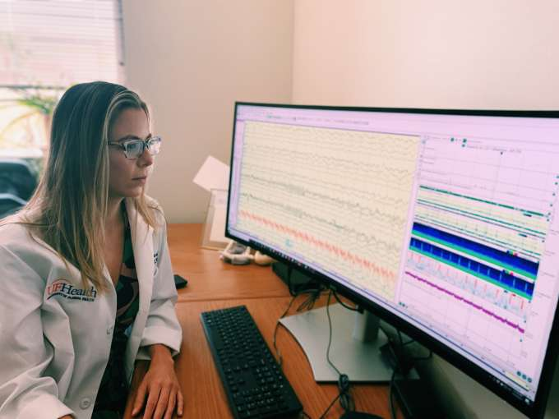
Solution
Automatic Seizure Detection System
Enables long-term patient monitoring
Helps reduce neurologists’ training time
Improves quality and reliability of detection
https://neurology.ufl.edu/divisions/epilepsy/outpatient-clinic/critical-care-eeg-monitoring/

Slide 5
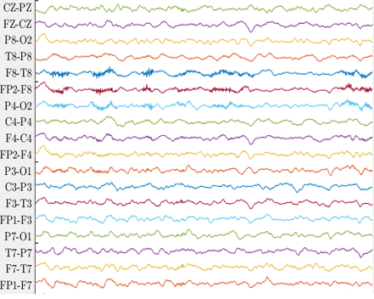
Recent Prior Works in Automated Seizure Detection
Features:
Wavelet
Fourier Transform
Spectrogram
…
Complex preprocessing steps
Classification
Seizure
No-seizure
Ignores temporal correlations
Feature Extraction¹⁻³
Machine Learning
Input data
Computationally expensive
Mostly Consider
Per Patient Training
Ignores diversity among patients
Deep Learning⁴⁻⁶
¹ Slimen et al. 2020
² Sharan et al.2020
³ Jana et al. 2020
⁴ Khalilpour, et al. 2020
⁵ Boonyakitanont et al.2019
⁶ Liang et al. 2020

Slide 6
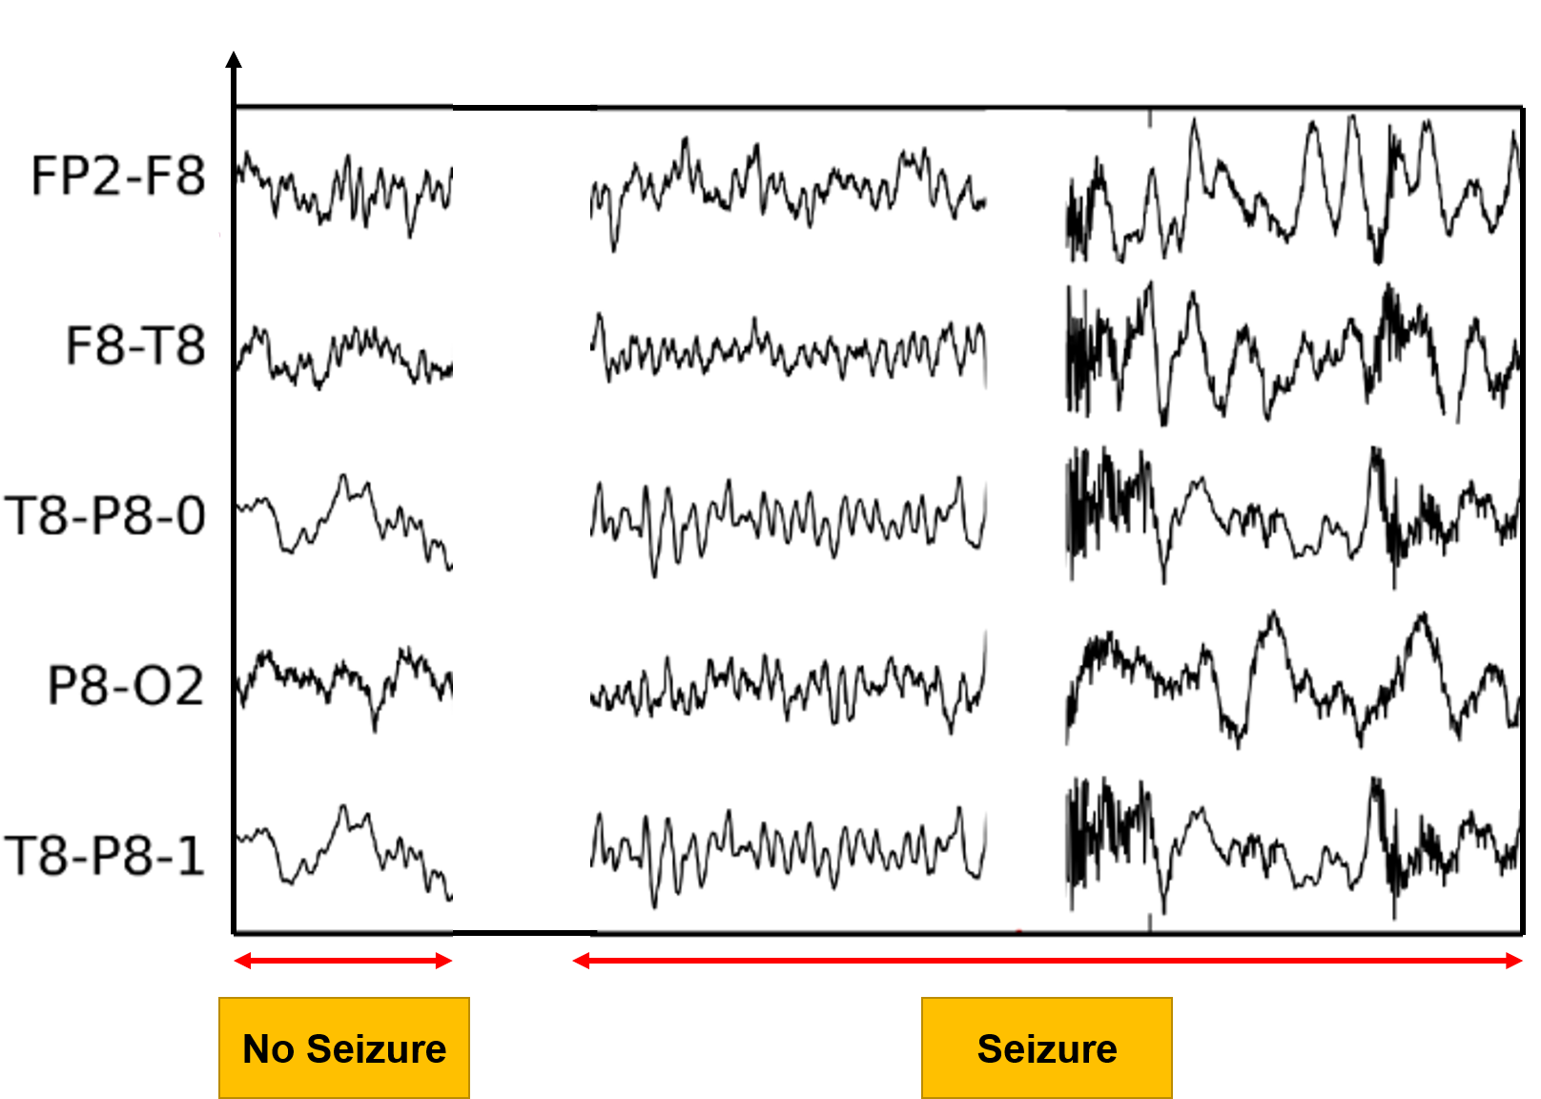
Motivating Observations
Seizure vs. no-seizure times:
Presence of highly inter-channel correlation during seizure¹
Mutual information extraction
Presence of temporal correlation
Structured inference over factor graphs
Complex relationship between the signals and the seizure state
Abstract deep learning techniques
¹Imene Jemal, Amar Mitiche and Neila Mezghani, ” A Study of EEG Feature Complexity in Epileptic Seizure Prediction”

Slide 7
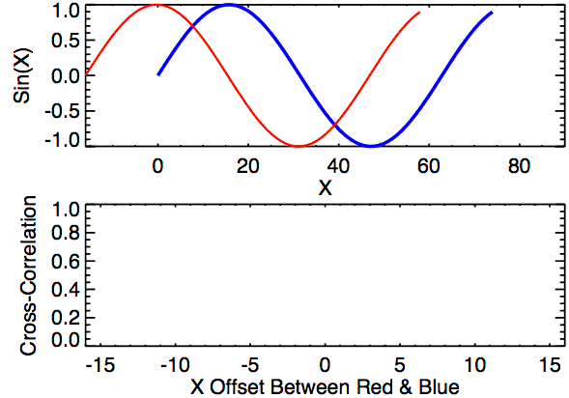
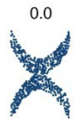
Dependence measures
Cross correlation:
Measure of similarity between one signal and the time delayed version of other signals:
Unable to capture nonlinearity between recordings
Image: towardsdatascience.com
https://courses.lumenlearning.com/ivytech-collegealgebra/chapter/distinguish-between-linear-and-nonlinear-relations/

Slide 8
Our Approach
We use mutual information as a measure of mutual dependence between EEG channels
Measures the KL divergence between joint distribution and the product of the marginals
We use neural mutual information estimators
To the best of our knowledge this is the first time this has been used in this problem domain
$$I(X_{i};X_{j})=D_{KL}\left(f(x_{i}, x_{j})\left\|f\left(x_{i}\right)f(x_{j})\right.\right)$$
$X_{i}$: Signal from the $i$-th channel
$X_{j}$: Signal from the $j$-th channel
$f(x_{i}, x_{j})$: Joint distribution
$f\left(x_{i}\right)f(x_{j})$: Product of the marginals

Slide 9
Neural MI Estimation: SMILE
SMILE [Song et al.]
Relies on Donsker-Varadhan (DV) representation
The function 𝑇 can be represented as a neural network parametrized by 𝜙
Negative of this expression is used as a loss function for optimization using SGD
The expectation terms are estimated using the elements in the minibatch
The clipping function provides a knob for better tuning the bias-variance trade-off

Slide 10
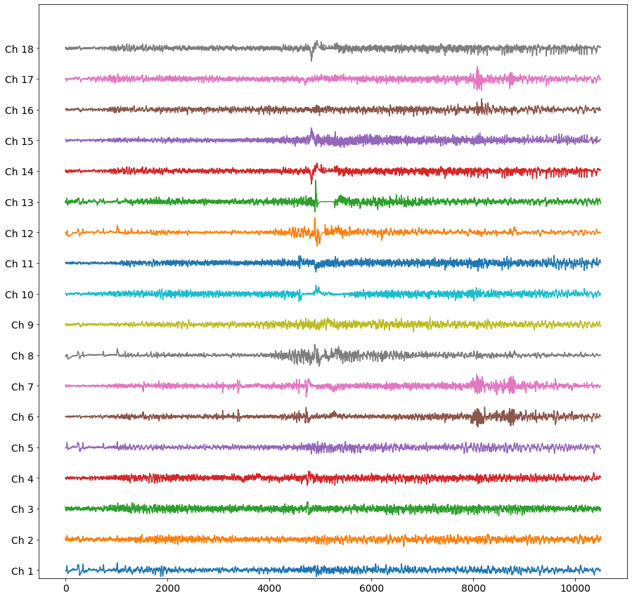
Qualitative Results
During Non-seizure Regions
During Seizure Regions
Channel
Channel
Channel
Channel
(Patient 1)
Channel
Channel
Channel
Channel
School of Biomedical Engineering
(Patient 2)

Slide 11
Using MI for Seizure Detection
Using MI as a sole feature will not yield good results
Many other important features in the data is ignored
Our approach: Use a carefully designed 1D CNN to extract more features
from EEG signals
6 ConvNet layers with ReLU activation
Minimal preprocessing (only remove the 60Hz power line)
Use the past 4 seconds of data for feature extraction
4-second block
6-Layer 1D CNN
ReLU Activation
Flattened Features

Slide 12
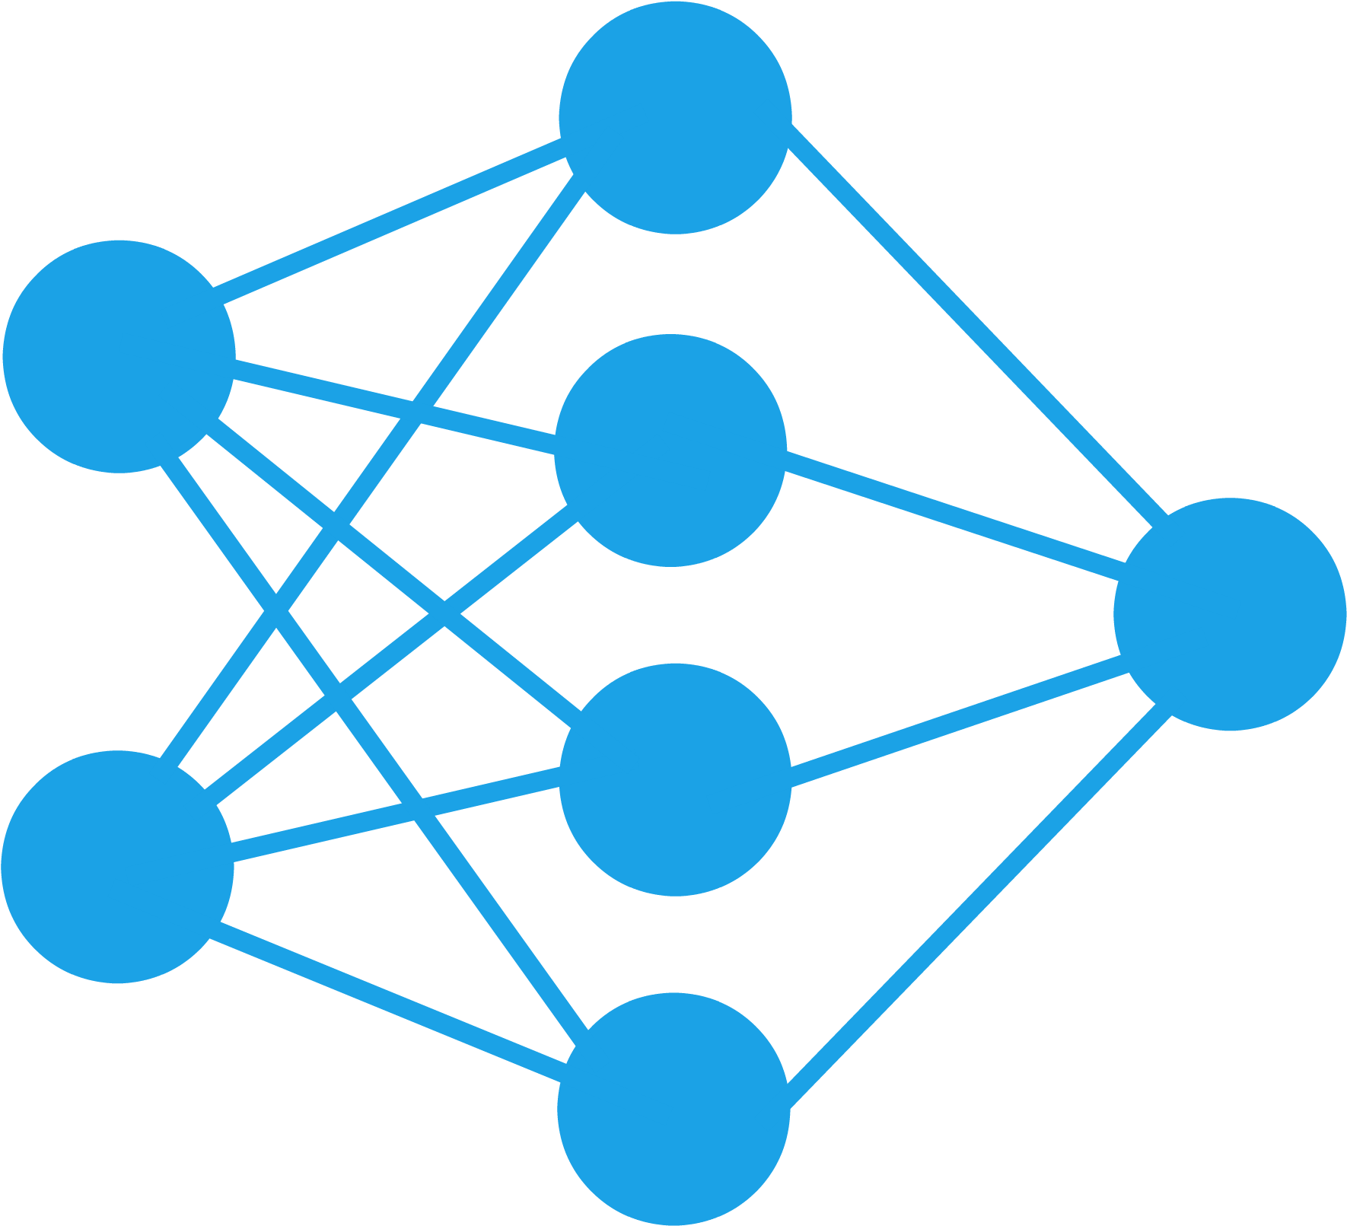
Per-Second Seizure Detection
Using the neural mutual estimator and 1D CNN, we can perform per second seizure detection
This does not fully exploit all temporal dependences
Spatial Processing for time step $t_{k}$
$$t_{k}$$
Past 32 seconds
Mutual Information Estimation
$$y_{t_{k}}$$
$$\hat{P}(s_{t_{k}}|y_{t_{k}})$$
EEG Recording
$$x_{t_{k}}$$
$$\max_{θ}{{\hat{I}}_{θ}(x_{t_{k}}^{(i)};x_{t_{k}}^{(j)})}$$
Dense + Sigmoid Layer
1D CNN for Feature Extraction
Past 4 seconds
We use hidden Markov models and factor graphs to further improve the estimates.

Slide 13
Factor Graphs
Factor graphs are graphical models (re-invented numerous times )
Represent factorization of a multivariable function (e.g., joint distribution)
A node for every factor (Forney-style)
An edge (or half-edge) for every variable (Forney-style)
$$f\left(u,w,x,y,z\right)=f_{1}\left(u\right)f_{2}\left(w\right)f_{3}\left(x | u,w\right)f_{4}\left(y | x\right)f_{5}(z|x)$$
Image from Loeliger (2004)
Forney-style factor graph

Slide 14
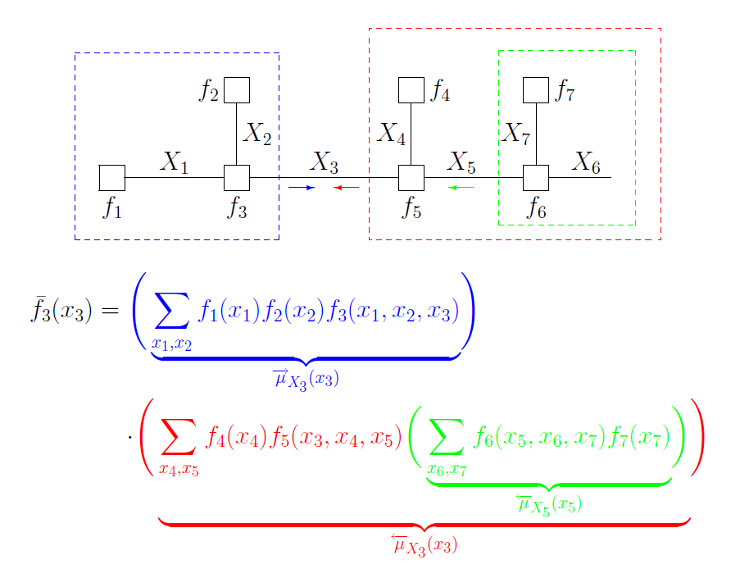
How Does Message Passing Work?
Compute “messages” locally and pass the message along edges
Forward message
Backward message
Both are computed recursively!

Slide 15
MICAL Algorithm
Spatial Processing for time step $t_{k}$
$$t_{k}$$
Past 32 seconds
Mutual Information Estimation
$$y_{t_{k}}$$
$$\hat{P}(s_{t_{k}}|y_{t_{k}})$$
EEG Recording
$$x_{t_{k}}$$
$$\max_{θ}{{\hat{I}}_{θ}(x_{t_{k}}^{(i)};x_{t_{k}}^{(j)})}$$
Dense + Sigmoid Layer
1D CNN for Feature Extraction
Past 4 seconds
Temporal Processing for all time steps $t_{k}$
$$t_{k}$$
$$s_{0}$$
$$f_{1}$$
$$s_{1}$$
$$f_{2}$$
$$s_{2}$$
$$f_{3}$$
$$s_{3}$$
$$s_{n−1}$$
$$f_{n}$$
$$s_{n}$$
Seizure probability
$$\hat{P}(s_{t_{k}}|Y)$$
$$μ_{f_{n}→f_{n−1}}(s_{n−1})$$
$$μ_{f_{2}→f_{3}}(s_{3})$$
$$μ_{f_{4}→f_{3}}(s_{3})$$
FG Inference
$$y_{t_{1}}$$
$$y_{t_{2}}$$
$$y_{t_{3}}$$
$$y_{t_{n}}$$
: Forward Message
: Backwards Message

Slide 16
8 Models for Comparison
Two baseline models (best SOTA results) :
Feature Engineering: Spectrogram detector
Deep Learning-based design: 2D CNN for raw EEG signals
Our proposed 1D CNN
Our proposed 1D CNN + GRU
Our proposed 1D CNN + FG
Our proposed 1D CNN + SMILE
Our proposed 1D CNN + SMILE+GRU
Our proposed MICAL
6-fold leave-4-patient-out

Slide 17
Quantitative Results
 | AUC ROC | AUC PR | F1 Score
2D CNN¹ | 0.78± 0.08 | 0.37± 0.17 | 0.88± 0.03
Spectrogram² | 0.77± 0.07 | 0.37± 0.1 | 0.92± 0.03
1D CNN | 0.82± 0.04 | 0.42± 0.12 | 0.91± 0.02
1D CNN-GRU | 0.82± 0.03 | 0.44± 0.10 | 0.90± 0.06
1D CNN-FG | 0.82± 0.05 | 0.44± 0.1 | 0.92± 0.02
1D CNN-SMILE | 0.83± 0.04 | 0.48± 0.11 | 0.92± 0.01
1D CNN-SMILE GRU | 0.84± 0.03 | 0.48± 0.15 | 0.93± 0.01
MICAL | 0.84± 0.04 | 0.50± 0.13 | 0.93± 0.01
5% improvement

Slide 18
Quantitative Results
 | AUC ROC | AUC PR | F1 Score
2D CNN¹ | 0.78± 0.08 | 0.37± 0.17 | 0.88± 0.03
Spectrogram² | 0.77± 0.07 | 0.37± 0.1 | 0.92± 0.03
1D CNN | 0.82± 0.04 | 0.42± 0.12 | 0.91± 0.02
1D CNN-GRU | 0.82± 0.03 | 0.44± 0.10 | 0.90± 0.06
1D CNN-FG | 0.82± 0.05 | 0.44± 0.1 | 0.92± 0.02
1D CNN-SMILE | 0.83± 0.04 | 0.48± 0.11 | 0.92± 0.01
1D CNN-SMILE GRU | 0.84± 0.03 | 0.48± 0.15 | 0.93± 0.01
MICAL | 0.84± 0.04 | 0.50± 0.13 | 0.93± 0.01

Slide 19
Quantitative Results
 | AUC ROC | AUC PR | F1 Score
2D CNN¹ | 0.78± 0.08 | 0.37± 0.17 | 0.88± 0.03
Spectrogram² | 0.77± 0.07 | 0.37± 0.1 | 0.92± 0.03
1D CNN | 0.82± 0.04 | 0.42± 0.12 | 0.91± 0.02
1D CNN-GRU | 0.82± 0.03 | 0.44± 0.10 | 0.90± 0.06
1D CNN-FG | 0.82± 0.05 | 0.44± 0.1 | 0.92± 0.02
1D CNN-SMILE | 0.83± 0.04 | 0.48± 0.11 | 0.92± 0.01
1D CNN-SMILE GRU | 0.84± 0.03 | 0.48± 0.15 | 0.93± 0.01
MICAL | 0.84± 0.04 | 0.50± 0.13 | 0.93± 0.01
5% improvement

Slide 20
Quantitative Results
 | AUC ROC | AUC PR | F1 Score
2D CNN¹ | 0.78± 0.08 | 0.37± 0.17 | 0.88± 0.03
Spectrogram² | 0.77± 0.07 | 0.37± 0.1 | 0.92± 0.03
1D CNN | 0.82± 0.04 | 0.42± 0.12 | 0.91± 0.02
1D CNN-GRU | 0.82± 0.03 | 0.44± 0.10 | 0.90± 0.06
1D CNN-FG | 0.82± 0.05 | 0.44± 0.1 | 0.92± 0.02
1D CNN-SMILE | 0.83± 0.04 | 0.48± 0.11 | 0.92± 0.01
1D CNN-SMILE GRU | 0.84± 0.03 | 0.48± 0.15 | 0.93± 0.01
MICAL | 0.84± 0.04 | 0.50± 0.13 | 0.93± 0.01

Slide 21
Summary
MICAL, a hybrid model-based/data-driven detector exploiting both inter-channel and temporal correlations
Using simple preprocessing steps based on raw EEG data and training the model across all patients
Incorporating mutual information estimation results in capturing dependency among EEG channels
Factor graphs applied to the combined features of MI estimation and CNN helps in exploiting temporal correlation at reduced complexity

Slide 22
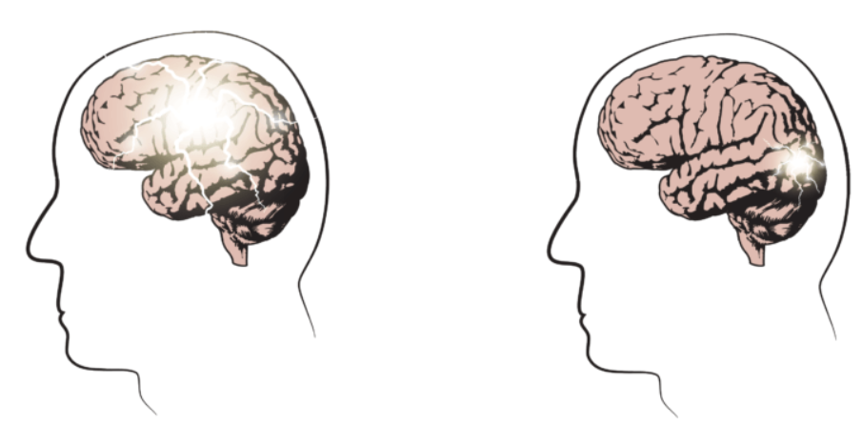
Future Directions
Including large dataset such as TUH database
better evaluation of generalizability across a larger population
Explore MI measure for seizure prediction
Focal and generalized seizure classification
Generalized
Focal
Images from : https://epilepsyqueensland.com.au/about-epilepsy-epilepsy-queensland/seizure-types/what-are-the-different-types-of-seizures/

Slide 23
Thank you for listening!

