Slide 1
Federated Intelligent Terminals Facilitate Stuttering Monitoring
Yongzi Yu¹, Wanyong Qiu¹, Chen Quan¹, Kun Qian^{1*}, Zhihua Wang², Yu Ma¹, Bin Hu^{1*}, Bjoern W. Schuller³ and Yoshiharu Yamamoto²
1 School of Medical Technology, Beijing Institute of Technology, Beijing, China
2 Educational Physiology Laboratory, The University of Tokyo, Japan
3 GLAM -- Group on Language, Audio, & Music, Imperial College London, UK
Notes:
This is the presentation of our paper [name], My name is yuyongzi. It’s my honor to be here to present our paper.

Slide 2
CONTENT
01
Overview
02
Motivation
03
Data & Method
04
Result
05
Conclusion
Notes:
The presentation will show our work from five parts.

Slide 3
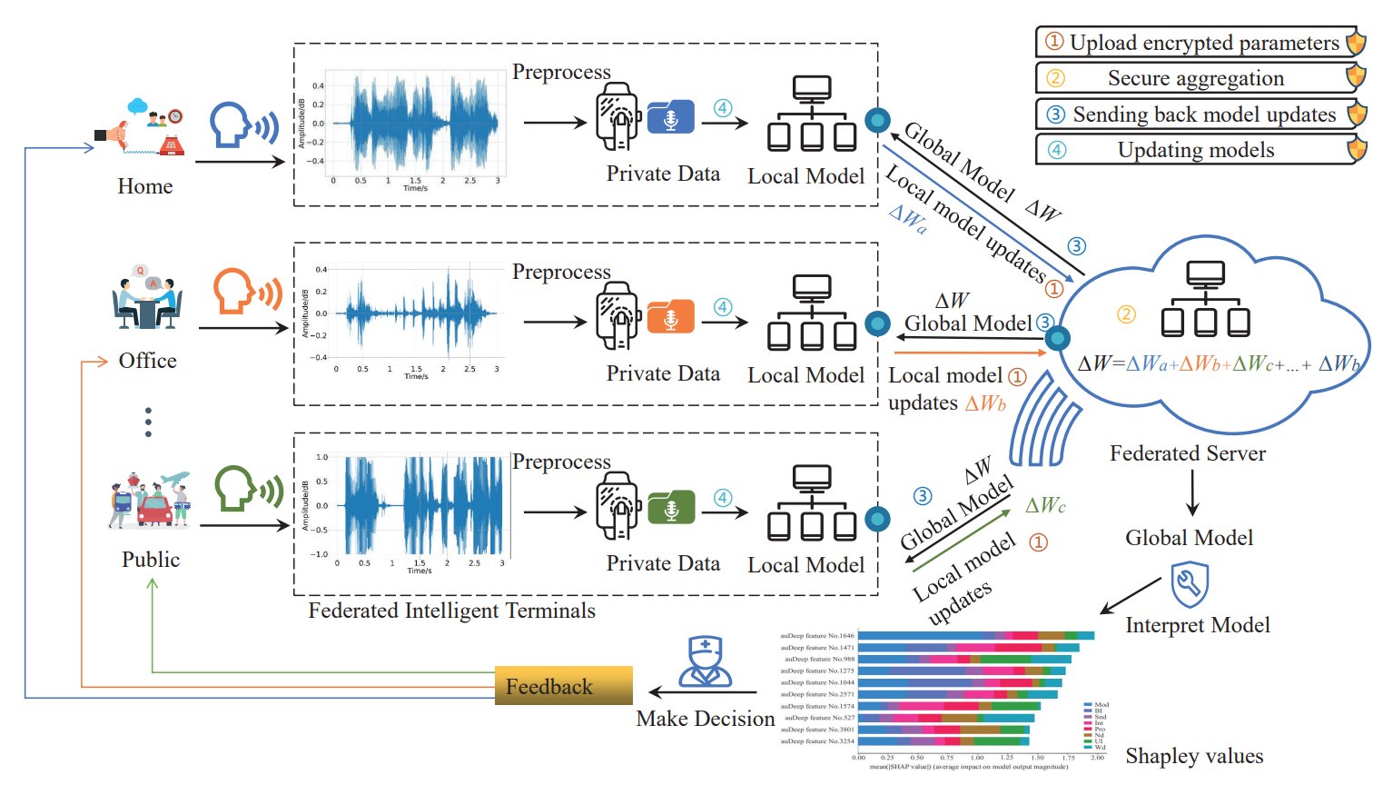
Overview
Federated intelligent terminals for automatic monitoring of stuttering
Contribution
The first time that FL^{[1]} has been applied to stuttering scenarios
Verify that XGBoost-based FL has comparable performance with centralised learning for stuttering classification
Introduce Shapley values to measure changes in feature importance
Fig.1 The framework of federated intelligent terminals
[1] FL(Federated Learning)
Notes:
We proposed the [黑字]. The contribution of our work could be included as three parts: Firstly, this is the first time that FL has been applied to stuttering scenarios. Secondly, considering privacy protection, we find that XGBoost-based FL has comparable performance with centralized learning for stuttering classification. Thirdly We introduce Shapley values to measure changes in feature importance. Fig 1shows the framework of federated intelligent terminals. Different scenarios collect the audio and train in their own client, then they upload the parameters to the federated server. After federated learning, we get the global model and we use shapley value to check. Clients get the global model and make decision, which is a feedback to the users.

Slide 4
Motivation
Monitoring of stuttering is crucial to speech therapy.
Evaluation of stuttering by speech therapists can be influenced by too much manual subjective intervention
Comprehensive evaluation in various contexts is required.
The therapist's evaluation might be influenced by many factors
communication situation
psychological factors
linguistic complexity
personal subjectivity
Problem of data security.
So we propose the federated intelligent terminals for automatic monitoring of stuttering speech in different contexts!
Notes:
Stuttering is a multifactorial language disorder. The physical and emotional symptoms of people who stutter exert an adverse impact on their lives. Therefore, the monitoring of stuttering is crucial to speech therapy. Besides, Evaluation of stuttering by speech therapists can be influenced with too much manual subjective intervention.So, a comprehensive evaluation in various contexts is required. Further, the results of the speech therapist's evaluation might be influenced by many factors, such as the communication situation, psychological factors, linguistic complexity, and personal subjectivity. Also, the question of data security for AI is need to be concerned. So we propose FITs which stands for the federated intelligent terminals

Slide 5
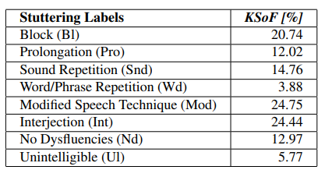
Method-Data and Explainable
Shapley[2] value Tool
Fairly evaluate feature contributions by assigning each feature a numerical value to represent its impact.
Data Preparation
The experimental data are taken from the Kassel State of Fluency (KSoF) corpus.^{[1]}
Train: 23 speakers
Devel: 6 speakers
Sample number: 3,471
Length of each audio: 3-second
Classes: 8
Feature: 4,096 dimensions extracted by auDeep.
Table.1 The Distribution of annotations in KSoF dataset
[1] The data can be accessed by request from the Kassel State of Fluency (KSoF) dataset at https://zenodo.org/record/6801844
[2] SHAP (SHapley Additive exPlanations) is a game-theoretic method to explain the output of ML models.https://shap.readthedocs.io.
Notes:
The experimental data are taken from the Kassel State of Fluency. It can be accessed from this link. The dataset is split based on speakers. It contains 3,471 speech segments from speeches of stutterers, each labeled as one of 8 classes. The distribution of labels is shown in Table1. Each sample contains 4\,096 static features extracted by auDeep. auDeep uses a sequence-to-sequence learning-based approach to extract features with timing information from audio signals. The SHapley Additive exPlanations provides an efficient method to fairly evaluate feature contributions by assigning each feature a value to represent its impact.

Slide 6
Method-Centralised model
XGBoost Ensemble Learning Model
Positive:
Good at parallel computing
Highly scalable
Uses minimal resources for algorithmic optimization
Has flexible portability and precise libraries
Object Function:
$$Obj^{\left(t\right)}=\sum_{i=1}^{n}{ }l\left(y_{i},{\hat{y}}_{i}^{\left(t\right)}\right)+\sum_{i=1}^{t}{ }Ω\left(f_{i}\right)≈\sum_{i=1}^{n}{ }[g_{i}f_{i}(x_{i})+\frac{1}{2}h_{i}f_{t}^{2}(x_{i})]+Ω(f_{i})$$
i refers to the i^{th} sample, $\hat{y_{i}}=\sum_{k=1}^{K}{ }f_{k}\left(x_{i}\right).$
$g_{i}=∂_{{\hat{y}}^{(t−1)}}l(y_{i},{\hat{y}}^{(t−1)})$ and $h_{i}=∂_{{\hat{y}}^{(t−1)}}^{2}l\left(y_{i},{\hat{y}}^{(t−1)}\right)$
the first order gradient
the second order gradient
Notes:
Ensemble learning XGBoost is used for our multi-classification task. Compared with other algorithms, XGBoost is good at parallel computing，highly scalable, and uses minimal resources for algorithmic optimization. Besides, it has flexible portability and precise libraries, which makes it easier to be used in FITS. The object function is on the right. L is loss function and omega is Regularization function. gi is the first order gradient of loss and hi is the second order gradient of loss.

Slide 7
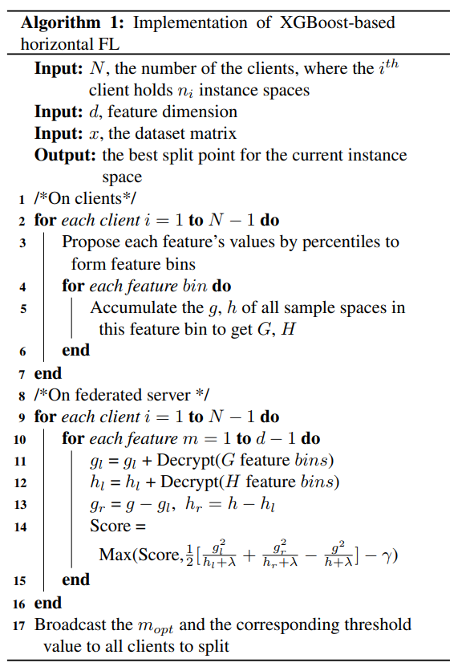
Method-Federated model
The framework is based on FATE[1].
The XGBoost-based horizontal FL steps:
Clients hold different training samples and train the ensemble tree model.
For each feature, the client accumulates the gradient of its samples’ loss.
Clients send the gradient to the server.
The server aggregates the gradients from the clients and finds out the best weights.
The server broadcasts the best weights to clients.
[1] FATE (Federated AI Technology Enabler) supports the FL architecture, as well as the secure computation and development of various ML algorithms.https://github.com/FederatedAI/FATE
Notes:
In order to set up the FL system for automatic stuttering speech monitoring, we makes a multi-classification FL with XGBoost. The framework is based on the FATE platform. Participants are divided into a central server and several clients. Clients hold different training samples, but share the same set of features and class labels. All the clients learn the same ensemble tree model. The central server only aggregates the gradients passed by the clients and broadcasts to the clients what the best global split point is now. Algorithm1 briefly shows the pseudocode.

Slide 8
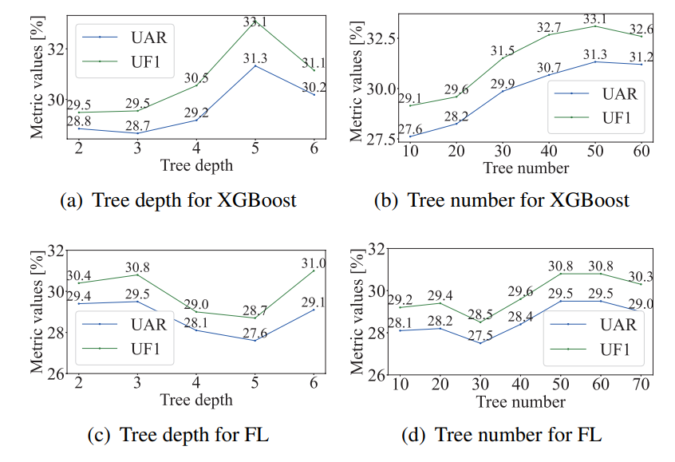
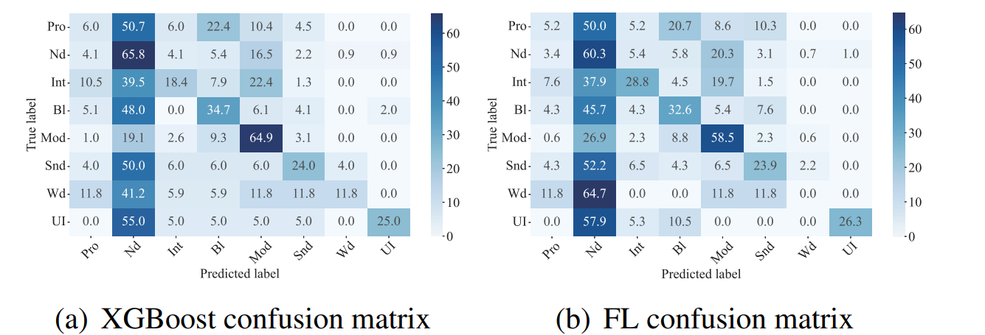
Result
Evaluation matrix: UAR and UF1
Fig.2 Model performance variation (UAR and UF₁ in [\%]) between centralised learning and federated learning XGBoost is optimal with 50 trees and depth 5
FL is optimal with 50 trees and depth 3
Fig.3 Normalised confusion matrix (in [\%]) of true labels and predicted labels between centralised learning and federated learning.
Notes:
We use UAR and UF1 to evaluate the matrix. According to the fig2 and fig3, the performance of the FL model has little reduction compared to XGBoost on the testing set, despite the skewed label distribution of the data. This means that we can implement the horizontal FL with a lower complexity ensemble tree model, which is very attractive in practice, especially in larger healthcare data conditions.

Slide 9
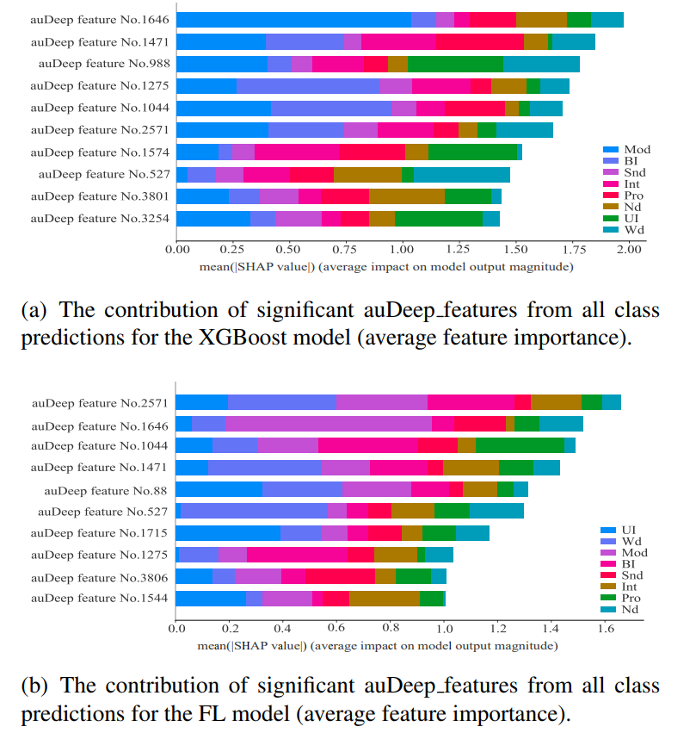
Conclusion
FL has considerable privacy-preserving advantages over centralised learning
Offered a valid verification and basis for the FL paradigm on automatic monitoring of stuttering is provided
Shapley values can fairly evaluate the contribution of features
Future work: lightweight models and the deployment of FITs models on devices
Fig.4 The features sorted by the mean of Shapley values for all class predictions
Notes:
In conclusion, FL has considerable privacy-preserving advantages over centralised learning. This study provided a valid verification for the FL paradigm on automatic monitoring of stuttering. Fig4 shows the Shapley values for the whole feature space. It shows that the FL can still obtain very close results of feature importance, compared to centralized learning. Shapley value is important to support the advancement of mechanism design. And the Future work will focus on the development of lightweight models , and the deployment of FITS models on devices. That’s all of our presentation. Thank you for listening.

