Slide 1
LDADeep+: Latent Aspect Discovery with Deep Representations
Chieh-En Tsai (Andy Tsai), Hui-Lan Hsieh, Winston Hsu
Communication and Multimedia Lab
National Taiwan University, Taipei, Taiwan
“LDADeep+: Latent Aspect Discovery with Deep Representations” – ICASSP 2016
Chieh-En Tsai (b01902004@csie.ntu.edu.tw)

Slide 2
LDADeep+: Latent Aspect Discovery with Deep Representations
Chieh-En Tsai (Andy Tsai), Hui-Lan Hsieh, Winston Hsu
Communication and Multimedia Lab
National Taiwan University, Taipei, Taiwan
“LDADeep+: Latent Aspect Discovery with Deep Representations” – ICASSP 2016
Chieh-En Tsai (b01902004@csie.ntu.edu.tw)
Notes:
So why would we like to perform aspect discovery?

Slide 3
Motivation: explosive growth of visual data
“LDADeep+: Latent Aspect Discovery with Deep Representations” – ICASSP 2016
Chieh-En Tsai (b01902004@csie.ntu.edu.tw)
Notes:
The visual data on the internet is growing explosively. So how to get the best use of those images become extraordinary important

Slide 4
Motivation: Finding Essential Concepts
To empower complicated image applications, we wish to find essential concepts of images
“LDADeep+: Latent Aspect Discovery with Deep Representations” – ICASSP 2016
Chieh-En Tsai (b01902004@csie.ntu.edu.tw)

Slide 5
Motivation: Finding Essential Concepts
To empower complicated image applications, we wish to find essential concepts of images
“LDADeep+: Latent Aspect Discovery with Deep Representations” – ICASSP 2016
Chieh-En Tsai (b01902004@csie.ntu.edu.tw)

Slide 6
Motivation: Finding Essential Concepts
[Essential concepts]
Rectangle
Triangle
Orange
Blue
To empower complicated image applications, we wish to find essential concepts of images
“LDADeep+: Latent Aspect Discovery with Deep Representations” – ICASSP 2016
Chieh-En Tsai (b01902004@csie.ntu.edu.tw)

Slide 7
Motivation: Finding Essential Concepts
[Essential concepts]
Rectangle
Triangle
Orange
Blue
To empower complicated image applications, we wish to find essential concepts of images
[Non-essential concepts]
“LDADeep+: Latent Aspect Discovery with Deep Representations” – ICASSP 2016
Chieh-En Tsai (b01902004@csie.ntu.edu.tw)

Slide 8
Motivation: Finding Essential Concepts
[Essential concepts]
Rectangle
Triangle
Orange
Blue
To empower complicated image applications, we wish to find essential concepts of images
[Non-essential concepts]
In the reality …
“LDADeep+: Latent Aspect Discovery with Deep Representations” – ICASSP 2016
Chieh-En Tsai (b01902004@csie.ntu.edu.tw)
Notes:
You may think this is so simple. A 5 years old kid could also done that

Slide 9
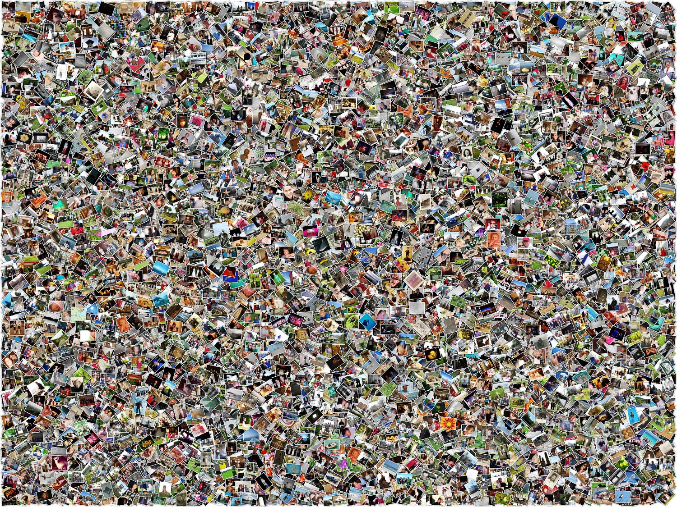
Motivation: Finding Essential Concepts
“LDADeep+: Latent Aspect Discovery with Deep Representations” – ICASSP 2016
Chieh-En Tsai (b01902004@csie.ntu.edu.tw)
Notes:
When we are facing hundreds of millions of images, those essential concepts may not be so obvious to see.
So you may think, ok, let’s use the description of those images to help us

Slide 10
Motivation: text is rare
Text is not always reliable
Tags and description can be very few and contain little amount of information.
“LDADeep+: Latent Aspect Discovery with Deep Representations” – ICASSP 2016
Chieh-En Tsai (b01902004@csie.ntu.edu.tw)
Notes:
Another horrible truth about online-image is that when users are uploading a bunch of images at a time, the text description can be very few and contain only little amount of information

Slide 11
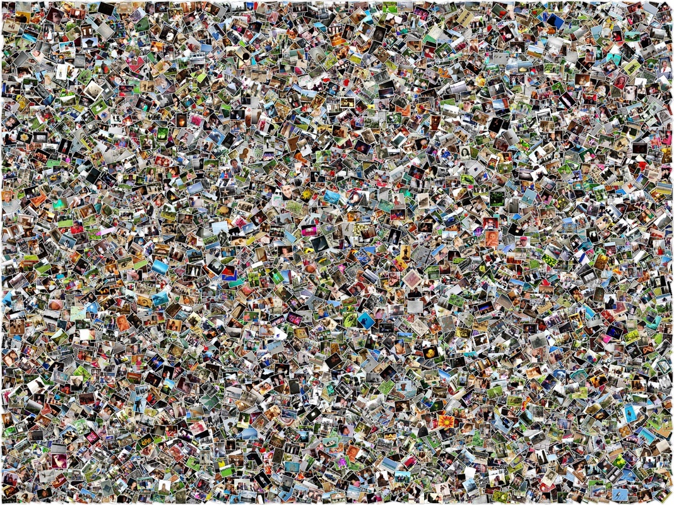
Introducing LDADeep+
photos of related aspects
“Cherry Blossom”
#Hanami
“Japanese Food”
“Picnics”
variant (diverse) aspects
“Riverside trees”
“representative”
“diverse”
Without the need of text
“LDADeep+: Latent Aspect Discovery with Deep Representations” – ICASSP 2016
Chieh-En Tsai (b01902004@csie.ntu.edu.tw)
Notes:
We propose a model called LDADeep+ to find the most representative and diverse aspects of a group of images automatically

Slide 12
Outline
Why and What
Framework
Define “aspect”
Method
Evaluation
Visualizing results
Idea takeaways
“LDADeep+: Latent Aspect Discovery with Deep Representations” – ICASSP 2016
Chieh-En Tsai (b01902004@csie.ntu.edu.tw)
Notes:
Before we dive into our method, we have to first define what an aspect is

Slide 13
Define “aspect”
We define a good aspect as:
- Commonly seen concept among images
We define a good aspect discovery as:
- The more aspects discovered the better
- The more diverse the discovered aspects are the better
“LDADeep+: Latent Aspect Discovery with Deep Representations” – ICASSP 2016
Chieh-En Tsai (b01902004@csie.ntu.edu.tw)

Slide 14
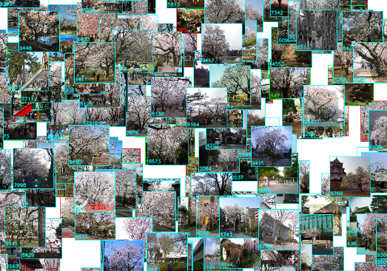
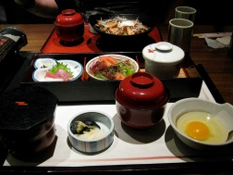
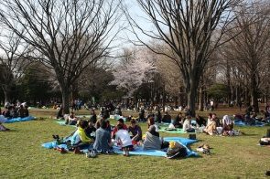
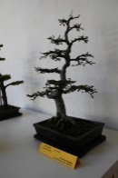
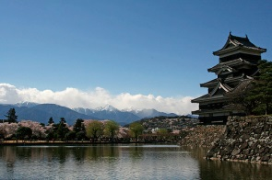
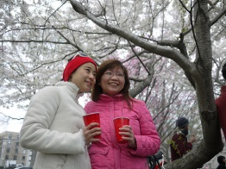
Define “aspect”: commonly seen & diverse
# Hanami
(Japanese flower viewing)
Aspects of # Hanami
. . .
Japanese food
Picnic
Potted art
Historical site
Photo taking
Cherry blossom
“LDADeep+: Latent Aspect Discovery with Deep Representations” – ICASSP 2016
Chieh-En Tsai (b01902004@csie.ntu.edu.tw)
Notes:
So for example, if we are looking at a group of images related to Hanami, which is the Japanese flower viewing event. The possible aspects of this group of images might be …. Something like that, which are commonly happen in Hanami event.
And notice that these aspects are actually discovered by our system, we’ll talk about that in more detail later on

Slide 15
Outline
Why and What
Framework
Define “aspect”
Method
Evaluation
Visualizing results
Idea takeaways
“LDADeep+: Latent Aspect Discovery with Deep Representations” – ICASSP 2016
Chieh-En Tsai (b01902004@csie.ntu.edu.tw)

Slide 16
Naïve Method - Kmeans
Centroid as the aspect
Optimize diversity
No “commonly-seen” guaranteed
“LDADeep+: Latent Aspect Discovery with Deep Representations” – ICASSP 2016
Chieh-En Tsai (b01902004@csie.ntu.edu.tw)
Notes:
A naïve method might be using kmeans model and view each centroid as an aspect
This kind of method can optimize the diversity of the aspect, however, they are not guaranteed to be commonly seen among those images

Slide 17
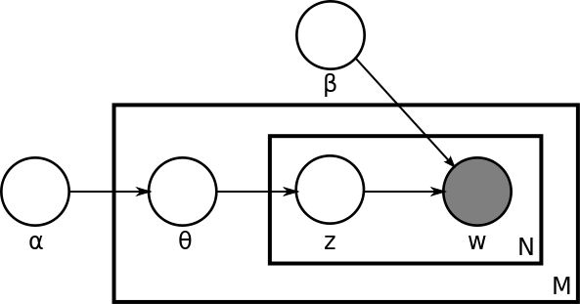
Commonly-Seen & Diverse – LDA
Documents
Topics
Latent Dirichlet Allocation (LDA)
$$prob\left(word \right|topic)$$
Words
word
$$prob\left(topic \right|document)$$
document
$$prob\left(topic \right|document)$$
Word → Visual-word
Document → Image
Topic → Aspect
$$prob\left(word \right|topic)$$
“Latent Dirichlet Allocation”, David M. Beli, JMLR, 2003
“LDADeep+: Latent Aspect Discovery with Deep Representations” – ICASSP 2016
Chieh-En Tsai (b01902004@csie.ntu.edu.tw)
Notes:
So a better method may be using the topic model like latent dirichlet allocation.
This model assume that
1. each document contains a topic distribution
2. And each topic contains a word distribution

Slide 18
Commonly-Seen & Diverse – LDA
Documents
Topics
Latent Dirichlet Allocation (LDA)
$$prob\left(word \right|topic)$$
Words
word
$$prob\left(topic \right|document)$$
document
$$prob\left(topic \right|document)$$
Word → Visual-word
Document → Image
Topic → Aspect
$$prob\left(word \right|topic)$$
“Latent Dirichlet Allocation”, David M. Beli, JMLR, 2003
“LDADeep+: Latent Aspect Discovery with Deep Representations” – ICASSP 2016
Chieh-En Tsai (b01902004@csie.ntu.edu.tw)
Notes:
So when we look at a document, we can actually observe the word distribution

Slide 19
Commonly-Seen & Diverse – LDA
Documents
Topics
Latent Dirichlet Allocation (LDA)
$$prob\left(word \right|topic)$$
Words
word
$$prob\left(topic \right|document)$$
document
$$prob\left(topic \right|document)$$
Word → Visual-word
Document → Image
Topic → Aspect
$$prob\left(word \right|topic)$$
“Latent Dirichlet Allocation”, David M. Beli, JMLR, 2003
“LDADeep+: Latent Aspect Discovery with Deep Representations” – ICASSP 2016
Chieh-En Tsai (b01902004@csie.ntu.edu.tw)
Notes:
And form the word distribution we observed, we can inference the topic distribution of that document.
So, if we can find a way to view each image as a collection of words. We can discover aspects of that image by topic modeling

Slide 20
Commonly-Seen & Diverse – LDA
Documents
Topics
Latent Dirichlet Allocation (LDA)
$$prob\left(word \right|topic)$$
Words
word
$$prob\left(topic \right|document)$$
document
$$prob\left(topic \right|document)$$
Word → Visual-word
Document → Image
Topic → Aspect
$$prob\left(word \right|topic)$$
How to define
“visual-word” ?
“Latent Dirichlet Allocation”, David M. Beli, JMLR, 2003
“LDADeep+: Latent Aspect Discovery with Deep Representations” – ICASSP 2016
Chieh-En Tsai (b01902004@csie.ntu.edu.tw)
Notes:
So the big problem now become “how to define words in an image?”

Slide 21
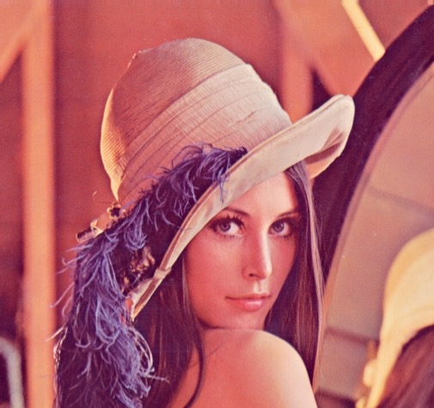
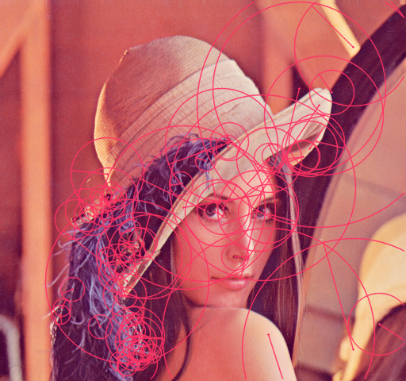
LDA – SIFT ( the traditional way )
SIFT feature extraction
Codebook Building
Bag of SIFT local descriptors as visual words
“Distinctive Image Features from Scale-Invariant Keypoints”, Lowe, David G., IJCV, 2004
“A bag-of-features approach based on hue-sift descriptor for nude detection,” Ana PB Lopes, SPC, 2009
“LDADeep+: Latent Aspect Discovery with Deep Representations” – ICASSP 2016
Chieh-En Tsai (b01902004@csie.ntu.edu.tw)
Notes:
A typical solution is to use bag-of-sift as the visual word

Slide 22
LDA – SIFT ( the traditional way )
Word index (w)
Prob(#0): 0.009
Prob(#1): 0
Prob(#2): 0
…
Prob(#4094): 0.00018
Prob(#4095): 0
Prob(w)
SIFT feature extraction
Codebook Building
Bag of SIFT local descriptors as visual words
“Distinctive Image Features from Scale-Invariant Keypoints”, Lowe, David G., IJCV, 2004
“A bag-of-features approach based on hue-sift descriptor for nude detection,” Ana PB Lopes, SPC, 2009
“LDADeep+: Latent Aspect Discovery with Deep Representations” – ICASSP 2016
Chieh-En Tsai (b01902004@csie.ntu.edu.tw)
Notes:
With the codebook building process, we can obtain the word distribution of that image

Slide 23
LDA – SIFT ( the traditional way )
Recall our LDA framework ?
Word index (w)
Prob(#0): 0.009
Prob(#1): 0
Prob(#2): 0
…
Prob(#4094): 0.00018
Prob(#4095): 0
Prob(w)
SIFT feature extraction
Codebook Building
Bag of SIFT local descriptors as visual words
“Distinctive Image Features from Scale-Invariant Keypoints”, Lowe, David G., IJCV, 2004
“A bag-of-features approach based on hue-sift descriptor for nude detection,” Ana PB Lopes, SPC, 2009
“LDADeep+: Latent Aspect Discovery with Deep Representations” – ICASSP 2016
Chieh-En Tsai (b01902004@csie.ntu.edu.tw)
Notes:
With the word distribution of the image, we can actually inference the aspect distribution of the image and so perform aspect discovery

Slide 24
LDA – SIFT ( the traditional way )
Word index (w)
Prob(#0): 0.009
Prob(#1): 0
Prob(#2): 0
…
Prob(#4094): 0.00018
Prob(#4095): 0
Prob(w)
SIFT feature extraction
Codebook Building
Bag of SIFT local descriptors as visual words
“Distinctive Image Features from Scale-Invariant Keypoints”, Lowe, David G., IJCV, 2004
“A bag-of-features approach based on hue-sift descriptor for nude detection,” Ana PB Lopes, SPC, 2009
“LDADeep+: Latent Aspect Discovery with Deep Representations” – ICASSP 2016
Chieh-En Tsai (b01902004@csie.ntu.edu.tw)

Slide 25
LDA – SIFT ( the traditional way )
Word index (w)
Prob(#0): 0.009
Prob(#1): 0
Prob(#2): 0
…
Prob(#4094): 0.00018
Prob(#4095): 0
Prob(w)
SIFT feature extraction
Codebook Building
Bag of SIFT local descriptors as visual words
“Distinctive Image Features from Scale-Invariant Keypoints”, Lowe, David G., IJCV, 2004
“A bag-of-features approach based on hue-sift descriptor for nude detection,” Ana PB Lopes, SPC, 2009
“LDADeep+: Latent Aspect Discovery with Deep Representations” – ICASSP 2016
Chieh-En Tsai (b01902004@csie.ntu.edu.tw)
Notes:
This kind of LDA-sift model is actually very popular in image recognition around 2009.
However, with the surge of deep learning. We propose a new model called LDADeep+ to combine the power of deep learning and the LDA model

Slide 26
LDADeep+ (I)
Word index (w)
Prob(#0): 0.009
Prob(#1): 0
Prob(#2): 0
…
Prob(#4094): 0.00018
Prob(#4095): 0
Aspects discovery by LDA
Represent images as the neuron responses
Prob(w)
convolutional neural network
“LDADeep+: Latent Aspect Discovery with Deep Representations” – ICASSP 2016
Chieh-En Tsai (b01902004@csie.ntu.edu.tw)
Notes:
we normalize the neural activation of the CNN to encode each image into word distribution
And then perform aspect discovery using LDA model on top of these word distribution.
And hopefully, we can find some high-level aspect of images

Slide 27
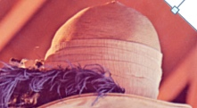
LDADeep+ (II)
LDA - SIFT
LDADeep+
Low level bag-of-word feature
Sensitive to edge, corner, texture
Cannot deal with “Deformation”
Bag-of-local-descriptor
Semantic-rich feature
Only sensitive to high-level meaning
Robust to “Deformation”, “Rotation”
Global descriptor
Appearance pattern matching
High quality aspect
“LDADeep+: Latent Aspect Discovery with Deep Representations” – ICASSP 2016
Chieh-En Tsai (b01902004@csie.ntu.edu.tw)
Notes:
So a quick comparison between two model
Corner of mouth, flower pattern, wood texture.

Slide 28
Outline
Why and What
Framework
Define “aspect”
Method
Evaluation
Visualizing results
Idea takeaways
“LDADeep+: Latent Aspect Discovery with Deep Representations” – ICASSP 2016
Chieh-En Tsai (b01902004@csie.ntu.edu.tw)

Slide 29
Event Summarization
# Hanami
(Japanese flower viewing)
Aspects of # Hanami
. . .
Japanese food
Picnic
Potted art
Historical site
Photo taking
Cherry blossom
“LDADeep+: Latent Aspect Discovery with Deep Representations” – ICASSP 2016
Chieh-En Tsai (b01902004@csie.ntu.edu.tw)
Notes:
We evaluate the performance of aspect discovery by performing event summarization.
We first filter images related to that event by searching the hashtag.
Just like what I’ve show you before, the system should summarize the event by showing all aspect it discovered

Slide 30
Event Summarization
Dataset
Comparing Methods
YFCC100M
100M user generated daily photos
32% with text description
69% with tags (mostly about which camera used)
LDADeep+
Base Model: - LDA
Feature: - FC7 (alexnet, ImageNet pretrained)
LDA - SIFT
Base Model: - LDA
Feature: - SIFT
Kmeans – FC7
Base Model: - Kmeans
Feature: - FC7
Online Questionnaire
Generation of Summarization
LDA-Based
Kmeans
“YFCC100M: The New Data in Multimedia Research”, Bart Thomee et.al., Communications of the ACM 2015
“LDADeep+: Latent Aspect Discovery with Deep Representations” – ICASSP 2016
Chieh-En Tsai (b01902004@csie.ntu.edu.tw)

Slide 31
Event Summarization
Dataset
Comparing Methods
YFCC100M
100M user generated daily photos
32% with text description
69% with tags (mostly about which camera used)
LDADeep+
Base Model: - LDA
Feature: - FC7
LDA - SIFT
Base Model: - LDA
Feature: - SIFT
Kmeans – FC7
Base Model: - Kmeans
Feature: - FC7
Online Questionnaire
Generation of Summarization
LDA-Based
Kmeans
Latent aspects
CNN
LDA
aspect
response
“YFCC100M: The New Data in Multimedia Research”, Bart Thomee et.al., Communications of the ACM 2015
“LDADeep+: Latent Aspect Discovery with Deep Representations” – ICASSP 2016
Chieh-En Tsai (b01902004@csie.ntu.edu.tw)
Notes:
For LDA-Based model, we generate the summarization by the following process.

Slide 32
Event Summarization
Dataset
Comparing Methods
YFCC100M
100M user generated daily photos
32% with text description
69% with tags (mostly about which camera used)
LDADeep+
Base Model: - LDA
Feature: - FC7
LDA - SIFT
Base Model: - LDA
Feature: - SIFT
Kmeans – FC7
Base Model: - Kmeans
Feature: - FC7
Online Questionnaire
Generation of Summarization
LDA-Based
Kmeans
Latent aspects
CNN
LDA
aspect
response
“YFCC100M: The New Data in Multimedia Research”, Bart Thomee et.al., Communications of the ACM 2015
“LDADeep+: Latent Aspect Discovery with Deep Representations” – ICASSP 2016
Chieh-En Tsai (b01902004@csie.ntu.edu.tw)
Notes:
For each image we pass it through our model and obtain an aspect distribution of that image.

Slide 33
Event Summarization
Dataset
Comparing Methods
YFCC100M
100M user generated daily photos
32% with text description
69% with tags (mostly about which camera used)
LDADeep+
Base Model: - LDA
Feature: - FC7
LDA - SIFT
Base Model: - LDA
Feature: - SIFT
Kmeans – FC7
Base Model: - Kmeans
Feature: - FC7
Online Questionnaire
Generation of Summarization
LDA-Based
Kmeans
Latent aspects
CNN
LDA
aspect
response
“YFCC100M: The New Data in Multimedia Research”, Bart Thomee et.al., Communications of the ACM 2015
“LDADeep+: Latent Aspect Discovery with Deep Representations” – ICASSP 2016
Chieh-En Tsai (b01902004@csie.ntu.edu.tw)

Slide 34
Event Summarization
Dataset
Comparing Methods
YFCC100M
100M user generated daily photos
32% with text description
69% with tags (mostly about which camera used)
LDADeep+
Base Model: - LDA
Feature: - FC7
LDA - SIFT
Base Model: - LDA
Feature: - SIFT
Kmeans – FC7
Base Model: - Kmeans
Feature: - FC7
Online Questionnaire
Generation of Summarization
LDA-Based
Kmeans
Latent aspects
argmax
5
CNN
LDA
aspect
response
“YFCC100M: The New Data in Multimedia Research”, Bart Thomee et.al., Communications of the ACM 2015
“LDADeep+: Latent Aspect Discovery with Deep Representations” – ICASSP 2016
Chieh-En Tsai (b01902004@csie.ntu.edu.tw)
Notes:
So in the end, for each dimension in the latent aspect space, we choose the image with the highest response to that dimension as the image that represent the aspect.

Slide 35
Event Summarization
Dataset
Comparing Methods
YFCC100M
100M user generated daily photos
32% with text description
69% with tags (mostly about which camera used)
LDADeep+
Base Model: - LDA
Feature: - FC7
LDA - SIFT
Base Model: - LDA
Feature: - SIFT
Kmeans – FC7
Base Model: - Kmeans
Feature: - FC7
Online Questionnaire
Generation of Summarization
LDA-Based
Kmeans
Latent aspects
argmax
5
CNN
LDA
aspect
response
“YFCC100M: The New Data in Multimedia Research”, Bart Thomee et.al., Communications of the ACM 2015
“LDADeep+: Latent Aspect Discovery with Deep Representations” – ICASSP 2016
Chieh-En Tsai (b01902004@csie.ntu.edu.tw)
Notes:
And for the kmens method

Slide 36
Event Summarization
Dataset
Comparing Methods
YFCC100M
100M user generated daily photos
32% with text description
69% with tags (mostly about which camera used)
LDADeep+
Base Model: - LDA
Feature: - FC7
LDA - SIFT
Base Model: - LDA
Feature: - SIFT
Kmeans – FC7
Base Model: - Kmeans
Feature: - FC7
Online Questionnaire
Generation of Summarization
LDA-Based
Kmeans
Latent aspects
argmax
5
CNN
LDA
aspect
response
“YFCC100M: The New Data in Multimedia Research”, Bart Thomee et.al., Communications of the ACM 2015
“LDADeep+: Latent Aspect Discovery with Deep Representations” – ICASSP 2016
Chieh-En Tsai (b01902004@csie.ntu.edu.tw)
Notes:
We simply choose the image that is closest to the centroid as the image that represent the aspect.
So for each of the 3 model we generate the summarization on 4 selected event and conduct online questionnaire to evaluate the models

Slide 37
Event Summarization
Dataset
Comparing Methods
YFCC100M
100M user generated daily photos
32% with text description
69% with tags (mostly about which camera used)
LDADeep+
Base Model: - LDA
Feature: - FC7
LDA - SIFT
Base Model: - LDA
Feature: - SIFT
Kmeans – FC7
Base Model: - Kmeans
Feature: - FC7
Online Questionnaire
Generation of Summarization
Define “aspect”
For each of the 4 events:
Introduce the event by Wiki
Show 3 summarization
Criterion: [score 1-6]
LDA-Based
Kmeans
Latent aspects
argmax
5
CNN
LDA
The more aspects discovered the better
The more diverse aspects the better
aspect
response
“YFCC100M: The New Data in Multimedia Research”, Bart Thomee et.al., Communications of the ACM 2015
“LDADeep+: Latent Aspect Discovery with Deep Representations” – ICASSP 2016
Chieh-En Tsai (b01902004@csie.ntu.edu.tw)

Slide 38
Event Summarization
Dataset
Comparing Methods
YFCC100M
100M user generated daily photos
32% with text description
69% with tags (mostly about which camera used)
LDADeep+
Base Model: - LDA
Feature: - FC7
LDA - SIFT
Base Model: - LDA
Feature: - SIFT
Kmeans – FC7
Base Model: - Kmeans
Feature: - FC7
Online Questionnaire
Subjective Test Result
Define “aspect”
For each of the 4 events:
Introduce the event by Wiki
Show 3 summarization
Criterion: [score 1-6]
event | LDADeep+ | LDA - SIFT | Kmeans
Hanami | 51.5 % | 26.3 % | 22.2 %
Holi | 29.7 % | 15.0 % | 55.4 %
Batkid | 39.4 % | 38.5 % | 22.1 %
Occupy Movement | 47.2 % | 31.2 % | 21.6 %
Latent aspects
argmax
5
CNN
LDA
The more aspects discovered the better
The more diverse aspects the better
aspect
response
“YFCC100M: The New Data in Multimedia Research”, Bart Thomee et.al., Communications of the ACM 2015
“LDADeep+: Latent Aspect Discovery with Deep Representations” – ICASSP 2016
Chieh-En Tsai (b01902004@csie.ntu.edu.tw)
Notes:
And here’s the result, we can see that our method outperform other method except for the Holi event.
We will explain why this happen very soon

Slide 39
Comparison Between Models
Dataset
Comparing Methods
YFCC100M
100M user generated daily photos
32% with text description
69% with tags (mostly about which camera used)
LDADeep+
Base Model: - LDA
Feature: - FC7
LDA - SIFT
Base Model: - LDA
Feature: - SIFT
Kmeans – FC7
Base Model: - Kmeans
Feature: - FC7
Online Questionnaire
Subjective Test Result
Define “aspect”
For each of the 4 events:
Introduce the event by Wiki
Show 3 summarization
Criterion: [score 1-6]
event | LDADeep+ | LDA - SIFT | Kmeans
Hanami | 51.5 % | 26.3 % | 22.2 %
Holi | 29.7 % | 15.0 % | 55.4 %
Batkid | 39.4 % | 38.5 % | 22.1 %
Occupy Movement | 47.2 % | 31.2 % | 21.6 %
Latent aspects
argmax
5
CNN
LDA
The more aspects discovered the better
The more diverse aspects the better
aspect
response
Comparison between “Models”
“LDADeep+: Latent Aspect Discovery with Deep Representations” – ICASSP 2016
Chieh-En Tsai (b01902004@csie.ntu.edu.tw)
Notes:
To interpret the result. I would like to do an in depth comparison between base model

Slide 40
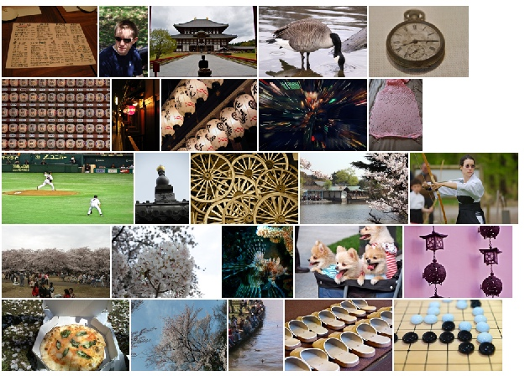
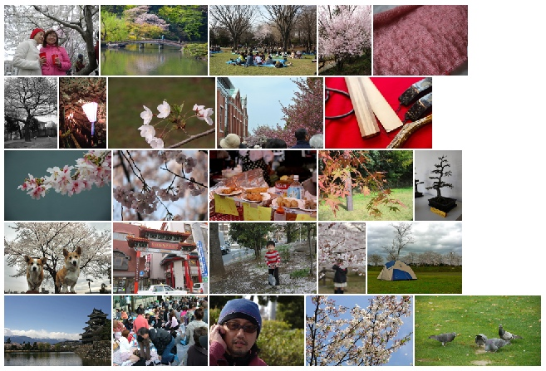
Comparison between Models (I)
# Hanami
Occupy Movement
Holi
# Hanami
(Japanese flower viewing)
22.2 %
51.5 %
Kmeans – FC7
LDADeep+
Summarizations of # Hanami:
Kmeans – FC7 only focus on finding the most diverse centroids (aspects)
LDADeep+ can emphasize both diversity and how frequently they are seen
“LDADeep+: Latent Aspect Discovery with Deep Representations” – ICASSP 2016
Chieh-En Tsai (b01902004@csie.ntu.edu.tw)
Notes:
We can see that kmeans model only focus on finding the most diverse centroids, therefor many of the aspects are not commonly-seen.
On the otherhand, LDADeep+ method can emphasize both diversity and how frequently they are seen. And generate a descent summarization
9,888

Slide 41
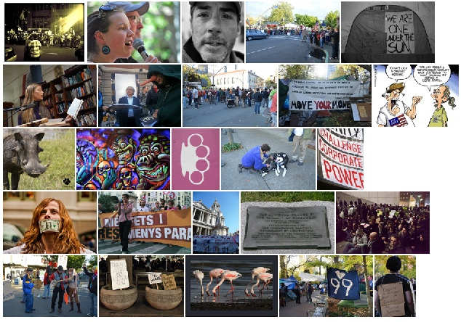
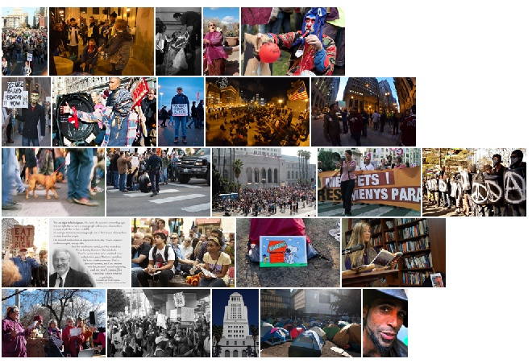
Comparison between Models (II)
Hanami
# Occupy Movement
Holi
21.6 %
47.2 %
Kmeans – FC7
LDADeep+
Summarizations of # Occupy Movement:
Kmeans – FC7 only focus on finding the most diverse centroids (aspects)
LDADeep+ can emphasize both diversity and how frequently they are seen
“LDADeep+: Latent Aspect Discovery with Deep Representations” – ICASSP 2016
Chieh-En Tsai (b01902004@csie.ntu.edu.tw)
Notes:
We see the same effect again. So LDADeep+ still outperform Kmeans method.

Slide 42
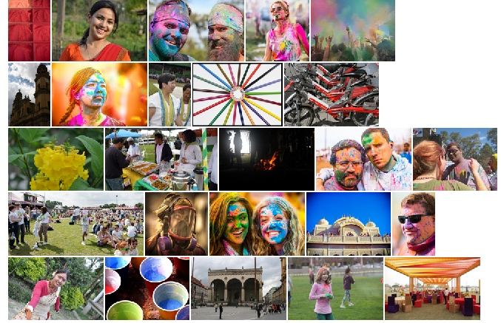
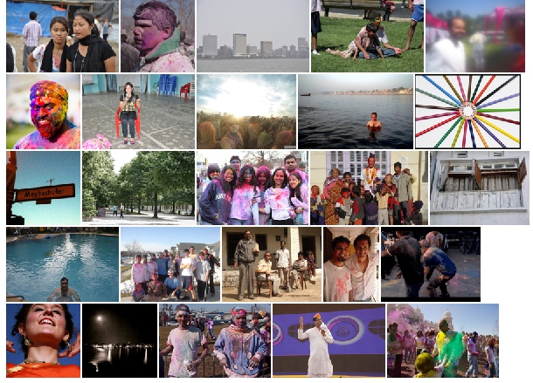
Comparison between Models (III)
Hanami
Occupy Movement
# Holi
# Holi
(Indian festival of colors)
55.4 %
29.7 %
Kmeans – FC7
LDADeep+
Summarizations of # Holi: Kmeans – FC7 outperform LDADeep+ on Holi case.
LDADeep+ finds the aspect of “colorful” and avoids repeated summarizations.
However, people favor colorful images.
“LDADeep+: Latent Aspect Discovery with Deep Representations” – ICASSP 2016
Chieh-En Tsai (b01902004@csie.ntu.edu.tw)
Notes:
So why would kmeans outperform our method in #Holi event?
We print out the 5 highest responding images of each topic in LDADeep+ summarization to visualize what topic it is actually about.
And we found that this specific photo represent the aspect of “colorful”.
So we claim that LDADeep+ found the aspect of “colorful” and avoids repeated summarizations.
However, people favor colorful images and that leads a higher score for kmeans method

Slide 43
Comparison Between Features
Dataset
Comparing Methods
YFCC100M
100M user generated daily photos
32% with text description
69% with tags (mostly about which camera used)
LDADeep+
Base Model: - LDA
Feature: - FC7
LDA - SIFT
Base Model: - LDA
Feature: - SIFT
Kmeans – FC7
Base Model: - Kmeans
Feature: - FC7
Online Questionnaire
Subjective Test Result
Define “aspect”
For each of the 4 events:
Introduce the event by Wiki
Show 3 summarization
Criterion: [score 1-6]
event | LDADeep+ | LDA - SIFT | Kmeans
Hanami | 51.5 % | 26.3 % | 22.2 %
Holi | 29.7 % | 15.0 % | 55.4 %
Batkid | 39.4 % | 38.5 % | 22.1 %
Occupy Movement | 47.2 % | 31.2 % | 21.6 %
Latent aspects
argmax
5
CNN
LDA
The more aspects discovered the better
The more diverse aspects the better
aspect
response
Comparison between “Features”
“LDADeep+: Latent Aspect Discovery with Deep Representations” – ICASSP 2016
Chieh-En Tsai (b01902004@csie.ntu.edu.tw)

Slide 44
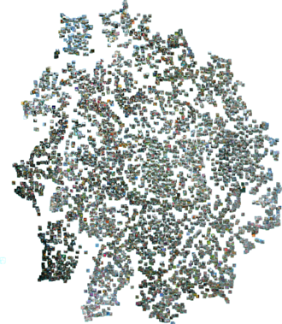
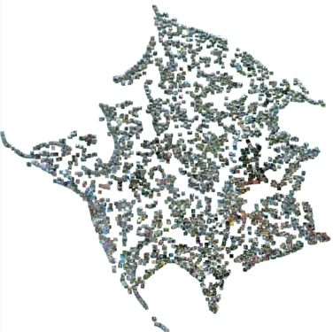
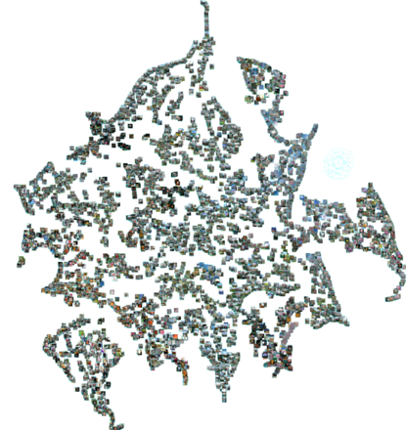
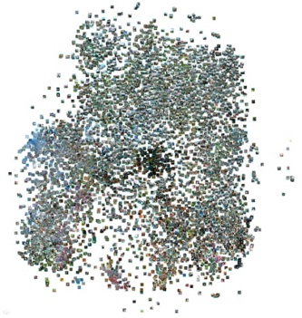
Comparison between Features (II)
t-sne Visualization of Clustering Effect
FC7 space
Latent (topic) space
Purely FC7
LDA - SIFT
LDA – conv5
LDADeep+ (FC7)
Density of each result cluster implies the confidence of the model in recognizing this aspect
The clearer the boundaries between aspects are, the more discriminative the model is.
“Visualizing data using t-sne”, Laurens Van der Maaten, JMLR, 2008
“LDADeep+: Latent Aspect Discovery with Deep Representations” – ICASSP 2016
Chieh-En Tsai (b01902004@csie.ntu.edu.tw)
Notes:
In the first part
We visualize the clustering effect of each model by using t-sne, which is a dimension reduction technique that is often used to visualize the relation between vectors.
Density of each result cluster implies the confidence of the model in recognizing this aspect
The clearer the boundaries between aspects are, the more discriminative the model is.
You can see that the clustering effect is not significant.

Slide 45
Comparison between Features (II)
t-sne Visualization of Clustering Effect
FC7 space
Latent (topic) space
Purely FC7
LDA - SIFT
LDA – conv5
LDADeep+ (FC7)
Density of each result cluster implies the confidence of the model in recognizing this aspect
The clearer the boundaries between aspects are, the more discriminative the model is.
FC7 feature is
Highly discriminative
“Visualizing data using t-sne”, Laurens Van der Maaten, JMLR, 2008
“LDADeep+: Latent Aspect Discovery with Deep Representations” – ICASSP 2016
Chieh-En Tsai (b01902004@csie.ntu.edu.tw)

Slide 46
Comparison between Features (III)
Example of Aspects discovered by LDA - SIFT
Max responding image
Top5 responding images to visualize aspect
“Cherry blossom”
“Ruffle pattern”
“Woven fabric”
LDA – SIFT tends to discover low-level concepts
“LDADeep+: Latent Aspect Discovery with Deep Representations” – ICASSP 2016
Chieh-En Tsai (b01902004@csie.ntu.edu.tw)
Notes:
In the second part, we will visualize some of the aspect found by each model by showing the 5 highest responding image.

Slide 47
Comparison between Features (IV)
Aspects discovered by LDA – Conv5
Max responding image
Top5 responding images to visualize aspect
“Cherry blossom”
“Lake”
“Branches”
LDA – Conv5 can discover higher semantic aspects but still not robust to different appearance of a same aspect
“LDADeep+: Latent Aspect Discovery with Deep Representations” – ICASSP 2016
Chieh-En Tsai (b01902004@csie.ntu.edu.tw)
Notes:
LDA – Conv5 can discover higher semantic aspects than LDA-SIFT does. But it is still not robust to different appearance of a same aspect

Slide 48
Comparison between Features (V)
Aspects discovered by LDADeep+
commonly seen
“Cherry blossom”
“Japanese food”
diverse aspects
“Picnics”
LDADeep+ discovers high-level concepts that focus on the semantic meaning of photos and robust to different appearance
“LDADeep+: Latent Aspect Discovery with Deep Representations” – ICASSP 2016
Chieh-En Tsai (b01902004@csie.ntu.edu.tw)

Slide 49
Comparison between Features (VI)
Cherry blossom aspect
Robustness
LDA – SIFT
LDA – Conv5
LDADeep+
While all three models found the Cherry blossom aspect, LDADeep+ shows its robustness against deformation and understand the aspect not only by its appearance, but also by its meaning
“LDADeep+: Latent Aspect Discovery with Deep Representations” – ICASSP 2016
Chieh-En Tsai (b01902004@csie.ntu.edu.tw)
Notes:
It is interesting to see that all three models found the cherry blossom aspect.
If you look at the highest responding images of LDA-SIFT, you can find that those photos are visually very similar
And the lda-conv5 images are similar too.
But you can see that LDADeep+ shows its robustness against different appearance of a same aspect and understand the aspect not only by its appearance, but also by its meaning

Slide 50
Outline
Why and What
Framework
Define “aspect”
Method
Evaluation
Visualizing results
Idea takeaways
“LDADeep+: Latent Aspect Discovery with Deep Representations” – ICASSP 2016
Chieh-En Tsai (b01902004@csie.ntu.edu.tw)

Slide 51
Conclusions
What we have done
What we can do
We proposed a content-based automatic aspect discovery model: LDADeep+
Major breakthrough: represent visual-word by employing deep learning global representation
Build a LDA-based model on top of deep representations
Understand deep models more
Graphical Model + Neural Network
Interpretable
Powerful
Finally …
CNN
LDA
“LDADeep+: Latent Aspect Discovery with Deep Representations” – ICASSP 2016
Chieh-En Tsai (b01902004@csie.ntu.edu.tw)
Notes:
Deep learning models are often used as black-boxes

Slide 52
Conclusions
What we have done
What we can do
We proposed a content-based automatic aspect discovery model: LDADeep+
Major breakthrough: represent visual-word by employing deep learning global representation
Build a LDA-based model on top of deep representations
Understand deep models more
Graphical Model + Neural Network
Interpretable
Powerful
Finally …
Thank you
for your attention ☺
CNN
LDA
“LDADeep+: Latent Aspect Discovery with Deep Representations” – ICASSP 2016
Chieh-En Tsai (b01902004@csie.ntu.edu.tw)
Notes:
Deep learning models are often used as black-boxes

Slide 53
Any Question ?
“LDADeep+: Latent Aspect Discovery with Deep Representations” – ICASSP 2016
Chieh-En Tsai (b01902004@csie.ntu.edu.tw)
“LDADeep+: Latent Aspect Discovery with Deep Representations” – ICASSP 2016
Chieh-En Tsai (b01902004@csie.ntu.edu.tw)
Notes:
There’s another horrible truth about online images is that text description is rare to see

Slide 54
Backup Slides

Slide 55
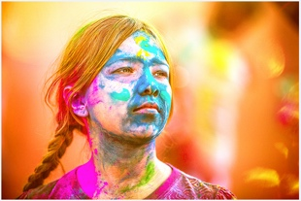
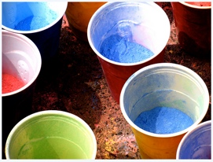
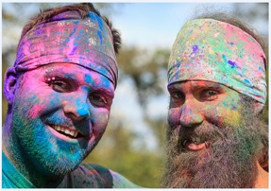
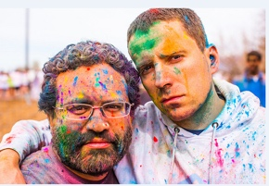
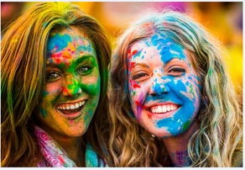
Comparison between Models (IV)
max: 0.48
Topic #5
Average Response of Topic #5 among #”Holi” photos:
- 0.093
Average Response of Topic #5 among Kmeans-FC7’s summarization:
- 0.107
Average Response of Topic #5 among LDADeep+’s summarization:
- 0.051
Top 5 Kmeans summarized photos responding to Topic #5 & their responses
0.34
0.32
0.28
0.24
0.24
“LDADeep+: Latent Aspect Discovery with Deep Representations” – ICASSP 2016
Chieh-En Tsai (b01902004@csie.ntu.edu.tw)

Slide 56
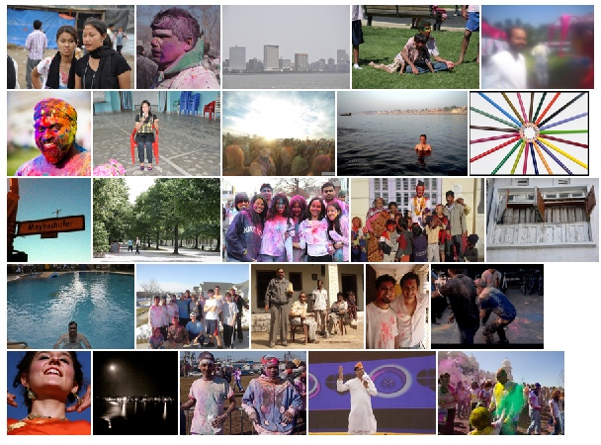
Comparison between Models (V)
Responses to Topic #5 of LDADeep+ summarized photos
Only 2 photo with response >= 0.2
Only 6 photos with response >= 0.1
0.0
0.13
0.0
0.02
0.13
0.48
0.05
0.19
0.07
0.0
LDA model
better suit the purpose !
Most commonly seen
Most diverse
0.0
0.08
0.01
0.0
0.0
0.07
0.01
0.0
0.02
0.09
0.21
0.01
0.03
0.08
0.10
“LDADeep+: Latent Aspect Discovery with Deep Representations” – ICASSP 2016
Chieh-En Tsai (b01902004@csie.ntu.edu.tw)

