Slide 1
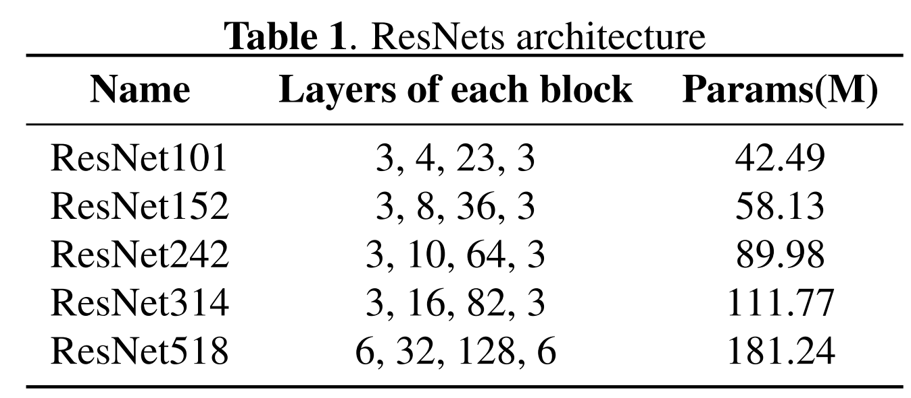
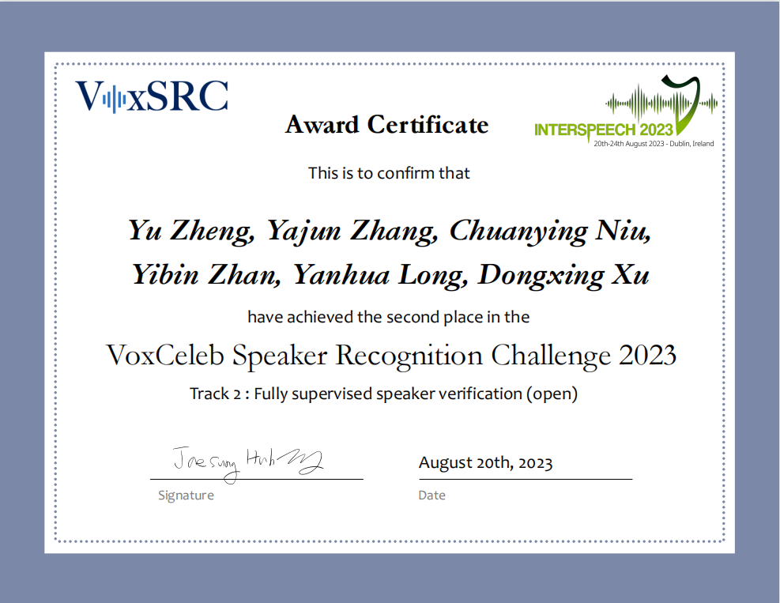
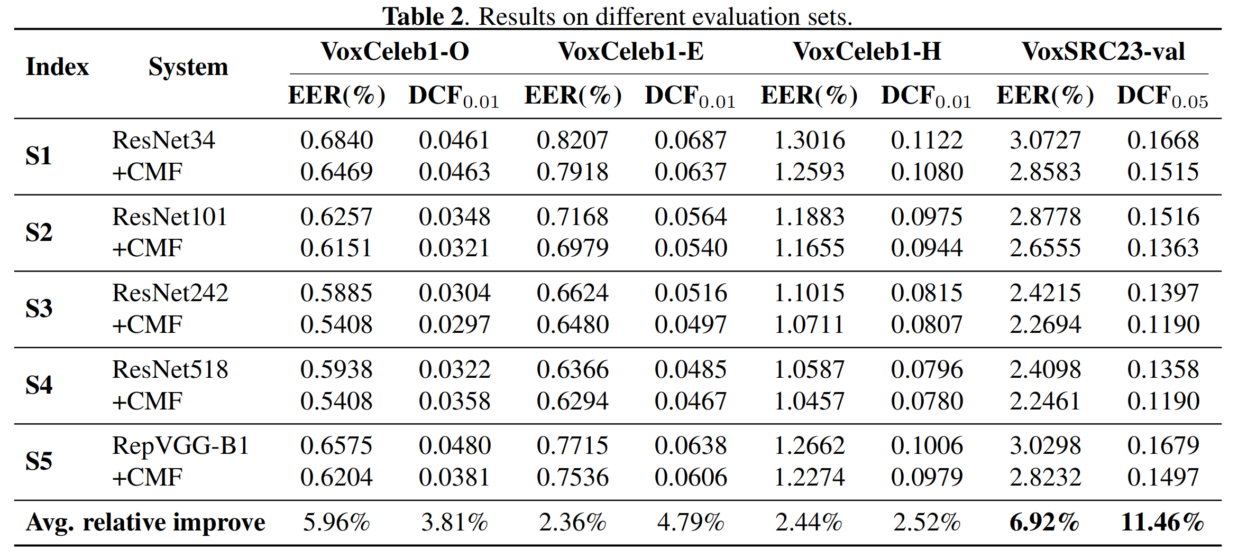
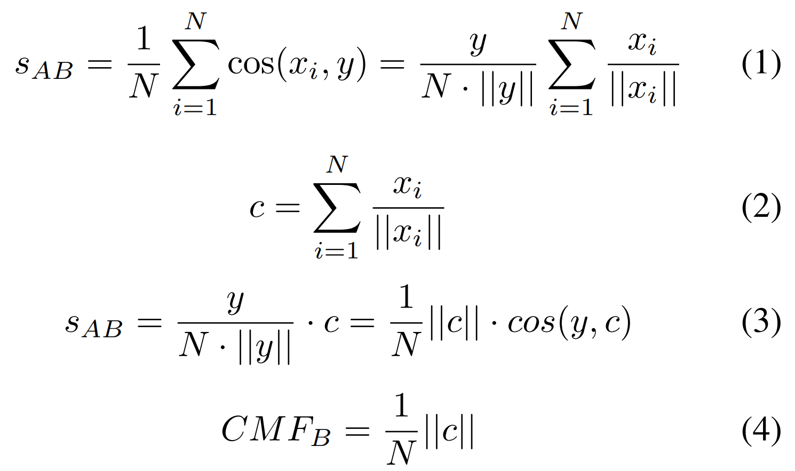
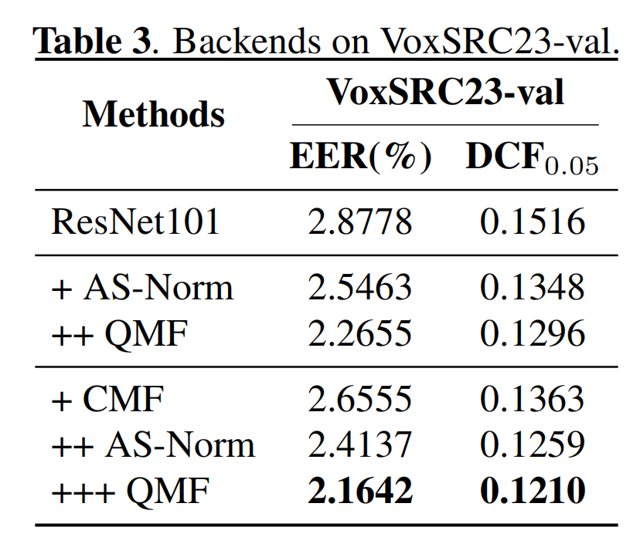
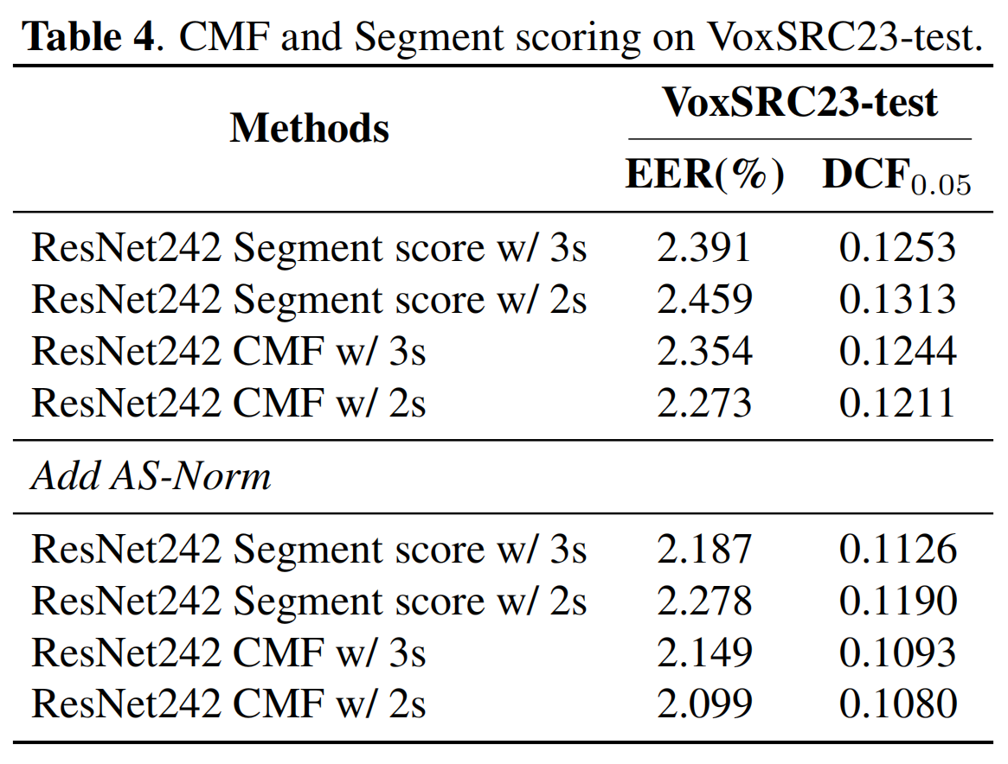
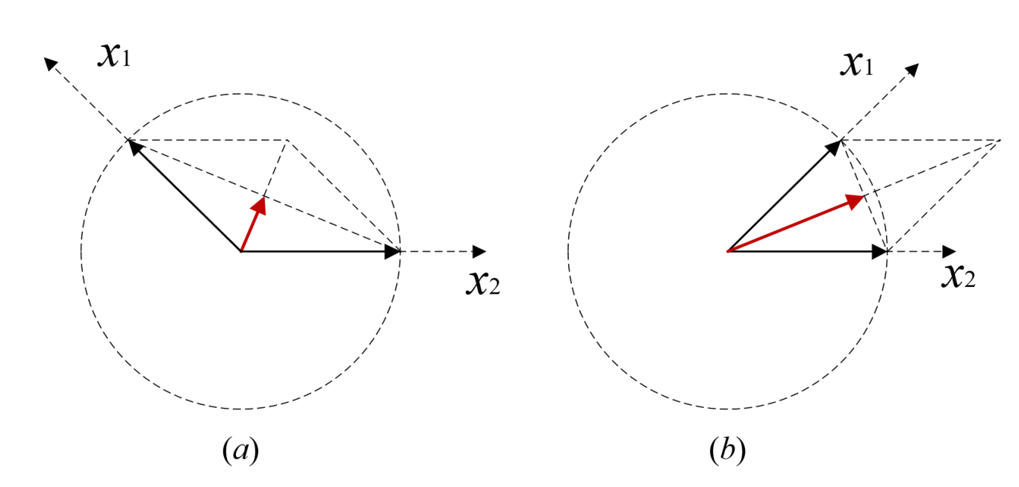
Score calibration based on consistency measure factor for speaker verification
Yu Zheng ¹, Yajun Zhang ¹, Chuanying Niu ¹, Yibin Zhan ¹, Yanhua Long ², Dongxing Xu ¹
1. Unisound AI Technology Co., Ltd., Beijing, China
2. SHNU-Unisound Joint Laboratory of Natural Human-Computer Interaction,Shanghai Normal University, Shanghai, China
1
Introduction
3
Systems
This paper proposes a new scoring calibration method named “Consistency-Aware Score Calibration”, which introduces a Consistency Measure Factor (CMF) to measure the stability of audio voiceprints in similarity scores for speaker verification.
We are inspired by segment score^{[1]} and derive the process of it and find the Consistency Measure Factor (CMF).
We use CMF transform the segment scoring method into a score calibration method, which has a more brief form and achieves better performance.
We used VoxCeleb2-dev as training data, adopted a 3-fold speed augmentation (with 0.9 and 1.1 factor) and we used RIRs and MUSAN for data augmentation.
We extracted 80-dimensional log Mel filter bank.
MQMHA, Inter-TopK^{[3]} were used.
Our models were trained through two stages; The second stage was large-margin-based fine-tuning stage^{[4]}.
CMF and systems of this paper help us achieve the 1st place in Track1 of VOXSRC2023^{[2]}.
4
Results
2
Methods
We evaluated our model’s performance using VoxSRC23-val, VoxSRC23-test, VoxCeleb1-O, VoxCeleb1-E, VoxCeleb1-H.
Definition of CMF: Supposing y is an embedding of audio A, and (x₁, x₂, ...,x_{N} ) are the embeddings of N segments from audio B which cut into N crops. The segment score s_{AB} of audio A and audio B is defined as:
As shown in Eq.(4), we define ||c||/N ∈ (0, 1) as the Consistency Measure Factor (CMF).
We provide a visual representation of the relationship between CMF and segment embeddings, clearly demonstrating that a larger CMF value indicates a more concentrat- ed distribution of vectors.
5
Conclusions
CMF consistently enhances performance across various network structures with different parameter sizes, even within state-of-the art systems.
CMF is compatible with other backend methods, such as AS-Norm and QMF, and thus resulting in further complementary performance gains.
Compared with segment score, CMF got better performance especially in the case of short audio.
By transforming the segment scoring into a score calibration method, CMF not only simplifies the process but also achieves better performance.
Calibration with CMF: We propose a solution in which CMF is employed as a scaling factor for score calibration, as defined in Eq. (5).
flow chart
References
[1] Joon Son Chung and Jaesung Huh et al., “In defence of metric learning for speaker recognition,” in Interspeech 2020. oct 2020, ISCA.
[2] Yu Zheng, Yajun Zhang, Chuanying Niu, Yibin Zhan, Yanhua Long, and Dongxing Xu, “Unisound system for voxceleb speaker recognition challenge 2023,”arXiv:2110.05042, 2023.
[3] Miao Zhao, Yufeng Ma, Yiwei Ding, Yu Zheng, MinLiu, and Minqiang Xu,“Multi-query multi-head attention pooling and inter-topk penalty for speaker verification,” in ICASSP 2022. IEEE, 2022, pp. 6737–6741.
[4] Jenthe Thienpondt, Brecht Desplanques, and Kris De_x0002_muynck, “The idlab voxsrc-20 submission: Large mar_x0002_gin fine-tuning and quality-aware score calibration indnn based speaker verification,” in ICASSP 2021. IEEE,2021, pp. 5814–5818.
Mail of author Yu Zheng: 1092557924@qq.com
& WeChat of Yu Zheng: →

