Slide 1
CNN ORIENTED FAST PU MODE DECISION FOR HEVC HARDWIRED INTRA ENCODER
Nan Song
Tsinghua University
Email: songn15@mails.tsinghua.edu.cn

Slide 2
Outline
Introduction
What are we concerned about?
PU mode decision in intra coding mode
CNN oriented fast PU mode decision
CNN based RMD process
Corner detection based RDO process
Comparison with previous methods
Experiments
Conclusion
References
Notes:
The outline is structured as follows. In the first part, I want to introduce intra PU mode decision in HEVC.
The second part presents the design of our proposed work. Third, Comparison of different methods;
then experiments and finally conclusion

Slide 3
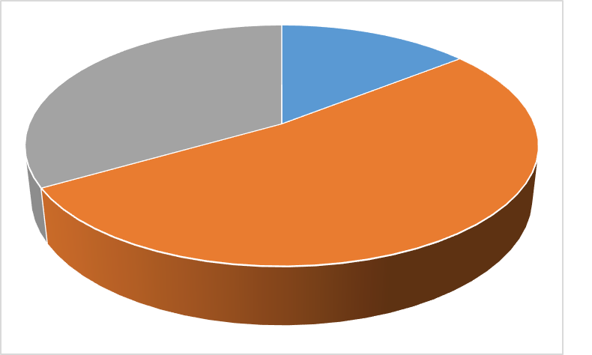
Introduction
What are we concerned about?
PU mode decision cost a lot of time in intra coding mode.
The parallel of the encoder in hardware implementation
Lower complexity and power of hardwired
RMD
14.34%
Others
33.35%
Full RDO
52.31%
Run-time percentages of intra encoding mode for encoder_intra_main configurations
Notes:
In intra coding mode of HEVC, the PU mode decision, which is including RMD process and Full RDO process, plays a vital role.
Naturally, our goal is to optimize those two processes. when implementation in hardwired, we know that the parallel could influence coding efficiency.
And the complexity and power consumption also should be considered.

Slide 4
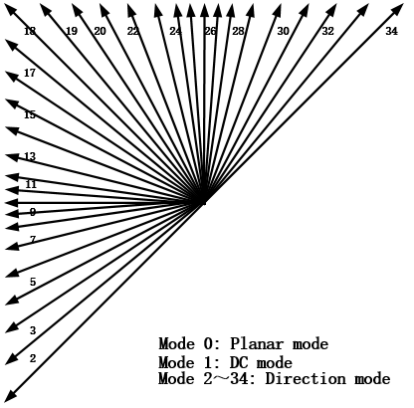
Introduction
PU mode decision in intra coding mode
The number of intra prediction modes in HEVC has been increased up to 35.
The prediction mode of PU in HEVC
Notes:
In RMD process, there are 35 prediction modes, including DC, Planar and 33 direction modes.
Compared with H.264, the number of prediction modes has increased by about three times.
That is to say, HEVC is more precise on PU prediction. But the cost is high computational complexity

Slide 5
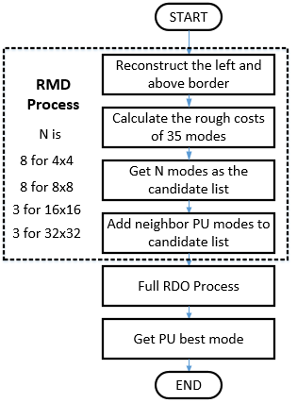
Introduction
PU mode decision in intra coding mode
In RMD process, the computations come from the traversing of 35 prediction modes
The use of neighbor PU modes impedes the parallel processing
In Full RDO Process, the candidate list maybe too large for some PU whose textures are simple
The flowchart of intra PU mode decision in HEVC
Notes:
let me introduce the intra PU mode decision process in original HEVC simply. Firstly, preparing the reference pixels.
Secondly, traversing 35 prediction modes to calculate the rough cost of each mode. Thirdly, Get N modes mapped the smallest rough cost as PU candidate list.
Fourthly, adding above and left Pus’ predicted modes to its candidate list. Finally, doing Full RDO process under the PU candidate list.
In RMD process, computational complexity comes from traversing 35 modes, the use of neighbor PU modes is not good for high parallel and the candidate list maybe a little large for simple texture PU

Slide 6
Outline
Introduction
What are we concerned about?
PU mode decision in intra coding mode
CNN oriented fast PU mode decision
CNN based RMD process
Corner detection based RDO process
Comparison with previous methods
Experiments
Conclusion
References

Slide 7
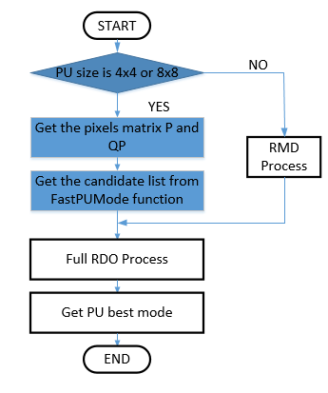
CNN oriented fast PU mode decision
Proposed work
Aiming at 4x4/8x8 PU
The essential procedure FastPUMode function will give the candidate list of current PU
FastPUMode function consists of CNN based RMD Process and Corner detection based Full RDO Process
Intra PU mode decision in our method
Notes:
OK, now, let me introduce our proposed work. In this chart, we can see, Our work is aiming at 4x4 and 8x8 PU. Firstly, we get the PU pixel matrix P and QP, the matrix P comprises current PU and its top row and left column pixels. Then we send them to a function named FastPUMode. This function integrated with CNN and corner detection will give the candidate list of current PU.

Slide 8
CNN oriented fast PU mode decision
CNN based RMD process
Sub-sampling 8x8 PU
Calculating the coarse edge strength of PU:
$$∆x_{i,j}=I_{i,j}+I_{i+1,j}−I_{i,j+1}−I_{i+1,j+1}$$
$$∆y_{i,j}=I_{i,j}−I_{i+1,j}+I_{i,j+1}−I_{i+1,j+1}$$
$$iEdgePwr=\sum_{i,j}{({∆x_{i,j}}^{2}+{∆y_{i,j}}^{2})}$$
Three types of PU:
Flat PU : $iEdgePwr$ < $4∗{QP}^{2}$
Weak edge PU : $4∗{QP}^{2}$ < $iEdgePwr$ < $25∗{QP}^{2}$
Strong edge PU : $iEdgePwr$ > $25∗{QP}^{2}$
Notes:
OK, let’s see our CNN based RMD process. Firstly, we should sub-sample 8x8 PU matrix P to 5x5, in order to alleviate the complexity of hardwired. We next carry out the coarse edge strength by this formula(指向PPT上的式子, 可以简单的读一下). Then we divide the PUs into three types: flat PU, weak edge PU and strength edge PU by this rule(指向下面的公式). if the PU is flat, DC and Planar modes are appropriate to be chosen as its candidate list. If the PU is not flat we will send it to CNN.

Slide 9
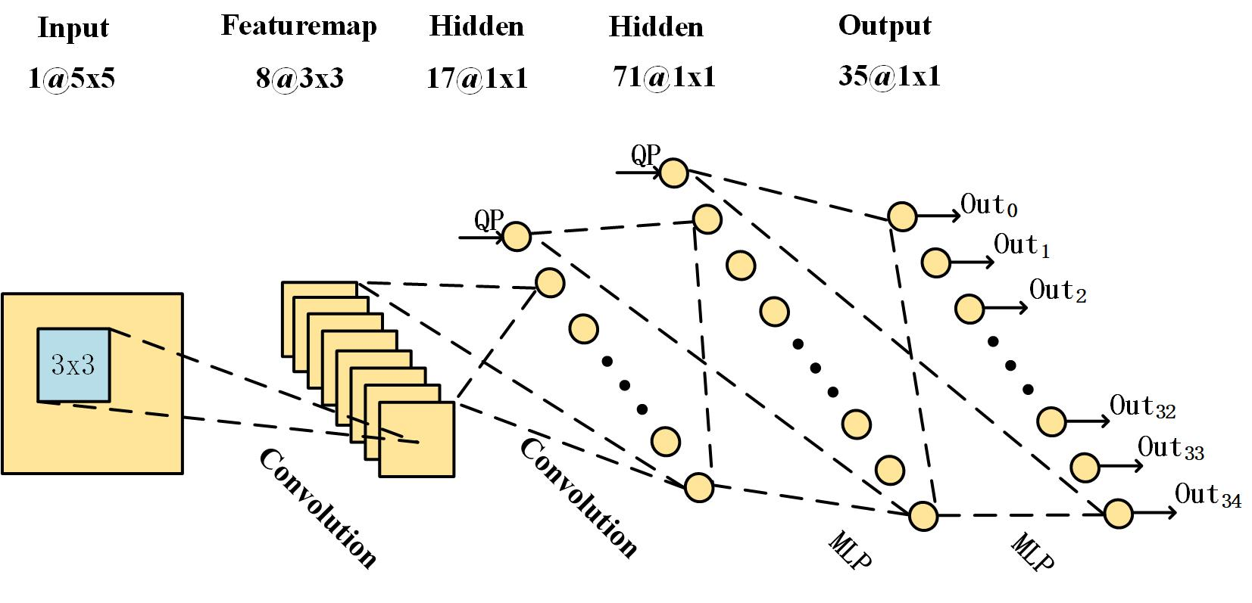
CNN oriented fast PU mode decision
CNN based RMD process
The CNN units in our algorithm are shared the same architecture
The Proposed Architecture of CNN
Notes:
There are four CNN units in our algorithm. To alleviate the computational complexity of hardwired, the CNN units in our algorithm are shared the same architecture. The input of CNN is a 5×5 pixels block, if PU size is 4x4, the input is matrix P, if PU size is 8x8, the input is the sub-sampled matrix. The first convolution layer has 8 feature maps. Each neuron is connected to a 3×3 field in the input layer receptively. The size of those feature maps is 3×3.The kernels in this layer are regarded as feature extractors. The second convolution holds seventeen 1×1 neurons including 16 outputs of the convolution kernels and one for QP. The last two hidden layers are fully connected MLP. They possess 71 and 35 neurons respectively.

Slide 10
CNN oriented fast PU mode decision
CNN based RMD process
Training Sample Extraction:
Eliminating such PU whose RD-costs difference are too small, The parameter $∆RD$ is defined as
$$∆RD= \frac{{RDC}_{max}− {RDC}_{min}}{{RDC}_{max}+ {RDC}_{min}}$$
The samples must not belong to the flat type PU:
$iEdgePwr$ > $4∗{QP}^{2}$
Dividing training data set into four groups: ${strong}_{4x4}$, ${strong}_{8x8}$,
${weak}_{4x4}$, ${weak}_{8x8}$
Notes:
OK, about the training sample extraction, we adopt following techniques. Firstly, eliminating such PU whose RD-costs difference are too small. If PU whose $∆RD<0.01$ will be picked out. Secondly, pick out flat PUs, from previous work, we studied that the flat PUs were burdens to the CNN because their simplex textures would dull the CNN training process. Thirdly, Dividing training data set into four groups. In our experiments, we find a single CNN, can hardly get a precise result, while we divide the PU into four groups, the accuracy is much higher than single one. Because we unity the CNN architecture, we just load different parameters for different groups. So the complexity in hardwired just increase a little.

Slide 11
CNN oriented fast PU mode decision
CNN based RMD process
Target Value Extraction:
Traditional methods which choose modes as their classification are not suitable
The target values based on rate RDC
Calculating the average value $\overline{C}$ of RDCs,
$$\overline{C}=\frac{1}{35}\sum_{m=0}^{34}{{RDC}_{m}}$$
Deriving the target value $T_{m}$ of CNN as follow,
$T_{m} =$ $\left\{\begin{aligned}\ln\left(−{RDC}_{m}+ \overline{C}+ \sqrt{e}\right), {RDC}_{m} < \overline{C} \\ −ln\left({RDC}_{m}− \overline{C}+ \sqrt{e}\right), {RDC}_{m} ≥ \overline{C}\end{aligned}\right.$
Notes:
About the selection of target values, instead of the traditional methods which choose modes as their classification, we take the target values based on rate distortion cost (RDC). The reason lies that the sample integer can hardly get the meaning of the PU modes, but the RDCs are the determining criterion of PU modes. Firstly, Calculating the average value of RDC, then Deriving the target value $T_{m}$ of CNN as follow formalu(指着公式). In these equation, we can acknowledge that the RDCm is in inverse proportion to the Tm. So we choose 8 modes which map the maximum outputs of CNN as the PU candidate list.

Slide 12
CNN oriented fast PU mode decision
Corner detection based RDO process
Corner detection in order to reduce the modes of candidate list
Adopt Sobel operator to get Hor and Ver components of gradient,
$$\left\{\begin{aligned}{Gx}_{i,j}=I_{i+1,j−1}+2×I_{i+1,j}{+I}_{i+1,j+1}−I_{i−1,j−1}−2×I_{i−1,j}−I_{i−1,j+1} \\ {Gy}_{i,j}=I_{i−1,j+1}+2×I_{i,j+1}{+I}_{i+1,j+1}−I_{i−1,j−1}−2×I_{i,j−1}−I_{i+1,j−1} \end{aligned}\right.$$
Calculate three parameters A, B, C as,
$A= \sum_{i,j}{{Gx}_{i,j}^{2}}$, $B= \sum_{i,j}{{Gy}_{i,j}^{2}}$, $C= \sum_{i,j}{{Gx}_{i,j}∗{Gy}_{i,j}}$
Notes:
About corner detection based RDO process, we think a PU without corners have simplex texture, it could be well predicted by a small candidate list. We first using Sobel operator to get horizontal and vertical components of gradient by the follow formulas(指向公式，停几秒瞅瞅观众再继续). Then we Calculate three parameters A, B, C by those formulas in order to get the matrix M which borrowed from Harris

Slide 13
CNN oriented fast PU mode decision
Corner detection based RDO process
Get the matrix M as,
$$M=\left[\begin{matrix}A & C \\ C & B\end{matrix}\right]$$
Calculate the corner response R,
$$Tr\left(M\right)=α+β=A+B$$
$$Det\left(M\right)=αβ=A×B−C^{2}$$
$$R=\frac{\left({\left.α+β\right)}^{2}\right.}{αβ}=\frac{{\left.Tr(M\right)}^{2}}{\left.Det(M\right)}$$
Notes:
The matrix M is(指向那个矩阵) Finally, we calculate the response R by the next equations.$α,β$ stand for the two eigenvalues of M. From Harris work, we know the R in inverse proportion to the probability that the block owning corner. In our experiments, if R > 10, we think there is no corner in the block. Thus, if current PU has no corner, we will choose the 5 modes mapped the largest out of CNN as PU candidate list

Slide 14
Outline
Introduction
What are we concerned about?
PU mode decision in intra coding mode
CNN oriented fast PU mode decision
CNN based RMD process
Corner detection based RDO process
Comparison with previous methods
Experiments
Conclusion
References

Slide 15
Comparison with previous methods
Optimization of RMD Process
Adopting the edge strength extractor to get PU candidate list
Applying the rough to fine search strategy to reduce the overall complexity
Optimization of Full RDO Process
Using texture information to reduce the candidate list of current PU
Bringing in network as the technique to decrease the candidate modes
Notes:
OK, the previous works on intra PU mode decision main adopted follow technologies, in RMD process, the first method is Adopting the edge strength extractor to get PU candidate list, the other one is applying the rough to fine search strategy to reduce the overall complexity; in RDO process, there are also many strategies. Like Using texture information to reduce the candidate list of current PU. Bringing in network as the technique to decrease the candidate modes.

Slide 16
Comparison with previous methods
Proposed method VS Empirical feature extractors
CNN can understand the texture strength and the edge topology from the training data
Friendly to high parallel hardwired encoder
Corner detection algorithm can reduce redundant
modes in PU candidate list
Notes:
Compared with previous works, our algorithm bringing in CNN as the technology to get PU candidate list. The inputs of our CNN are merely composed of the source image pixels and QP. This feature prompts the proposed method efficient to the high parallel hardwired encoder design. Corner detection algorithm can also reduce redundant modes in PU candidate list. It should be further emphasized that our PU mode decision method is orthogonal to the previous algorithms belonging to the next part.

Slide 17
Outline
Introduction
What are we concerned about?
PU mode decision in intra coding mode
CNN oriented fast PU mode decision
CNN based RMD process
Corner detection based RDO process
Comparison with previous methods
Experiments
Conclusion
References

Slide 18
Experiments
$∆PSNR$ and $∆BR$ are used to represent the evaluations of coding quality
$$∆PSNR={PSNR}_{p}−{PSNR}_{r}$$
$$∆BR=\frac{{bitrate}_{p}−{bitrate}_{r}}{{bitrate}_{r}}$$
$∆T$ is regarded as the reference to the computational complexity reduction
$$∆T=\frac{T_{r}−T_{p}}{T_{r}}×100\%$$
Notes:
In HEVC,（照着PPT上念）

Slide 19
Experiments
Coding performance of Proposed algorithm
Class | Sequence | $$∆PSNR$$ [dB] | $$∆BR$$ [%] | $$∆T$$ [%]
A | Traffic | -0.028 | 0.74 | 28.85
B | Kimono | -0.006 | 0.20 | 27.76
C | BQMall | -0.059 | 1.09 | 28.56
D | Keiba | -0.032 | 0.53 | 25.39
E | Vidyo4 | -0.028 | 0.77 | 25.88
F | SlideEditing | -0.219 | 1.64 | 26.93
F | ChinaSpeed | -0.187 | 2.38 | 27.26
Notes:
This is the part of coding performance of Proposed algorithm.
It should be note that in Class F, the most sensitive sequence, our coding performance is still optimistic.

Slide 20
Experiments
Coding performance of different Algorithm
Algorithm | $∆BR$[%] | $∆T$[%] | Class F
 |  |  | $∆BR$[%] | $∆T$[%]
Proposed | 1.15 | 27.92 | 2.01 | 27.10
[4] | 1.46 | 25.74 | 3.47 | 23.84
[5] | 0.34 | 13.83 | 1.23 | 13.27
[6] | 1.37 | 18.89 | 3.34 | 18.66
[4]: Chen’s work [5]: Fini’s work [6]: Silva’s work
Notes:
This is the Comparison Between Our Proposed Algorithm and Previous works. Algorithm [4][6] are based on the edge strength extractor to get PU candidate list, Algorithm [5] adopt network as the technique to decrease the candidate modes. We can get our algorithm are more precise than algorithm [4][6], and save more coding time. Because algorithm [5] Apply the rough to fine search strategy to reduce the overall complexity. So our work is less precise than their work. But because corner detection algorithm, our work save more time too.

Slide 21
Outline
Introduction
What are we concerned about?
PU mode decision in intra coding mode
CNN oriented fast PU mode decision
CNN based RMD process
Corner detection based RDO process
Comparison with previous methods
Experiments
Conclusion
References

Slide 22
Conclusion
CNN oriented fast PU mode decision algorithm:
Alleviating the computation complexity of intra coding in HEVC
Time saving 27.92% , BDBR=+1.15%
Providing the advanced performance in the most sensitive sequence
In Class F, time saving 27.10% , BDBR=+2.01%
Efficient to the high parallel hardwired encoder design
Notes:
In this paper, our goal is alleviating the computation complexity of intra coding in HEVC. By introducing CNN and corner detection algorithm,
the intra coding time saving 27.92%, BDDR just increase 1.15%. And our method provides the advanced performance in the most sensitive sequence.
What’s more, the inputs of our CNN are merely composed of the source image pixels and QP, this feature prompts the proposed method efficient to the high parallel hardwired encoder design.

Slide 23
Outline
Introduction
What are we concerned about?
PU mode decision in intra coding mode
CNN oriented fast PU mode decision
CNN based RMD process
Corner detection based RDO process
Comparison with previous methods
Experiments
Conclusion
References

Slide 24
References
Wu Liu, Tao Mei, Yongdong Zhang, Cherry Che, and Jiebo Luo, “Multi-task deep visual-semantic embedding for video thumbnail selection,” in Computer Vision and Pattern Recognition, 2015, pp. 3707–3715
C Harris, “A combined corner and edge detector,” Proc Alvey Vision Conf, vol. 1988, no. 3, pp. 147–151, 1988
Z. Liu, X. Yu, Y. Gao, S. Chen, X. Ji, and D. Wang, “Cu partition mode decision for hevc hardwired intra encoder using convolution neural network.,” IEEE Transactions on Image Processing A Publication of the IEEE Signal Processing Society, vol. 25, no. 11, pp. 5088–5103, 2016
Guang Chen, Zhenyu Liu, T Ikenaga, and Dongsheng Wang, “Fast hevc intra mode decision using matching edge detector and kernel density estimation alike histogram generation,” in IEEE International Symposium on Circuits and Systems, 2013, pp. 53–56
Mohammadreza Ramezanpour Fini and Farzad Zargari, “Two stage fast mode decision algorithm for intra prediction in hevc,” Multimedia Tools and Applications, vol. 75, no. 13, pp. 7541–7558, 2016
Thałsa L. Da Silva, Luciano V. Agostini, and Luis A. Da Silva Cruz, “Fast hevc intra prediction mode decision based on edge direction information,” in Signal
Processing Conference, 2012, pp. 1214–1218

Slide 25
Thank you!

