Slide 1
Measuring the Similarity of Files by Data Compression
Hubert Schölnast
Institute of IT Security Research, St. Pölten University of Applied Sciences, Austria
hubert.schoelnast@fhstp.ac.at
Data Compression Conference 2023
Funded by Gesellschaft für Forschungsförderung des Landes Niederösterreich
under the Dissertation Grant Research, Technology, and Innovation.
Notes:
Measuring the Similarity of Files by Data Compression
My name is Hubert Schölnast. I am a staff member of the Institute for IT Security Research at the University of Applied Sciences St. Pölten in Austria, and this is my presentation for the Data Compression Conference 2023 in Snowbird, Utah, United States.
This work is an early part of my dissertation, which I am writing at the University of Vienna under the supervision of Prof. Edgar Weippl. My dissertation project is funded by the Gesellschaft für Forschungsförderung des Landes Niederösterreich under the Dissertation Grant Research, Technology, and Innovation.

Slide 2
Theoretical Background, State of the Art
Based on Kolmogorov Complexity
Algorithmic Joint Complexity (AJC) [1]
AJC of the files $x$ and $y$: Length of the shortest input given to a certain type of Turing machine, which outputs $x$, immediately followed by $y$, and then halts.
Algorithmic Mutual Information (AMI) [1]
AMI between the files $x$ and $y$: Sum of the algorithmic complexities of $x$ and $y$ minus the algorithmic joint complexity $ALC\left(x,y\right)$ of the two.
[1] G. Chaitin, “Algorithmic Information Theory,” IBM Journal of Research and Development, vol. 21, no. 4, pp. 350–359, 1977.
Notes:
Theoretical Background
Already Gregory Chaitin described in 1977 some values that measure the information that two files have in common.

Slide 3
Theoretical Background, State of the Art
Based on Shannon Entropy
Kullback-Leiber Divergence (KLD) [2]
The KLD between the probability distributions $x$ and $y$ is the information that is lost when approximating the distribution $x$ with the distribution $y$.
[2] S. Kullback, R. Leibler, “On Information and Sufficiency,” Annals of Mathematical Statistics, vol. 22, no. 1, pp. 79-86, 1955.
Notes:
Similar measures were also derived from Shannon Entropy decades earlier, such as Kullback-Leibler divergence.

Slide 4
Drawbacks
Kullback-Leibler Divergence
“post” and “spot” are two examples of the same probability distribution. Therefore:
$KLD\left(“post”,”spot”\right)=0$ (meaning: “no difference between the two strings”)
Also “spot” and even “poststopspot” look equal.
Kolmogorov Complexity
Simplified: “The smallest possible size of a program that outputs a given string and then halts.”
You never can know if the smallest size you found is really the smallest possible size.
When a program runs for a long time, you can never know for sure, if it will halt.
Notes:
But Kullback-Leibler divergence does not see that "post," "stop," "spot," and even "poststopspot" are four distinct strings, and the Kolmogorov complexity is incomputable for theoretical reasons, and so are all measures derived from it.

Slide 5
The Solution
Derive new measures as “practical” approximations of “theoretical” meassures: [3]
Algorithmic Joint Complexity → Compression Joint Complexity
Kullback-Leibler Divergence → Compression Divergence
Both values can be found by applying two meta-algorithms¹
“Concat Compress” finds Compression Joint Complexity
“Cross Compress” finds Compression Divergence
In this paper both meta-algorithms are practically tested.
¹Concat Compress was already described in theory and practice in [3], but not named as such. Cross Compress was described in the same document only as a theoretical concept (and also not named so).
[3] D. Cerra and M. Datcu. “Algorithmic cross-complexity and relative complexity,” Data Compression Conference. IEEE, pp. 342-351, 2009
Notes:
The Solution is to replace impractical theoretical measures by practical approximations to these values.
Here, Algorithmic Joint Complexity and Kullback-Leibler Divergence are replaced by Compression Joint Complexity and Compression Divergence.
The two meta-algorithms that can be used to determine these values are explained in the following slides.
In this paper, both algorithms are compared in a practical test.

Slide 6
Meta-Algorithm ”Concat Compress”
Finds Compression Joint Complexity [3]
This is a practical approximation to Algorithmic Joint Complexity.
Concatenate the files $x$ and $y$ to obtain the file $xy$.
Compress the file $x$ and get the compressed file $x^{∗}$. Size of $x^{∗}$ is $C\left(x\right)$
Do the same for file $y$: get $y^{∗}$ with size $C\left(y\right)$
And again, for file $xy$: get ${\left(xy\right)}^{∗}$ with size $C\left(x,y\right)$ (note the comma)
Compression Joint Complexity: (note the colon) $C\left(x:y\right)=C\left(x\right)+C\left(y\right)−C\left(x,y\right)$
[3] D. Cerra and M. Datcu. “Algorithmic cross-complexity and relative complexity,” Data Compression Conference. IEEE, pp. 342-351, 2009
Notes:
The 1st meta-algorithm is Concat Compress.
It works as follows:
Concatenate the two files x and y so that you get the concatenated file xy.
Use any compression algorithm to compress the file x. The result is the compressed file x*, and the compressed size of x* is C(x). Then do the same with file y. You get the compressed file y* with size C(y). Then compress the concatenated file xy and you get (xy)* whose size is C(x,y).
The Compression Joint Complexity C(x:y) is now C(x)+C(y)-C(x,y).

Slide 7
Meta-Algorithm ”Cross Compress”
We need two new versions of a compression program:
“Conventional Compressor” with modified output
outputs $x_{c}$ and $x_{r}$ as two separate files.
“Advanced Compressor” with additional input
Input 1: the file $x$ to be compressed
Input 2: a rules-set $y_{r}$ that must be produced before by the conventional compressor (in this example when it compressed the file $y$)
Output $x_{y}^{∗}=\left\{{{}_{y}^{ }x}_{c}^{ },y_{r}\right\}$
${{}_{y}^{ }x}_{c}^{ }$ is that version of $x_{c}$ that needs $y_{r}$ to be interpreted correctly
$x_{y}^{∗}$ is a compressed version of file $x$, but compressed with the rules that are optimized for file $y$.
Notes:
For a compression program to be used with Cross Compress, we need two new versions of it:
The first one is the "Conventional Compressor".
It works like a "normal" compression program, but instead of writing only one file to the output, it writes x_{c} and x_{r} as two separate files.
The second modified version of the compression program is the "Advanced Compressor" which reads two input files:
Of course, it reads file x, which is the file to be compressed, but it also reads the rule file y_{r}, which was previously created by the conventional compressor from another file y.
Let's see the next slide to better understand how this works.

Slide 8
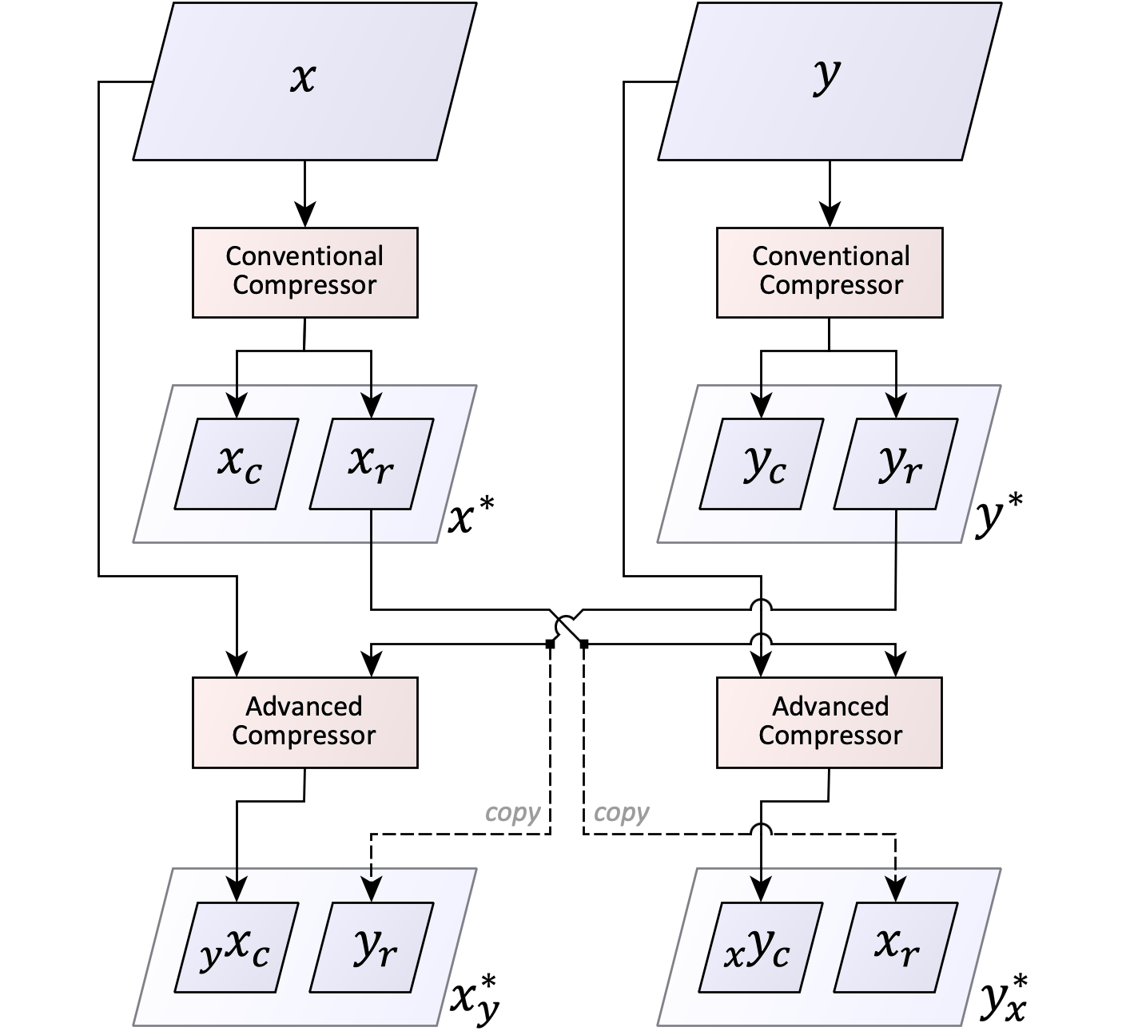
Meta-Algorithm ”Cross Compress”
Notes:
Here you can see the whole process of Cross Compress
In the upper left quarter of the image, you can see how the conventional compressor compresses file x and creates x*, which contains x_{c} and x_{r}. To the right you can see the same for file y.
In the lower left quarter, you can see the advanced compressor. It reads the uncompressed file x and the rule set y_{r}. Its output _{y}x_{c} is a version of x_{c} that needs the rules file y_{r} to be interpreted correctly. _{y}x_{c} and yr together make the compressed file x_{y}*. In the lower right quarter of the image, you can see how y_{x}* is generated.
Notice that both decompressing x* and decompressing x_{y}* result in the same decompressed file, x. The same is true for y* and y_{x}*, which both result in the file y when decompressed.

Slide 9
Meta-Algorithm ”Cross Compress”
The file $x_{y}^{∗}$ is larger than the file $x^{∗}$ if $x≠y$ and vice versa
$\left|x_{y}^{∗}\right|>\left|x^{∗}\right|$
$\left|y_{x}^{∗}\right|>\left|y^{∗}\right|$
The difference is the Compression Divergence
$C\left(x⊕y\right)=\left|x_{y}^{∗}\right|−\left|x^{∗}\right|$
$C\left(y⊕x\right)=\left|y_{x}^{∗}\right|−\left|y^{∗}\right|$
Compression Divergence measures how different two files are
Notes:
The point is now, that x_{y}* is larger than x*. The difference of these sizes is the Compression Divergence.

Slide 10
Experiments
Comparison between Concat Compress and Cross Compress
Three Compression Algorithms
gzip (combination of LZ77 and Huffman coding) (only used with Concat Compress)
bzip2 (Burrows-Wheeler) (only used with Concat Compress)
Re-Pair (Grammar based) used in two different versions and in combination with both meta-algorithms
Five labeled dataset
6533 files
approximately 10 MB
Full classification was performed on each dataset
Accuracy was used to measure the quality
Two normalized metrics were also compared on one data set.
Notes:
Experiments
The two meta-algorithms were subjected to an extensive practical test together with the compression algorithms gzip, bzip2 and Re-Pair.
Five labeled datasets containing about 6500 files were subjected to a classification process using these algorithms. A full confusion matrix was created for each combination of dataset, meta-algorithm, and compression algorithm. From each matrix, the accuracy was calculated, which was used as an indicator of the quality of the classification.
Two normalized metrics were also compared on one data set.

Slide 11
Results
Re-Pair in combination with both meta-algorithms
Concat Compress showed a higher accuracy in about 2/3 of all experiments
Needs further investigation
Average accuracy of Concat Compress in combination with gzip, bzip2 and Re-Pair
gzip: 70.73%
bzip2: 72.62%
Re-Pair: 74.56%
Maximum accuracy
gzip: 100.0%
bzip2: 100.0%
Re-Pair: 94.10%
Notes:
Results
When Re-Pair was used, Concat Compress achieved the better results in about 2/3 of all cases, but this finding is not conclusive.
Concat Compress was combined with three different compression algorithms in this study. This showed that in the experiments performed, the average accuracy of Re-Pair was slightly better than that of the two other algorithms which, on the other hand, achieved 100% accuracy in some cases, while in some cases they gave much weaker results than Re-Pair.
Re-Pair, on the other hand, was never better than 94.1%, but was also never noticeably bad.

Slide 12
Conclusion and Future Work
Concat Compress is easy to implement
no modifications of existing compression programs are necessary
Cross Compress needs modified compression programs
More programs that work together with Cross Compress Other must be written and tested in the future. (Now only Re-Pair was tested with Cross Compress.)
Cross Compress shows a higher accuracy on some datasets while on other datasets Concat Compress performs better.
The reasons for this are unclear and need to be investigated in the future.
A short test with different normalizing metrices showed, that they also can have a big impact to the quality of the results.
Needs also to be investigated in the future
Notes:
Conclusion and Future Work
Concat Compress needs to be tested with additional compression algorithms.
Cross Compress requires modified compression programs to be written to be able to test this meta-algorithm more extensively as well.
Sometimes Cross Compress showed better results than Concat Compress, then again it was the other way around. It is unclear why this is so. Future studies will have to clarify this.
Normalization metrics were only tested with one data set, but the results showed that the impact of the metrics is larger than expected. Therefore, further experiments are needed.

Slide 13
Thank you and goodbye
Notes:
Thank you and goodbye

