Slide 1
Are Soft prompts good zero-shot learners for speech recognition?
2024 International Conference on Acoustics, Speech, and Signal Processing (ICASSP)
Dianwen Ng, Chong Zhang, Ruixi Zhang, Yukun Ma, Fabian Ritter-Gutierrez, Trung Hieu Nguyen, Chongjia Ni, Shengkui Zhao Eng Siong Chng, Bin Ma
Alibaba Group
ALIBABA-NTU SINGAPORE JOINT RESEARCH INSTITUTE

Slide 2
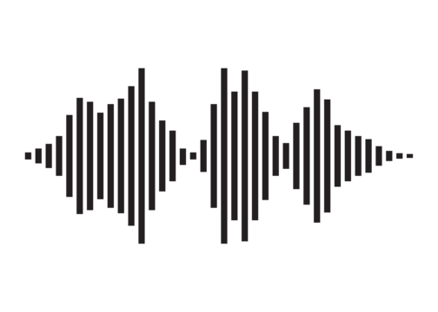
Speech recognition with prompt tuning
INTRODUCTION
Text Prediction
Decoder (Optional)
Involves prepending a set of soft prompt tokens to the latent speech features before sending to transformer
The soft prompts learn task specific instructional signals that guide the model’s attention towards relevant information for target task
Transformer
Off-the-Shelves SSL Speech Encoder
Soft-prompts
Latent Features
CNN Encoder
Pros (Why is this useful and why do we care?)
[1]
Optimize for training resources like energy, and computational power. Useful for building target domain specialized or personalized ASR model [1].
Small tunable parameters (on the external module) largely preserve the knowledge of the backbone model, preventing catastrophic forgetting and overfitting to the low-resource downstream domain [2].
[1] Zih-Ching Chen, Chin-Lun Fu, Chih-Ying Liu, Shang-Wen Daniel Li, and Hungyi Lee. 2023. Exploring Efficient-Tuning Methods in Self-Supervised Speech Models. In 2022 IEEE Spoken Language Technology Workshop (SLT). 1120–1127. https://doi.org/10.1109/SLT54892.2023.10023274
[2] Weijieying Ren and Xinlong Li and Lei Wang and Tianxiang Zhao and Wei Qin. 2024. Analyzing and Reducing Catastrophic Forgetting in Parameter Efficient Tuning. arXiv preprint arXiv:2402.18865

Slide 3
We heard voices…
NLP: Soft-prompts assist in accelerating convergence and enhance attention.
NLP: Soft-tokens (prompts) resemble natural language tokens, offering flexibility and being explainable.
Samet Oymak et al., 2023. “On the role of attention in prompt tuning,” in ICLR 2023 Workshop
Brian Lester, et al., 2021. “The power of scale for parameter-efficient prompt tuning,” in EMNLP 2021
SPEECH: Design for suitable soft-tokens remains a challenge, resulting in performance lagging behind NLP applications. (Not transferable across modality)
NLP: Soft-prompts do not generally correspond to natural language prompts (Hard/Hand engineered prompts)
Zih-Ching Chen et al., 2023. “Exploring Efficient-Tuning Methods in Self-Supervised Speech Models,” in SLT 2023
Luke Bailey, et al., 2023. “Soft prompting might be a bug, not a feature,” in ICML 2023 Workshop

Slide 4
QUESTIONS WE ASKED (What do soft-prompts mean to ASR model?)
What roles might soft-prompts play? (Based on our empirical experiments)
In the context of tuning and generalizability of fine-tuned models, how do soft prompts influence performance?
Can soft prompts be designed to enable quick adaptation in zero-shot learning?

Slide 5
Training details
EXPERIMENT DESIGN
Datasets
Backbone SSL Speech Encoder
HuBERT (Base)
Utilizes a 2-layer LSTM network like the one used in SUPERB system as decoder [1].
Learning rate: 1e-4
Number of steps: 80,000
Size of prompts: {20, 50}
Standard LibriSpeech 100h (EN Corpus)
Mixing FreeSound (0 – 20dB)
Stationary Noise: Car, Metro, Traffic
Non-stationary Noise: Babble, Airport/Station, Café, and AC/Vacuum
Testing data
Official LibriSpeech: Test-clean, Test-other
Pre-mixed: LS (subset) + FreeSound [2]
1] Zih-Ching Chen, Chin-Lun Fu, Chih-Ying Liu, Shang-Wen Daniel Li, and Hungyi Lee. 2023. Exploring Efficient-Tuning Methods in Self-Supervised Speech Models. In 2022 IEEE Spoken Language Technology Workshop (SLT). 1120–1127. https://doi.org/10.1109/SLT54892.2023.10023274
[2] Archiki Prasad, Preethi Jyothi, and Rajbabu Velmurugan, “An investigation of end-to-end models for robust speech recognition,” in ICASSP 2021-2021 IEEE International Conference on Acoustics, Speech and Signal Processing (ICASSP). IEEE, 2021, pp. 6893–6897

Slide 6
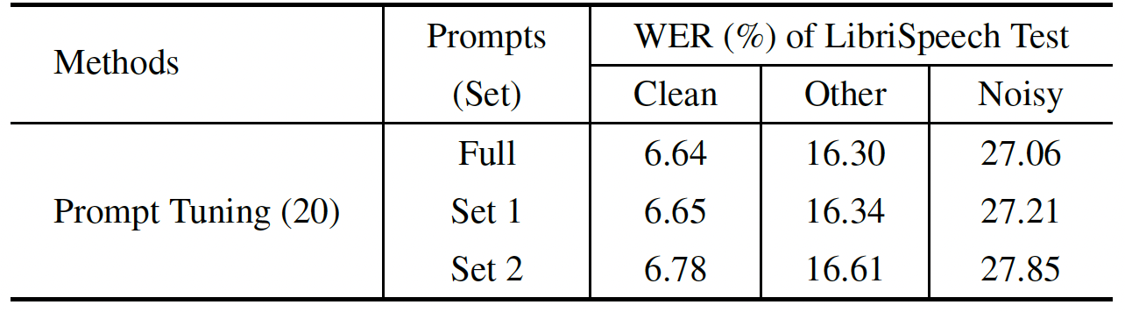
Role of soft-prompts
Cluster identification (Experiment Setup)
Analyze impact of soft-prompts on ASR performance by removing single prompts (Probing)
Visualize soft-prompts and their relationships using t-SNE plot. Highlighted sets in the plot correspond to the identified prompt clusters.
ASR Performance
With prompts from set 1 (omitting set 2) results in similar ASR performance for clean but affects noisy ASR
Using only prompts from set 2 leads to noticeable decrease in general ASR performance
Performance comparison between the prompt tuning (20) model with the utilization of different prompt sets on the LibriSpeech test set.
Visualization of soft-prompts using t-SNE plot

Slide 7
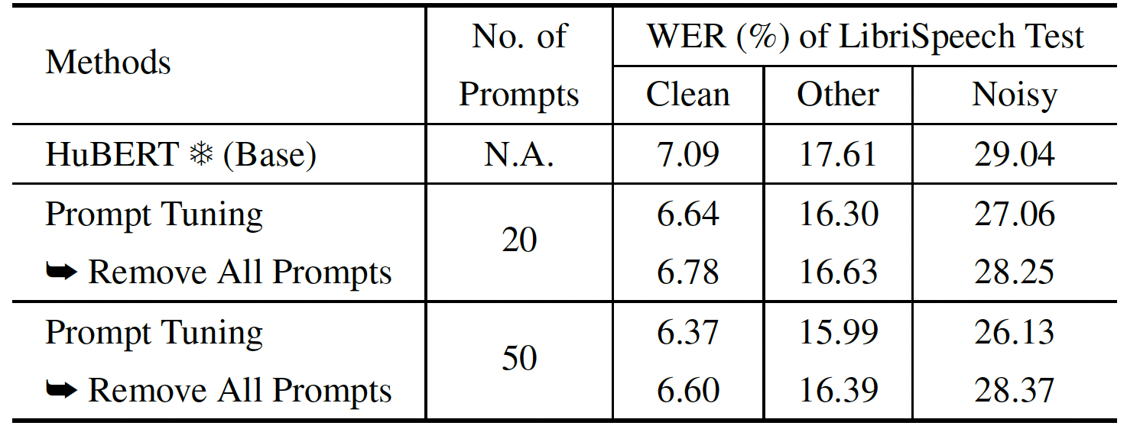
soft-prompts help better fine-tuning & improve generalizability
Experiment Setup:
Remove prompts during inference. (Explore if the model depends on prompt instructional signals or can function adequately without them.)
NOTE: The simplification makes them equivalent to the frozen-based model (Fully frozen encoder)
Results:
Prompt-tuned model outperforms even without soft-prompts (more pronounced with larger prompt size)
WER of different models, exhibiting the generalization power of the downstream decoder and predictor head by removing the use of all soft prompts during feedforward

Slide 8
Quick adaptation in zero-shot learning setting
Experiment Setup:
Evaluate FreeSound Noise model on new FSD50K dataset (select specifically office noise – Writing, Typing, Typewriter…)
Corrupt official LS with SNR of 0-20dB to make OOD set
Naively: we pool and average representations from the FSD50K using the prompt tuning (PT) model for global representations of the noise.
Broadcast the vector and apply Hadamard product to geometrically shift the set of noise prompts in the embedding space of PT to align the “instructions” with the information of the new noise domain.
Performance comparison of different models on out-of-domain noise augmented testing sets from LibriSpeech, where noisy speech is simulated with SNR of 0-20dB.

Slide 9
Conclusion
We identified two primary role of soft prompt:
content processing prompts
noise processing prompts
to work on adaptation against background noise distortion in speech signals.
We find that the soft prompts offer the model capacity to avoid suboptimal local minima during training, leading to improved performance by enabling exploration of better alternatives
We demonstrate a modification to the noise prompts to achieve zero-shot learning on adapting to out-of-domain noise environments.

Slide 10
Thank You for Your attention
dianwen001@e.ntu.edu.sg

