Slide 1
Neural JPEG: End-to-End Image Compression Leveraging a Standard JPEG Encoder-Decoder
Ankur Mali*, Alexander G. Ororbia**, Dan Kifer*, C. Lee Giles*
* Pennsylvania State University, University Park, PA
**Rochester Institute of Technology, Rochester, NY

Slide 2
Outline
Motivation
Problem description
Model Architecture
Conclusions/Future work

Slide 3
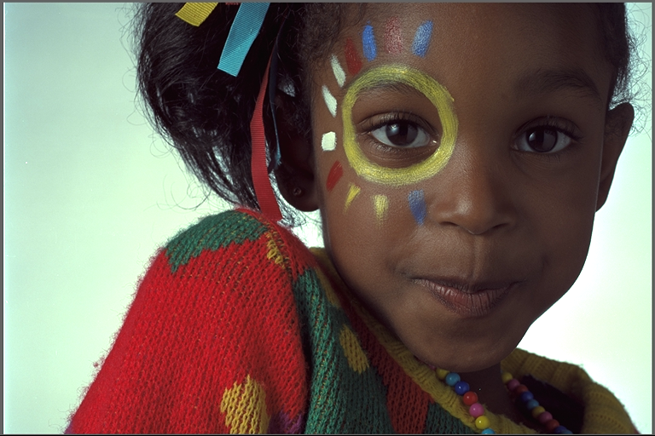
What we need from compression system
To achieve better visual quality at lowest bit rates
Preserve important features of images while conversation

Slide 4
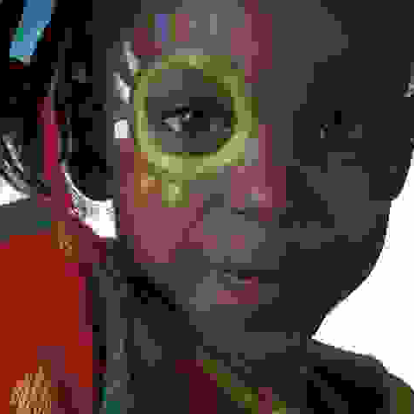
Issues with traditional methods
Transform/Block artifacts
Deformed Edges
Ringing
Flattened Textures
Staircasing

Slide 5
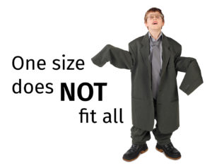
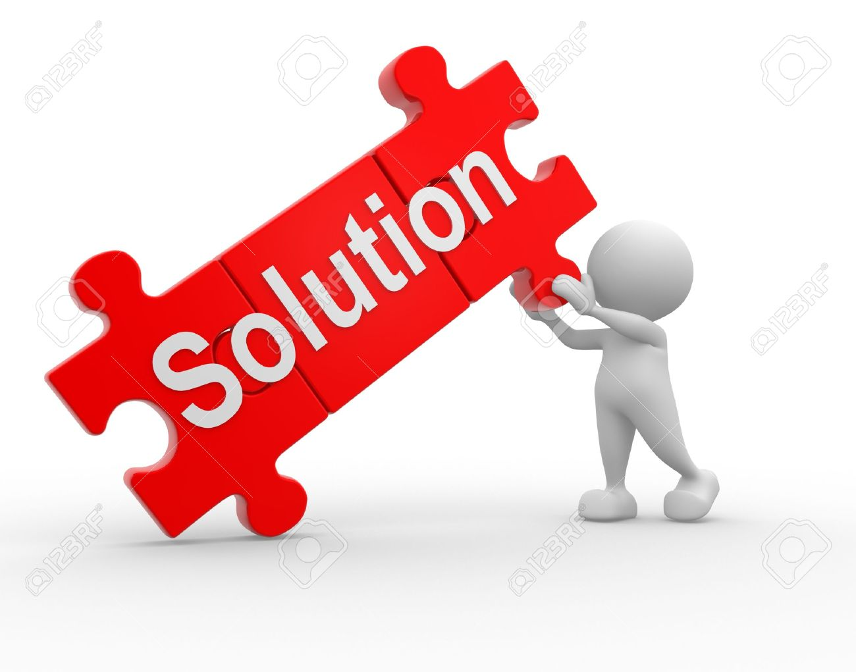
Motivation
Hard coded transformation cannot work for all problems/images
Learned features/domain adaptation and Reduce the redundancy in the system

Slide 6
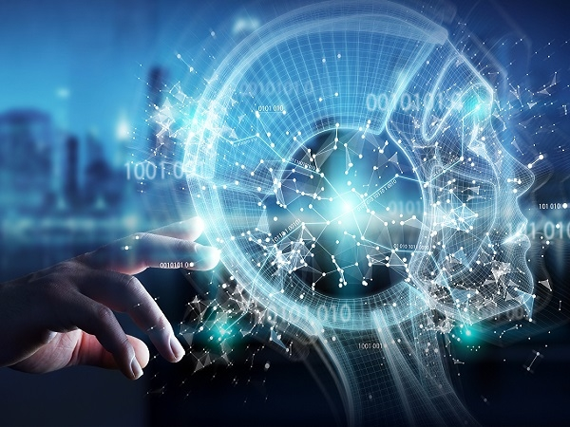
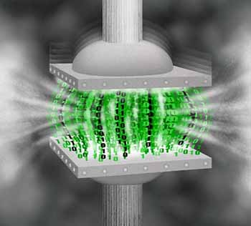
Why Deep Learning?
Machine Learning meets Compression
Compression model
Machine Learning system
Goal :- Better and automatic feature representation, Domain adaptation, learns from large unstructured data
Goal :- Reducing the size of the image, better transmission over web, higher visual quality with minimal loss

Slide 7
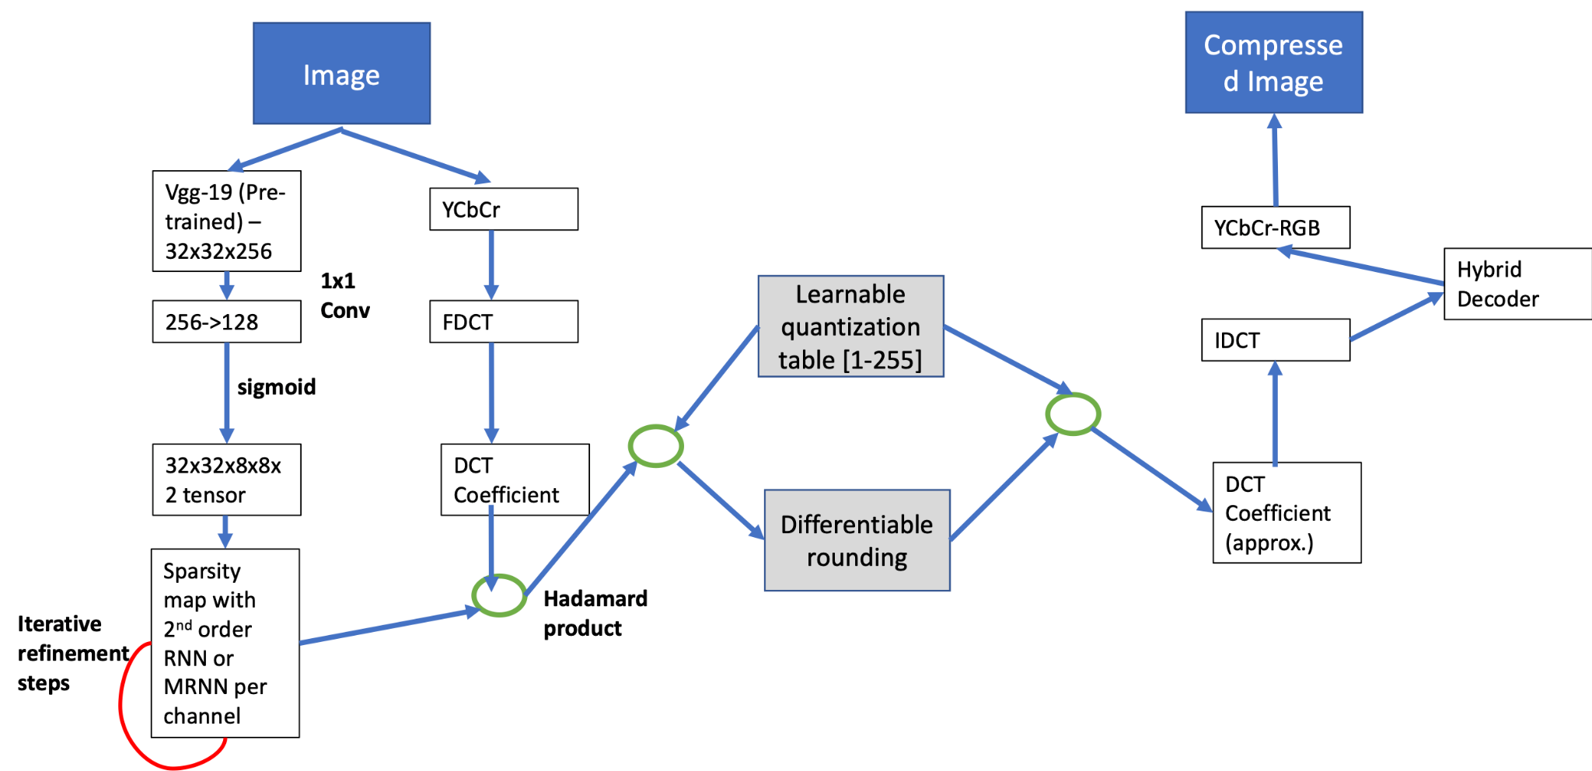
Neural JPEG: Model Design

Slide 8
Proposed Model?

Slide 9
Proposed Model?

Slide 10
Outcome and Conclusion
The result indicate that our model can lead to improved compression and tries to restrict artifact generation at decoder end
Standard compression techniques when coupled with deep learning, leads to improved compression and minimum artifacts.
Such combination creates a form of guided learning, that leads to faster convergence
Another interesting venue is to explore neural jpeg with different transformation such as wavelet and study model performance and adaptability.
Future work will be focused on using transformers based vision model trained large scale dataset to encode strong visual prior into our framework

