Slide 1
Contact Matrix Compressor
Yeremia Gunawan Adhisantoso, Jörn Ostermann
Institut für Informationsverarbeitung
DCC 2022

Slide 2
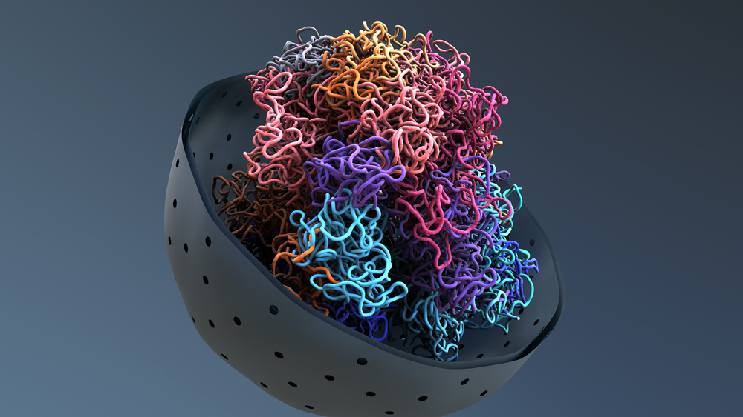
Background – 3D structure of DNA
Genome structure
3D structure of DNA
https://www.nagwa.com/en/explainers/472187081634/

Slide 3
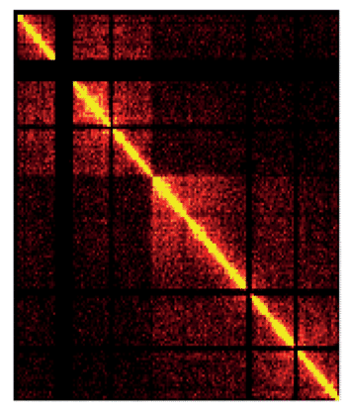
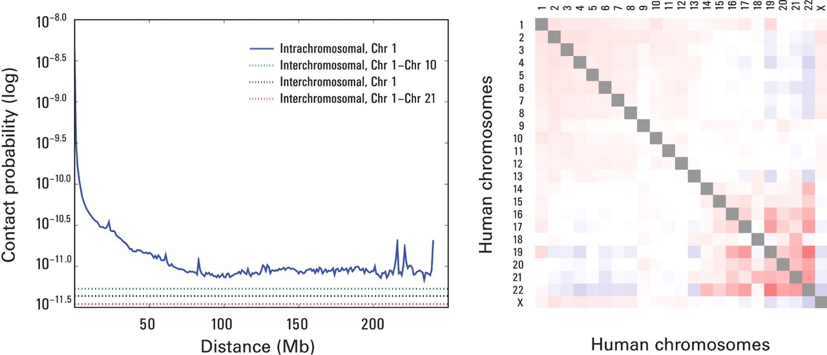
Background – Contact Matrix
Visualization of Contact Matrix
Lieberman-Aiden et. al., Comprehensive Mapping of Long-Range Interactions Reveals Folding Principles of the Human Genome
Yardimci et. al., Software tools for visualizing Hi-C data

Slide 4
Background – Data Representation
Table 1: An example of how Hi-C data is represented in a coordinate-value form.
Table 2: Compact data representation by splitting table 1 into 2 different tables.
https://cooler.readthedocs.io/en/latest/schema.html

Slide 5
Method – Contact Matrix Compressor
Store only the upper triangle contact matrix
Split into smaller matrices to enable random access capability
Remove regions with no contact by masking the rows and columns of the matrix
Assign variable bit-length
Visualization of Contact Matrix
MPEG-G ISO/IEC 23092
Genomic Information Representation

Slide 6
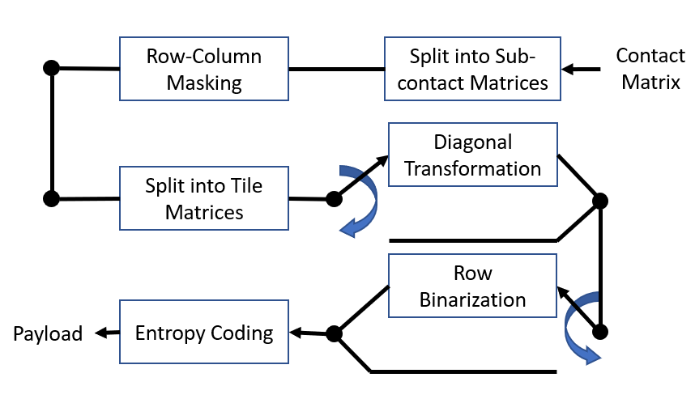
Method - Pipeline

Slide 7
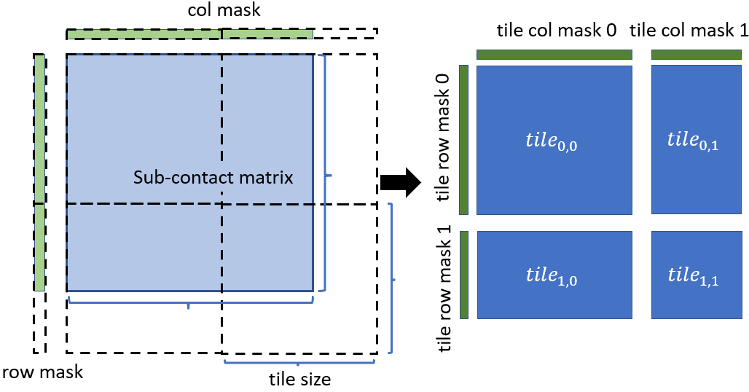
Method – Sub-contact Matrices and Tile Matrices
Chr 1
Chr 2
Chr 3
Intra
Inter
Inter
Chr 1
Inter
Intra
Inter
Chr 2
Inter
Inter
Intra
Chr 3
Sub-contact matrices
Tiles

Slide 8
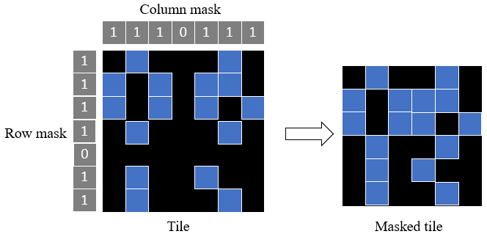
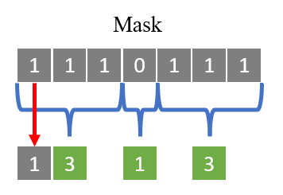
Method – Row and Column masking
Masking process
Binary run-length encoding

Slide 9
Method – Diagonal Transformation
Matrix
Bit-length
5
Diagonal
transformation
$$\left[\begin{matrix}127 & 2 & 3 \\ 3 & 125 & 7 \\ 1 & 3 & 120\end{matrix}\right]→\left[\begin{matrix}7 bits \\ 7 bits \\ 7 bits\end{matrix}\right]$$
4
3
2
8
1
6
Mode 0
4
2
Matrix
Bit-length
$$\left[\begin{matrix}127 & 125 & 120 \\ 2 & 7 & 3 \\ 3 & 3 & 1\end{matrix}\right]→\left[\begin{matrix}7 bits \\ 3 bits \\ 2 bits\end{matrix}\right]$$
9
7
5
3
1
Mode 1
Minimizing the bits required
Transformation of a symmetrical matrix

Slide 10
Method – Diagonal Transformation Modes
5
8
9
1
4
6
8
2
3
4
7
3
2
2
6
4
1
9
7
5
3
1
1
2
3
4
5
9
8
7
6
5
Original
Mode 0
Mode 1
Mode 2
Mode 3
$$\left[\begin{matrix}0 & 1 & 2 & 3 & 4 \\ 5 & 6 & 7 & 8 & 9 \\ 10 & 11 & 12 & 13 & 14 \\ 15 & 16 & 17 & 18 & 19 \\ 20 & 21 & 22 & 23 & 24\end{matrix} \right]$$
$$\left[\begin{matrix}0 & 6 & 12 & 18 & 24 \\ 1 & 7 & 13 & 19 & 2 \\ 8 & 14 & 3 & 9 & 4 \\ X & X & X & X & X \\ X & X & X & X & X\end{matrix} \right]$$
$$\left[\begin{matrix}0 & 6 & 12 & 18 & 24 \\ 1 & 7 & 13 & 19 & 5 \\ 11 & 17 & 23 & 2 & 8 \\ 14 & 10 & 16 & 22 & 3 \\ 9 & 15 & 21 & 4 & 20\end{matrix} \right]$$
$$\left[\begin{matrix}20 & 15 & 21 & 10 & 16 \\ 22 & 5 & 11 & 17 & 23 \\ 0 & 6 & 12 & 18 & 24 \\ 1 & 7 & 13 & 19 & 2 \\ 8 & 14 & 3 & 9 & 4\end{matrix} \right]$$
$$\left[\begin{matrix}4 & 3 & 9 & 2 & 8 \\ 14 & 1 & 7 & 13 & 19 \\ 0 & 6 & 12 & 18 & 24 \\ 5 & 11 & 17 & 23 & 10 \\ 16 & 22 & 15 & 21 & 20\end{matrix} \right]$$

Slide 11
Method – Row Binarization
$$\left[\begin{matrix}1 & 2 & 3\end{matrix}\right]→\left[\begin{matrix}1 & 0 & 1 \\ 0 & 1 & 1\end{matrix}\right]$$
$$\left[\begin{matrix}0 & 1 & 0 & 1 \\ 1 & 0 & 1 & 1\end{matrix}\right]$$
2
3
1 | 2 | 3
4 | 5 | 6
Bits from least significant to most significant
Put flag to signal the most significant bit
Number of bits required
per row
Matrix
$$\left[4\begin{matrix} & 5 & 6\end{matrix}\right]→\left[\begin{matrix}0 & 1 & 0 \\ 0 & 0 & 1 \\ 1 & 1 & 1\end{matrix}\right]$$
$$\left[\begin{matrix}0 & 0 & 1 & 0 \\ 0 & 0 & 0 & 1 \\ 1 & 1 & 1 & 1\end{matrix}\right]$$
concatenated
$$\left[\begin{matrix}0 & 1 & 0 & 1 \\ 1 & 0 & 1 & 1 \\ 0 & 0 & 1 & 0 \\ 0 & 0 & 0 & 1 \\ 1 & 1 & 1 & 1\end{matrix}\right]$$
Binary matrix

Slide 12
Method – Entropy Coding
JBIG ISO/IEC 11544
Joint Bi-level Image Experts Group
JBIG context
Sayood et. al., Introduction to Data Compression

Slide 13
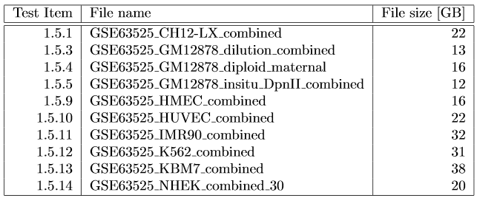
Comparison - Dataset

Slide 14
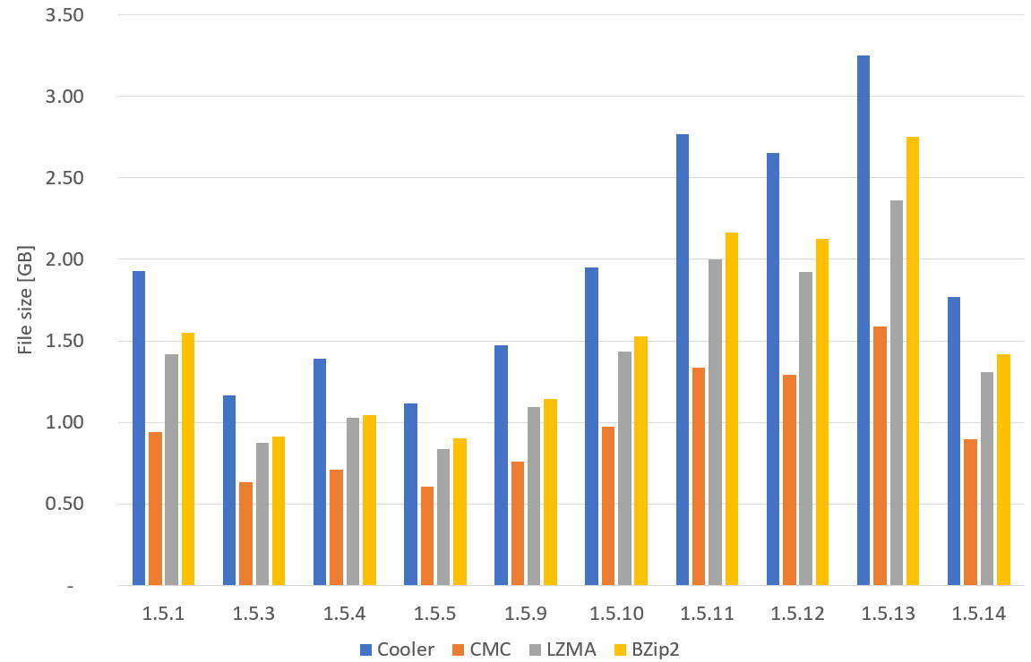
Comparison – Compression Performance

Slide 15
Comparison – Compression Time

Slide 16
Comparison - Decompression Time
CMC
Tile size: 5000
242 sub-contact matrices
LZMA and BZip2
Solid

Slide 17
Summary
Present a specialized compressor for Hi-C data
Achieved up to 40% reduction over LZMA and BZip2
Better compression performance is achieved by exploiting the properties of the data.
Allows random access and possible parallel decoding process.
Can be extended to other 2-dimensional array with similar properties.

