Slide 1
MULTI-EXIT VISION TRANSFORMER WITH CUSTUM-FINE-TUNING FOR FINE-GRAINED IMAGE RECOGNITION
Tianyi Shen, Chonghan Lee, and Vijaykrishnan Narayanan
The Pennsylvania State University
Dept. of Electrical Engineering and Computer Science
State Colege, USA
Presenter: Tianyi Shen (tqs5537@psu.edu)
Paper #2852
IEEE International Conference on Image Processing

Slide 2
Outline
Problem Statement & Related Works
Approach
Experiment Setup
Results
Conclusion

Slide 3
Problem Statement & Related Works
Fine-grained Visual Classification (FGVC)
Popular area in computer vision domain
Accurately identify discriminative local parts and features from visually similar subcategories (bird species, car models)
Harder than category-level classification

Slide 4
Problem Statement & Related Works
Vision Transformers (ViT) dominate the FGVC tasks
ViT-based model achieve better performance than CNN
TransFG [1]: Generates overlapping image patches with a sliding window to avoid any information loss among hard-split patches
FFVT [2]: Aggregates features of important patches from early layers to extract low-level and middle-level information effectively
[1] Ju He et al., “Transfg: A transformer architecture for fine-grained recognition,” in Proceedings of the AAAI Conference on Artificial Intelligence, 2022, vol. 36, pp. 852–860.
[2] Jun Wang, Xiaohan Yu, and Yongsheng Gao, “Feature fusion vision transformer for fine-grained visual categorization,” in BMVC, 2021.

Slide 5
Problem Statement & Related Works
Vision Transformers (ViT) dominate the FGVC tasks
ViT-based model achieve better performance than CNN
TransFG [1]: Generates overlapping image patches with a sliding window to avoid any information loss among hard-split patches
FFVT [2]: Aggregates features of important patches from early layers to extract low-level and middle-level information effectively
Vision Transformers (ViT) are expensive during inferencing
$O(n^{2})$ time complexity for self-attention calculation
Unrealistic to be implemented on edge devices or real-time application
[1] Ju He et al., “Transfg: A transformer architecture for fine-grained recognition,” in Proceedings of the AAAI Conference on Artificial Intelligence, 2022, vol. 36, pp. 852–860.
[2] Jun Wang, Xiaohan Yu, and Yongsheng Gao, “Feature fusion vision transformer for fine-grained visual categorization,” in BMVC, 2021.

Slide 6
Problem Statement & Related Works
Early-Exit: model-level tradeoffs between accuracy and efficiency
Fewer layers in CNN can still precisely identify a large number of classes in classification tasks [1]
BranchyNet augmented the existing early CNN model architectures with additional side branch classifiers [2]
BERxiT proposed an advanced finetuning strategy to make the early-exit structure take full advantage of BERT [3]
[1] Priyadarshini Panda, Abhronil Sengupta, and Kaushik Roy, “Conditional deep learning for energy-efficient and enhanced pattern recognition,” in 2016 Design, Automation & Test in Europe Conference & Exhibition (DATE). IEEE, 2016, pp. 475–480.
[2] Surat Teerapittayanon, Bradley McDanel, and Hsiang- Tsung Kung, “Branchynet: Fast inference via early exiting from deep neural networks,” in 2016 23rd International Conference on Pattern Recognition (ICPR). IEEE, 2016, pp. 2464–2469.
[3] Ji Xin, Raphael Tang, Yaoliang Yu, and Jimmy Lin, “BERxiT: Early exiting for BERT with better finetuning and extension to regression,” in Proceedings of the 16th Conference of the European Chapter of the Association for Computational Linguistics: Main Volume, Online, Apr. 2021, pp. 91–104, Association for Computational Linguistics.

Slide 7
Approach
In this paper…
We introduce a Multi-exit Vision Transformer architecture (MEViT) with an uncertainty score predictor module
We apply layer-wise in-place distillation and sandwich rule technique during training to address the knowledge degradation problem

Slide 8
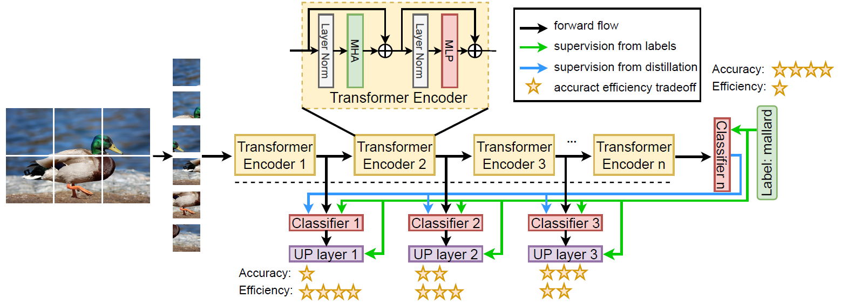
Approach
Fig. 1. Overview of our proposed Multi-exit Vision Transformer

Slide 9
Approach
Fig. 2. Visualization of attention probability distribution on each layer

Slide 10
Experiment Setup
Datasets
FGVC-Aircraft
10,200 images with 100 images for each of 102 different aircraft model variants
Stanford Cars
16,185 images of 196 classes of cars
[1]S. Maji, J. Kannala, E. Rahtu, M. Blaschko, and A. Vedaldi. 2013. Fine-Grained Visual Classification of Aircraft.
[2] Jonathan Krause, Michael Stark, Jia Deng, and Li Fei-Fei, “3d object representations for fine-grained categorization,” in 4th International IEEE Workshop on 3D Representation and Recognition (3dRR-13), Sydney, Australia, 2013

Slide 11
Experiment Setup
We use…
ViT-B/16, Image 21K pre-trained
12 layers in total with 6 corresponding classification heads starting from 6th encoder layer
TransFG data augmentation with random cropping size 448*448
Minibatch training with 32 batch size
Stochastic gradient descend (SGD) optimizer with cosine annealing scheduler
$β:0.9$
$α:0.001, 0.003$
Training on Tesla V100 GPU
Inferencing on Nvidia Jetson Nano

Slide 12
Results
$MEViT_{12}$
0.6% accuracy increase from ViT-B in Stanford Car dataset
1.1% accuracy increase from ViT-B in FGVC Aircraft dataset
Almost same latency with ViT-B
$MEViT_{6}$
0.7 % accuracy reduction from ViT-B in Stanford Car dataset
0.8 % accuracy reduction from ViT-B in FGVC Aircraft dataset
Half the latency of ViT-B
Table 1. Model comparison on Stanford Car dataset
Table 2. Model comparison on FGVC Aircraft dataset

Slide 13
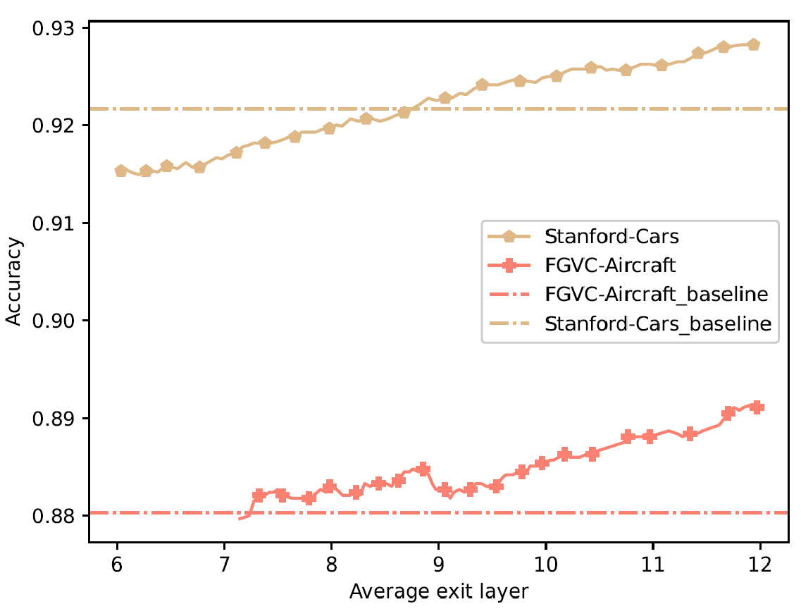
Results
Table 3. Efficiency evaluation on Stanford Car dataset
After 6th encoder, Layer-wise knowledge distillation helps all the encoders learn fine-grained features.
Our sparse model half the size, latency, power and Memory usage while maintaining a good performance.
Fig. 3. Layer-wise trade-off curves of accuracy to the average
number of exit layers

Slide 14
Conclusion
We propose MEViT for efficient inference on FGVC tasks.
The uncertainty score predictor module enables the early-exit functionality
Extensive experiments are conducted, and the results show the superior accuracy-efficiency trade-offs
MEViT drastically reduces the overall compute cost and memory usage on various systems with different computational budgets.

