Slide 1
Low-Complexity Recursive Convolutional Precoding for OFDM-based Large-Scale Antenna Systems
Yinsheng Liu, Beijing Jiaotong University, China
Geoffrey Ye Li, Georgia Institute of Technology, USA

Slide 2
Authors
Yinsheng Liu
Beijing Jiaotong University, China
Email: ys.liu@bjtu.edu.cn.
Geoffrey Ye Li
Georgia Institute of Technology, USA
Email: liye@ece.gatech.edu.

Slide 3
Outlines
Introduction
System Model
Recursive Convolutional Precoding
Performances
Conclusions

Slide 4
Introduction
Large-Scale Antenna (LSA) system
Key technology for 5G
Large amount of antennas at the base-station
Improved spectrum- and energy-efficiencies
LSA-OFDM: combination of LSA and OFDM
Straightforward evolution from MIMO-OFDM
Provide frequency-selective channels for LSA systems
Notes:
Massive-MIMO is the key enabling technology for the future 5G wireless communication systems.
In a Massive-MIMO system, the base-station is equipped with a large antenna array.
The large amount of array elements will provide significant spectral and energy efficiency gains for the wireless network.

Slide 5
System Model
Scenario: Downlink multiuser precoding
M antennas at the BS
P users with single antenna for each user
Received signal at n-th OFDM block and k-th subcarrier
Channel statistics with different large-scale gain
P-by-1
receive vector
M-by-P
precoding matrix
P-by-1
noise vector
P-by-M
channel matrix
P-by-1
transmit vector
Notes:
For the system model, we consider the scenario of downlink multiuser precoding in a cell.
The BS has M antennas to serve P users with single antenna for each user.
The received signal at the k-th subcarrier of the n-th OFDM block can be represented by the following model.

Slide 6
LSA-OFDM
Drawback: large complexity of LSA-OFDM due to
Huge number of IFFT/FFT modules
Matrix inverse for ZF/MMSE precodings
Our Solution: recursive convolutional precoding
Recursive: no need of matrix inverse
Convolutional: reduce the number of IFFT/FFTs
P-by-1
receive vector
M-by-P
precoding matrix
P-by-1
noise vector
P-by-M
channel matrix
P-by-1
transmit vector
Notes:
The evolution from MIMO-OFDM to Massive-MIMO-OFDM is straightforward, however the traditional MIMO-OFDM architect suffers from a few significant drawbacks in the Massive-MIMO scenario.
First, the MIMO-OFDM architect accomplishes the mapping from user-domain (P) to spatial-domain (M) in a per sub-carrier (K) manner. The precoded signals are then transformed back into time-domain waveform via IFFT operations for each one of the M spatial sub-streams.
While it is not a problem when M << K due to limited (M) IFFT operations, it consumes significant computational efforts and power resources, when M >> K, as in Massive-MIMO-OFDM case.
Second, the ZF/MMSE precoding requires channel inversion. While it is not a problem when both M and P are small, it consumes significant computational efforts and power resources as in Massive-MIMO-OFDM case.

Slide 7
Recursive Convolutional Precoding
Low-complexity of recursive convolutional precoding
Recursive: no need of matrix inverse
Convolutional: reduce the number of IFFT/FFTs
From traditional to recursive convolutional precoding
Step I: conversion from traditional frequency-domain (FD)
precoding to recursive FD precoding
Step II: conversion from recursive FD precoding to
convolutional precoding in time domain (TD)
Notes:
In this talk, the authors proposed a low complexity recursive convolutional precoding scheme for Massive MIMO, where two major steps are followed:
First, to replace the MIMO precoder with a recursive MIMO precoder without matrix inversion, and
Second, to replace the frequency-domain precoder with a time domain pre-filter.

Slide 8
Step I
Traditional FD precoding (e.g. ZF)
Taylor expansion (matrix form)
Taylor expansion (vector form)
Recursive FD precoding
Taylor expression
Q+1-th order Taylor expression of
Matrix form to vector form
p-th column of
From order recursion to time recursion
Notes:
In Step I, By using Taylor expansion, we can obtain an order-recursive version of the ZF precoding.
Then, we can rewrite the matrix form Taylor expansion into a vector form. Here, we note that the recursion is actually driven by the expansion order Q,
There is also an analogy between the OFDM symbol index n and the expansion order Q.
In other words, we can obtain recursive precoder indexed by n, if replacing Q with n.

Slide 9
Step II
Recursive FD precoding
Re-arrang vector representation
Converted to convolutional precoding
vector includes precoding coefficients on al l antennas
vector re-arrange
vector includes precoding coefficients on al l subcarriers
IDFT
CIR
Estimation error for adaptive control
Notes:
In step II, we manipulate the per-subcarrier MIMO precoders into per-user vector prefilters.
For this purpose, we re-arrange the precoder to let u_{m,p}[n] containing the precoding coefficients for user p over all subcarriers.
Then, a time domain prefilter can be obtained by IDFT, leading to the adaptive updating of the coefficients of the prefilter.

Slide 10
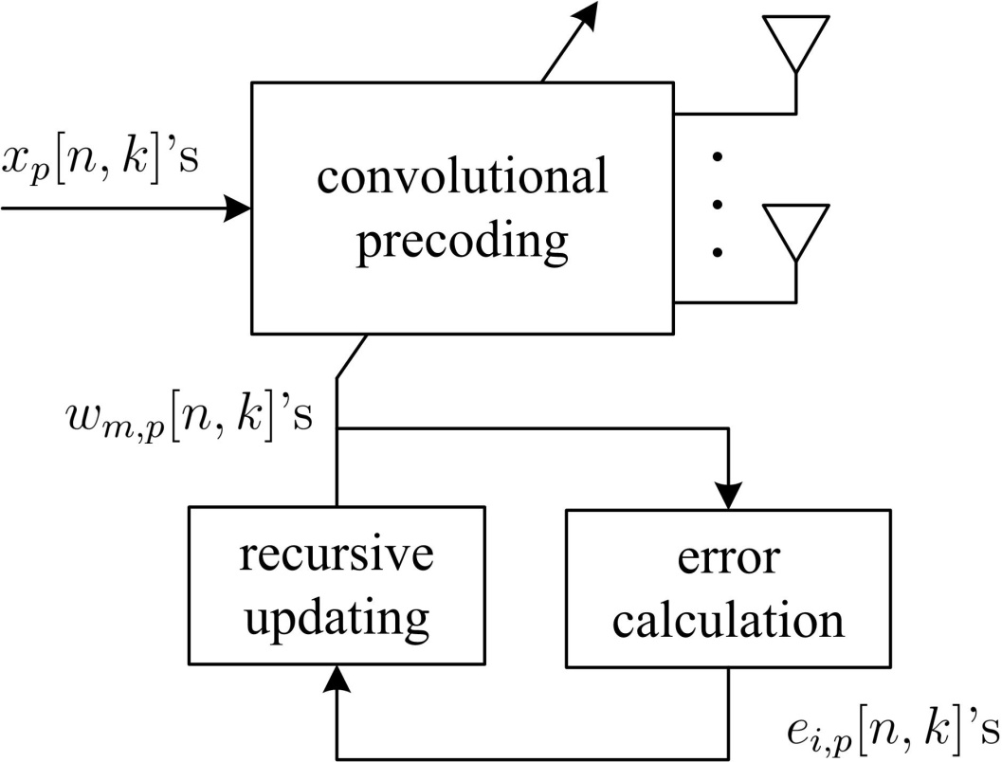
Structure
Recursive convolutional precoding includes
convolutional precoding
recursive updating
error calculation
Notes:
The proposed recursive convolutional precoder can be summarized as two major parts:
A discrete-time vector prefilter for each user, and an algorithmic module for filter updating and channel variation tracking.

Slide 11
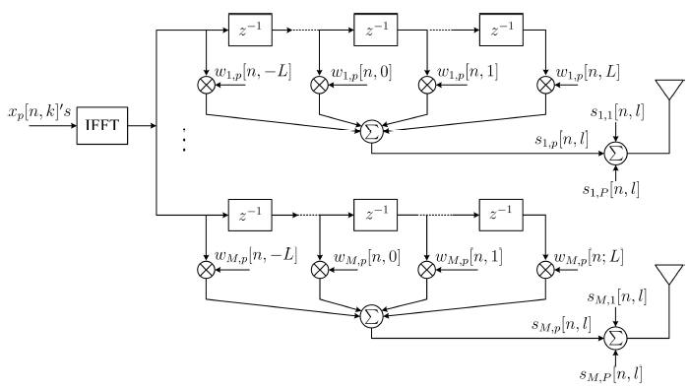
Convolutional precoding
Notes:
The major benefit of replacing per subcarrier MIMO precoder by per user vector prefilter is that only P << M IFFT modules in total are required.
The vector prefilters consist of P2ML taps, which is far less than the complexity of M IFFT modules.

Slide 12
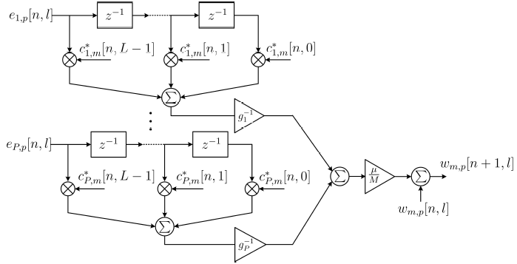
Recursive updating

Slide 13
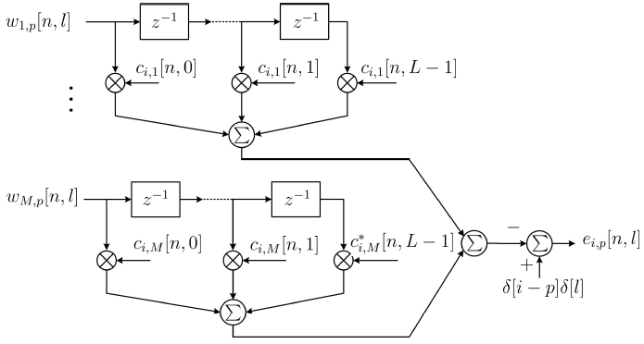
Error Calculation

Slide 14
Performances
Complexity comparison among
Proposed approach
Truncated polynomial expansion (TPE) (Q iterations)
Traditional FD ZF
(B subcarriers share same precoding matrix)
Symbol-error-rate (SER) simulation
ETU channel with equal large gains for different users
QPSK modulation
5MHz LTE bandwidth
(512 FFT size and 300 data subcarriers)
100 antennas and 10 users

Slide 15
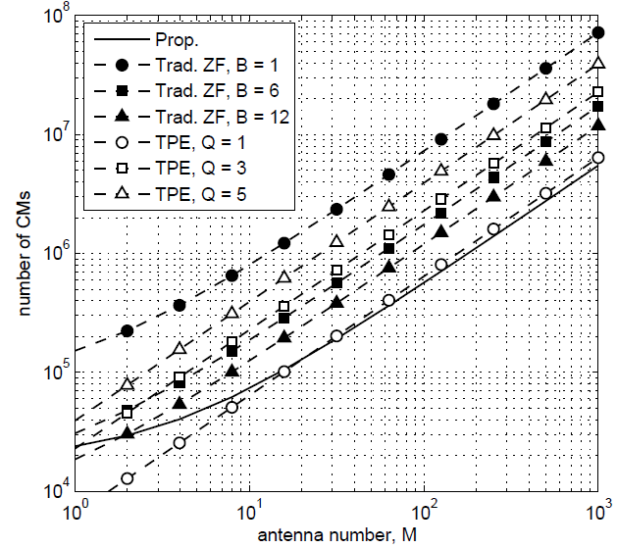
Complexity comparison
Significant complexity reduction

Slide 16
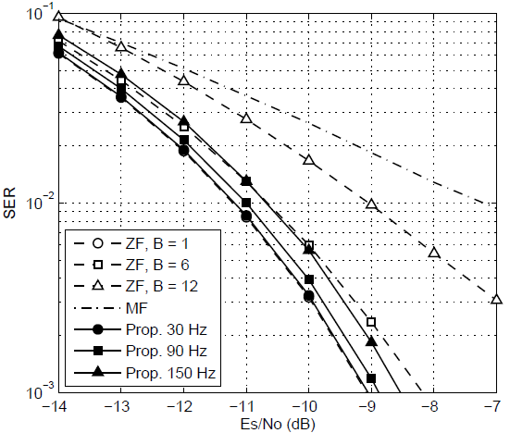
SER Simulation
Significant improvement than MF
Better performance than ZF with similar complexity

Slide 17
Conclusions
Recursive convolutional precoding can achieve lower complexity than traditional LSA-OFDM while maintaining satisfied performance

