Slide 1
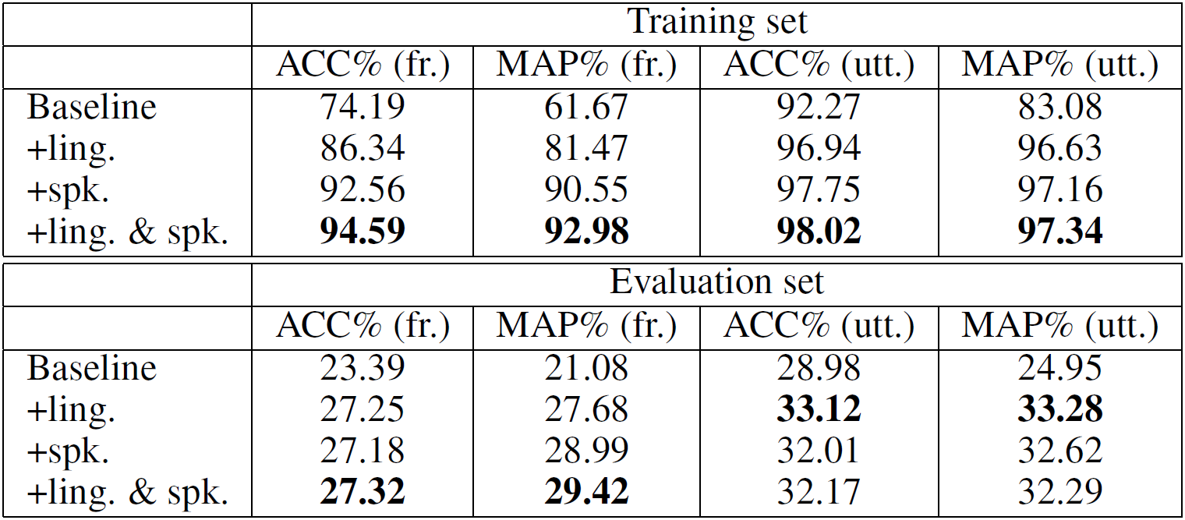
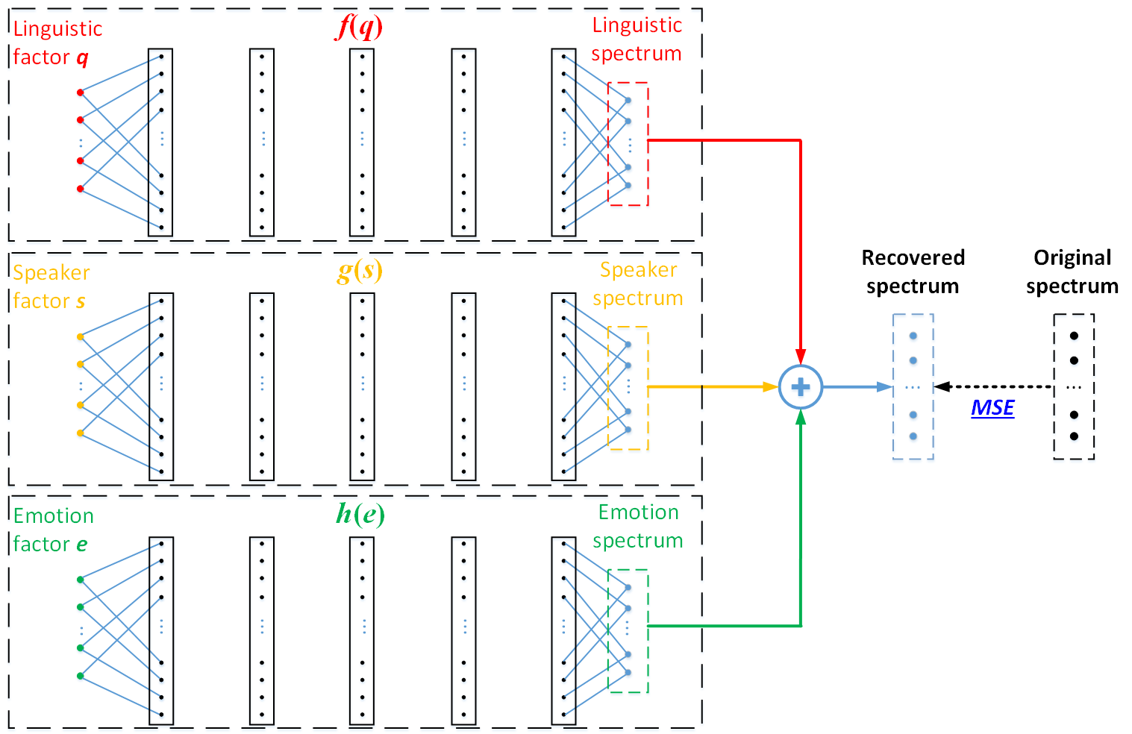
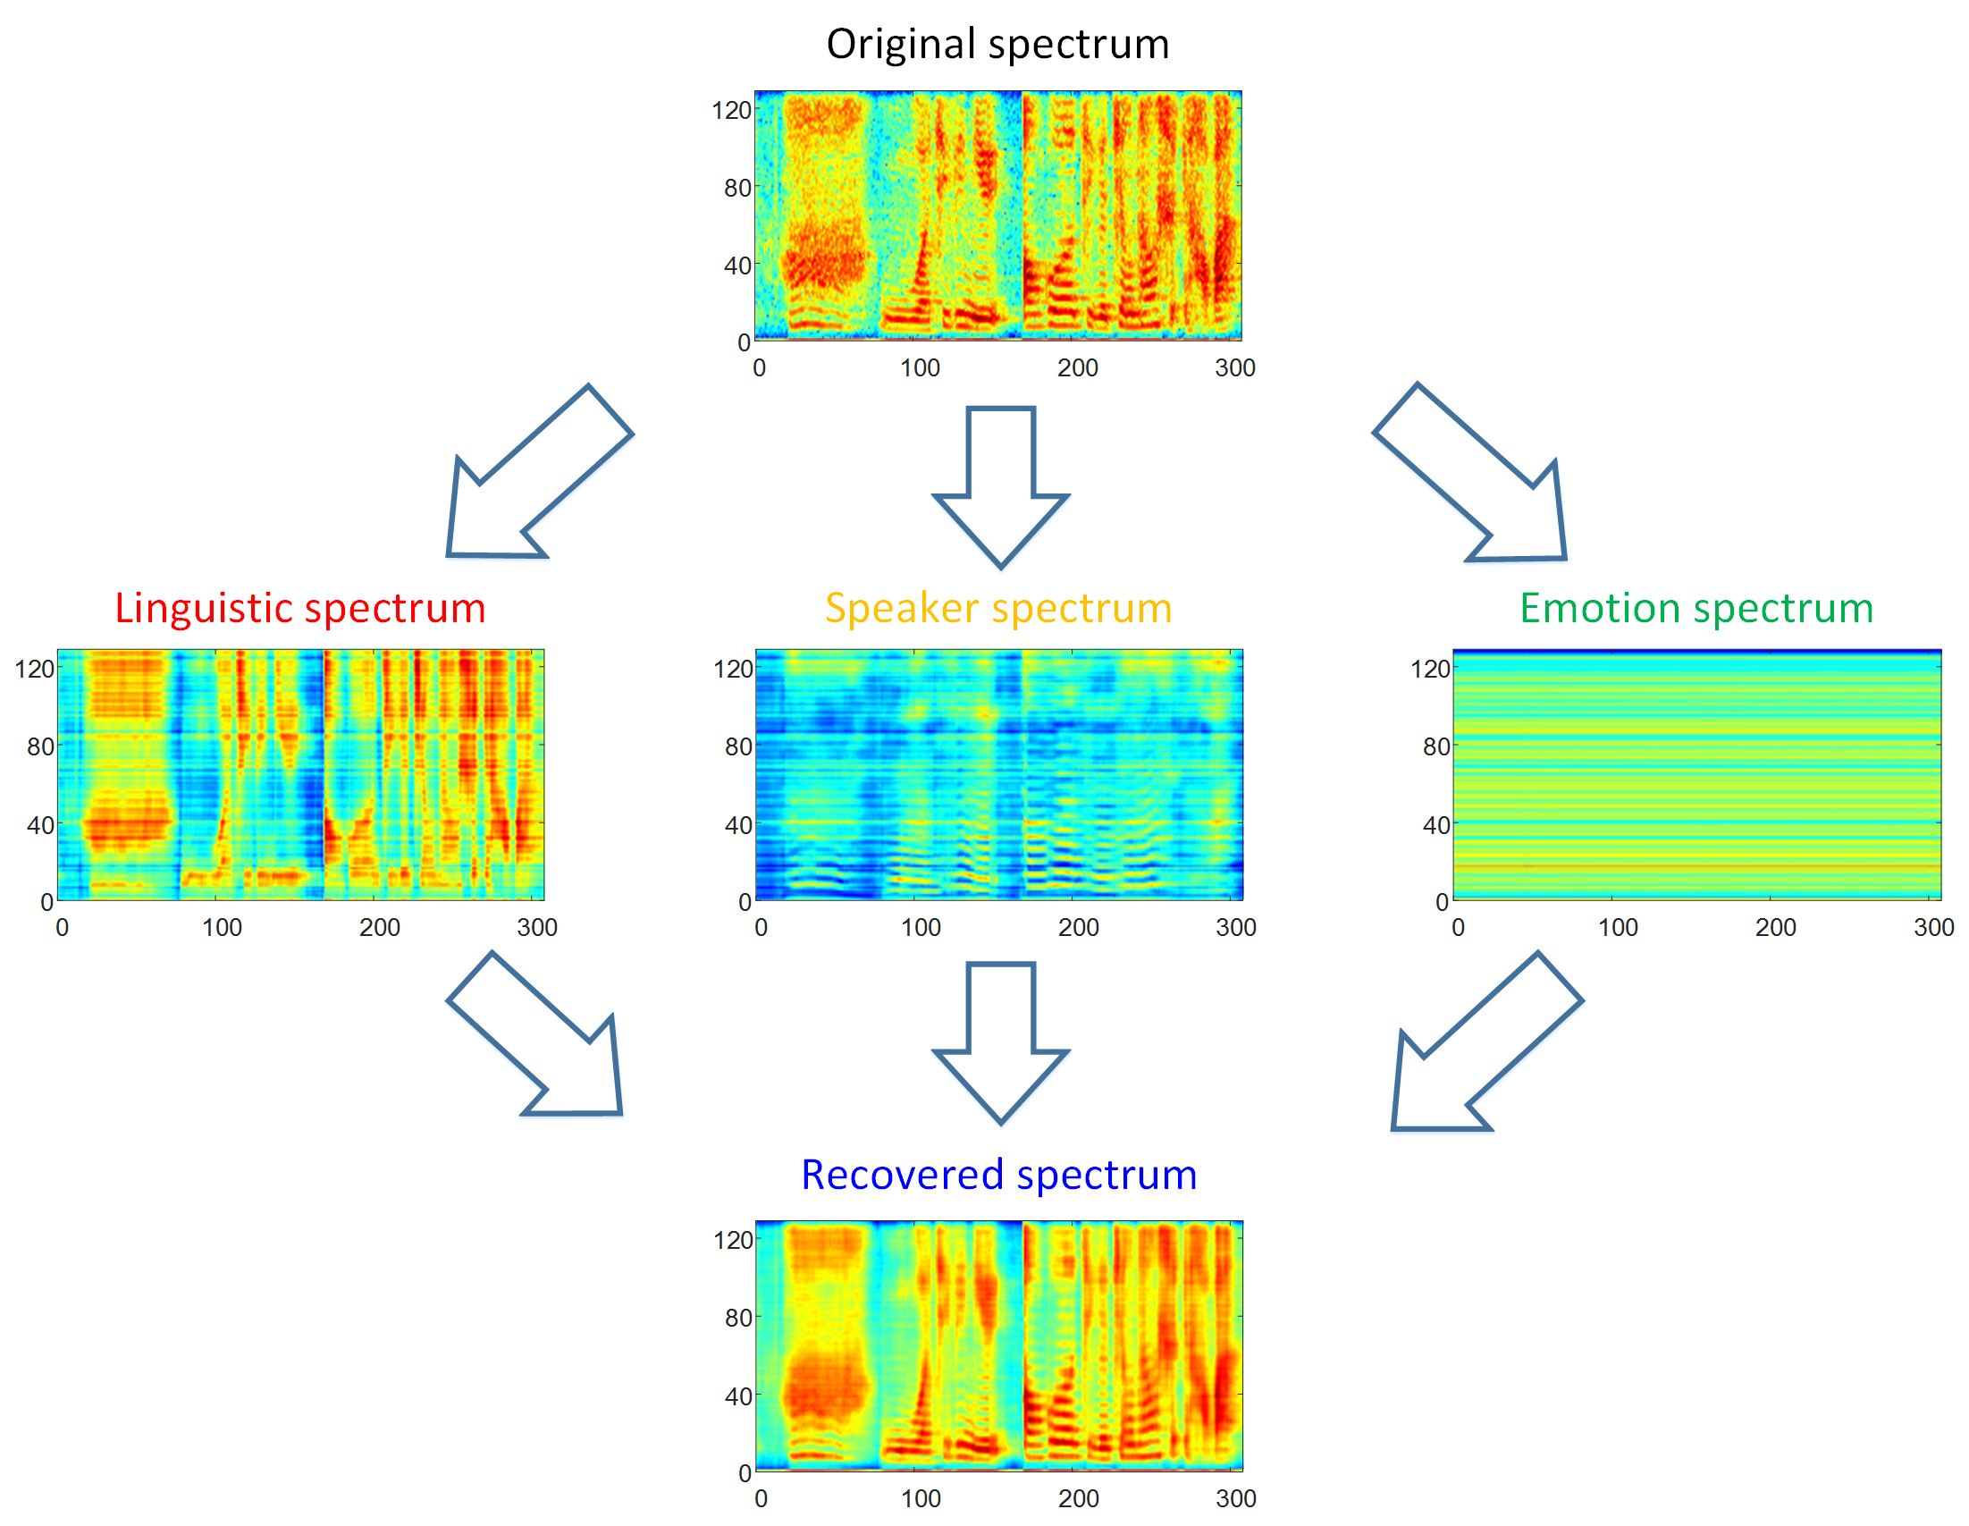
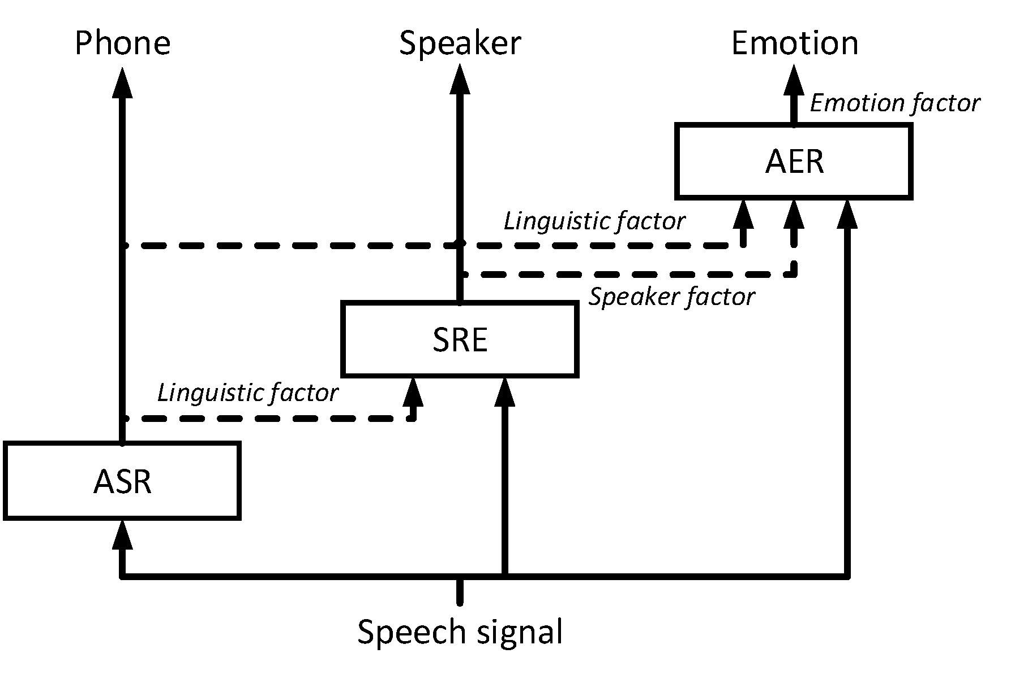
Deep Factorization for Speech Signal
Lantian Li, Dong Wang, Yixiang Chen, Ying Shi, Zhiyuan Tang, Thomas Fang Zheng
Center for Speech and Language Technologies (CSLT), RIIT, Tsinghua University, China
http://cslt.riit.tsinghua.edu.cn
Introduction
Spectrum reconstruction
Experiments (2)
Speech signal
Multiple informative factors.
Various speech processing tasks.
Difficulty of these tasks
Factor blending
Uncertainties
An intuitive idea
Speech factorization
such as JFA
Convolutional view
Architecture of spectrum recovery
AER by IDF and CDF on CHEAVD
Spectrum reconstruction
Cascaded deep factorization
From significant to less significant
Frame-level conditional training
From IDF to CDF
Experiments (1)
ASR by IDF on WSJ
WER: 9.16%
SRE by IDF and CDF on Fisher
1k spks top-1 IDR(%)
Conclusions
Frame-level CDF for speech signal
Valuable for learning less significant factor

