Slide 1
ONLINE ANOMALY DETECTION IN MULTIVARIATE SETTINGS
Mahsa Mozaffari
Yasin Yilmaz
University of South Florida
Secure & Intelligent Systems Lab

Slide 2
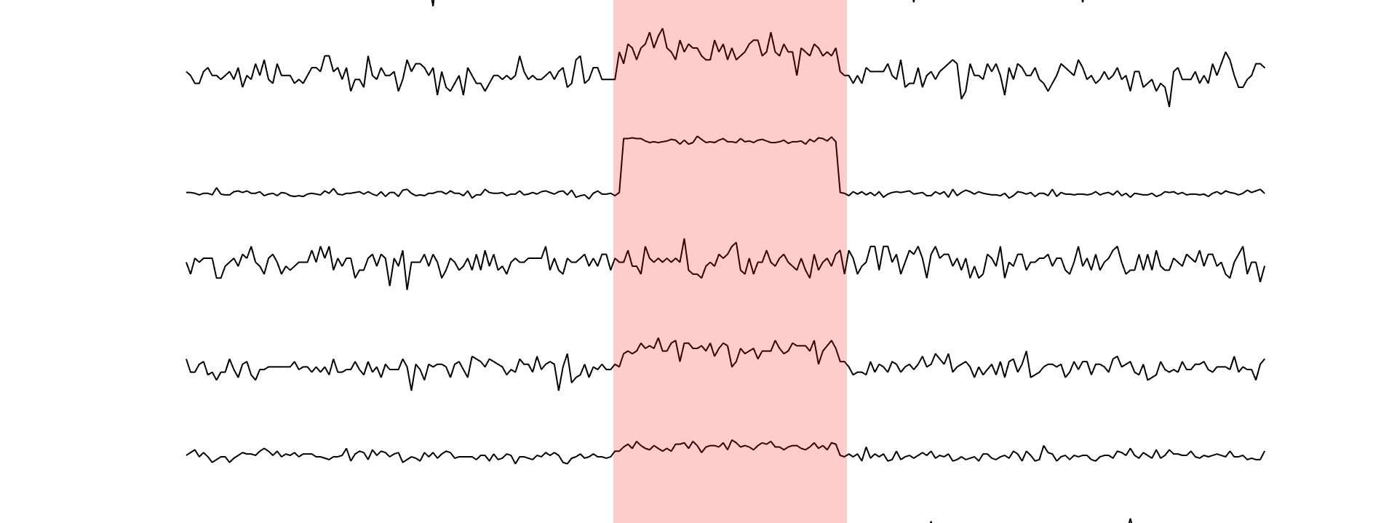
What is Anomaly Detection?
Deals with the detection of abnormal data patterns

Slide 3
Anomaly detection in Wireless systems
Examples of anomaly causes in wireless systems:
Software/Hardware failure
Malicious activity
Jamming
Eavesdropping
Spoofing
Protocol misbehavior
DDoS attack
Faulty data readings in WSNs
Timely detection
High-dimensionality and Heterogeneity
Dynamicity
Reliable and Effective Detection
Interpretability of anomaly

Slide 4
Existing Methods
Signature-based methods: use pre-defined set of anomalous behavior
Disadvantage: Not reliable and ineffective for unknown abnormal patterns
Statistical methods: model the statistical distribution of the nominal and anomalous behaviors
Disadvantage: Unknown distributions
Machine learning-based methods: Use of ML techniques (e.g. SVM, Deep Neural Network-based methods, Autoencoders, etc.) to classify observations as nominal or anomalous.
Disadvantage: Lack of labels
Shams, Erfan A., and Ahmet Rizaner. "A novel support vector machine based intrusion detection system for mobile ad hoc networks." Wireless Networks 24.5 (2018): 1821-1829.
Anomaly-based methods: use model of nominal behavior to detect deviations in the observations
Advantage: capability of handling unknown anomalous patterns
Disadvantage: High rate of false positive alarms
Sequential methods: Take the history of observations into account for making decision
Advantage: timely detection while controlling the false alarm rate by considering history of data
Cheng, Maggie X., Yi Ling, and Wei Biao Wu. "MAC Layer Misbehavior Detection Using Time Series Analysis." 2018 IEEE International Conference on Communications (ICC). IEEE, 2018.

Slide 5
Online anomaly detection problem
Train phase:
Training Data $χ_{N}$
Training
$$χ_{N}$$
Data Source
Extract features of streaming data
Trained Model
$$Streaming data$$
$$x_{t}$$
$$x_{1},x_{2}, …,x_{t}$$
if $Δ_{t}≥h$
Declare Anomaly
Test phase:
Get new observation
Compute test statistic${ Δ}_{t}$
else

Slide 6
Problem formulation
Objective: Detect the anomaly as soon as possible, while satisfying a false alarm constraint
Sequential change detection problem:
Problem objective in minimax sense:
CUSUM algorithm minimax optimum:
$S_{t}=\max\left\{S_{t−1}+\log{\frac{f_{1}(x_{t})}{f_{0}(x_{t})}}, 0\right\}, T=min⁡\{t:S_{t}≥h\}$

Slide 7
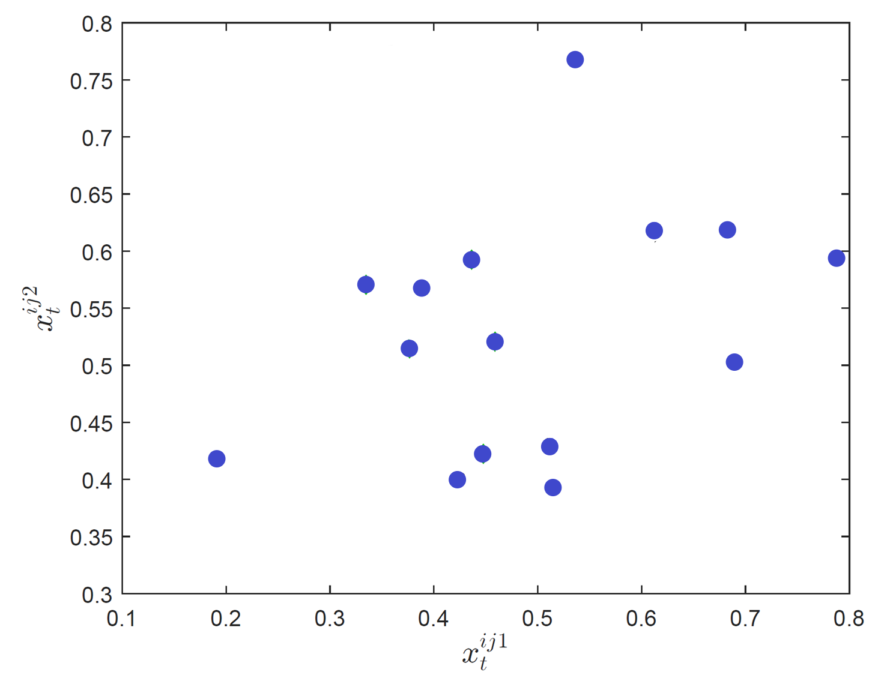
ODIT: Training
Online Discrepancy Test (ODIT)
Training set $X=\left\{X_{1},X_{2},…,X_{N}\right\}$ of nominal data

Slide 8
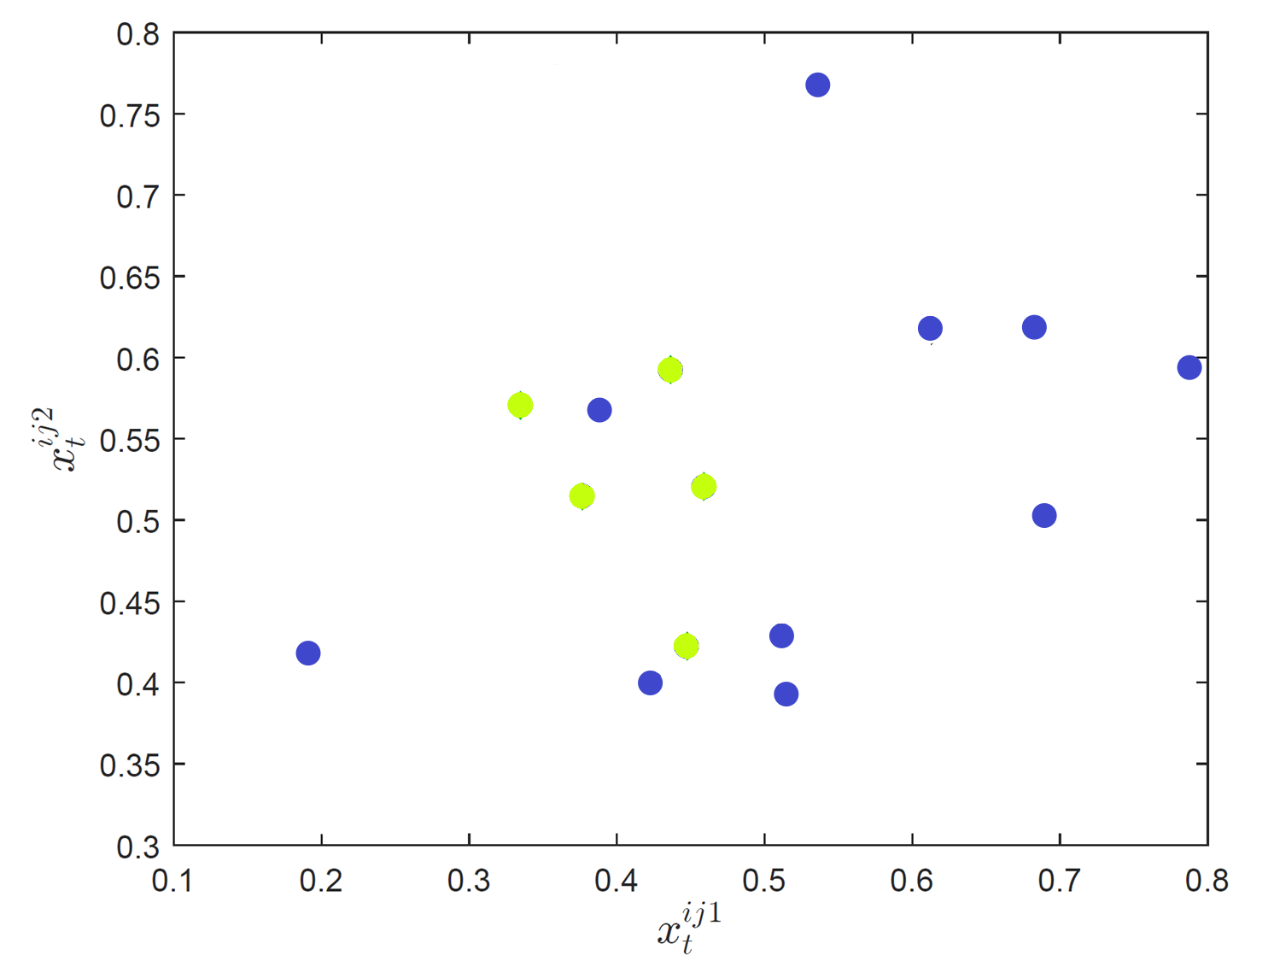
ODIT: Training
Online Discrepancy Test (ODIT)
Training set $X=\left\{X_{1},X_{2},…,X_{N}\right\}$ of nominal data
Randomly separates into two sets $X^{N_{1}},X^{N_{2}}$

Slide 9
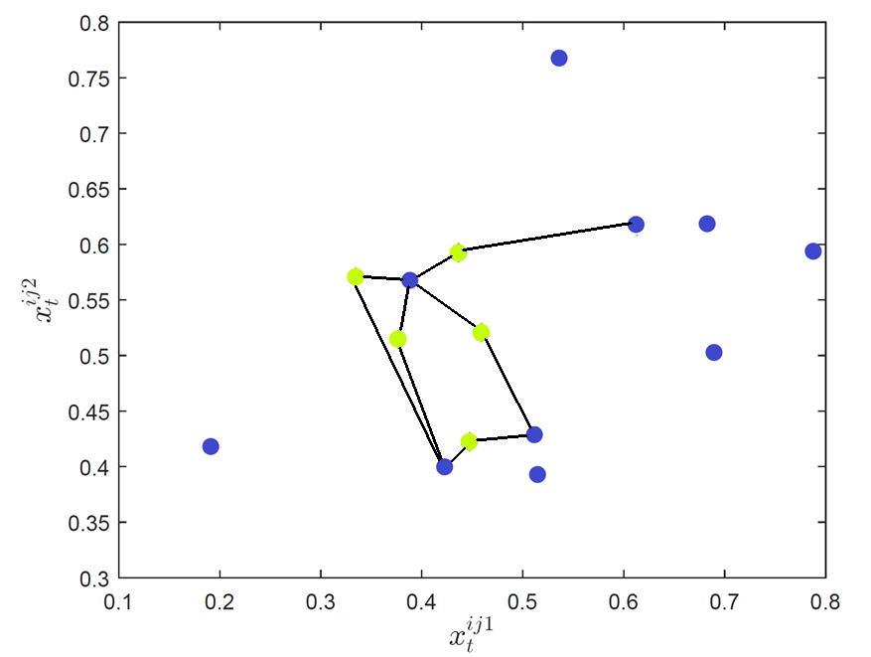
ODIT: Training
Online Discrepancy Test (ODIT)
Training set $X=\left\{X_{1},X_{2},…,X_{N}\right\}$ of nominal data
Randomly separates into two sets $X^{N_{1}},X^{N_{2}}$
For each point in $X^{N_{1}}$find kNN from $X^{N_{2}}$

Slide 10
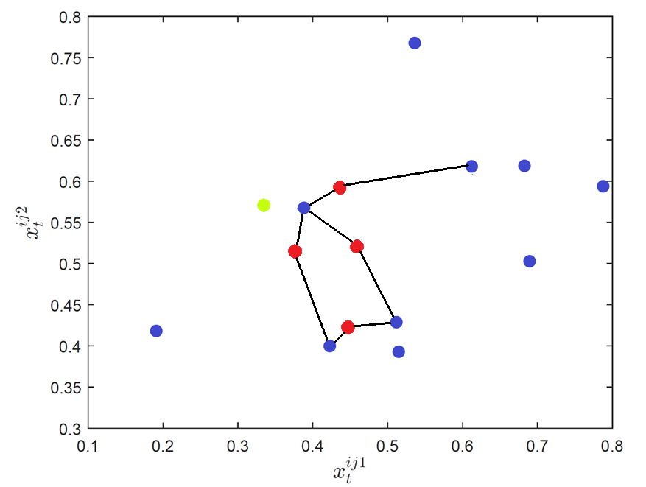
ODIT: Training
Online Discrepancy Test (ODIT)
Training set $X=\left\{X_{1},X_{2},…,X_{N}\right\}$ of nominal data
Randomly separates into two sets $X^{N_{1}},X^{N_{2}}$
For each point in $X^{N_{1}}$find kNN from $X^{N_{2}}$
Select K points $X_{K}^{N_{1}}$ from $X^{N_{1}}$ with the smallest total edge length
$X_{K}^{N_{1}}$: is the estimate of the most compact set of $X^{N}$
$L_{(K)}$ = K^{th} smallest total edge length
$$L_{(K)}$$

Slide 11
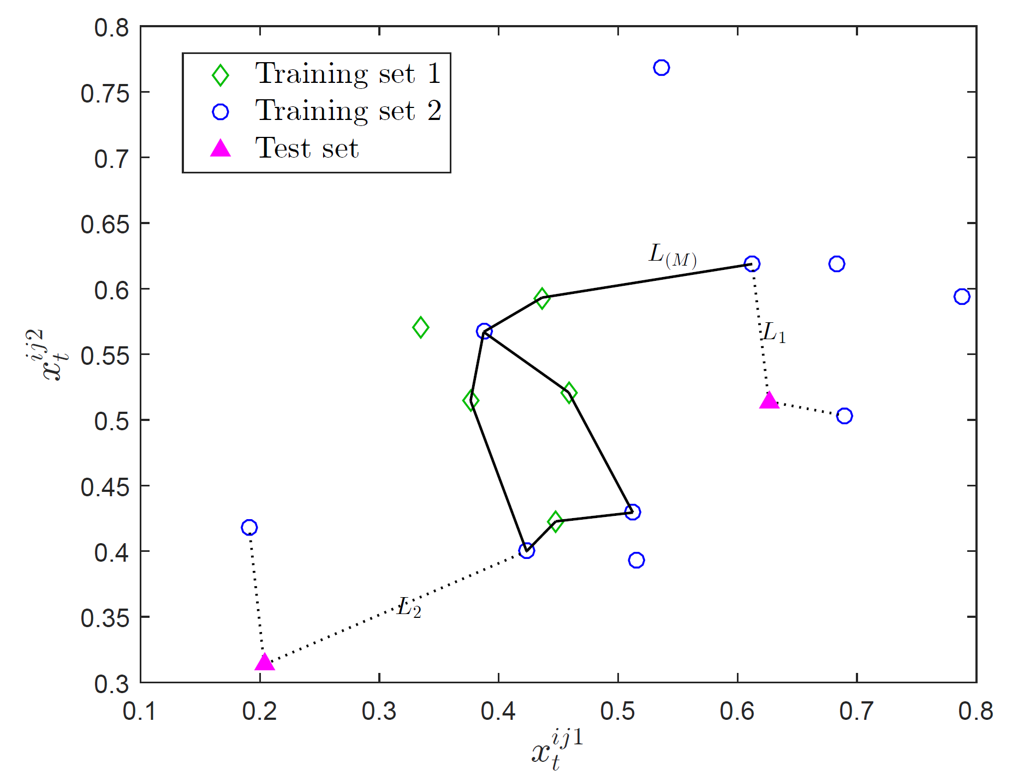
Odit: Test
For each test point $x_{t}$ find total edge length to kNN from $X^{N_{2}}$
$D_{t}=d×(\log{L_{t}}−\log{L_{(K)}})$ : positive/negative evidence for anomaly

Slide 12
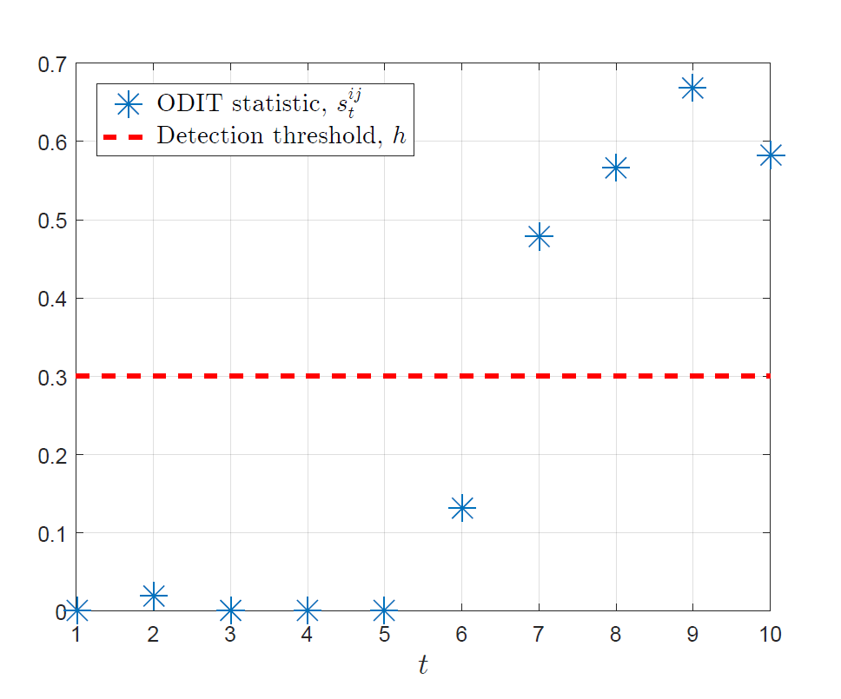
Odit: Test
For each test point $x_{t}$ find total edge length to kNN from $X^{N_{2}}$
$D_{t}=d×(\log{L_{t}}−\log{L_{(K)}})$ : positive/negative evidence for anomaly
Accumulate anomaly evidences over time
$S_{t}=\max\left\{S_{t−1}+D_{t} , 0\right\}, S_{0}=0$
Declare anomaly when evidence exceeds threshold
$T=min⁡\{t:S_{t}≥h\}$
Threshold is selected to strike a balance between early detection and small false alarm rate

Slide 13
Selection of threshold
FAR $≤e^{−h}$ as $N_{2}→∞$
A practical choice is $h=log{β^{−1}}$ where $β$ is a desired false alarm rate
$h≈4.6$ for $β=0.01$
Sketch of Proof:
Assumes independent samples
kNN distance distribution of Poisson point process

Slide 14
ODIT is asymptotically optimum when:
Sketch of Proof
$S_{t}∈ℝ^{d}:$hypersphere centered at $x_{t}$, with radius $L_{t}$
$L_{t}$: kNN distance of $x_{t}$ w.r.t. points in $X^{N_{2}}$
$V_{d}L_{t}^{d}$: Volume of $S_{t}$
$k/N$: Maximum likelihood estimate for probability of a point being inside $S_{t}$
${\hat{f}}_{0}\left(x_{t}\right)=\frac{k/N}{V_{d}L_{t}^{d}}, {\hat{f}}_{0}\left(x_{(K)}\right)=\frac{k/N}{V_{d}L_{(K)}^{d}}$
As $N→∞$:
$k/N \underset{→}{L_{2}} \int_{S_{t}}{f_{0}\left(x\right)ⅆx}$
${\hat{f}}_{0}\left(x_{t}\right)$ $\underset{→}{P} f_{0}\left(x_{t}\right)$, ${\hat{f}}_{0}\left(x_{(K)}\right)$ $\underset{→}{P} f_{0}\left(x_{(K)}\right)$ = $f_{1}\left(x_{t}\right)$
$\log{\frac{\frac{k/N}{V_{d}L_{(K)}^{d}} }{\frac{k/N}{V_{d}L_{t}^{d}}}}$ $=d×\left(\log{L_{t}}−\log{L_{(K)}^{d}}\right)\underset{→}{P}\log{\frac{f_{1}\left(x_{t}\right)}{f_{0}\left(x_{t}\right)}}$
The nominal distribution is finite and continuous
The anomaly distribution is Uniform
ODIT statistic converges to the log-likelihood ratio:
$D_{t}\underset{→}{p}\log{\frac{f_{1}(x)}{f_{0}(x)}}$ , $N_{2}→∞$
ODIT converges to CUSUM as training data grows

Slide 15
Towards supervised anomaly detection an extension: odit-2
Motivation: we can take advantage of historical anomaly observations, to enhance performance of detection procedure.
Nominal dataset:
$X_{N}=\{x_{1}, x_{2}, …, x_{N}\}$
Anomalous Dataset:
${X′}_{M}=\{{x′}_{1}, {x′}_{2}, …, {x′}_{M}\}$
ODIT-2 anomaly evidence for observation $x_{t}$:
$D_{t}=d×\left(\log{L_{t}}−\log{{L^{′}}_{t}}\right)+\log{\frac{N}{M}}$

Slide 16
ODIT-2 pre-processing: data cleaning
Nominal and anomalous data may be overlapping, e.g.:
Challenging scenario in which nominal and anomalous data are similar
Overlapping introduced by inaccuracy in labeling and data gathering
Cleaning process:
Find and remove data points in ${X′}_{M}$ which lie in the compact region of $X_{N}:$
${X′}_{M}^{clean}=$ ${X′}_{M} \backslash \{ {x′}_{m}∈{X^{′}}_{M} | L_{m ≤ }^{′}L_{(K) }\}$, $L_{(K) }$: K^{th} smallest total edge length in $X_{N}$

Slide 17
odit procedures – toy example

Slide 18
Asymptotic Optimality of odit-2

Slide 19
Unified framework - Online learning
Is more powerful in detecting the previously known anomaly types
Not guaranteed to detect new anomaly types
ODIT:
Can detect new anomaly types
Unified framework:
Running ODIT and ODIT-2 in parallel
Update the anomaly dataset as ODIT detects new anomaly types
As the dataset extends to contain new anomaly types, ODIT-2 will improve detecting anomalies of that type
ODIT-2:
Stop rule:
$$T=\min\left\{t \right|{ S_{t}}^{(1)} ≥h_{1} or {S_{t}}^{(2)} ≥h_{2}\}$$
𝑇=min⁡{𝑡 ┤| 〖 𝑆_𝑡〗^((1)) ≥ℎ_1 𝑜𝑟 〖𝑆_𝑡〗^((2)) ≥ℎ_2}
${ S_{t}}^{(1)}$ = max{0, ${ S_{t}}^{(1)}$+ ${ D_{t}}^{(1)}$}, ${S_{t}}^{(2)}$ = max{0, ${ S_{t}}^{(2)}$+ ${ D_{t}}^{(2)}$}
〖 𝑆_𝑡〗^((1)) = max{0, 〖 𝑆_𝑡〗^((1))+ 〖 𝐷_𝑡〗^((1))}, 〖𝑆_𝑡〗^((2)) = max{0, 〖 𝑆_𝑡〗^((2))+ 〖 𝐷_𝑡〗^((2))}
Lacks any information about anomaly data

Slide 20
Unified framework - toy example
Nominal distribution: Standard Gaussian Distribution
Anomaly is manifested by change in the mean
Anomaly type 1: $μ=\left[\begin{matrix}3 \\ 3\end{matrix}\right]$
Anomaly type 2: $μ=\left[\begin{matrix}−3 \\ −3\end{matrix}\right]$

Slide 21
Experiment:
Synchronization-based stealth Ddos attack
Synchronization-based Attack is realized by simultaneous request of service, from multiple sources
The service request of individual sources look regular, while the aggregate service request at the target is anomalous
An Example:
MadIoT attack: Adversary launches an attack to the power grid by synchronously switching on/off the compromised high-wattage IoT devices
Challenges:
The service request at individual sources look regular
The correlation between service demands at different sources increases
Requires Multivariate Analysis
Unknown set of anomalous dimensions: combinatorial complexity!

Slide 22
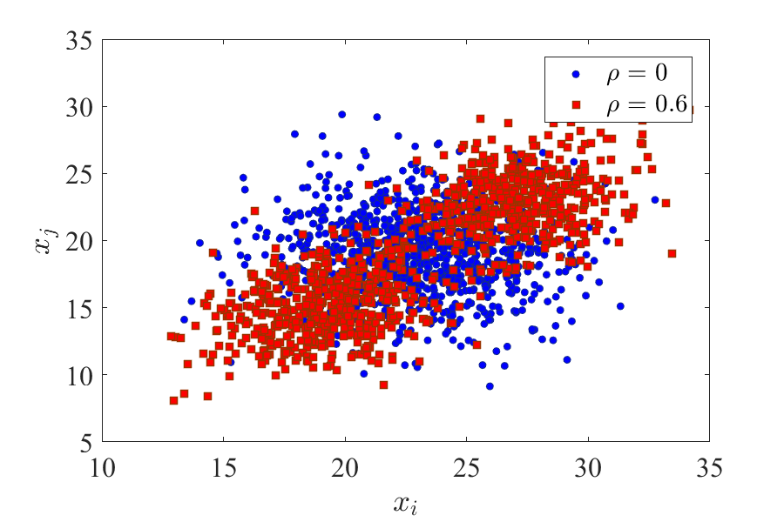
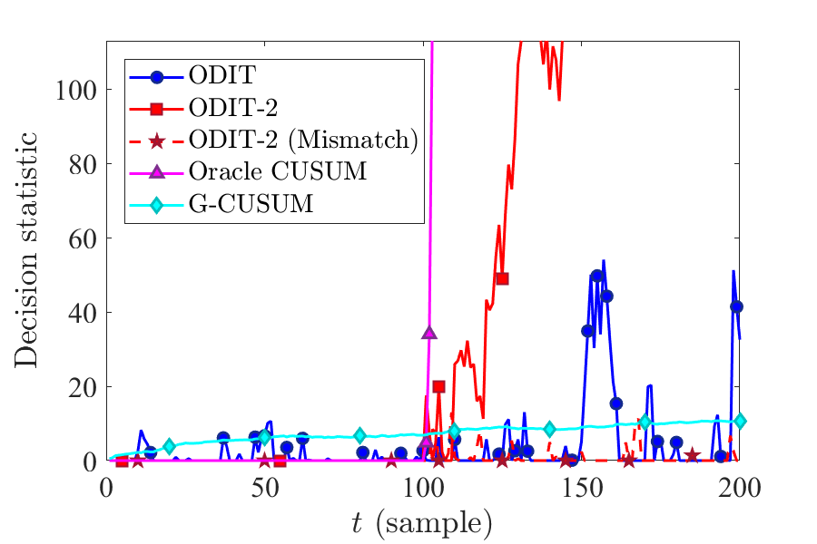
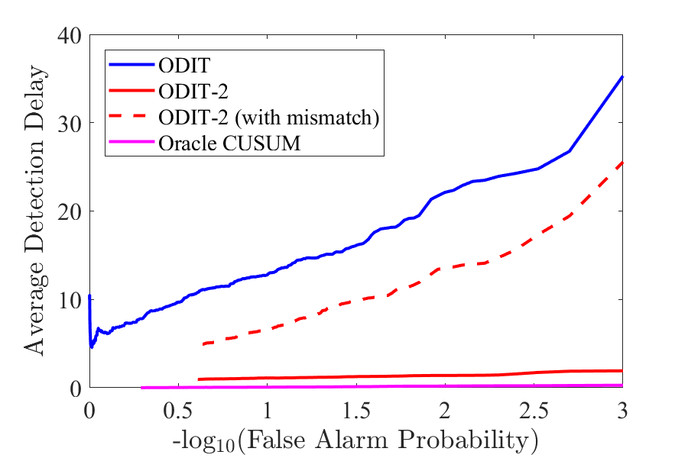
Synchronization-based stealth DDOS attack
G-CUSUM fails to detect
Oracle CUSUM knows the exact probability distributions
ODIT-2 outperforms ODIT and achieves similar performance as oracle CUSUM
ODIT-2 is still able to perform well under non-ideal conditions (mismatch in anomalous dimensions w.r.t. training data)
Notes:
d = 50
N = 2e4
M = 2e4
M_clean = 4836
ODIT-2 with mismatch -> 27 out of 50 correlated dimensions are not seen in the training set

Slide 23
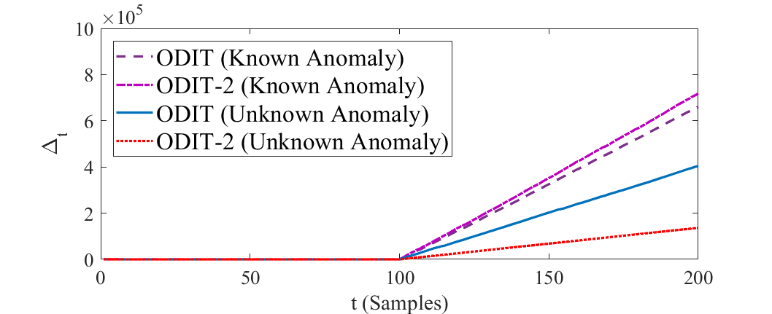
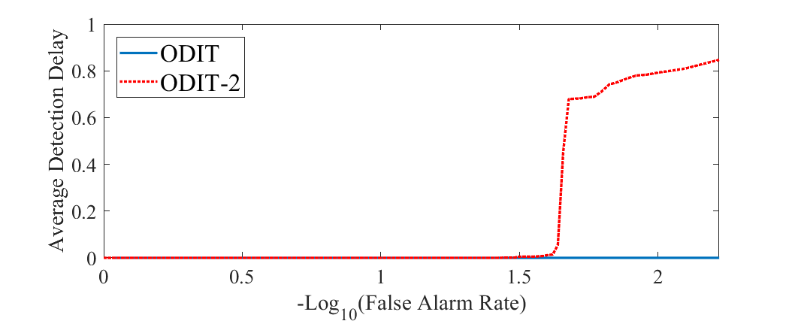
Detection of IoT Botnet attacks
N-BaIoT dataset: 1035-dimensional real IoT traffic observations, collected from 9 IoT devices:
doorbell, thermostat, baby monitor, etc. infected by Mirai and BASHLITE malwares
Detection of known and unknown attacks by ODITs
ODITs achieve zero detection delay and zero false alarm rate for known anomaly type.
Unknown anomaly case

Slide 24
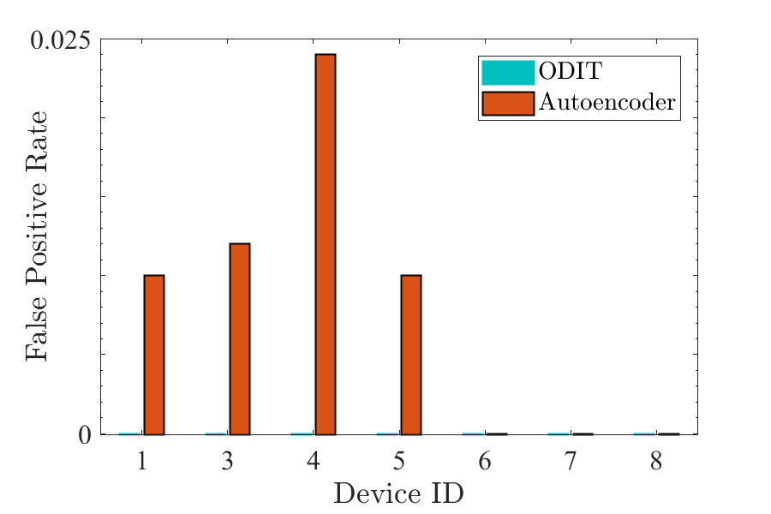
Comparison to deep autoencoder-based detection method

Slide 25
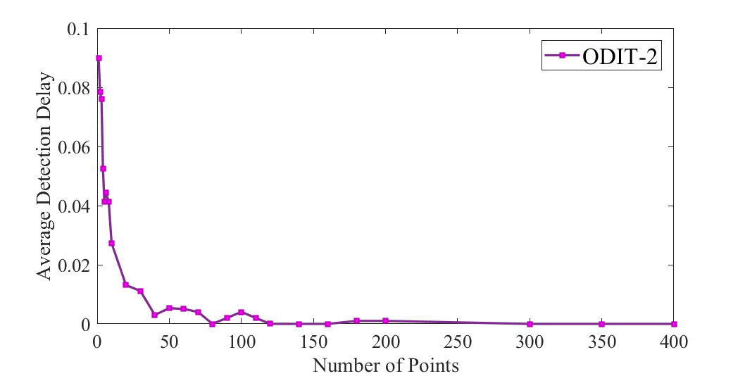
Unified ODIT – online learning
Performance of ODIT-2 for an unknown anomaly type, versus the number of the data instance of the unknown anomaly added to the anomaly train set

Slide 26
Thank you for your attention!

Slide 27
Anomaly localization and mitigation
Question: How to identify the dimensions which (incoming traffic) lead to the detection?
We Monitor contribution of each dimension to the increase of detection statistic individually
$$D_{t}=d×(\log{L_{t}}−\log{L_{M}})$$
Compute anomaly onset time $\hat{τ}$
Compute anomaly onset time 𝜏 ̂
$$\hat{τ}=max⁡\{t>τ: ∆_{t}=0\}$$
𝜏 ̂=max⁡{𝑡>𝜏: ∆_𝑡=0}
Compute mean and standard deviation of $\left\{δ_{t}^{i}:t=\hat{τ}+1… \hat{τ}+S\right\} ∀i$
Compute mean and standard deviation of {𝛿_𝑡^𝑖:𝑡=𝜏 ̂+1… 𝜏 ̂+𝑆} ∀𝑖
$\overline{δ_{i}}$: sample mean
(𝛿_𝑖 ) ̅: sample mean
Apply a t-test to identify the anomalous dimensions
Dimension i is anomalous if $\frac{\overline{δ_{i}} − μ_{i}}{η_{i}/\sqrt{S}}≥ θ$
Dimension i is anomalous if ((𝛿_𝑖 ) ̅ − 𝜇_𝑖)/(𝜂_𝑖/√𝑆)≥ 𝜃
$η_{i}$ : sample std
𝜂_𝑖 : sample std
Eliminate traffic from anomalous dimension
$$L_{t}= \sum_{i=1}^{d}{δ_{t}^{i}}$$

Slide 28
Anomaly localization

