Slide 1
Real-time Total Focusing Method for Ultrasonic Imaging of Multilayered Object
Reporter: Wenkai Cui
Institution: Tsinghua University
Date: 2018-04-20

Slide 2
Outline
1. Introduction
2. Region-Division TFM
3. Experiment
4. Conclusion

Slide 3
1.Introduction

Slide 4
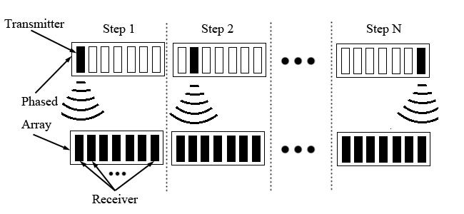
1.Introduction
Full Matrix Capture: one transmit, all receive
Notes:
In ultrasonic phased array imaging, full matrix capture is an advanced data acquisition technique.
Every time one element is selected as the transmitter, all elements in the phased array receives the echo signal.
Keep repeating the process until all elements have already acted as transmitter.

Slide 5
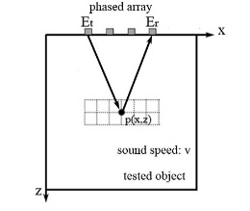
1.Introduction
Total focusing method (TFM): Delay and Sum
element number
transmitter
receiver
received signal (Et, Er)
Notes:
After the ultrasonic data are acquired, there are many algorithms to process the data to generate the result image. Among all the processing algorithms, the most common method is the total focusing method because it can provide high-quality result image.
TFM is based on delay and sum principle, in order to acquire the value of one pixel, we first calculate the distance along the propagation path, from transmitter to the pixel, then back to the receiver. Then distance divides the speed to get the transmission time. Finally accumulate the received signal corresponding to the transmission time.

Slide 6
1.Introduction
Calculate and save the transmission time between every (element, pixel) to avoid repeated computation.
Notes:
In order to avoid repeated computation, we first calculate and save the transmission time between every (element, pixel) pair.

Slide 7
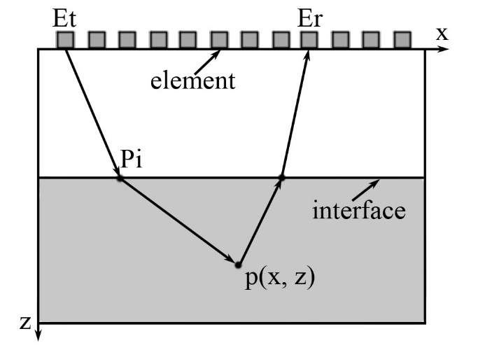
1.Introduction
TFM for multi-layer object
Notes:
In imaging of multilayered object, the sound is refracted at the interface between different media. Therefore, in order to apply TFM in imaging of multilayered object, the point of incidence at the interface need to be calculated first.

Slide 8
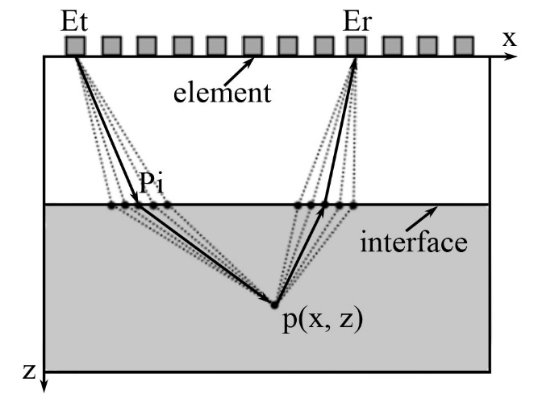
1.Introduction
Ray-tracing method: Fermat’s principle
Notes:
The most common used method is the ray-tracing method:
Based on Fermat’s principle, for every point at the interface, calculate the transmission time from the element to p(x, z) and select the one with the minimum time of flight as the incident point.

Slide 9
1.Introduction
Disadvantages of ray-tracing method
High time complexity:
Root Mean Square computation
Aim of this paper
New method to calculate the point of incidence (POI) with low time complexity
Notes:
Ray-tracing method can be applied to irregular multilayered object. But the time complexity of ray-tracing method is high, and it involves lots of root mean square computation. It greatly increases the processing time of TFM.
The aim of our paper is to propose a new method to calculate POI with low time complexity, which will improve the imaging speed of TFM.

Slide 10
2.Region-Division TFM

Slide 11
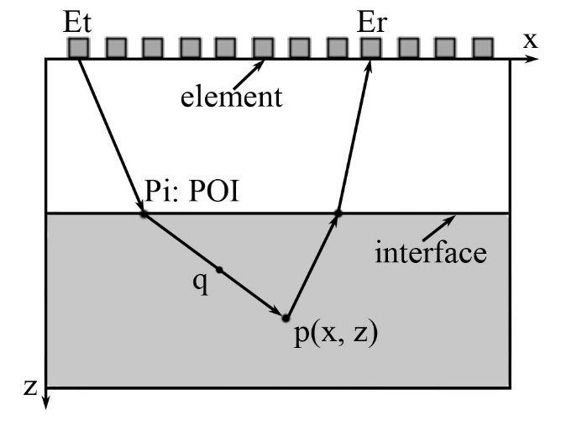
2.Region-Division TFM
Principle of Region-Division TFM: p and q share the same POI.
Notes:
The principle of our method is simple: Pi is the incident point, EtPi is the incident vector and Pip is the refraction vector. For every point on line, the corresponding POI is Pi. Therefore, we don’t have to calculate it. we can acquire multiple POIs at the same time.

Slide 12
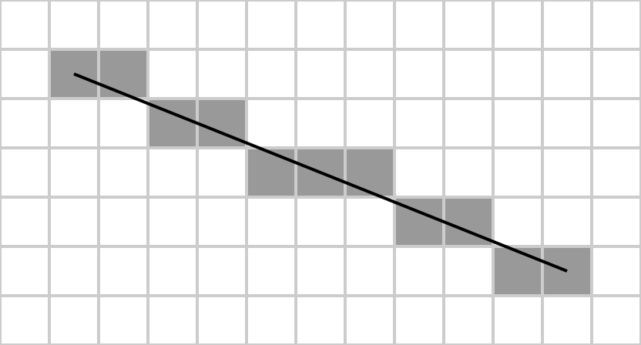
2.Region-Division TFM
How to acquire pixels on a line?
Bresenham line algorithm in computer graphics
Notes:
How to acquire pixels on a given line segment? We can adapt the Bresenham line algorithm in computer graphics because it only involves simple multiplication and addition operation.

Slide 13
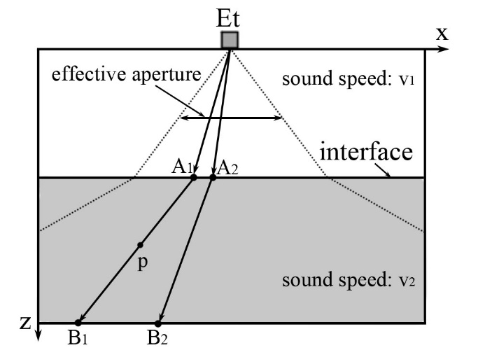
2.Region-Division TFM
Calculate the transmission time between element Et and p(x, z).
For every point A at the interface
Incident vector
Refraction vector : Snell’s law
Bresenham line algorithm
Notes:
In ray-tracing method, the starting point and the end point is known condition, and the point of incidence is unknown condition. We consider the POI as known condition and the end point is unknown. The process is shown below:
First, For every point at the interface, A, we calculate the incident vector. Then based on Snell’s law, we can obtain its refraction vector AB. Then adapt line drawing algorithm to acquire the coordinates of pixels on the refraction vector. For every point on refraction vector, the POI is A, therefore we can calculate the transmission time directly.

Slide 14
2.Region-Division TFM
Points not passed by refraction vectors
are adjacent points at the interface.
are refraction vectors.
Every point p in
Notes:
The above method can’t cover every pixel in the result image. A1, A2 are adjacent pixels at the interface. A1B1 and A2B2 are the refraction vectors. Every point p in region A1A2B2B1 are not passed by refraction vectors. Therefore, their transmission time.
How to calculate the transmission time of p?

Slide 15
2.Region-Division TFM
How to calculate the transmission time of p?
Incident point:
Refraction vector:
The corresponding POI of p is or
Select the one with minimum time of
flight as p’s POI.
Notes:
How to calculate the transmission time of p?
When the incident point change from A1 to A2, the refraction vector change from A1B1 to A2B2.
Therefore, for every point in region A1A2B2B1, the corresponding incident point is either A1 or A2.
Based on Fermat’s principle, we select the one the minimum transmission time.

Slide 16
2.Region-Division TFM
Region-Division method to calculate POI
Number of candidate point:
Time complexity:
Notes:
In TFM with ray-tracing, the number of candidate point is XL. While in our method, the number is only 2.
Therefore, the time complexity of TFM is reduced by one order of magnitude.

Slide 17
3.Experiment

Slide 18
3.Experiment
Simulation experiment: k-wave
Multilayered object with planar interface
Multilayered object with non-planar interface
Notes:
We use the matlab software package k-wave to simulate ultrasonic testing process.
There are two different kinds of multilayered object. One with planar interface, the other with nonplanar interface.

Slide 19
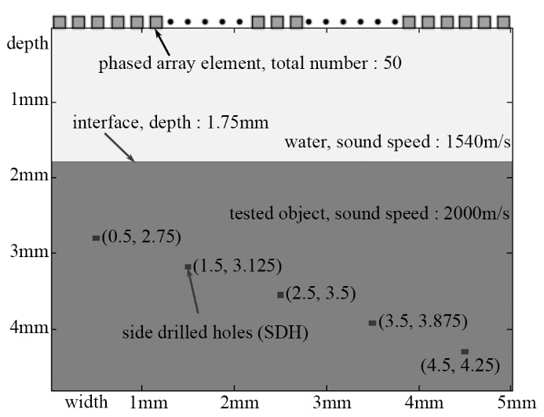
3.Experiment
Multilayered object with planar interface
Notes:
There are five side drilled holes inside the tested object and the interface is parallel to the phased array.

Slide 20
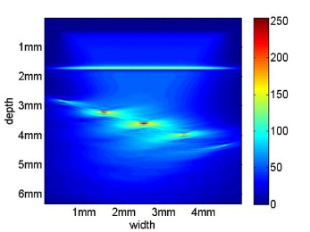
3.Experiment
Result images. left: TFM with ray-tracing. Right: RD-TFM
Notes:
The result images of both algorithms are shown below.

Slide 21
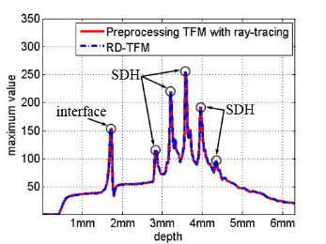
3.Experiment
Maximum amplitude along the depth direction.
Notes:
The maximum amplitudes of both result images along the depth direction is plotted. We can see both plots coincidence with each other. That proves RD-TFM shares the same result with TFM with ray-tracing.

Slide 22
3.Experiment
Processing time of both algorithm
TFM with ray-tracing: 2192.35s
RD-TFM: 90.601s
Imaging speed improves 24 times.
Notes:
But the imaging speed of our algorithm is 24 times as TFM with ray-tracing.

Slide 23
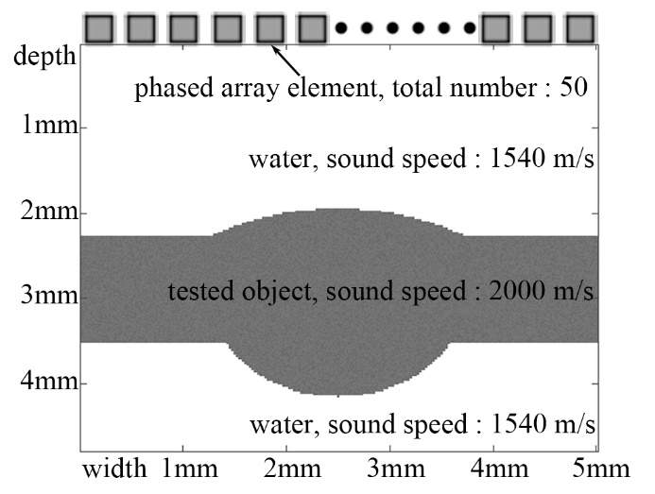
3.Experiment
Multilayered object with nonplanar interface

Slide 24
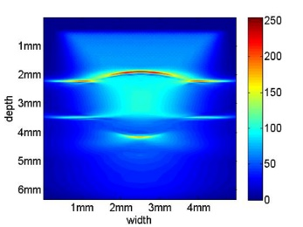
3.Experiment
Result images. left: TFM with ray-tracing. Right: RD-TFM
Notes:
The result images of both algorithms are shown below.

Slide 25
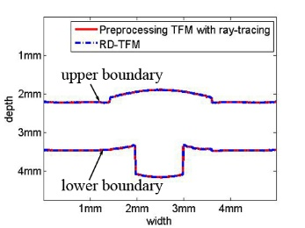
3.Experiment
The boundary of tested object
Notes:
To compare the result images of both algorithms, the boundaries of tested object in both result images are extracted, both boundaries coincides with each other.

Slide 26
3.Experiment
Processing time of both algorithm
TFM with ray-tracing: 2223.08s
RD-TFM: 99.507s
Imaging speed improves 22 times.
Notes:
The maximum amplitudes of both result images along the depth direction is plotted. We can see both plots coincidence with each other. That proves RD-TFM shares the same result with TFM with ray-tracing.

Slide 27
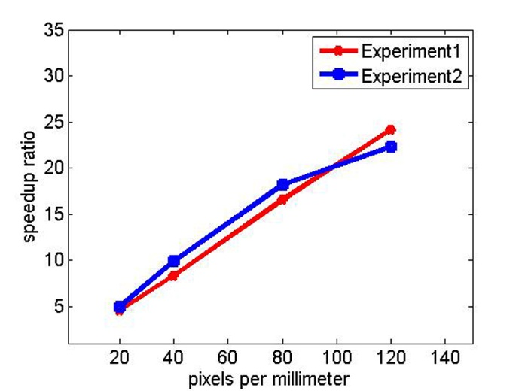
3.Experiment
The speedup ratio of RD-TFM under different image sizes.
Notes:
The maximum amplitudes of both result images along the depth direction is plotted. We can see both plots coincidence with each other. That proves RD-TFM shares the same result with TFM with ray-tracing.

Slide 28
4.Conclusion

Slide 29
4.Conclusion
RD-TFM
Low time complexity
Same result as TFM with ray-tracing
Combined with other optimization technique: GPU
Extended to 3D ultrasonic testing
Notes:
The advantage of RD-TFM is obvious, it can increase the imaging speed by one order of magnitude.
Besides, it can be combined with other optimization technique such as GPU.
This strategy can be extended to 3D ultrasonic testing.

Slide 30
Thanks

