Slide 1
END-TO-END SPEECH RECOGNITION CONTEXTUALIZATION WITH LARGE LANGUAGE MODELS
Egor Lakomkin*, Chunyang Wu, Yassir Fathullah , Ozlem Kalinli, Michael L. Seltzer, Christian Fuegen
SLP-L5.6:: Context and LLM speech recognition
Tue, 16 Apr, 16:30 - 18:30
✶ Presenter
Notes:
-

Slide 2
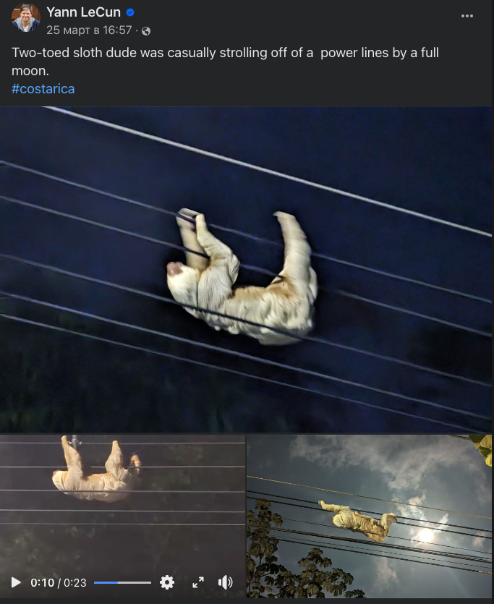
Context in Speech Recognition
Notes:
I would like to start this presentation by highlighting one of the key motivations behind this research - the importance of context in speech recognition.
We as humans adopt many different cues like visual information from the scene to better understand the speech.
Lets say we want to provide accurate speech transcription of a video uploaded to a social network. Usually beyond speech signal there are additional cues that may contain very useful information: like visual frames and user-provided title and description in free text form. And in this work we conduct experiments based on incorporating additional text information like title and description into recognition process.
Like in this example we have a very relevant information provided right in the description - this is two-toed sloth strolling of a power lines and that it happens in costra rica. The word sloth is relatively rare and may be misrecognized and confused with another similar sounding word, but if we would condition our recognition on the provided text the model has a good chance to get it right if it can cross-corellate that sloths can be found in costa rica and they are likely to stroll.
So in ideal situation we want the model to be able to pick up the whole context into account during recognition.

Slide 3
Text-only Large Language Models
LLM decoder
Self-attention
[/INST]
Text instruction
Target text
Notes:
And in this research we investigate contextualisation abilities of speech large language models. One of the reasons we chose the models based on LLMs is that LLMs have been shown to be particularly good in utilizing contextual information to perform text-based tasks. And our intuition was that capabilities and knowledge distilled in the LLMs may help in picking up key information from unstructured and potentially noisy context.
Just a brief recap as we have seen it already in this session and in some previous talks at this conference - the traditional large language models are text-only models that given some instruction predict the next token with a stack of transformer layers.
But we want to equip them with abilities to understand both spoken input and condition on some free form text to achieve contextual speech recognition.

Slide 4
Speech Large Language Models
LLM decoder
Self-attention
Audio tokens
[/INST]
Audio encoder
Target text
Thu, SS-L11.4, Fathullah et. al, "Prompting Large Language Models with Speech Recognition Abilities"
Notes:
And to get there that we embed audio signal with some pretrained encoder and get a sequence of audio tokens which can be used as a prompt.
I link here the paper from my colleagues where more details will be shared at the ICASSP conference about this approach and how audio encoder is aligned with text-only LLM decoder. It will be presented this Thursday, so check it out if you are interested.

Slide 5
Contextualising Speech Large Language Models
LLM decoder
Self-attention
Audio tokens
[/INST]
Video title + description
Audio encoder
Spoken text
Notes:
But as in this work we want to condition speech model output based not only on audio tokens but also on some free form text like video description - we essentially concatenate text and audio tokens into a mixed-modal prompt and use it as an instruction for further supervised fine-tuning for contextualised ASR task.

Slide 6
Data
Training:
In-house dataset derived from public videos
~25% of videos contain text title or description
Evaluation
~30 hours of videos sampled with non-empty text context
At least one non-frequent word match transcription and context
Notes:
Few words about data. The models are trained on an in-house dataset that
was de-identified and removed all personal information derived from public Facebook and Instagram videos.
Only around 25% of videos contain either text title or description which is particularly interesting for us as a source of external context
For evaluation, we have sampled around 3 tousand videos
comprising around 30 hours of speech that have context of
at least 100 characters long with at least one non-frequent
word from the context also occuring in the transcription. This is particularly important as we would like to probe the abilities of ours systems to pick up relevant information from the context

Slide 7
Architecture
Audio encoder
24 layer offline Conformer, pretrained with a CTC objective
320ms stride -> each second of audio correspond to ~4 audio tokens
Decoder
Llama-7B
LORA adapters to all self-attention weight matrices
Notes:
A bit more details about our architecture for this work:
We used 24 layer offline conformer audio encoder with roughly 100M parameters. It was pretrained with CTC objective on the same training data prior to aligning it with the text decoder.
The resulting stride is 320ms, so we downsample from 10ms stride 32 times, effectively representing a one second of audio with 4 tokens.
As for decoder we used a llama 7b variant publicly available as it is and added low rank adapters to all self-attention layers of Llama decoder to further laylor it towards ASR task.

Slide 8
Results
Notes:
And here are our results:
First of all we present decoding results of our 1 billion param RNN-T baseline which is contextualised by a shallow fusion approach, where the biasing word-piece based language model was constructed on-the-fly from video title and descriptions and the scores are combined during decoding.
Here we report overall word-error rate and Rare WER and the latter is specifically focused on recognizing non-frequent words.
As we see on this data the external context leads to 3% rare word error rate reduction

Slide 9
Results
Notes:
Our speech llama baseline trained and decoded without any contextual information performed already competitive with the model trained on more data with more trainable params.
But at the same time the Speech Llama model has significantly more parameters overall due to a huge 7 billion decoder

Slide 10
Results
Notes:
Here we present results of the model trained with context and show two results: one when we do not feed it during evaluation and we have a little degradation in WER compared to the third row, indicating that the model may not be fully robust to this regime.
At the same time if we decode the same model and feed the actual context we observe more than 12% reduction over speech llama trained completely without context on same data.
There results suggest that speech llama more effectively utilizes the contextual information compared to the baseline model considering relative gains.

Slide 11
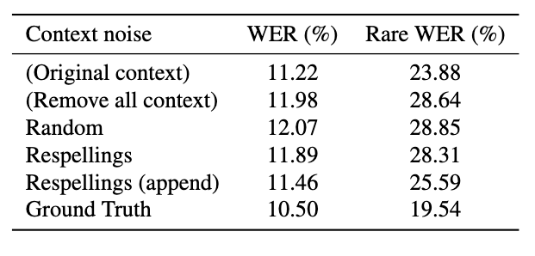
Context perturbation analysis
Notes:
And further we wanted to investigate deeper how the model uses the contextual information.
To achieve that we perturbed the context in different ways during decoding to understand how our manually introduced perturbations translates in WER changes.
For example if we just remove all the context, we see a degradation from 23.8% to 28.6% on this data.

Slide 12
Context perturbation analysis
Notes:
If we replace all words in the context to just randomly chosen words from training data we get roughly same WER as for the decoding without any context,
This suggest that the model is quite robust towards completely non-relevant context.

Slide 13
Context perturbation analysis
Two-toed slough dude was casually strolling …
Notes:
Further we introduced a more complex perturbation, where we replaced all the rare words from the context with their closely sounding variants or homophones using a grapheme-to-grapheme model. In this example the word sloth could be replaced with the similar sounds word slouth. And our results suggest that the model's performance drops almost to the same level as with the random context.
While this perturbation affects only 1 or few words it has almost the same impact as removing all of the context.

Slide 14
Context perturbation analysis
Two-toed sloth slough dude was casually strolling off of a power lines by a full moon.
Notes:
And if we instead of replacing the word with a respelling variant rather append this distractor word to the context - I am showing here an example of a perturbed context. we give a model at least a chance to try to disambiguate and pick the correct word during decoding. We observe that the model performance now became significantly better, though we could not fully achieve the original context performance.
As the same time this results suggest that the decoder is able to disambiguate and select the correct relevant words during decoding

Slide 15
Context perturbation analysis
Notes:
And if we use ground truth as a prompt we get of course the best accuracy, but still showing evidence that the model not maximizing the usage of a context as it in principle could

Slide 16
Takeaways
Speech LLMs offer a natural way to bring-in external context
Significant gains when relevant context is provided and reasonable robustness towards the non-relevant context
More work on improving the context usage efficiency is necessary
Notes:
So few takeaways from these results:
We showed a relatively simple way of conditioning speech recognition based on the external text without changing the artchitecture or introducing additional trainable parameters or hyperparameters
We note that the method using prompting seems to be more efficiently utilizing the relevant contextual information compared to shallow fusion
It is reasonably robust towards noise, but still there is room for improvement to make context usage more effective overall

Slide 17
Thank you!
Notes:
Thank you very much for your attention and staying until the last talk!
I would be happy to answer any questions now or feel free to reach out anytime during the conference.
Thank you

