Slide 1
Speech Recognition Model Compression – ICASSP 2020
Madhumitha Sakthi, Ahmed Tewfik, Raj Pawate

Slide 2
Overview
Motivation
Related work
Overview of three compression schemes applied
Pre-trained deep learning models
Pre-trained model’s architecture
Matrix compression techniques
Sensitivity analysis results
Results
Conclusion

Slide 3
Motivation
- Weight matrices are very large and significantly contribute to the system cost
- Can we reduce the size of the weight matrices without losing on inference accuracy?
Trained Model
Size: X1
Accuracy: Y1
Compressed Model
Size: X2
Accuracy: Y2
Compress
1. Compression Factor( CF)
CF = X1/X2 such that Y2 ~= Y1
Compressed Model
Size: X2
Accuracy: Y2
Decompress on the fly during inference
2. Decompression cost (DC):
New MACs/
Original MACs
Recognition result
accuracy: Y2
Notes:
Compression factor: X/X1
Accuracy: Y1 ~= Y
Decompress on the fly during inference (decompression cost)

Slide 4
Related work – Speech, Image
Pang et,al – Model trained on ~15000 hours of voice traffic data (Interspeech 2018)
A 28M parameter model obtained through factorization and distillation performs at the same level as a 58M parameter model at a WER 7.1% and 7.2% respectively
Han et,al - Three stage pipeline: pruning, trained quantization, Huffman coding
(ICLR 2016)
Quantization by clustering and weight sharing
On the ImageNet dataset, this method reduced the storage required by AlexNet 35×, from 240MB to 6.9MB, without loss of accuracy

Slide 5
3 compression techniques applied
1. SVD – Singular value decomposition for Image compression
2. K-means – ML algorithm for unsupervised clustering
3. Bin & Quant – Our approach
Notes:
SVD and K-means are baseline used on speech and vision applications. Focus only on B&Q for this talk.

Slide 6
Pre-trained DEEp LEARNING models
Baidu’s DeepSpeech 1 model
LVCSR Model
Trained on Fisher, LibriSpeech, Switchboard
WER on LibriSpeech test set is ~18%
Original Model size is 189MB
DeepSpeech 2 model
LVCSR model
Trained on LibriSpeech dataset
Bidirectional GRU
WER 11.481% CER 3.075%
Original Model Size is 158 MB
Speech command and control model
10 word speech recognition
Trained on Google dataset
The error rate of 11-13%
Original model size is 3.7MB
VGG16 vision model
On the ImageNet dataset:
Performance on ImageNet test dataset:
Top-1 val error: 23.7%
Top-5 test error: 6.5%
Original Model size is 528 MB
Notes:
VGG16 into 1000 classes

Slide 7
Pre-trained Model’S ARCHITECTURE
Speech command and control
DeepSpeech 1
DeepSpeech 2
VGG16
Output class
Output class
Output Class
Output class
Fully connected layer
(2)- 4255773
Fully Connected layer (1) - 24800
Fully connected layer
(1) - 752652
Fully connected layers
(3) - 123642856
LSTM
FW-BW layer
(1) - 33562624
RNN (GRU) layers
(5) - 38996000
Conv2D
Layer
(2) - 174208
Conv2D layer
(13) - 14715978
Fully connected layer
(3)- 18825216
Conv2d layer
(2) - 251296
Speech Input
Image Input
Speech Input
Speech Input
Notes:
Add the total parameters in each layer represented in this slide.

Slide 8
Bin & Quant for 1 layer explained
Original matrix: nxm, 32 bits
Index-value
i1: 00
i2: 01
i3: 10
i4: 11
V1 | … | … | V1 | V4
V2 | … | … | V3 | V2
V3 | V1 | V1 | V4 | V3
V1 | V4 | V2 | V3 | V4
Compressed matrix: Index table + value table
Index table: nxm, 2 bits
B1
B2
B3
B4
i1 | … | … | i1 | i4
i2 | … | … | i3 | i2
i3 | i1 | i1 | i4 | i3
i1 | i4 | i2 | i3 | i4
Value table:
V1
V2
V3
V4
i1: -0.01 | i2: 0.03 | i3: -0.01 | i4: -0.03
Original matrix: nxm, 32 bits
Compressed matrix, nxm, 2 bits
Storage reduction: 16x reduction

Slide 9
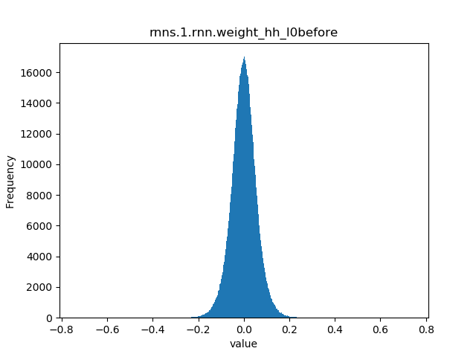
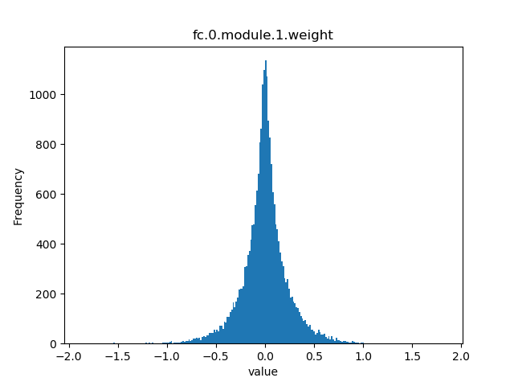
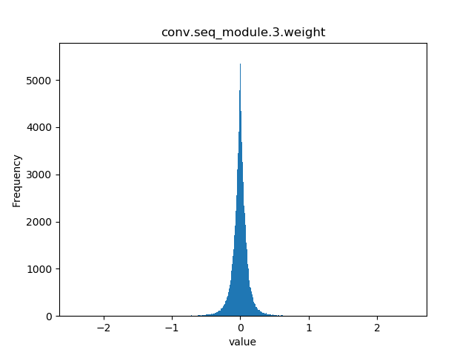
Matrix compression techniques - Bin & Quant
Histogram of parameters
Divide into 8 equal bins
Run sensitivity analysis
Divide the most sensitive bins in half
Run sensitivity analysis again
Histogram of DeepSpeech 2 weights

Slide 10
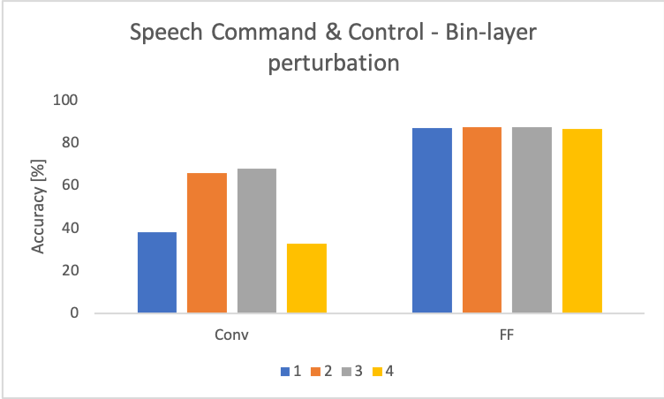
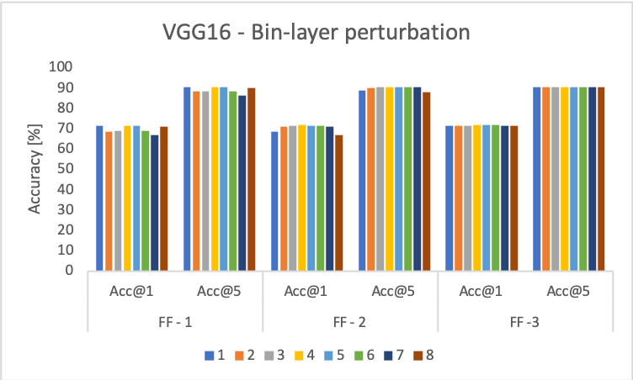
Sensitivity analysis results
Notes:
±50% relative magnitude perturbation

Slide 11
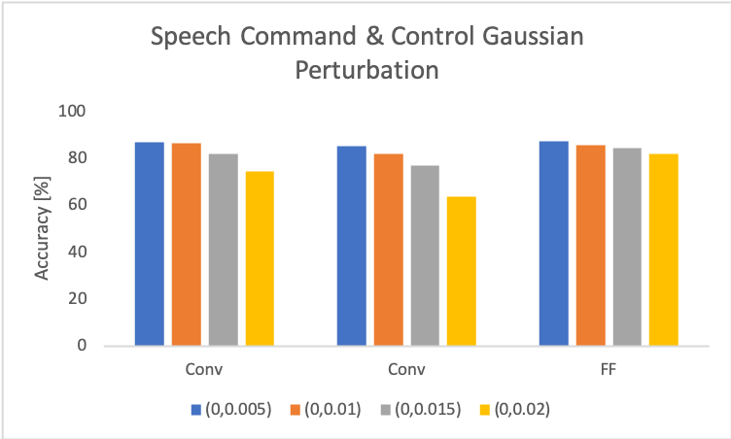
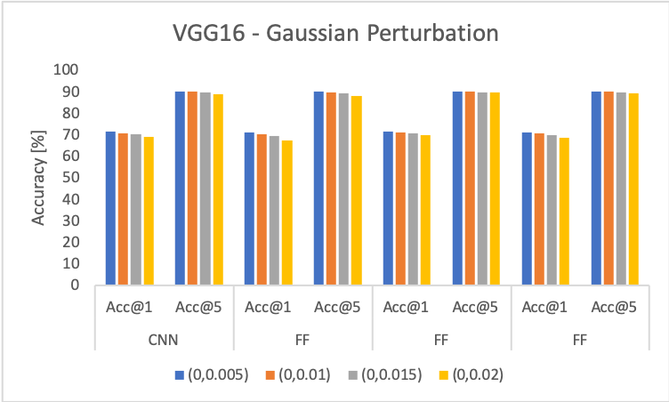
Sensitivity Analysis results
Notes:
CNN more sensitive than FF, GN less than 0.1 STD, Bi-LSTM were more sensitive, as we went down, layers were more sensitive in SPC, VGG16, DS but RNN layers towards the end more sensitive

Slide 12
Results
SPC: Original size: 3.7 MB, Accuracy of 87.5%
DS 1: Original size: 189MB, WER: ~18%, CER: ~9%
DS 2: Original size: 158MB, WER: 11.481, CER: 3.075
VGG16: Original size is 528 MB, Top-1 error: 23.7%, Top-5 error: 6.5%

Slide 13
Conclusion
Our B&Q approach performed better than the baseline methods, SVD and k-means
Also, B&Q consistency gave better compression rates across different models
Sensitivity analysis helped in identifying the most sensitive regions in the n/w parameter space.
Empirically we have shown that RNN layers were more sensitive than CNN followed by FC layers
Model | SPC | DS1 | DS2 | VGG16
SVD | x
K-Means |  | x | x | x
B&Q

Slide 14
Thank you!

