Slide 1
DenoiSpeech: Denoising Text To Speech With Frame-Level Noise Modeling
Chen Zhang, Yi Ren, Xu Tan, Jinglin Liu,
Tao Qin, Tie-Yan Liu, Sheng Zhao, Kejun Zhang
Zhejiang University
Microsoft Research Asia
Microsoft Azure Speech
Notes:
Hello everyone, I'm Chen Zhang from Zhejiang University. Now I'm presenting our work, DenoiSpeech: Denoising text to speech with frame-level noise modeling, which is joint work with Microsoft Research.

Slide 2
Outline
Motivation
Related Work
Method
Experiments
Notes:
Next, I will introduce our work from the following aspects: motivation, related work, our method and the experiment results.

Slide 3
Motivation
The training of text-to-speech (TTS) system requires a large amount of clean speech data;
Collecting enough clean speech data costs a lot while collecting noisy speech is easy;
A certain speaker may only has noisy speech data;
DenoiSpeech aims to leverage noisy speech when training TTS.
Notes:
As we all know, text-to-speech is playing a more and more important role in our daily life, and has achieved great progress recently. It aims to synthesize natural and intelligible voice from text, and neural-based TTS models can synthesize high-quality voice when training with a large amount of clean speech data.
However, it’s hard to ensure a quiet recording environment and good recording equipments when collecting speech data, so collecting enough clean speech data always costs a lot.
On the contrary, noisy speech is easy to collect, such as daily conversations and public talks.
And in some scenarios, we can only access noisy speech of a certain speaker.
So, if we can leverage noisy speech in the training procedure of a TTS model, we will reduce a lot of data collection cost and greatly extend the applicability of TTS.

Slide 4
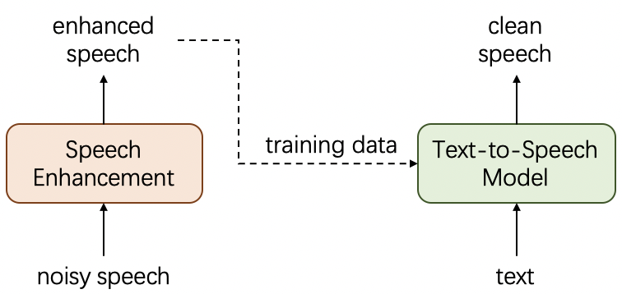
Related Work
Enhancement-Based method
Limited by the performance of pre-trained speech enhancement model.
Noise Embedding Method
Utterance level, cannot cover the complicated noise patterns.
Wei-Ning Hsu, Yu Zhang, Ron J Weiss, Yu-An Chung, Yuxuan Wang, Yonghui Wu, and James Glass, Disentangling correlated speaker and noise for speech synthesis via data augmentation and adversarial factorization
Notes:
Of course, it’s non-trivial to model noise speech data in TTS. A straight-forward way, (as called enhancement-based method), is to first denoise the noisy speech with a pre-trained speech enhancement model, and then use the enhanced speech to train the TTS model.
Honestly speaking, this method can perform well in simple noise situations, however, it can not deal with a little bit more complicated noise situation because the speech cannot be enhanced properly and in turn harm the TTS model training. In a word, the performance of this method is limited by the pre-trained speech enhancement model.
Therefore, recent works proposed to directly train the TTS model using the noisy speech data. They leverage some techniques such as data augmentation and adversarial factorization to disentangle the noise embedding and then use the embedding as conditional input.
However, the noise embedding they used is usually an utterance-level vector, which is coarse-grained and cannot cover the complicated noise patterns that vary greatly along the time dimension.

Slide 5
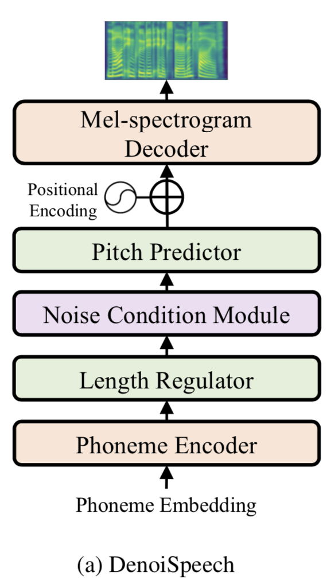
Method——Pipeline
Based on FastSpeech 2;
Phoneme -> Mel-spectrogram -> Wav;
Noise Condition Module: extracts noise condition from the noisy speech and add it into the hidden sequence.
Notes:
So in this paper, we proposed DenoiSpeech, which improves the previous methods with fine-grained frame-level noise modeling to better handle the complicated noise in real-world noisy speech.
As shown in this figure, our DenoiSpeech is based on FastSpeech2 and we add a noise condition module to leverages the noise information.
During the training procedure, the noise condition module can add noise condition from the noisy speech into the TTS decoder. And when inference, we just use the information from the silence audio as the input and then we can synthesize clean speech.

Slide 6
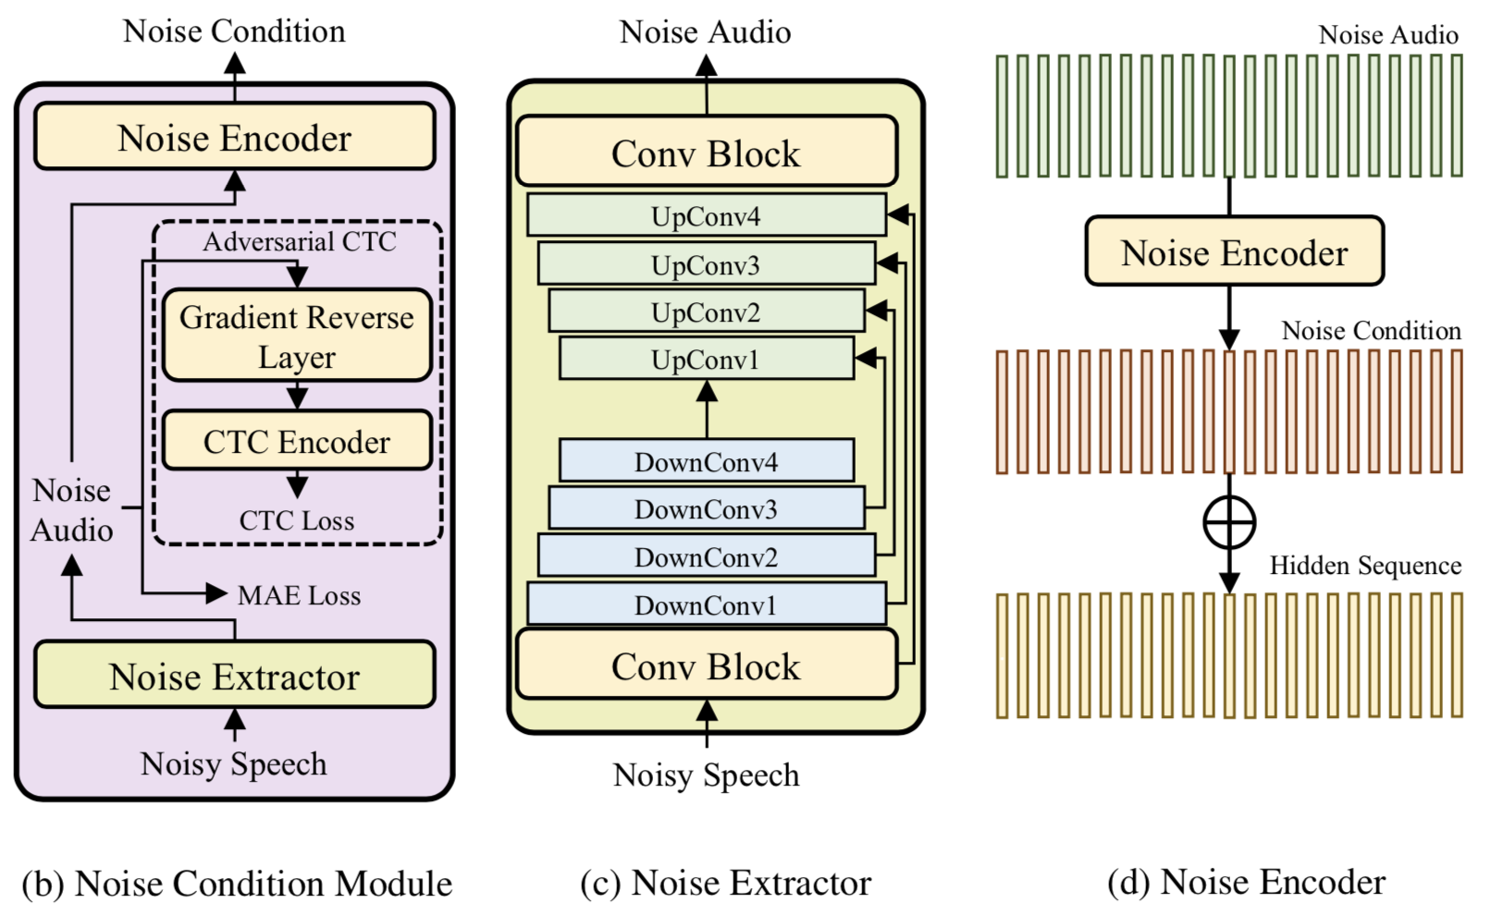
Method——Noise Condition Module
Notes:
The noise condition module leverages a noise extractor to extract the frame-level noise information from the target-speaker noisy speech and then the extracted noise information is taken as input by the TTS decoder.
As shown in the figure, the noise extractor extracts the background noise audio, which is then converted into noise condition using the noise encoder. After that, the noise condition is added to the hidden sequence to introduce the noise information to our model. The adversarial CTC sub-module is introduced to ensure only noise information is extracted, without any text/phoneme related information.

Slide 7
Experiments——Datasets
Artificial Noisy Dataset:
clean speech utterances are mixed with noise with SNR randomly chosen from 5 dB to 25 dB.
VCTK corpus (clean speech): 44 hours from 109 speakers;
Nonspeech (background noise): 100 noise utterances from 20 different noise classes.
Real-world Noisy Dataset:
an internal noisy dataset collected from real-world noisy situations;
25 hours noisy English speech from 55 speakers;
contains more complicated noise types, not only including the additive noise we simulated, but also reverberation and multiplicative noise.
Notes:
Next is the experiment part.
We use two types of dataset: artificially generated noisy dataset and real-world noisy dataset.
For artificial noisy dataset, we use the VCTK corpus as the clean speech and the Nonspeech100 for background noise.
Half of the speakers in VCTK are randomly selected to be noisy to simulate speaker-correlated noise. All of the utterances of the noisy speakers are mixed with noise sampled from Nonspeech100 with an SNR randomly chosen from 5 dB to 25 dB.
For the real-world noisy dataset, we use an internal noisy dataset collected from real-world noisy situations. And it contains more complicated noise types, whose patterns and distributions are quite different from those in the artificial dataset.

Slide 8
Experiments——Evaluation
MOS (Mean Opinion Score):
We randomly selected 20 utterances from the test set, and distributed them (randomly shuffled) to 20 participants (native speakers). The MOS values varying from 0 to 5.
CMOS (Comparative Mean Opinion Score):
Participants were asked to listen to both versions (randomly shuffled) and to attribute a score according to their overall preference. The CMOS values range on a gradual scale varying from -3 (the latter is better) to +3 (the former is better).
Notes:
For the evaluation of the output speech, we use MOS and CMOS to measure perceptual quality of synthesized speech.
We randomly selected 20 utterances from the test set, and distributed them (randomly shuffled) to 20 participants (native speakers). Each speaker give a score according to the speech quality.
SMOS (Similarity Mean Opinion Score):
Similar to CMOS, and the SMOS values varying from 0 (dissimilar) to 5 (identical).

Slide 9
Experiments——Baselines
Clean GT:
the ground-truth clean recordings;
Noise GT:
the ground-truth clean recordings mixed with background noise in the artificial noisy corpus or the ground-truth noisy recordings of real-world noisy corpus;
Augment-Adversarial:
apply data augmentation and adversarial factorization to FastSpeech 2.
Enhancement-Based:
FastSpeech 2 trained on enhanced speech denoised with an enhancement model (Phasen).
Notes:
In this work, we compare our DenoiSpeech mainly with two baselines: Augment-Adversarial and Enhancement-Based.
Augment-Adversarial means applying data augmentation and adversarial factorization to FastSpeech2, in order to disentangle the noise information from the context information.
In enhancement-based setting, we first denoise the noisy speech with a pre-trained enhancement model Phasen. And then train the TTS model on enhanced speech.

Slide 10
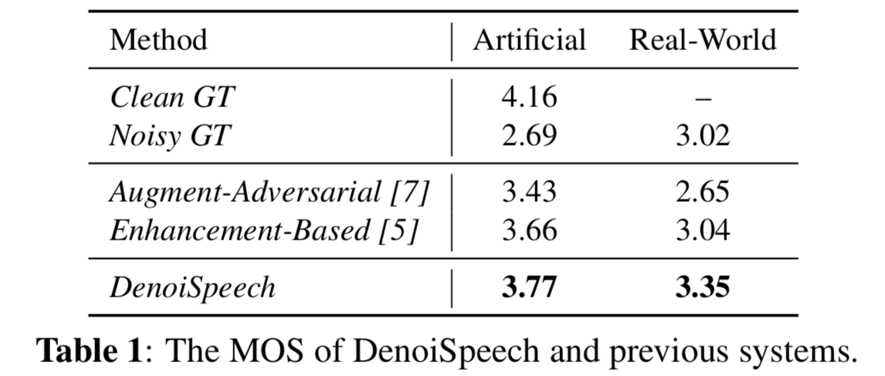
Experiments
Main Results
Notes:
In this page, the table shows the results of our DenoiSpeech and other baselines on two noisy datasets.
We only use the artificial VCTK noisy corpus for paired noisy data but evaluate our DenoiSpeech both on the artificial noisy corpus and the real-world noisy corpus.
The results illustrate that our DenoiSpeech greatly outperforms Noisy GT and generate more natural and clearer speech than two baselines, which demonstrates the effectiveness of fine-grained frame-level noise condition in DenoiSpeech.
Besides, it also can be seen that the gaps between two baselines and DenoiSpeech on the real-world noisy corpus are bigger than those on the artificial noisy corpus. It further verifies the robustness and effectiveness of DenoiSpeech on real-world noisy corpus.

Slide 11
Experiments
The Granularity of Noise Condition
Frame-Level Noise Condition: DenoiSpeech;
Utterance-Level Noise Condition: take the average of the frame-level noise condition;
Without Noise Condition: pure TTS model.
Notes:
Besides the main experiment, we also conduct some analysis on DenoiSpeech.
First, we study how the granularity of the noise condition can influence the synthesized speech quality.
We take the average of the frame-level noise condition along the time dimension as the utterance-level noise condition. And we also conduct experiments without noise condition.
As shown in this table, frame-level noise condition outperforms utterance-level one by 0.59 CMOS, it demonstrates that fine-grained noise condition can describe the noise information better.

Slide 12
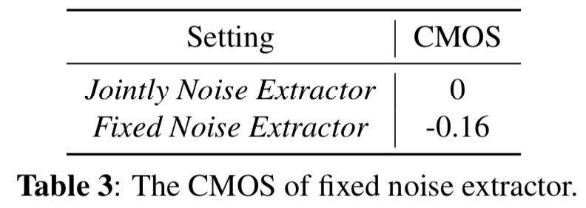
Experiments
Joint Training for Noise Extractor
Jointly Noise Extractor: DenoiSpeech;
Fixed Noise Extractor: fix the noise extractor when training the TTS part.
Notes:
Then, we study how joint training improves performance.
We compare DenoiSpeech with another model that fixes the noise extractor in the training procedure of the TTS. As shown in this table, the quality of the synthesized speech drops when we fix the noise extractor during the TTS model training, which shows that jointly training the noise extractor and the TTS model can have better generalization performance.

Slide 13
Experiments
Adversarial CTC Module
With Adversarial CTC Module: DenoiSpeech;
With Adversarial CTC Module: remove the adversarial CTC sub-module of the noise condition module.
Notes:
At last, inorder to study how the adversarial CTC module influences the model performance, we remove the adversarial CTC module and the comparison results are listed in this Table.
As the results show, the adversarial CTC module improves audio quality, indicating the effectiveness of the adversarial CTC module in extracting the noise audio.

Slide 14
Summary
We developed DenoiSpeech, a denoising text-to-speech system with frame-level noise condition, to synthesize clean speech for the speaker with only noisy training data;
We introduces a noise condition module to provide the corresponding noise information for noisy speech training;
Experiments on two datasets demonstrate that DenoiSpeech achieves significant improvements in synthesis quality over the two baselines.
In the future, we will consider training TTS model on more diverse types of noise and apply few-shot learning strategies on noisy speakers.
Notes:
In conclusion, we developed DenoiSpeech, a denoising text-to-speech system with frame-level noise condition, to synthesize clean speech for the speaker with only noisy training data.
DenoiSpeech introduces a noise condition module to provide the corresponding noise information for noisy speech training.
The noise condition module consists of a noise extractor to extract noise information from noisy speech and an adversarial CTC module to ensure the noise extractor not to generate text information so as to avoid information leakage.
Our experimental results show that DenoiSpeech outperforms other methods on both the artificial noisy corpus and real-world noisy corpus in terms of synthesis quality. Our further method analyses verify the effectiveness of each module in DenoiSpeech.
In the future, we will consider training TTS model on more diverse types of noise and apply few-shot learning strategies on noisy speakers.

Slide 15
Thank you for your listening.
Notes:
That's all, thank you for your listening.

