Slide 1
Block Codes with Embedded Quantization Step Size Information
DCC
Yuriy Reznik
Brightcove, Inc.
Seattle, WA, USA
Data
Compression
Conference
March 21-24, 2023
Snowbird, UT

Slide 2
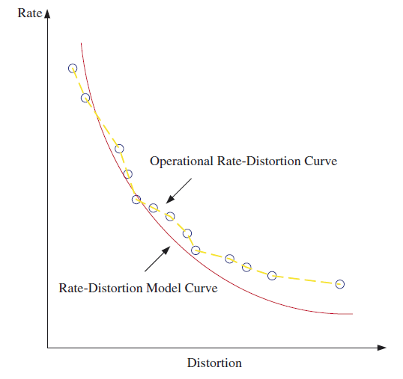
Motivational example
Rate control module in video coding
A unit ensuring that overall bitrate approaching target rate R
achieving best quality (or minimum distortion D)
within certain constraints (decode buffer size, max rate, etc.)
It does it by adjusting quantization step sizes in the bitstream:
Pictures/slices = have “quant” or “QP” parameter in headers
Macroblocks/CTUs = allow transmission of “Delta QPs”
Two levels of rate adaptations:
Frame-level bit allocation and QP derivation, and
Macroblock or CTU-level bit allocation and DeltaQP derivation
Models used to implement rate control methods
Typically influenced by information-theory concepts (*):
rate-distortion characteristic of a source (e.g. RD of Gaussian source)
operational rate-distortion characteristic, which is expected to be similar to an idealized rate-distortion curve
Questions
When we transmit QPs do we still solve the classic “quantization problem”?
How does transmission of QPs affect the performance of such codes?
Does the use of classic R(D) models still appropriate in this application?
$$QP$$
$$D^{∗} =\min_{\begin{aligned}R(QP)≤R^{∗^{`}} \\ +buffer constraints\end{aligned}}⁡D(QP)$$
(*) T. Cover and J. Thomas, “Elements of Information Theory”, Wiley, NY, 1991. (**) H. Chen, K-N. Ngan, “Recent advances in rate control for video coding,” Signal Processing: Image Communication, vol. 22, no. 1, 2007, pp 19-38

Slide 3
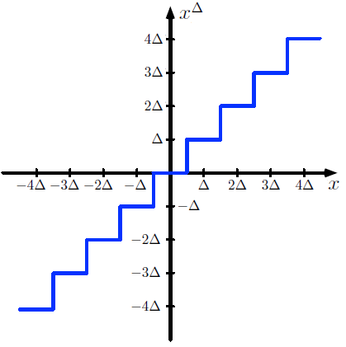
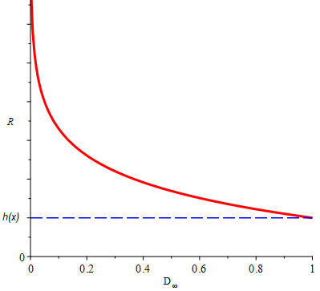
Some known facts
Uniform quantization
Effectively a map:$x→ x^{Δ}$
$x$– real-valued random variable, $x \sim p(x)$, $h\left(x\right)=−\int{p\left(x\right)\log{p\left(x\right)dx}}$
$x^{Δ}$– quantized output, $x^{Δ} \sim P\left(x^{Δ}\right), H\left(x^{Δ}\right)=−\sum_{i}{P\left(x_{i}^{Δ}\right)\log{P\left(x_{i}^{Δ}\right)}}$
$Δ$ – step size
The simplest example: $x^{Δ}=Δ⋅\left\lfloor x/Δ+1/2\right\rfloor$ (uniform mid-tread quantizer)
Performance in high-fidelity regime
If $p(x)$ is Riemann-integrable, then with $Δ→0$, the following holds (*):
$$H\left(x^{Δ}\right)→−\log\left(Δ\right)+h\left(x\right)$$
Operational rate-distortion function of uniform quantizer
$R$ – encoding bitrate, $R≥$ $H\left(x^{Δ}\right)$
$D_{∞}\text{–} ℓ_{∞}$- type distortion:
$$D_{∞}=\max_{x}{|x−x^{Δ}(x)|}≥Δ/2$$
Then, with $Δ,D_{∞}→0$:
$$R≥−\log\left(D_{∞}\right)+h\left(x\right)+O(1)$$
The $−\log\left(D_{∞}\right)$ term is the most important.
$$−\log\left(D_{∞}\right)$$
(*) T. Cover and J. Thomas, “Elements of Information Theory”, Wiley, NY, 1991.

Slide 4
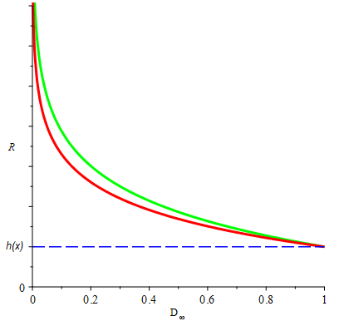
Code with embedded step size
Quantizer
Input:$x_{1},…., x_{n}$ – samples from variable x; quantized output: $x_{1}^{Δ},…., x_{n}^{Δ}$
Step size ($q$ – integer, $C$ – constant):
$$Δ\left(q\right)=C/q$$
Block code
Send parameter q, encoded any monotonic code for integers
Send quantized samples $x_{1}^{Δ},…., x_{n}^{Δ}$ , encoded by arithmetic codes for $x^{Δ} \sim P(x^{Δ})$
Bitstream :
$$<q><x_{1}^{Δ}>,…., <x_{n}^{Δ}>$$
Operational rate-distortion function
n – block length
$D_{∞}=\max_{x}{|x−x^{Δ}|}≥Δ/2$ – distortion
$R_{n}$ – per-sample bitrate:
$$R_{n}>\frac{1}{n}\log\left(q\right)+H\left(x^{Δ}\right) \underset{→}{ Δ→0 } −\left(1+\frac{1}{n}\right)\log\left(D_{∞}\right)+h\left(x\right)+O\left(1\right)$$
In comparison with regular uniform quantizer, we observe that the transmission of $Δ\left(q\right)$ increases the bitrate of a block code by a factor of $\left(1+\frac{1}{n}\right)$
$$−\left(1+\frac{1}{n}\right)\log\left(D_{∞}\right)$$
$$−\log\left(D_{∞}\right)$$

Slide 5
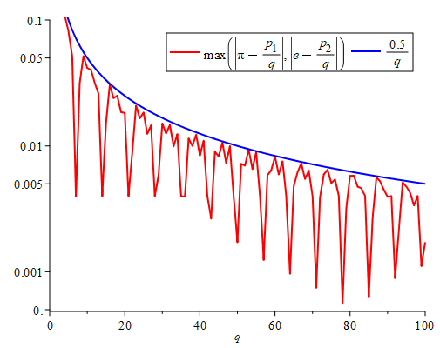
A related mathematical problem
Consider now the following problem:
Given n irrational numbers:$ξ_{1},…., ξ_{n}$, find integers $p_{1},…., p_{n}$ and $q$, such that
$${\frac{p_{1}}{q}≈ξ}_{1},…,\frac{p_{n}}{q}≈ξ_{n}$$
This problem is remarkably old and known in mathematics as simultaneous Diophantine approximations (named after Diophantus of Alexandria, 200s BC)
Performance of Diophantine approximations:
There exists infinitely many integers $p_{1},…., p_{n}$ and $q$, such that (*):
$$\max_{i}\left|ξ_{i}−p_{i}/q\right|<\frac{1}{1+1/n}q^{−\left(1+1/n\right)}$$
This is a significant improvement over a trivial bound:
$$\max_{i} \left|ξ_{i}−p_{i}/q\right|≤{0.5 q}^{−1}$$
Connection to quantization:
Given a block $x_{1},…., x_{n}$, and quantizer $Δ\left(q\right)=C/q$, we see that $ξ_{i}=\frac{x_{i}}{C}, i=1,…,n$ maps quantizer design to the Diophantine approximation problem!
However, in quantization, the distortion $D_{∞}\left(x\right)=\max_{x}\left|x−x^{Δ}\left(x\right)\right|$ is normally computed by assuming full range of possible values of random variable x.
In approximation problem, we compute distortion only for a given sample $x_{1},…., x_{n}$!
But if we only transmit this block – this is the correct metric!
Example:
$ξ_{1}=π≈3.14159…$
$ξ_{2}=e≈2.7182…$
Best approximations with q<100:
$$π≈22/7$$
$$e≈19/7$$
$$π≈157/50$$
$$e≈136/50$$
$$π≈245/78$$
$$e≈212/78$$
The accuracy of Diophantine approximations can be much higher than 0.5/q bound suggests !!
(*) J. Cassels, “An Introduction to Diophantine
Approximations”, Cambridge University Press, 1957.

Slide 6
Achievable performance
Main result
Theorem 1. Given a block of samples $x_{1},…,x_{n}$, there exist infinitely many values of quantization parameter q, such that the resulting rate-distortion performance of a block code with embedded quantization step size parameter satisfies:
$$R_{n}≥−\log\left(D_{∞}\right)+h\left(x\right)+O\left(1\right)$$
where $D_{∞}=\max_{i}{|x_{i}−x_{i}^{Δ}|}$, $x_{i}^{Δ}$ – quantized values of samples $x_{i}$, $i=1,…,n$, step size $Δ\left(q\right)=C/q$, C – constant, q – integer transmitted by the bitstream. This inequality holds in high-fidelity ($Δ(q)→0)$ regime.
Proof
The result follows by applying accuracy limit for Diophantine approximations: $D_{∞}=\max_{i}{|x_{i}−x_{i}^{Δ}|}≤C\frac{1}{1+1/n}q^{−\left(1+1/n\right)}$
Discussion
Compared to our earlier estimate: $R_{n}≥−\left(1+\frac{1}{n}\right)\log\left(D_{∞}\right)+…,$this means that the leading $\left(1+\frac{1}{n}\right)$ factor can be avoided!
This means, that block codes with embedded quantization step size information, may, theoretically, be as efficient as codes that do not transmit such information!
Good news for practical applications! But how to design such codes?

Slide 7
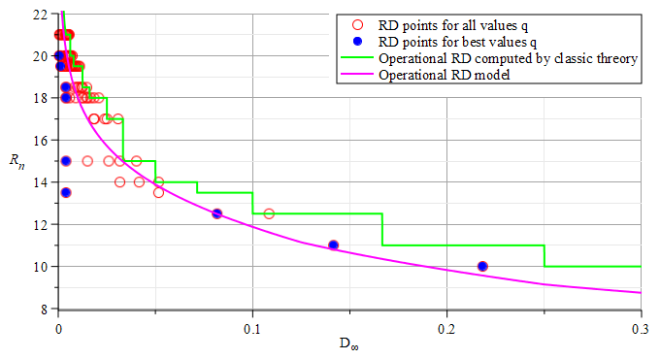
Example code construction
Input
Source: x – random variable, $x∈\left[0,x_{max}\right),$uniformly distributed, $x_{max}=100$
Input samples: $x_{1}=π≈3.14159…, x_{2}=e≈2.7182…$
Code construction
Find $p_{1},p_{2},$and $q$ such that: $x_{1}≈p_{1}/q$, $x_{2}≈p_{2}/q$
Send $q$ by using Levenstein code
Send $p_{1}$ and $p_{2}$by binary codes using $\left\lceil \log_{2}\left(q⋅x_{max}\right)\right\rceil$ bits
R/D performance (q=1..100):
Example codes:
$$q$$ | $$p_{1}$$ | $$p_{2}$$ | $<q>$ | $<p_{1}>$ | $<p_{2}>$ | $R_{n}$ [bits] | $$D_{∞}$$ | $$0.5/q$$
2 | 6 | 5 | 1100 | 00000110 | 00000101 | 4/2+8=10 | 0.21828 | 0.25000
3 | 9 | 8 | 1101 | 000001001 | 000001000 | 4/2+9=11 | 0.14159 | 0.16666
5 | 16 | 14 | 1110001 | 000010000 | 000001110 | 7/2+9=12.5 | 0.08171 | 0.10000
7 | 22 | 19 | 1110011 | 0000010110 | 0000010011 | 7/2+10= 13.5 | 0.00399 | 0.07142
36 | 113 | 98 | 1111000100100 | 000001110001 | 0000110 0010 | 13/2+12=18.5 | 0.00394 | 0.01388
57 | 179 | 155 | 1111000111001 | 0000010110011 | 0000010011011 | 13/2+13=19.5 | 0.00124 | 0.00877
78 | 245 | 212 | 11110010001110 | 0000011110101 | 0000011010100 | 14/2+13=20 | 0.00056 | 0.00641
Observations:
By varying q, the RD points can be all over the place.
There are few points q for which RD performance is much better. Their existence is predicted by Diophantine theory.
The reliance on classic RD models maybe rather misleading in this this case. The solution space is discrete and some operating points may fall significantly below the model curve.

Slide 8
Conclusions
This is fun !
The classic quantization theory does not fit exactly in this case!
We are not quantizing a “stochastic source” x
Instead, we are only quantizing and transmitting n samples $x_{1},…,x_{n}$
This narrows the definition of distortion:
Instead of computing distortion across the entire range of values x:
$$D_{∞}\left(x,x^{Δ}\right)=\max_{x∈ℛ⊂ℝ}{|x−x^{Δ}(x)|}$$
It is sufficient to compute distortion only for the given block of samples:
$$D_{∞}\left(x_{1},…x_{n},x_{1}^{Δ},…x_{n}^{Δ}\right)=\max_{i=1,…,n}\left|x_{i}−x_{i}^{Δ}\right|.$$
Further, the transmission of step sizes enables mapping of block coding problem to the one of finding best Diophantine approximations.
This leads to better understanding of achievable performance of such codes and some quite surprising results!
Applications & consequences
The discovered phenomena may help with improving designs of rate control algorithms and performance of encoders in general
But such improvements may require more compute power! The problem of finding best Diophantine approximations is known to be NP-complete. Related discussion and some useful near-optimal polynomial-time algorithms can be found in (*).
Example RD performance:
(*) M. Groetschel, L. Lovacz, and A. Schrijver, “Geometric algorithms and combinatorial optimization”, Springer, Berlin, 1988.

Slide 9
THANK
YOU

