Slide 1
SPEAKER DIARIZATION: A PERSPECTIVE ON CHALLENGES AND OPPORTUNITIES FROM THEORY TO PRACTICE
Kenneth Church, Weizhong Zhu, Josef Vopicka, Jason Pelecanos, Dimitrios Dimitriadis, Petr Fousek
IBM

Slide 5
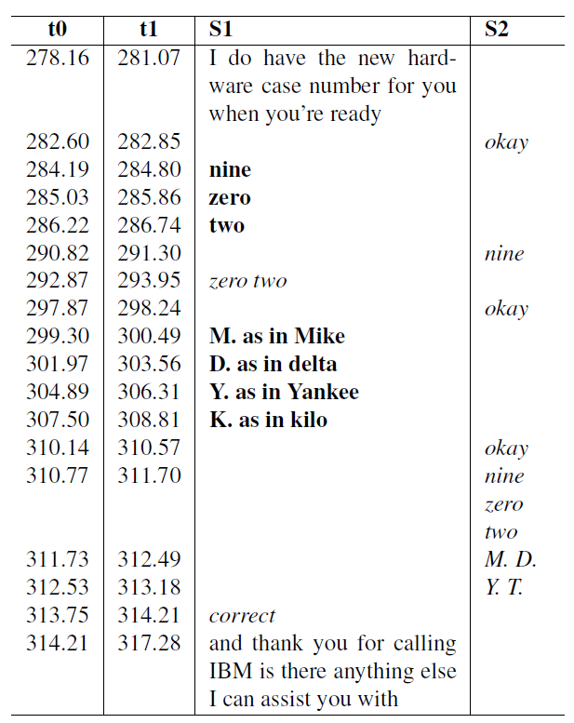
What is Diarization? Role Modeling?
Ticket Extraction Task → 902MDYK
ASR: what was said
audio → words with timestamps
Diarization: who spoke when
ASR output → S1, S2, …
Rows → Columns
Role Modeling
Diarization output → Roles: Customer, Agent, …
Related work (& future work):
Distinguish new info from given (confirmations)
Bold vs. Italics
Information extraction
Audio → Tickets, phone numbers, email addresses, company names, people names, products
Low Bandwidth communication channel
7 Bytes in 36 seconds < 2 bits per second

Slide 6
Motivation for Diarization & Role Modeling in IBM Call Centers
Example: identify escalations (request for a “Duty Manager”)
Big deal: hopefully this doesn’t happen often,
But when it happens, we want to know about it
We started with keyword spotting (based on ASR output)
Look for phrase: “Duty Manager”
But it matters, who said “Duty Manager”
If customer requests “Duty Manager” → Escalation
Near miss: agent ends call with innocuous standard boilerplate
if you aren’t 100% satisfied
you can always call back and request a “duty manager”

Slide 7
An “Alternative Fact”: Diarization is (Largely) Solved
Fact: Easy cases are easy
Prior work has been too successful: CallHome, Broadcast News, etc
Mostly just two speakers
Relatively little music, tones, recorded/synthesized speech
Fact: Standard metrics sound better than they are (next 3 slides)
Challenges for IBM Call Center Data (Technical Support)
Holds, transfers, music, tones, recorded/synthesized speech
In the bad old days, phones used to go beep, beep, beep,
but now they talk to you (with lots and lots of different voices)
Transcribers do not transcribe “uninteresting” speech (recorded/synthesized voices)
Computers don’t distinguish foreground/background (“interesting/uninteresting”)
ASR → Jericho
Gold → <prompt>

Slide 8
Loss Metrics: NIST Standard (weighted by frames)
DER = FA + Miss + Spk
DER: Diarization Error
SAD (Speech Activity Detection) Errors
FA: False Accept (error of commission)
Percentage of time that non-speech is incorrectly accepted as speech
Miss: error of omission
Percentage of time that speech is incorrectly recognized as non-speech
Spk: Percentage of time one speaker is confused for another
In this work, diarization starts with ASR output (words + timestamps)
SAD comes from ASR
And therefore, SAD errors are not our problem
We care about spk (speaker error), and nothing else

Slide 9
Speaker error (spk) is invariant to permutations
Note: we can freely permute columns
without impacting speaker error rate
There is no particular meaning to speaker labels: S1, S2, …
Permutations will become important when we talk about reconciliation

Slide 10
Standard metrics sound better than they are
Suppose we have 2 speakers
where gold has p seconds for S1
and q seconds for S2
and s seconds of silence
Consider a simple diarization baseline
Assign all speech to S1
Then spk ≤ min(p,q)/(p+q+s) << 50%
spk → 0 as s → ∞
spk → 0 as SAD errors → ∞
For example,
spk ≈ 10% sounds better than it is

Slide 11
Baseline Methods: Offline & Greedy
Two previously published methods: Offline & Online
In general: offline performance >> online (less speaker error)
But users like to see results in real time (before the end of the speech)
Previously published a greedy online algorithm
that worked well on Callhome
but not so well on IBM Call Center Data
because of violations of warm-up assumption (next slide)

Slide 12
Warmup Assumption: Beginning of call ≈ End of call
ASR → Jericho
Gold → <prompt>
Our previously published method depended on a warm-up period
Call center calls often start with a tone
followed by a computer voice (explaining to agent what happened in IVR)
The tone and the computer voice will not be heard again
Many calls end with a transfer
the first agent to talk may not be the last agent to talk
Many calls involve long holds
with one or more recorded/synthesized voices
These issues motivated us to propose a new alternative:
Prefix Method: avoids undesirable warmup assumption

Slide 13
Proposed Prefix Method (next slide) Replace greedy heuristics with non-determinism
Less speaker error (spk) is better
213%
Performance: sorted from best to worst
Offline >> Left-to-Right (L2R) Online
Non-determinism (Prefix) P >> Greedy
More important for Call Center Data than Callhome
Call Center Data has more violations of warm-up assumption

Slide 14
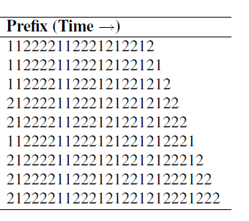
Prefix Method: Greedy Heuristics → Non-Determinism
After each turn, T[i]
Apply offline method to all turns seen thus far: T[1] … T[i]
Offline method returns a string of speaker labels: Prefix[i] = S[1] … S[i]
Reconciliation: avoid flip-flopping
(next slide)
When necessary,
Output speaker labels, S
But stall as much as possible
Because offline performance improves over time
novelty
Prefix[i]
S[1] … S[i]

Slide 15
Reconciliation: Avoid undesirable flip-flopping
Recall that there is no speaker meaning to S1, S2, …
Speaker error is invariant to permutations of speaker labels
Thus, there is a risk of undesirable flip-flopping
That is, when we apply the offline method to two (overlapping) prefixes
The offline method might return different permutations of the labels
Reconciliation solution to flip-flopping:
Let P[i] be the offline output for the current turn
Consider all permutations of speaker labels, π(Prefix[i])
Use the permutation that is most consistent with previous turn
Loss = hamming_distance(π(Prefix[i]), Prefix[i-1]))

Slide 16
Loss = hamming_distance(π(Prefix[i]), Prefix[i-1]))
After reconciliation, hamming distances tend to be small

Slide 17
Flip-flopping is more likely for short turns near the beginning of the call
More Flip-flopping
Less Flip-flopping

Slide 18
Trade-off: Performance vs. Latency Performance improves with more turns (left & bottom right), and longer turns (top right)
Longer Turns
More audio
More audio
More Turns
Callhome
Call Center

Slide 19
Diarization → Role Modeling
Role Modeling
Diarization output (S1, S2, …) → Roles: Customer (C), Agent (A), …
Two approaches:
Diarization-based (unsupervised):
agents speak on lots of calls, and customers don’t
Text classification (supervised):
agents use different words
“please”, “sorry”, and “sir”
Compromise:
Use diarization method to generate training data for text classification

Slide 20
Role Modeling works so well that it is hard to measure error rates (need ~1000 labeled calls to measure error rates of ~1%)

Slide 21
Script Modeling

Slide 22
Diarization Conclusions
“Alternative Fact”: Diarization is a solved problem
Fact: Easy cases are easy & hard cases are hard
IBM Call Center Data is harder than standard benchmarks (Callhome)
Violations of Warm-up Assumption (Beginning of call ≈ End of call)
Solution: Replace greedy heuristics with non-deterministm (Prefix Method)
6.6% SPK error → 3.1%
Shameless plug for 4th Frederick Jelinek Memorial Workshop
Cocktail party effect: debates, dinner parties, etc.
Clipping, people talking over one another, cooperative (and uncooperative) speakers
Established a link between diarization and new tasks (roles, scripts, etc.)
Opportunities for interdisciplinary collaboration between speech & language
Combining diarization (iVectors) with text classification

Slide 23
Backup

Slide 24
Design Decision: Run Diarization downstream of ASR
Call Center is much harder
We will use ASR for SAD (Speech Activity Detection) in this work
Performance is roughly comparable between Basic & ASR
Benefit of ASR for SAD:
Consistency: compatible timestamps between ASR & diarization
Modularity: Separate SAD task from Diarization task
Diarization task:
Input: N turns (intervals of speech as determined by ASR)
Output: N labels S1, S2, S3, …, indicating which speaker spoke which turn

Slide 25
Overview
Speech Activity Detection (SAD)
Challenge: NIST != Real World
Online vs Offline (Batch):
Violations of Warmup Assumption: Beginning of call ≈ End of call
Prefix Method: Greedy Heuristics → Non-Determinism
In addition to these unpleasant realities
We were pleasantly surprised by unexpected opportunities to collaborate
with colleagues in other disciplines (e.g., text analysis)
on tasks that go beyond standard diarization: role modeling, script modeling, etc.

