Slide 1
DCC 2021 Poster
Paper ID: 154
Invertible Resampling-based Layered Image Compression
Youmin Xu, Jian Zhang
Peking University

Slide 2
OUTLINE
Motivation
Model Design:
Framework of IRLIC
Decoupled Invertible Resampling Module
Loss Functions
Experiments:
Quantitative Comparisons
Rate-Distortion Curves
Reconstruction Samples

Slide 3
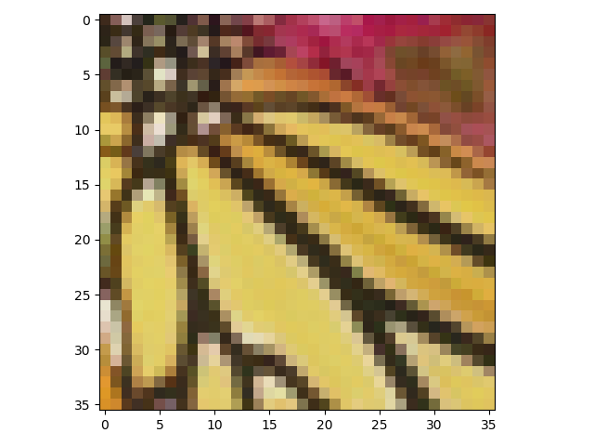
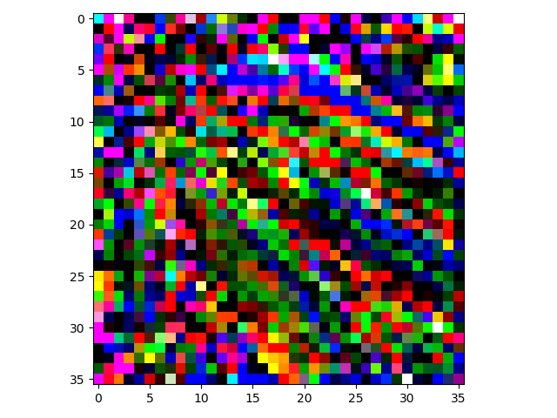
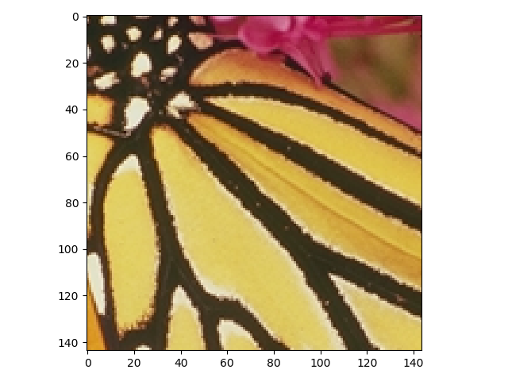
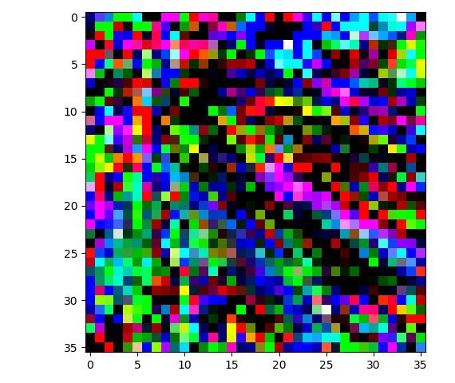
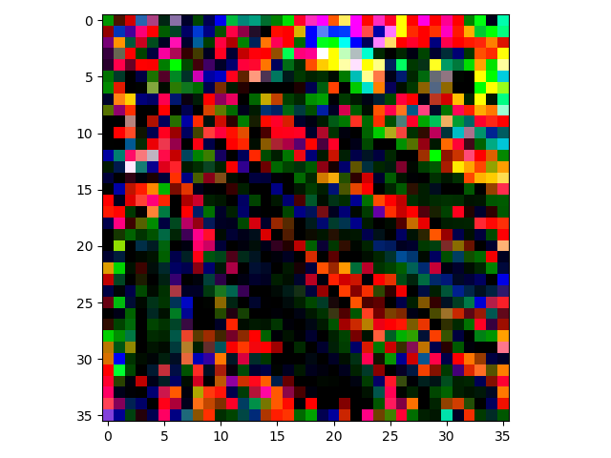
Motivation
The flow model segments high-quality images into downsampled thumbnails and redundant noise.
Thumbnails
Forward DIRN
Noise
Invertible Network
Sender:
Original Image
Backward DIRN
Invertible Network
Receiver:
Restored Image

Slide 4
Framework
A novel framework for lossy image compression based on the invertible neural network(INN).

Slide 5
Decoupled Invertible Resampling (DIRN)
DIRN generates the compact representation of the input image based on flow modules.

Slide 6
Loss Function
The total objective is the combination of downscaling similarity loss, reconstruction loss and distribution distance loss.

Slide 7
Experiments： Quantitative Comparisons
DIR module achieves comparable resampling performance with the state-of-the-art methods.

Slide 8
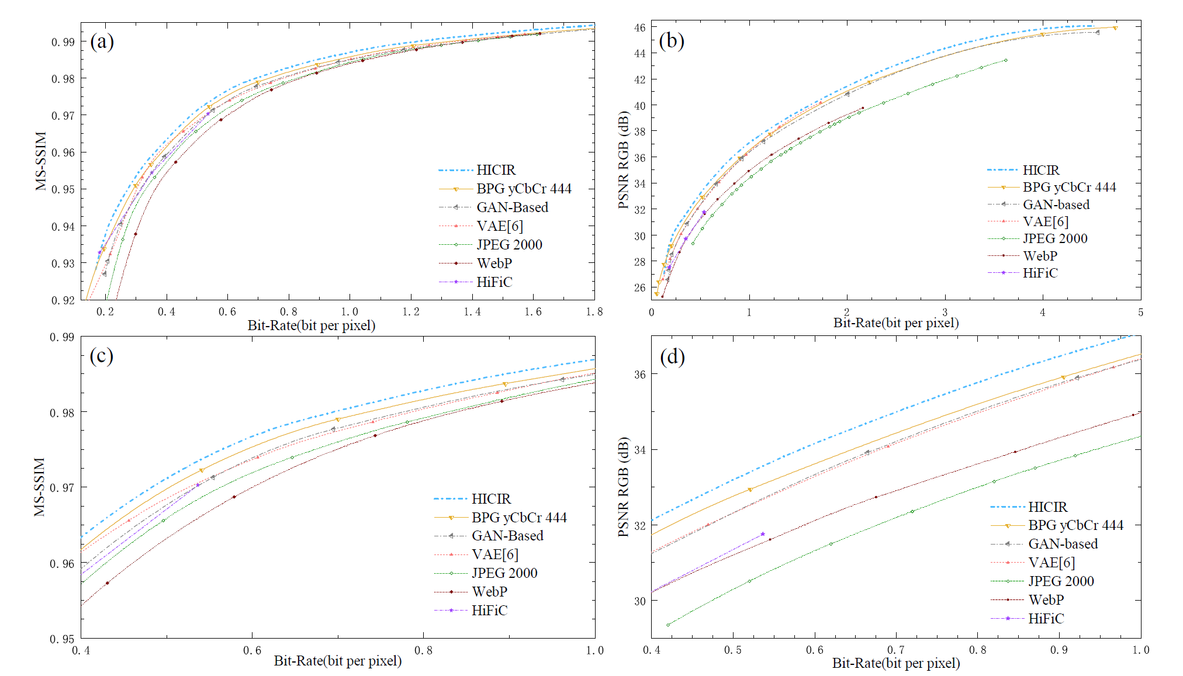
Rate-Distortion Curves

Slide 9
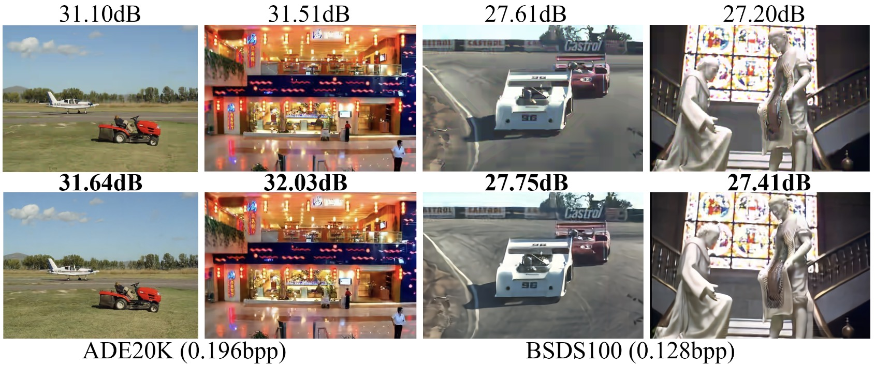
Reconstruction Samples
IRLIC will provide better reconstruction than BPG codec.
BPG
IRLIC

