Slide 1
FM-Directories: Extending the Burrows-Wheeler Transform for String Labeled Vertex Graphs of (Almost) Arbitrary Topology
DCC 2023
Unsal Ozturk, Paolo Ribeca, Marco Mattavelli
Notes:
Hello, I’m Unsal and today I’ll be talking about extending the Burrows Wheeler Transform for indexing string labeled graphs.

Slide 2
The Graph Indexing Problem
A string graph is defined as a directed string-labeled graph $G\left(V,E,N\right)$ where $V$ is the set of vertices, $E$ is the set of edges, and $N$ is a set of strings over an alphabet $Σ$ where each string $N_{i}∈N$ is associated with a vertex $V_{i}∈V$
An index $D:G×S→V^{∗}$ on this graph takes in a query string $Q∈S$ and returns a minimal ordered list of vertices $V_{j_{1}},…,V_{j_{k}}$ such that the concatenation of $N_{j_{1}},…,N_{j_{k}}$ contains $Q$ as a substring
Some (state of the art) approaches:
Hash tables
Wheeler Graphs [1]
Co-lex orders [2]
Notes:
We define a string graph as a graph with string labels on its vertices. We define an index on this graph as a function that takes the graph and a string as input and produces a walk on the graph that minimally contains the input string. We assume that each vertex and its string label are associated with an integer index.
Some of the state of the art approaches to this problem are Wheeler Graphs, and Co-lex orders. We will discuss another approach here which may be viewed as a practical recipe for realizing the total or partial indexing properties of Wheeler graphs.

Slide 3
Our Approach
We define a data structure called the FM-Directory based on the FM-Index, comprised of the following:
The FM-Index of a graph encoding string
Per-vertex incoming neighbors list
BW-rank to text-rank translation table of a special character $σ_{0}$
Text-rank to BW-rank translation table of a special character $σ_{1}$
The idea is to use an FM-Index as one would for regular text; however, fork a query into multiple queries and track multiple ranges when the beginning of a vertex is encountered
We then provide a scheme to minimize the number of forked queries as much as possible given the topology of the initial graph
Notes:
To this end, we define a data structure called the FM-Directory that uses a carefully crafted FM-Index on a graph encoding and three other tables under the hood.
The main idea is to use the FM-index to match queries until we exhaust the string labels of a set of vertices, at which point the query is forked to all incoming neighbors.

Slide 4
FM-Directories Without Permutation
Define the “permutationless” string encoding of a graph $G\left(V,E,N\right)$ with vertices $V_{1},…,V_{\left|V\right|}∈V$ and associated strings $N_{1},…,N_{\left|V\right|}$ as
$$RE\left(G\right)=σ_{0}N_{1}σ_{1}σ_{0}N_{2}σ_{1}…σ_{0}N_{\left|V\right|}σ_{1}\$$$
where $σ_{0},σ_{1}∉Σ$ and $σ_{0}<σ_{1}$ are special characters denoting the beginning and the end of a string. Construct a BWT on $RE\left(G\right)$ and denote it with $B_{RE\left(G\right)}$, and an FM-Index of $RE\left(G\right)$ based on $B_{RE\left(G\right)}$.
Let $B_{T}:ℕ→ℕ$ be the rank translation table that translates the ranks of $σ_{0}$ in $B_{RE\left(G\right) }$to $RE\left(G\right)$
Let $T_{B}:ℕ→ℕ$ be the rank translation table that translates the ranks of $σ_{1}$ in $RE\left(G\right)$ to $B_{RE\left(G\right) }$
Finally, let $Ɲ^{−}:V→V^{∗}$ denote the incoming neighbors table
Notes:
We first introduce a simpler version of our index called the FM-Directories without permutation to show how it works.
To construct the graph encoding take two special characters sigma zero and sigma one, and place them in the beginning and at the end of each vertex label. We then concatenate these strings in the order of the vertex indices. We then define two rank translation tables: one for translating sigma zero ranks from the Burrows Wheeler domain to the text domain, and one to translate sigma one ranks from the text domain to the Burrows Wheeler Domain. Finally, we define a table that stores the list of incoming neighbors per vertex.

Slide 5
FM-Directories Without Permutation: Algorithm Outline
For a query $Q=Q_{1}…Q_{n}, Q_{i}∈Σ$, we match it on $RE\left(G\right)$ using the LF-mapping of the FM-Index as follows:
1 - Set the FM-Index range to the whole table
2 - $i←n$
3 - Find the range of to be advanced on $Q_{i}$ using the LF-Mapping
4 - Compute $V_{occ}=\bigcup{B_{T}\left(Rank\left(B_{RE\left(G\right)}, σ_{0},k\right)\right) }$for all $k$ appearing in the range computed in 3, i.e. compute all vertex indices containing $Q_{i}…Q_{n}$ as a prefix in its string or a walk starting from this vertex
5 - Compute $V_{in}=\bigcup{Ɲ^{−}\left(V_{i}\right)}$ for all $V_{i}∈V_{occ}$, i.e, set of all incoming neighbors to the vertices in step 4
6 - Compute $V_{fork}=\bigcup{T_{B}(i)}$ for all $V_{i}∈V_{in}$, i.e. the ranks of $σ_{1}$
7 - For all $k∈V_{fork}$, fork a separate FM-Index lookup with initial range of length one of $σ_{1}$ of rank $k$ in $B_{RE\left(G\right)}$ starting from character $Q_{i}$ starting from step 3
8 - Decrement $i$ and return to step 3.
One should also keep track of the visited vertices in this process, and return them as a list
Notes:
We start matching a query as one would with an FM-index, but look up the occurrence more time for the character sigma zero. If sigma zero appears in the current range, then exists a vertex containing the current suffix of the query as its prefix. Whenever this happens, we translate the rank of these sigma zeros to text rank, compute incoming vertex indices to the corresponding sigma zero, then translate text ranks of sigma ones to Burrows Wheeler domain, over each of which a separate fork of ranges will be tracked.

Slide 6
FM-Directories Without Permutation: Time Complexity
Essentially, we query the FM-Index as normal, but create new queries when $σ_{0}$, i.e. the character marking the beginning of a vertex, is encountered.
Note that the text ($RE\left(G\right)$) rank of $σ_{0}$ is equal to the index of the vertex by construction
Then, for all such vertices, the query is forked as separate lookups in the FM-Index, starting from the appropriate ranges of the character $σ_{1}$, which mark the end of vertices in $RE\left(G\right)$.
What is the time complexity of this scheme?
Notes:
We now investigate the time complexity of this querying scheme.

Slide 7
FM-Directories Without Permutation: Time Complexity
Assuming that at each step, one lookup forks into at most $δ≤|V|$ lookups of one more character matched in the worst case, we have the recurrence relation with $T\left(0\right)=0$:
$$T\left(\left|Q\right|\right)=\left|Q\right|+δT\left(\left|Q\right|−1\right)$$
which can be written in closed form as:
$$T\left(\left|Q\right|\right)=\frac{{(δ}^{\left|Q\right|+1}−δ\left(\left|Q\right|+1\right)+\left|Q\right|) }{{\left(δ−1\right)}^{2}}$$
Case $δ=0$, i.e. the graph has a single vertex, yields the complexity for FM-Index lookups.
For the degenerate case $δ=1$, take a limit to discover that $T\left(Q\right)=\left|Q\right|\left|Q+1\right|/2$, or alternatively solve $T\left(\left|Q\right|\right)=\left|Q\right|+T\left(\left|Q\right|−1\right)$
Notes:
Assume that for each character matched there exists delta many forked queries in the worst case, we can write an upper bound to the number of matched characters as shown on the slide.
As one can see, the resulting number of character matches can be exponential in the worst case, and this is clearly undesirable for our index.
Letting delta be 0 means that we have a single vertex to query in the graph, and we get the same time complexity that of the FM-Index: linear in the length of the query.
The degenerate case where delta is one results in quadradic time queries.

Slide 8
FM-Directories Without Permutation: Decreasing $δ$
FM-Directories “without” permutation have no guarantees on the consecutiveness of the ranges of $σ_{1}$ after the translations
This therefore causes many forks with ranges of length 1 to be launched
If these ranges are consecutive, then it is possible to combine consecutive ranges into a single fork
In this case, the worst-case number of range advances $T\left(\left|Q\right|\right)$ is given by $δ=1$, i.e. $T\left(\left|Q\right|\right)∈{O(\left|Q\right|}^{2})$
Natural question: how to make $σ_{1}$’s consecutive as much as possible?
Notes:
We now investigate if we can let delta be one, i.e. our query forks into many queries with ranges of length one, however, if these ranges are consecutive they may be combined into a single one.
The question we now ask is how does one make sure that the sigma ones that are reachable by matching a particular suffix are found in a consecutive ranges in the suffix array as much as possible?

Slide 9
FM-Directories With Permutation
Idea: Find a permutation $π:ℕ→ℕ$ of vertices $V_{1},…,V_{\left|V\right|}→V_{π\left(1\right)},…,V_{π\left(n\right)}$ such that $σ_{1}$’s are as consecutive in $B_{RE\left(G\right)}$ as possible for any possible fork during a query
Some natural questions:
1 - For some arbitrary permutation $π$, is it possible to enforce it in $B_{RE\left(G\right)}$, and if so, how can it be done?
2 - Which subsets of the characters $σ_{1}$ must be consecutive to minimize the number of consecutive ranges after some arbitrary query?
3 - Is it always possible to find a permutation such that $δ≤1$, strictly?
Notes:
And therefore we now consider a permuted version of the FM-Directory, namely, we attempt to compute a permutation pi such that when it is applied on the indices of the vertices, it rearranges the vertices into such a new order that reachable sigma ones are in consecutive ranges of the suffix array.
We now pose three questions to this end: Firstly, assuming that we have such a permutation for the text domain, how does one enforce it in the Burrows-Wheeler domain?
Secondly, which subsets of sigma one does one need to make consecutive so that one always encounters as compact ranges as possible?
Thirdly, can one always guarantee that there is an optimal permutation that forces delta to be one at most

Slide 10
FM-Directories With Permutation: Enforcing a Permutation in $B_{RE\left(G\right)}$
Answer to 1: It is possible to enforce a permutation, and it is computationally inexpensive
Consider the following trick: Let $Σ′$ be a separate alphabet from $Σ$ such that $σ^{′}<σ$ for all $σ∈Σ, σ^{′}∈Σ^{′}$. Using characters from $Σ′$, construct a uniquely decodable code of size $\left|V\right|$ satisfying the upper bound on the Kraft inequality, and sort these codewords into a lexicographic order. Denoting these sorted codewords as $a_{1},…,a_{\left|V\right|}$ the encoding
$$RE^{π}\left(G\right)=σ_{0}N_{1}σ_{1}a_{π^{−1}\left(1\right)}σ_{0}N_{2}σ_{1}a_{π^{−1}\left(2\right)}…σ_{0}N_{\left|V\right|}σ_{1}a_{π^{−1}\left(\left|V\right|\right)}\$$$
enforces the permutation $π$ in the Burrows-Wheeler order, where $π^{−1}$ is the inverse permutation
Notes:
The answer to the first question turns out to be simple and computationally inexpensive. To enforce a permutation in the Burrows-Wheeler domain, one needs to modify the suffixes of the characters over which the permutation is to be enforced. To this end, pick a separate alphabet from the alphabet of the string labels, and construct a minimal average length uniquely decodable code of size equal to the number of vertices, and sort these codewords lexicographically. Denoting the sorted codewords as a_i, it can be shown that permuting these codewords with the inverse of the permutation and appending these codewords after sigma ones enforces the permutation in the Burrows Wheeler order.

Slide 11
FM-Directories With Permutation: Enforcing a Permutation in $B_{RE\left(G\right)}$
Proof Sketch:
We wish the $σ_{1}$ associated with vertex with index $i$ to be permuted to $π\left(i\right)$ in $B_{RE\left(G\right)}^{π}$
The order of $σ_{1}$ in $B_{RE\left(G\right)}^{π}$ depends on the lexicographic order of suffixes starting from $σ_{1}$
Modifying the suffixes starting from $σ_{1}$ by adding $a_{π^{−1}\left(i\right)}$ hence enforces the permutation by the construction of $a_{i}$
Notes:
Here’s a proof sketch

Slide 12
FM-Directories With Permutation: Finding $π$
Answer to 2: Consider the set of walks in $G$. For all of these walks, compute the strings induced by these walks, and let $P$ be the set of all prefixes of all strings induced by these walks. Let $p_{i}∈P$ be a prefix contained in some walk, and let $R_{p_{i}}$ the set of all vertices $V_{k}$ such that $p_{i}$ is a prefix for a walk starting from $V_{k}$. Then, finally, define the set
$$C_{p_{i}}=\bigcup_{V_{k}∈R_{p_{i}}}{Ɲ^{−}\left(V_{k}\right)}$$
called the constraint set of the prefix $p_{i}$.
Notes:
For the second question, consider how we can find a permutation pi that minimizes the number of forks. Firstly, we enumerate the sets of vertices whose sigma zero characters are reachable after some query or its suffixes have been matched to the graph encoding.
Let pi be a prefix of a string induced by a walk in the graph, let Rpi be the set of vertices vk such that pi is a prefix of a walk starting from vk. Now, let Cpi be union of the incoming vertices of each vertex in Rpi. Denote these sets as constraint sets.

Slide 13
FM-Directories With Permutation: Finding $π$
Proposition: If for all possible $p_{i}$, vertices in constraint sets $C_{p_{i}}$ are made to be consecutive in $π$, then $δ=1$.
Proof sketch: Forks happen when a suffix of the query is matched to the prefix of a string induced by a walk. If all incoming neighbors to all vertices with such matchable prefixes are made consecutive, then the fork can be expressed in a single range if the permutation $π$ is enforced in the BW-order.
Notes:
Turns out, these constraint sets are the sets to be made consecutive, as the set of vertices in each constraint set happens to be exactly the vertices to which a query will be forked after exhausting some string during the querying procedure. Hence, the forked query can be launched on a single combined range, yielding polynomial time queries.

Slide 14
FM-Directories With Permutation: Finding $π$ and Limitations
Answer to 3: Turns out, no. There is no guarantee that a $π$ with all $C_{p_{i}}$ consecutive exists; however it is still possible to compute a permutation where some or most of the sets are consecutive.
Proof sketch: Computing a permutation $π$ over $1,…,n$ such that some sets $S_{1},…,S_{k}$ over the same domain are consecutive can be proven to be NP-Complete, by reduction from the Consecutive-Block-Minimization (CBM) problem [3,4]. Conversely, this problem can be trivially converted to CBM. The optimal solution to CBM problems do not necessarily make all blocks consecutive.
[5] also provides a scheme to solve CBM by reducing it to the Travelling Salesman Problem (TSP). Hence, finding $π$ is also 1.5-approximable.
Notes:
As for the third question, unfortunately, it might be the case that a completely always-consecutive permutation might not exist, i.e. due to the topology of the indexed graph we might have to keep track of separate ranges for a given suffix of the query. Check the slide for more details.

Slide 15
FM-Directories With Permutation: Final Recipe
The final recipe for constructing FM-Directories is:
Compute a uniquely decodable code $a_{i}$ and a consecutive permutation $π$:
Enumerate constraint sets $C_{p_{i}}$
Solve a TSP after transforming $C_{p_{i}}$ as described in [5] for the optimal order
Compute the permuted graph encoding $RE^{π}\left(G\right)$ using $a_{i}$, $π$
Build an FM-Index on $RE^{π}\left(G\right)$:
Compute a BWT and occurrence tables
Or use any other recipe, e.g. wavelet-trees with RRR-bitvector nodes
Build rank translation tables for $σ_{0},σ_{1}$
Build per-vertex incoming neighbor table
Notes:
Here is the final recipe for the construction of the data structure.

Slide 16
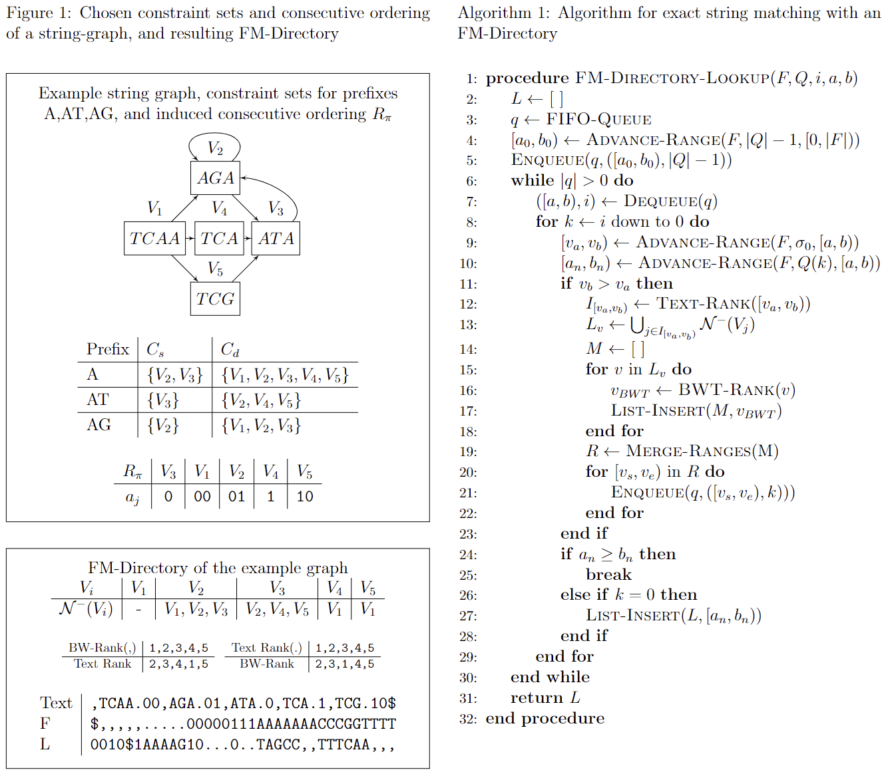
Notes:
Here is an example FM-Directory and the lookup algorithm

Slide 17
FM-Directories With Permutation: Remarks & Summary
Consecutiveness can be approximated, and the degree of consecutiveness of the resulting permutation depends on the “Wheelerness” of the graph
FM-Directories can be used to index graphs of arbitrary topology, and provides a practical way of implementing an approximate (or full) Wheeler-graph-like index
Constraint sets for rare prefixes could be “pruned” for faster index construction
The worst case of “fork $δ$ times” happens only on pathological cases – in practice forking patterns may be much better
The index can be constructed on existing string graphs without modification to the graph, and can be based off of FM-Index implementations (which are widely available)
Notes:
And here are some closing remarks.
The degree to which one has consecutive ranges depends on the Wheelerness of the graph.
Also note that the time complexity analysis is for the worst case performance of the index – which might not happen often in practice.

Slide 18
References
[1] Travis Gagie, Giovanni Manzini, and Jouni Sirén, “Wheeler graphs: A Framework for BWT-Based Data Structures,” Theoretical Computer Science, vol. 698, pp. 67–78, 2017, Algorithms, Strings and Theoretical Approaches in the Big Data Era (In Honor of the 60th Birthday of Professor Raffaele Giancarlo)
[2] Nicola Cotumaccio, “Graphs Can Be Succinctly Indexed for Pattern Matching in $O({\left|E\right|}^{2}+{\left|V\right|}^{5/2})$ time,” CoRR, vol. abs/2111.04595, 2021.
[3] M. R. Garey and D. S. Johnson, Computers and Intractability: A Guide to the Theory of NP-Completeness (Series of Books in the Mathematical Sciences), W. H. Freeman, first edition edition, 1979.
[4] Lawrence T. Kou, “Polynomial Complete Consecutive Information Retrieval Problems,” SIAM J. Comput., vol. 6, pp. 67–75, 1977.
[5] Salim Haddadi and Zoubir Layouni, “Consecutive Block Minimization is 1.5- Approximable,” Information Processing Letters, vol. 108, no. 3, pp. 132–135, 2008.
Notes:
Thank you for listening. Unfortunately I had to skip most of the details due to time constraints. Please contact the first author if you want more information.

