Slide 1
KEEP KNOWLEDGE IN PERCEPTION: ZERO-SHOT IMAGE AESTHETIC ASSESSMENT
(Guolong Wang*, Yike Tan*, Hangyu Lin, Chuchun Zhang)
Yike Tan
University of International Business and Economics
17 Apr, 2024
Notes:
Hello everyone, my name is Yike Tan, and I am from the University of International Business and Economics. It is my great honor to present our paper titled "KEEP KNOWLEDGE IN PERCEPTION: ZERO-SHOT IMAGE AESTHETIC ASSESSMENT."

Slide 2
1. Background and Motivation
2. Methods
3. Experiments and Analysis
4. Conclusion and Future Work
Notes:
In this talk, I will introduce our work from several perspectives:

Slide 3
Background
Image Aesthetic Assessment (IAA)
This task aims to quantify the human perceived aesthetics of a given image.
Applications:
Image recommendation, enhancement, retrieval, and generation [1] [2].
Stable Video Diffusion
Challenges:
high-dimensional
subjective nature
[1] Jiajing Zhang, Yongwei Miao, and Jinhui Yu, “A comprehensive survey on computational aesthetic evaluation of visual art images: Metrics and challenges,” IEEE Ac_x0002_cess, vol. 9, pp. 77164–77187, 2021.
[2] Blattmann, Andreas, et al. "Stable video diffusion: Scaling latent video diffusion models to large datasets." arXiv preprint arXiv:2311.15127 (2023).
Notes:
Let’s begin by the task definition, what is image aesthetic assessment? IAA task aims to quantify the human perceived aesthetics of a given image.
And IAA has many applications, such as image recommendation, enhancement, retrieval, and generation (like in the stable video diffusion, we need to filter the training clips using IAA methods).
And there are some challenges, like the high-dimensional image features and the subjective nature of user behavior.

Slide 4
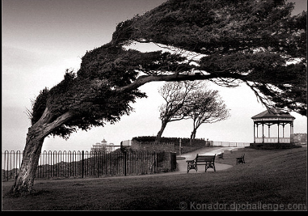
Background
Existing IAA methods, which primarily rely on human_x0002_labeled rating scores.
Corressponding Limitations:
Lack generalization ability (depended on the fit of specific data)
Annotated data insufficient
Zero-Shot IAA
No ground-truth score is needed for training
Ground-Truth Score
6.93
anchor images
& sentence
Supervised
Zero-Shot
[1] Nam et al., Zero-shot natural language video localization. ICCV 2021
Notes:
Existing IAA methods primarily rely on human-labeled rating scores. Although these supervised methods have achieved significant performance, (For instance, VGG network [5] has achieved 91.93% [6] accuracy on the CUHKPQ dataset [7]) they are hindered by some limitations:
* Firstly, they lacked generalization ability as they depended on the fit of specific data, while generalization ability is crucial for a practical method. The pattern of correlations between image features and aesthetic scores is rather heterogeneous across different datasets.
* Secondly, the annotated single score in current databases proved insufficient to meet the evolving needs.
These limitations drove the demand for zero-shot image aesthetic assessment, which means, no ground-truth score is needed for training.
(Though this may be different from the zero-shot setting in image recognition, it follows a setting in a related vision-language task [1].)
Given dataset, in our setting, the AVA dataset, we don’t use any human scores.

Slide 5
Motivation
Zero-Shot IAA
Knowledge is crucial in a zero-shot setting
Semantic information is always used as knowledge, such as aesthetic attributes [11].Some methods designed a multi-task framework by introducing a related task, such as emotion prediction [12]. Others designed network structures for a specific attribute [13]. Except for aesthetic attributes, some methods formulate external knowledge (e.g., object information [14] and image critiques [15]) and internal knowledge (e.g., selfsupervision [16]).
Attention shifted towards the finergrained aspects
Thus, assessing different aspects of an image’s aesthetics became increasingly valuable, desiring knowledge introduction. It can offer comprehensive information and enhance the generalization ability of models
[11~16] can be found in our reference part.
Notes:
From former works, we learned that Knowledge is crucial in a zero-shot setting. Semantic information is always used as knowledge, such as aesthetic attributes [11]. Some methods designed a multi-task framework by introducing a related task, such as emotion prediction [12]. Others designed network structures for a specific attribute [13]. Except for aesthetic attributes, some methods formulate external knowledge (e.g., object information [14] and image critiques [15]) and internal knowledge (e.g., selfsupervision [16]).
Image aesthetic assessment is a subjective task where more semantic information than a score is useful [17, 18]. Consequently, attention shifted towards the finergrained aspects of the aesthetic assessment of images [19, 20]. Thus, assessing different aspects of an image’s aesthetics became increasingly valuable, desiring knowledge introduction. It can offer comprehensive information and enhance the generalization ability of models

Slide 6
1. Background and Motivation
2. Methods
3. Experiments and Analysis
4. Conclusion and Future Work

Slide 7
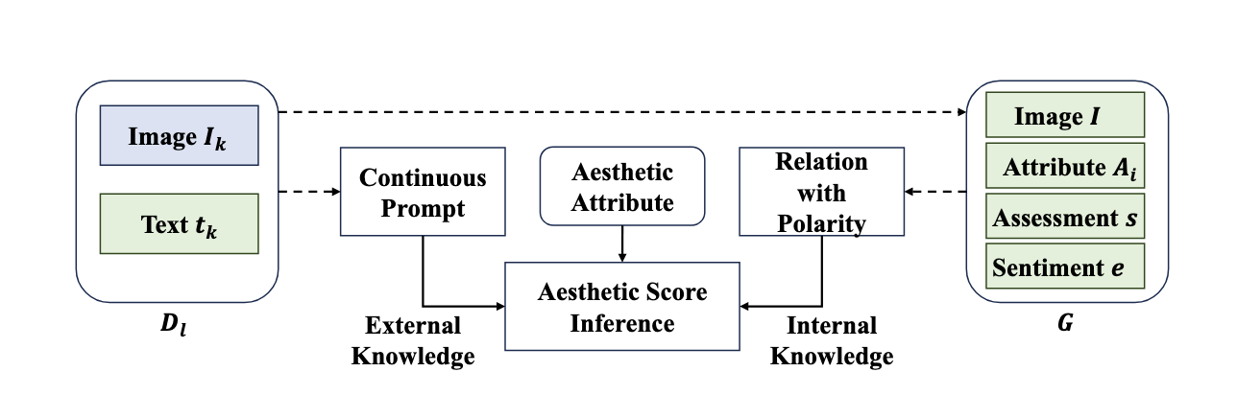
Methods - Overall Framework
KZIAA
(Knowledge-enhanced Zeroshot Image Aesthetic Assessment)
Three components:
continuous prompt (external)
relation with polarity (internal)
aesthetic score inference.
Three main novelties:
select a few image anchors and use image relations
construct a continuous prompt for each aesthetic attribute
incorporate external knowledge and internal relationships to distinguish between good and bad images, thereby obtaining an image’s score in a zero-shot manner.
Notes:
Knowledge-enhanced Zeroshot Image Aesthetic Assessment (KZIAA) framework
Our research design comprises three components:
(1) External knowledge of aesthetic attributes with continuous prompt,
(2) Internal knowledge of image relation with polarity
(3) Aesthetic score inference based on external and internal knowledge, as shown in figure
The framework has three main novelties:
1) We select a few image anchors and use image relations to enrich the aesthetic representation. Thus, image aesthetics combines external knowledge and internal relationships.
2) We construct a continuous prompt for each aesthetic attribute with a pre-trained model and combine prompts of all attributes to rate new images. (in this way, we improve the generalization ability of our method by utilizing prior knowledge from large models, in less it is over-fitted on a data distribution. )
3) We incorporate external knowledge and internal relationships to distinguish between good and bad images, thereby obtaining an image’s score in a zero-shot manner.
Then Let’s start from the data preparation part, and then we will go throught the details of the external part and internal part

Slide 8
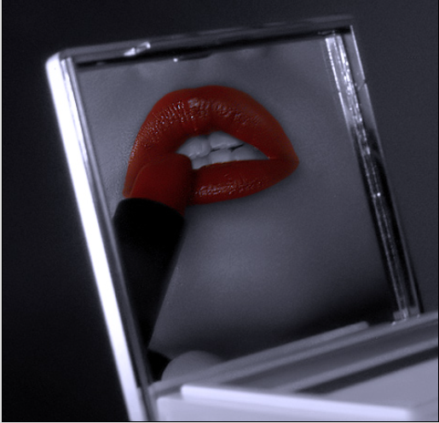
Methods - Multi-Modal Aesthetic Dataset (MMA)
Download image comments of the AVA dataset from dpchallenge.com
Design a set of aesthetic attribute keyword system to screen comments
Filter and categorize comments based on keyword system
General Impression | Subject of Photo | Composition &Perspective | Use of Camera, Exposure& Speed | Depth of Field | Color & Lighting | Focus
shot | theme | border | balance | length | coloring | softness
impression | rhythm | rotation | iso | blurriness | tune | attention
······ | ······ | ······ | ······ | ······ |  | ······
emotion | style | angle | lens | fuzz | histogram | sharpeness
Very simple, effective shot.
General Impression
yeah baby!
······
The colors are just great and the comp exudes such sensuality.
Very good work.
Color & Lighting
fig
Notes:
Multi-Modal Aesthetic (MMA) Database. We collect image aesthetic critiques for images in AVA to train attribute prompts and construct the quadruplet set:
(1) We collect critiques on the original website following [15] and use critiques in [18] as a supplement.
(2) We eliminate incomplete sentences (e.g., ‘This is a’).
(3) We classify the critiques into seven aspects according to keywords summarized by professional photographers. We show MMA’s statistics in Table 1. Note that our MMA only contains images in AVA’s training set without ground-truth scores.

Slide 9
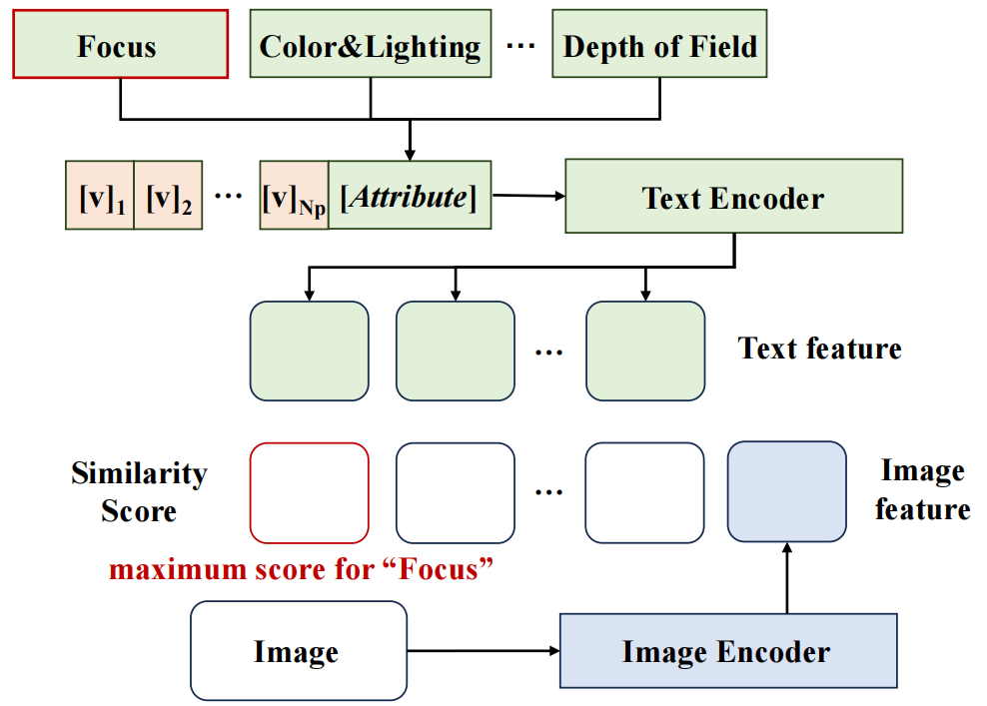
Methods - External Knowledge with Continuous Prompt
Prompt Tuning
Design Prompts for each of the seven attributes.
Fine-tune the prompts by the similarity of image
features and text features, obtain a unique context
for each attribute.
Weight Inference
Calculate the similarity between image features and the Prompt features of each attribute as the weight score
(2)
(3)
(4)
(6)

Slide 10
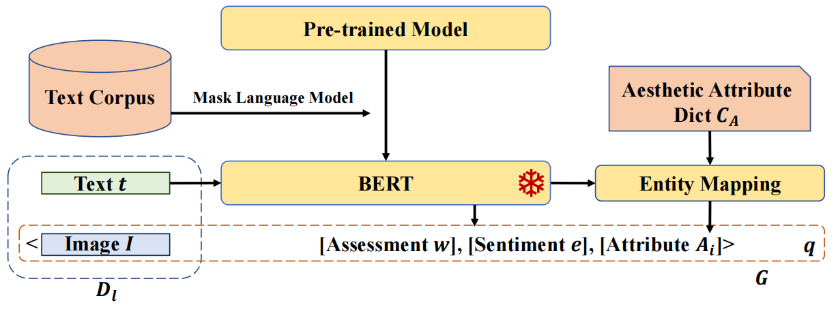
Methods - Internal Knowledge with Polarity
1. Generate a quadruplet for each comment
fig:
:Very simple, effective shot.
The pipeline of obtaining a quadruplet
Obtained quadruplet:
[fig,effective,Use of Camera,Exposure & Speed,0.9998]
2. Sample filtering and classification
Set emotional score threshold and select images based on it.
Classify the selected images based on the positive and negative signs of polarity values and aesthetic attributes.

Slide 11
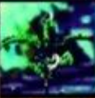
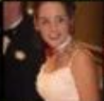
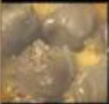
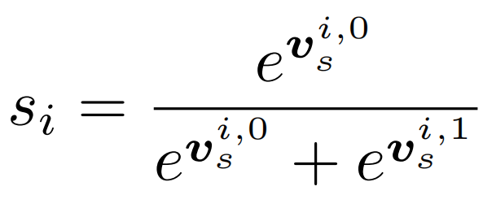
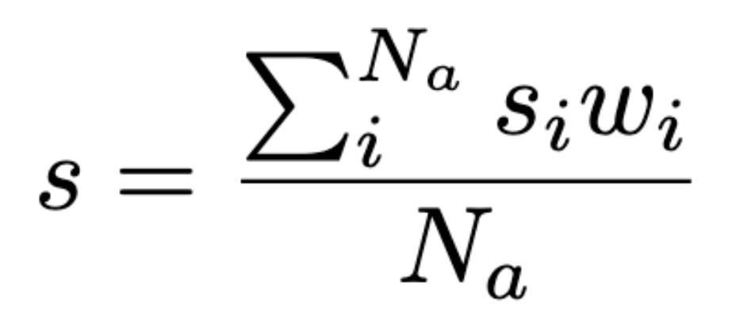
Methods - Internal Knowledge with Polarity
3. Obtain anchor images
Using the Image Encoder of the CLIP model to obtain the feature vectors of images for each category, and taking the average of them. From this, anchor plots representing positive and negative samples are obtained for each aesthetic attribute.
4. Calculate the score on a certain aesthetic factor according to formula (7)
pos and neg anchor image features on each attribute
····
averaging
Image
Encoder
······
...
····
(7)
At Last, combined the wieghts from the external knowledge, we could obtain our final score by weighted summation of scores under different attributes
(8)

Slide 12
1. Background and Motivation
2. Methods
3. Experiments and Analysis
4. Conclusion and Future Work
Notes:
In this talk, I will introduce our work from several perspectives:

Slide 13
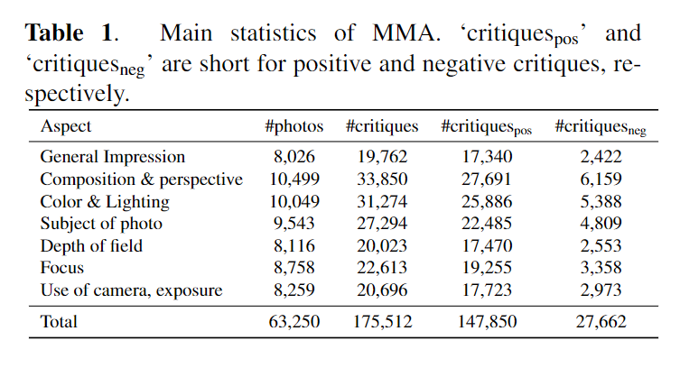
Experiment - Dataset
AVA
AVA dataset contains over 250,000 images.
We use 19,929 images as the test split, following [10]
MMA (ours)
[10] Junjie Ke, Keren Ye, Jiahui Yu, Yonghui Wu, Peyman Milanfar, and Feng Yang, “Vila: Learning image aesthetics from user comments with vision-language pretraining,” in Proceedings of the IEEE/CVF Conference on Computer Vision and Pattern Recognition, 2023, pp. 10041– 10051.
Notes:
AVA dataset training split serves as a foundational support for our MMA dataset.

Slide 14
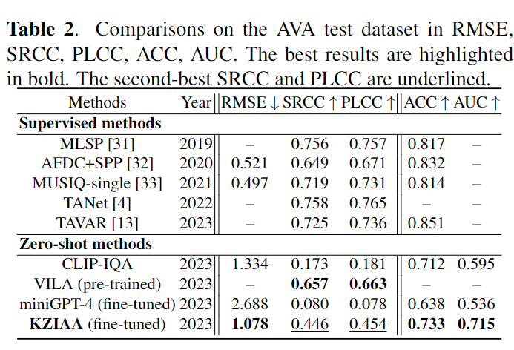
Experiment - Metrics
We evaluate our KZIAA with some supervised competitors and zero-shot competitors. Our KZIAA outperforms many zero-shot competitor
Regression
Binary Classification
Notes:
We contend that our comparative analysis is quite thorough, as it encompasses metrics for both the image aesthetics regression task and the binary classification. Within the binary classification metrics, we have specifically compared AUC. While there remains a substantial gap between our method and supervised learning approaches, our method closely aligns with supervised methods in binary classification and surpasses the CLIP-IQA, which was designed specifically for this purpose. As such, our method proves to be practical for the elimination of low-quality images. In comparison with zero-shot learning methods, our approach outperforms many contenders. However, there is a significant disparity between our method and VILA. We attribute this to two potential factors: firstly, the extensive scale of the pre-training dataset utilized by VILA is larger than ours, it used LAION-5B subset and AVA-Captions. Secondly, VILA adopted the CoCa method, which incorporates a generative module and facilitates enhanced multimodal understanding. In contrast, our method only uses pre-trained CLIP.

Slide 15
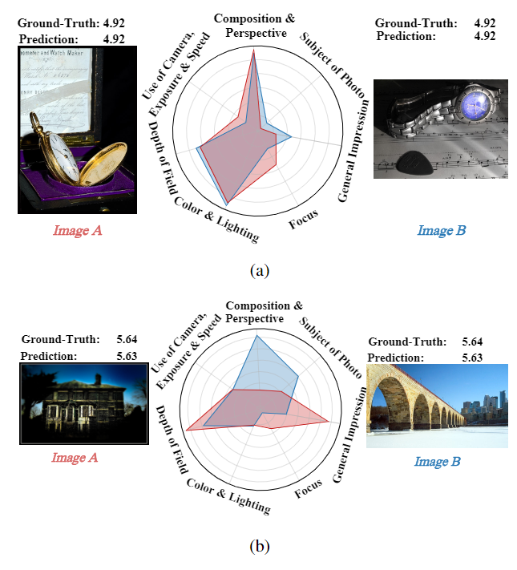
Experiment - Analysis
We can analyze aesthetic attributes first before obtaining the final score.
Notes:
In fact, there is another crucial distinction between our method and that of VILA: our approach allows for the acquisition of separate scores for each attribute of an image before aggregating them into an overall score. Please refer to Figure (a). The two images' content, lighting, and composition were highly similar. Our model gives predictions identical to the ground-truth scores and has hugely consistent attention to attributes. Then, please refer to figure (b), Our model gives the same score for the two images. However, it focuses on General Impression and Depth of Field in Image A, while focusing on the Composition and Depth of Field in Image B.
Given that image aesthetic quality assessment is a highly abstract task, interpretability in image aesthetics evaluation has always been considered a hot topic. Our method offers a new perspective for the task of interpretable image aesthetic quality assessment.

Slide 16
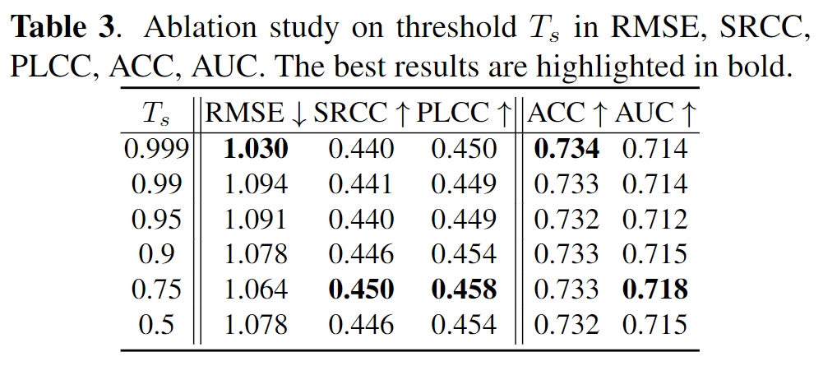
Experiment - Ablation
As selecting anchor images threshold T_{s} is a vital hyper-parameter, we perform an ablation study on T_{s}. The results summarized in Table 3 show that our KZIAA is insensitive to the threshold. It indicates that our method is feasible for expanded scenarios.

Slide 17
Conclusion
In this work, we propose a simple yet effective zero-shot strategy for image aesthetic assessment, a data-hungry subjective task.
We estimate the aesthetic score by leveraging external knowledge and internal knowledge. Firstly, we obtain a unique context for each aesthetic attribute by prompt tuning. Subsequently, we construct a quadruplet set with image relationships and utilize sentiment polarity to select anchor images. Finally, we estimate the score considering the information of different attributes. Experiment results indicate the superiority of the proposed method to some zero-shot baselines and the potential to approach supervised methods.

Slide 18
Future Work
How to teach LMMs for Visual Scoring via customized sentence-level features?
The following prompts seem not enough
Can you evaluate the aesthetics of the image?
Rate the aesthetics of this picture.
How is the aesthetics of this image?
Can you rate the aesthetics of this picture?
Please evaluate the aesthetics of the image.
Please tell the image quality in terms of aesthetics.

Slide 19
Future Work
How to teach LMMs for Visual Scoring via customized sentence-level features?
We will try in the following directions:
We will design sentence-level descriptions of image aesthetic attributes and connect them to different rating levels
We will design sentence-level descriptions of personality, rather than Big-Five code.
We will explore multi-modal feature representation of attributes, rather than uni-modal representation.

Slide 20
Thank you!
My Blog QR！

