Slide 1
Automatic Speech Emotion Recognition Using RNNs with local attention
Seyedmahdad (Matt) Mirsamadi
Emad Barsoum
Cha Zhang
ICASSP 2017

Slide 2
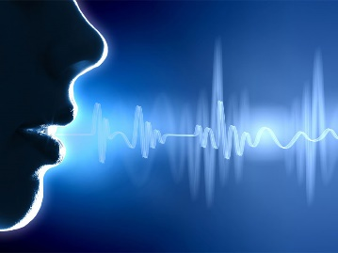
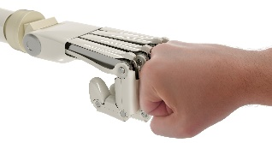
Speech Emotion Recognition (SER)
Human speech carries complex non-linguistic information beyond the spoken words
For a natural and effective human-machine interaction, it is important to be able to recognize, analyze, and respond to the emotional state of user.
Emotions affect different modalities of interaction: Facial expressions, voice characteristics, linguistic content
Various applications: Automated call centers, assessing drivers’ mental state, etc.

Slide 3
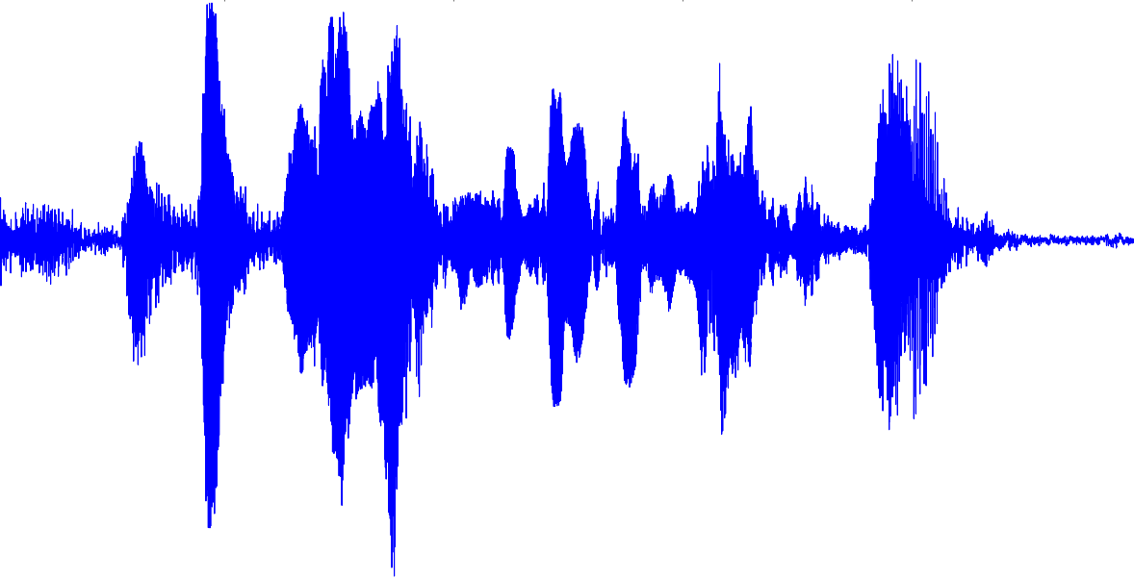
Existing Approaches in SER
Mean
MFCCs
MFCCs
MFCCs
MFCCs
var
…
LLDs:
min
(Low Level Descriptors)
ZCR
ZCR
ZCR
ZCR
HSFs
E
E
E
E
max
VP
VP
VP
VP
(High-level Statistical Functions)
F0
F0
F0
F0
mom-n
…
reg

Slide 4
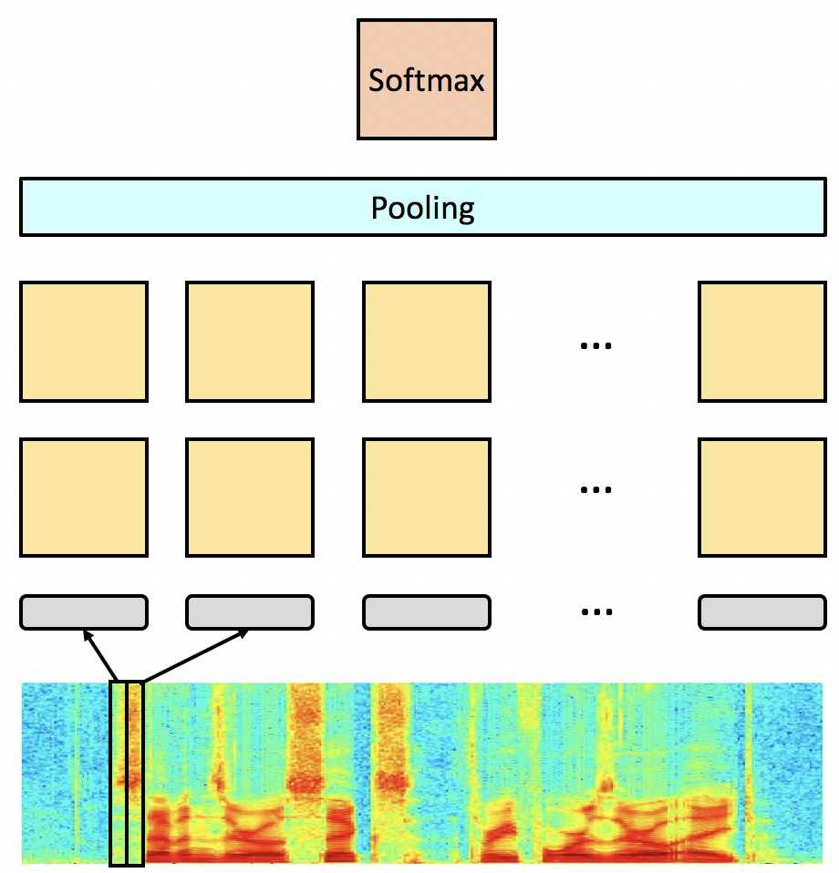
Can we learn frame-level features?
Most LLDs typically used in SER can be extracted from a spectral representation (Formants, MFCCs, Energy, etc.)
Similar (possibly better) frame-level LLDs can be learned using a few dense feed-forward layers
In the context of neural nets, HSFs are fixed forms of pooling across time (mean-pooling, max-pooling, etc.)

Slide 5
How can we learn temporal aggregation?
Recurrent layers can remember context information about input features
Can be trained to aggregate frame-level features into appropriate long term representations
Each RNN output node can be considered as a long-term statistic about input features
Challenge: Labeling resolution – Emotion labels are sentence-wide, RNN looks at each frame.
…
…

Slide 6
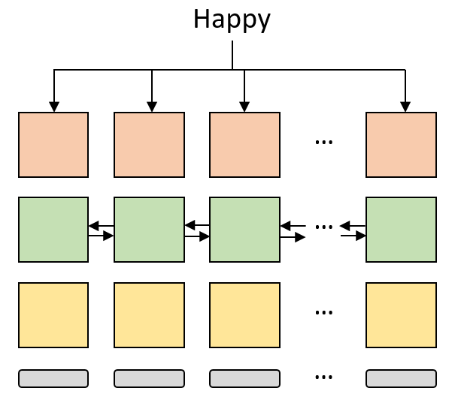
Frame-wise training
Problems:
RNN needs sufficient past history to produce appropriate long-term statistics over the input features.
We cannot expect the full duration of the sentence to carry the overall emotion:
Silence frames
Non-emotional speech frames

Slide 7
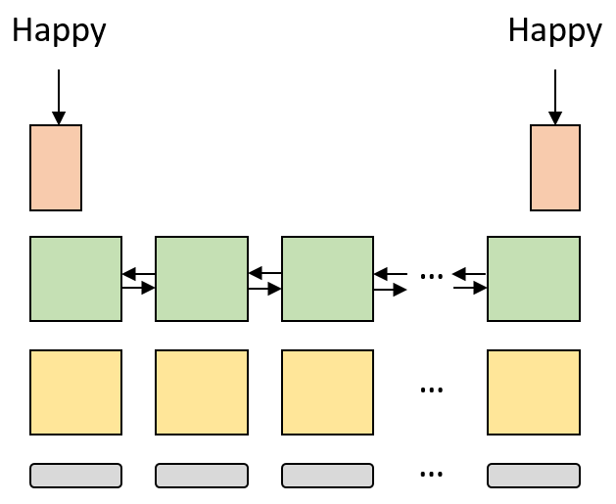
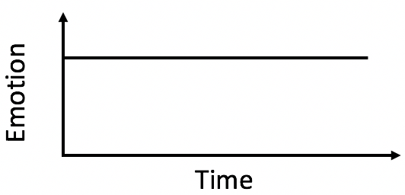
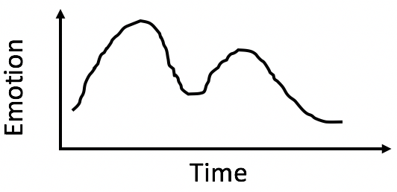
Final frame (many-to-one) training
RNN gets sufficient history before being expected to produce output
Problems
Not appropriate to rely on 1 single frame
We cannot expect the full duration of the sentence to carry the overall emotion.

Slide 8
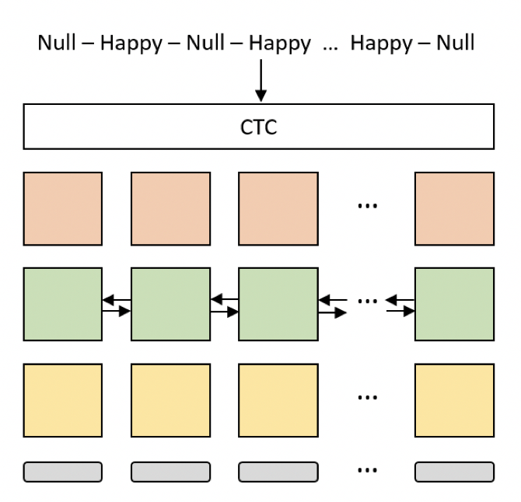
Blank label alignment
Use a sequence of labels which represent transitions from emotional segments to non-emotional segments
Problems:
Difficult to determine exact label sequence

Slide 9
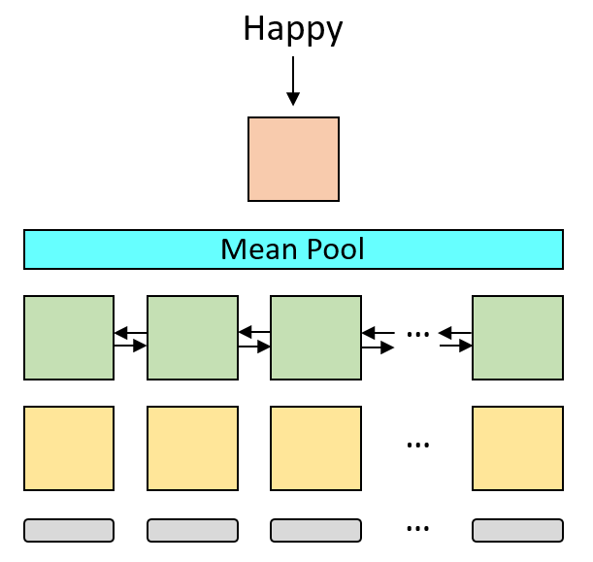
Mean-pooling through time
Problems:
Silence frames distort the overall average
Non-emotional frames distort the overall average
Still works better than all previous approaches
Particularly good for short & manually-segmented sentences where the emotional frames are dominant

Slide 10
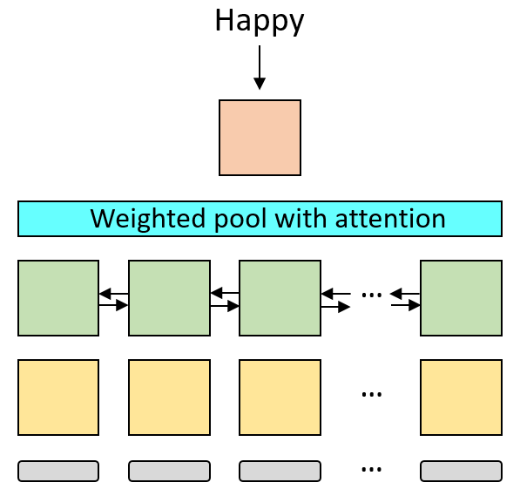
Weighted pooling with attention
The final sentence-level representation is a weighted sum of the RNN outputs at each frame.
The weights $w_{t}$ should enable us to focus on local parts of the sentence which carry more emotional information.

Slide 11
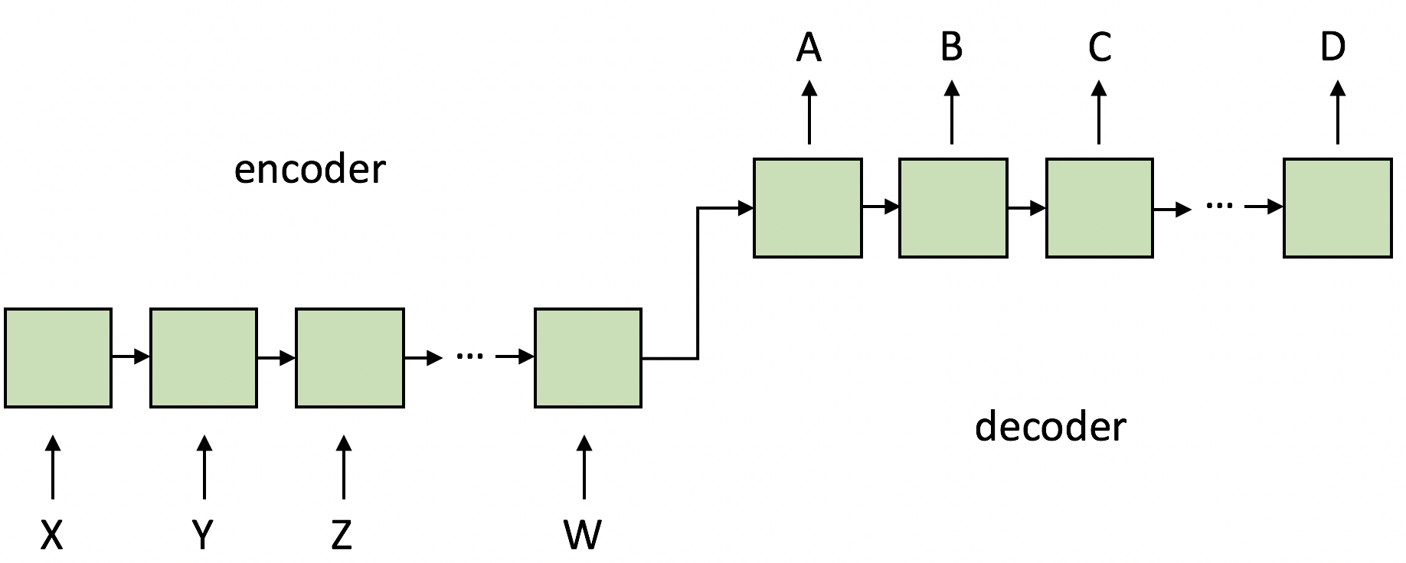
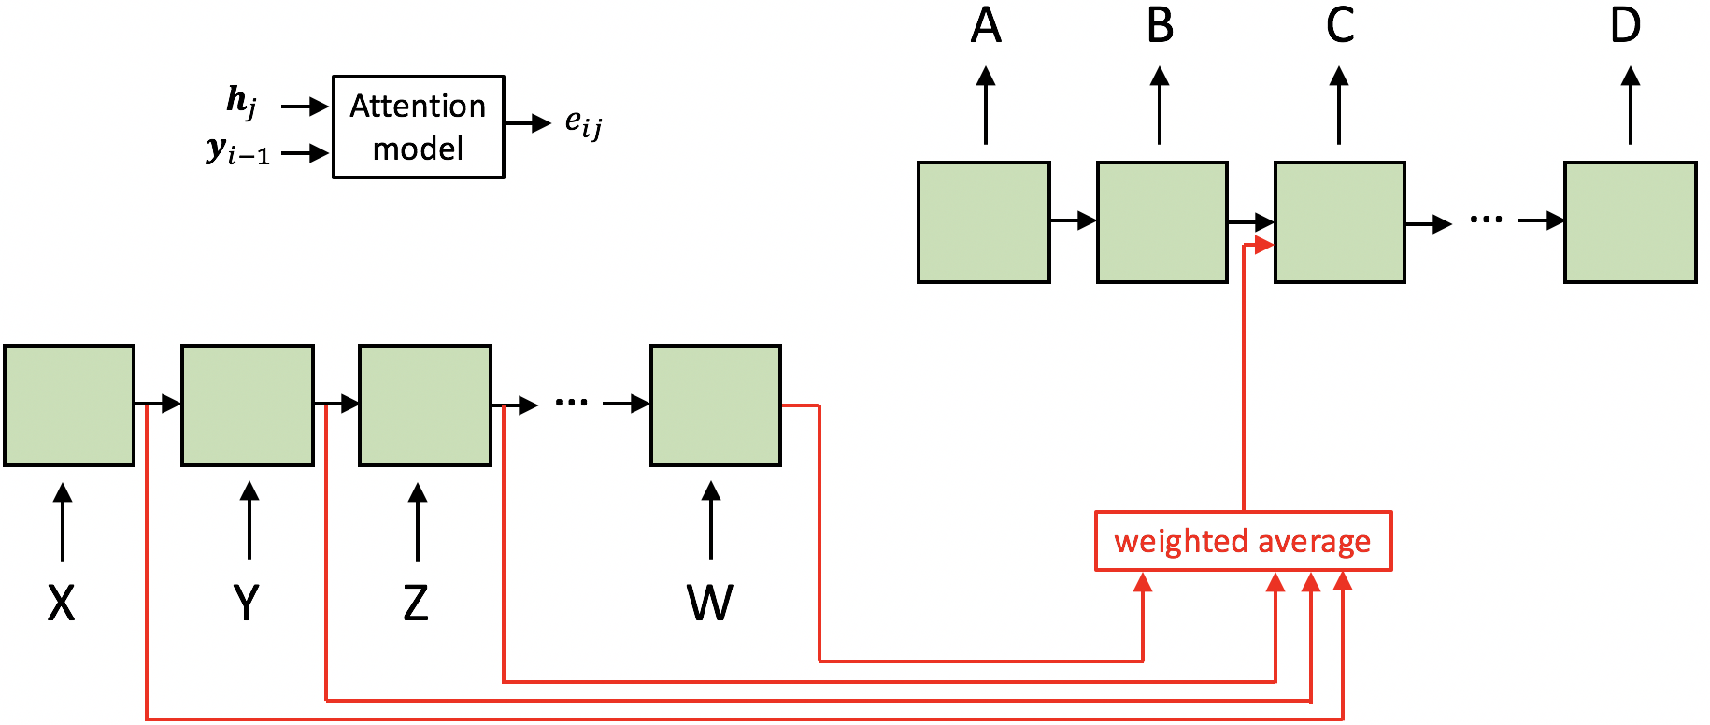
Attention in machine translation

Slide 12
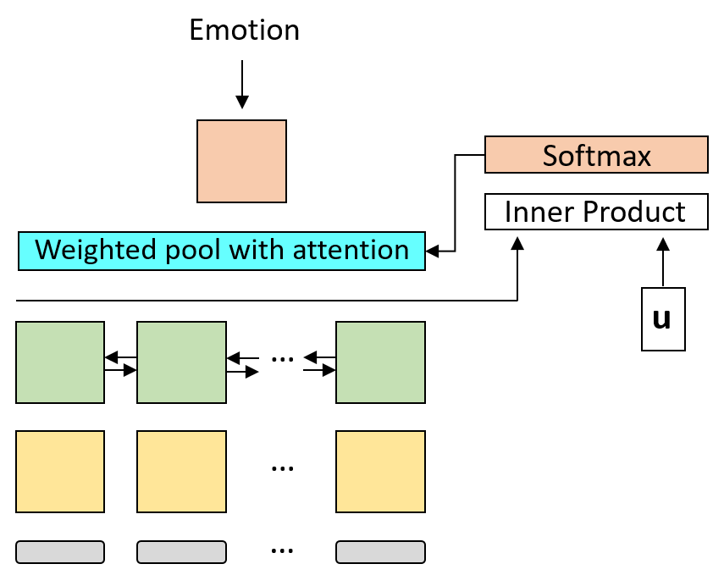
Weighted pooling with attention for SER
Simple logistic regression attention model
For each hidden state $h_{t}$, the inner product $u^{T}h_{t}$ is interpreted as the contribution of frame t to the overall encoded emotion.
$e_{t}=u^{T}h_{t}$ $t ε [1,⋯,T]$
$w_{t}=\frac{exp⁡(e_{t})}{\sum_{k=1}^{T}{exp⁡(e_{k})}}$ $t ε [1,⋯,T]$
$$y=\sum_{t=1}^{T}{w_{t}h_{t}}$$
u is trained together with the rest of the network parameters.

Slide 13
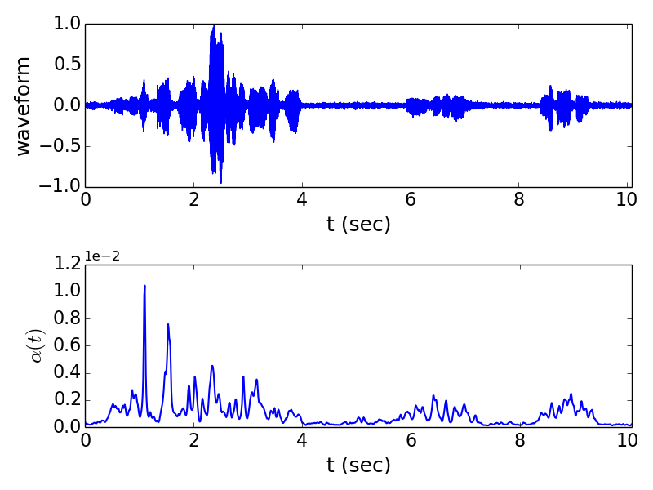
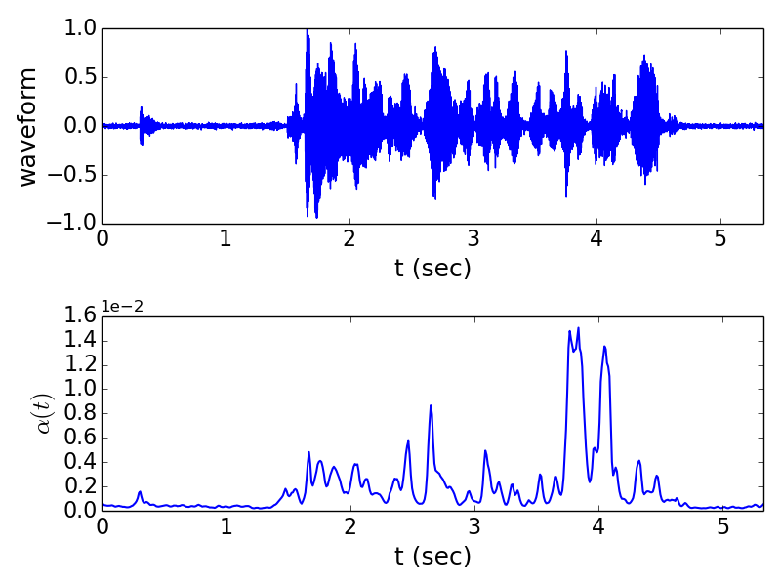
Examples: Attention weights over time
Sad
Angry

Slide 14
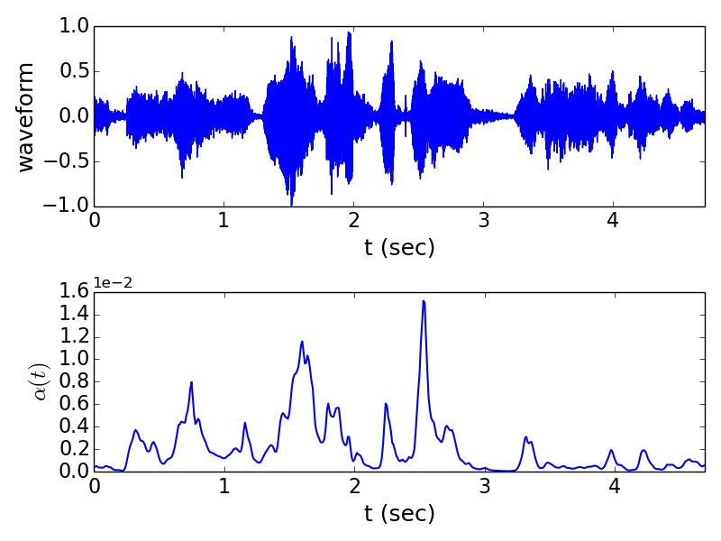
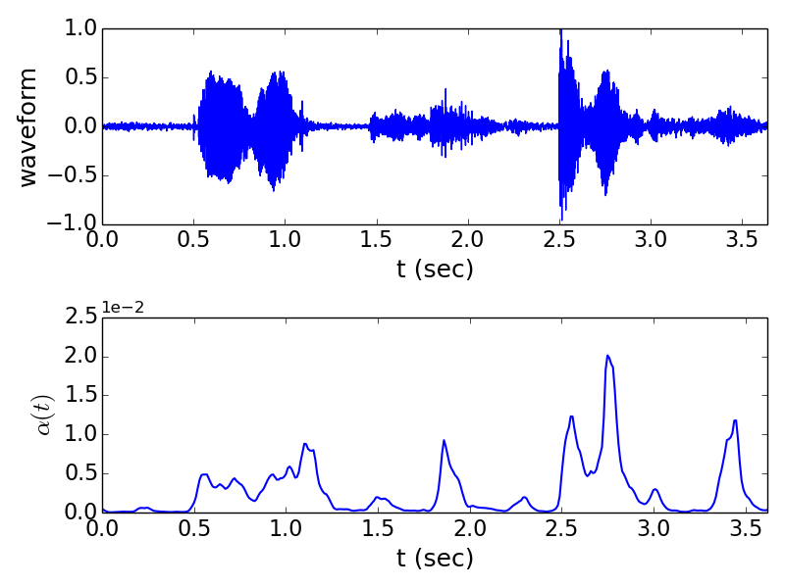
Examples: Attention weights over time
Happy
Happy

Slide 15
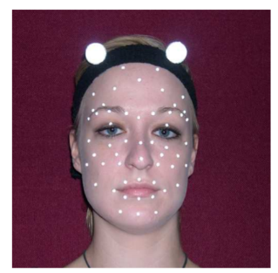
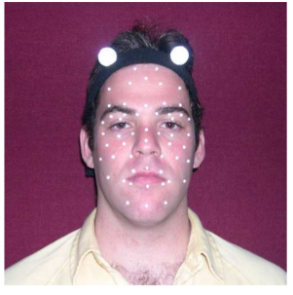
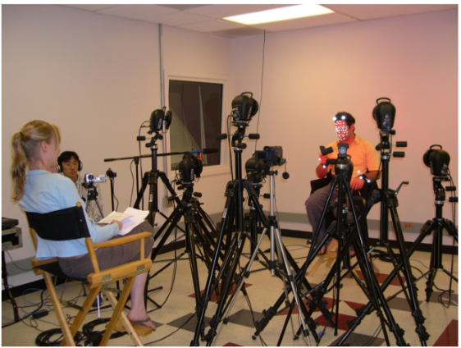
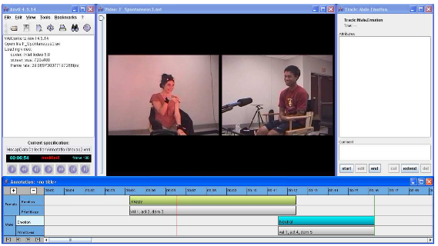
Experiments
Based on IEMOCAP corpus
Train on 4 sessions, test on remaining
LSTM RNN with peephole connections and full BPTT
ReLU nonlinearity for dense layers
Mini-batch size of 20 sentences in all experiments
50% dropout on all layers to prevent overfitting
512-point FFT for spectral features (257-dim raw features)
32-dim hand-crafted features (16 LLDs and 1st-order derivatives)
SVM with Radial Basis Kernel and weighted classes over HSDs as baseline

Slide 16
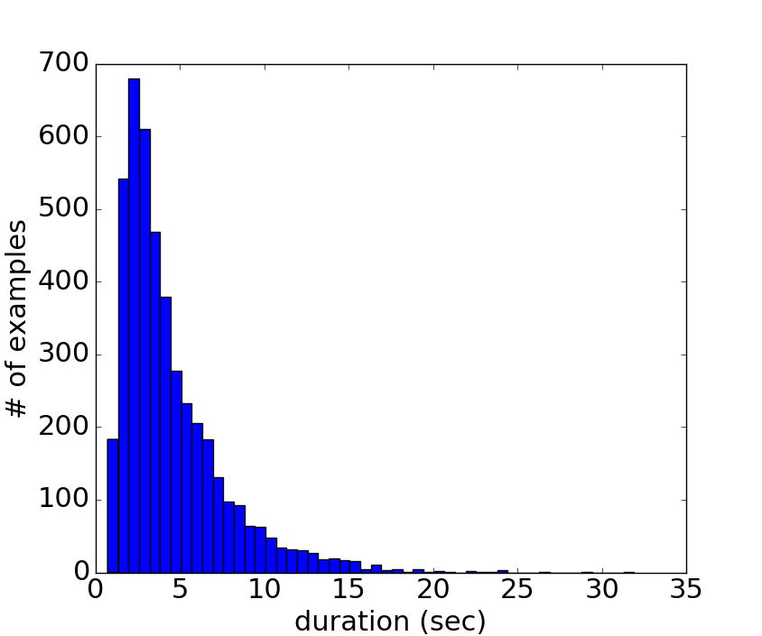
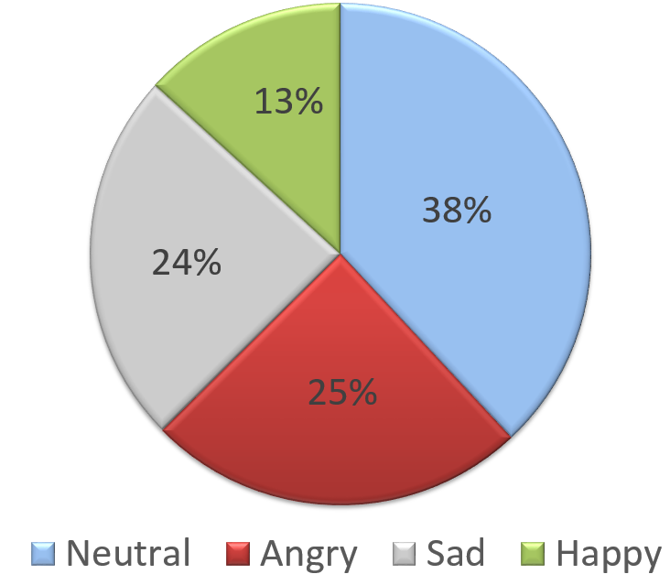
IEMOCAP data

Slide 17
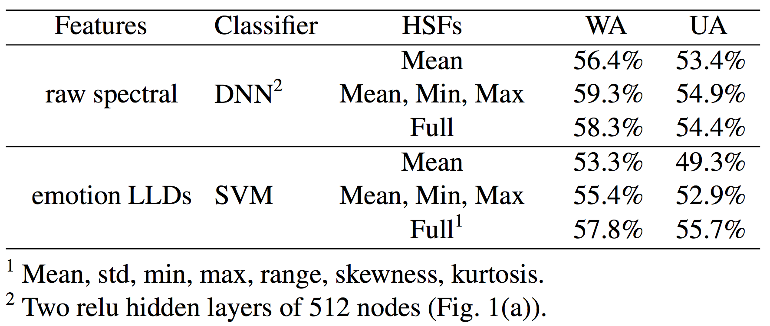
SER accuracies: Learning short-term LLDs

Slide 18
SER accuracies: Learning temporal aggregation

Slide 19
Summary & Conclusions
SER performance critically depends on the discriminative ability of extracted features
Using a deep RNN structure, we can automatically learn emotional features:
Feed-forward layers at the frame level: Learn LLDs
Final recurrent layer: Learns temporal aggregation
Mean pooling of RNN outputs across time provides best results
Weighted pooling with an attention mechanism can be used to focus on emotional parts of a sentence

Slide 20
Thank You
Contacting authors:
Seyedmahdad (Matt) Mirsamadi: mirsamadi@utdallas.edu
Emad Barsoum: ebarsoum@microsoft.com
Cha Zhang: chazhang@microsoft.com

